Slide 1

KENTUCKY OFFICE OF
DRUG CONTROL POLICY
Tobacco Settlement Agreement Fund Oversight Committee
Thursday, October 8, 2026
Van Ingram, Executive Director
Office of Drug Control Policy
Justice & Public Safety Cabinet

Slide 2
KY-ASAP & ODCP
Placed in the Office of Drug Control Policy in 2004, the Kentucky Agency for Substance Abuse Policy (KY-ASAP) incorporates the philosophy of ODCP using the three-pronged approach of prevention, treatment and law enforcement.
KY-ASAP is unique in that local boards determine the needs for their service area. Through a strategic plan and needs assessment, the local boards identify the issues where they need to direct their dollars. Local KY-ASAP boards are effective in their individual communities because these boards are comprised of the key stakeholders in the communities.
Local KY-ASAP boards are in all 120 Kentucky counties and used in many of these communities as the primary component of comprehensive drug education/prevention, treatment, and law enforcement programs.

Slide 3
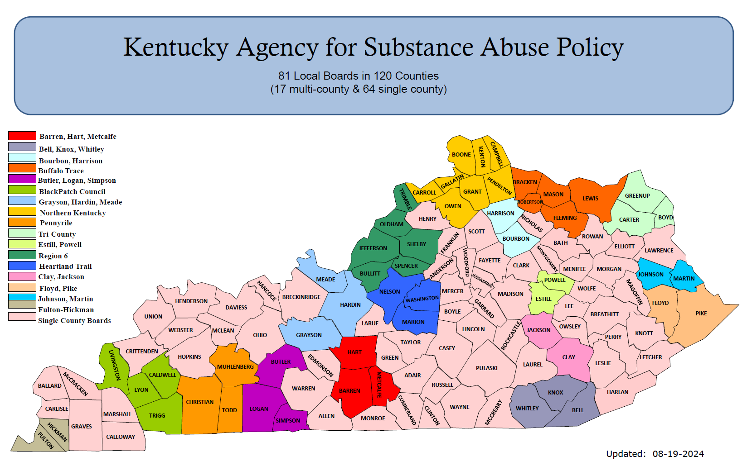

Slide 4
KY-ASAP State Board
Zach Ramsey, Director – Administrative Office of the Courts (Designee – Elizabeth Nichols)
Scott Tracy, Commissioner – Alcoholic Beverage Control (Designee: Rob Roberts)
Ashlea Christiansen – American Heart Association (Designee - David Sloane)
Shannon Black Baker – American Lung Association
Dr. Steven Stack, Secretary – Cabinet for Health & Family Services (Designee – Sarah Johnson)
Dr. Robbie Fletcher, Commissioner – Department of Education (Designee – Rachel Njenga)
Dr. John Langefeld, Commissioner – Department for Public Health (Designee – Chase Barnes)
Paula Brown – Division for Behavioral Health, Dept. of Behavioral Health, Developmental & Intellectual Disabilities (Designee – Camille Croweak)
Keith Jackson, Secretary – Justice & Public Safety Cabinet (Designee – Van Ingram)
Chair Charles Kendell – Local Tobacco Addiction, Substance Abuse Board
Shane Britt – Local Tobacco Addiction, Substance Abuse Board
Veronica Nunley – KY Association of Regional Programs
VACANT – KY Cancer Society
Amanda Heacock – KY Family Resource Youth Services Coalition (Designee – Ashli Taylor)
Dana Nickles, KY Public Health Association
Shelley Elswick, Private Community Based Organization
Tara Hyde, Private Community Based Organization

Slide 5
KY-ASAP SFY2026 Program Expenditures
KENTUCKY AGENCY FOR SUBSTANCE ABUSE POLICY SFY2026 Expenditures
Description | Amount
2026 Allocation | $3,250,000.00
2025 Carry Forward | $1,658,223.45
SFY2026 BUDGET | $4,908,223.45
Salary & Fringe | $115,506.50
KY-ASAP Traditional Allocations | $2,260,000.00
COT/Auditor/EMARS/Telephone/AGATE/Copier/Supplies/Rent | $20,893.47
Eastern KY Concentrated Employment Program - Recovery & Support Specialists | $261,117.05
Kentucky Chamber of Commerce - Recovery Friendly Workplaces | $375,000.00
Volunteers of America – Restorative Justice | $250,000.00
Child Fatality and Near Fatality Review Panel – RX Lockboxes | $60,999.04
Kentucky High School Athletics Association – Public Service Announcements | $35,000.00
CJSAC – Justice Assistance Grants | $107,543.07
Travel | $1,229.18
Naloxone for Law Enforcement – Kentucky Pharmacy Education & Research Foundation (KPERF) | $100,000.00
Community Foundations - Reducing Barriers to Re-Entry | $75,000.00
UK – Return of unexpended funds from FY2025 disbursement for findhelpky.com promotion | -$550.57
TOTAL EXPENDITURES | $3,486,737.74
BALANCE | $1,421,485.71

Slide 6
KY-ASAP SFY2026 Funded Programs
KY-ASAP Local Boards – Traditional & Harm Reduction Awards
  Operate ATOD prevention, enforcement projects and programs
Eastern Kentucky Concentrated Employment Program – Recovery & Support Specialists
  Increase access to and retention of employment for persons in recovery from addiction, as well as those with associated mental health issues seeking (re)employment and job training
Kentucky Chamber of Commerce – Recovery Friendly Workforce
  Destigmatize the addiction epidemic and support employers’ roles in opioid addiction prevention, treatment, and recovery in the workplace; business engagement; and opioid use, prevention, and response
Volunteers of America – Restorative Justice
  Provide restorative justice practices in the Kentucky District Court Judicial District 27, District 34 and District 41, which include Clay, Leslie, Jackson, Knox, Laurel, McCreary and Whitley counties
Child Fatality and Near Fatality Review Panel
  Purchase and distribute medication lock boxes to at-risk populations.
Kentucky High School Athletic Association – Public Service Announcements
  Provide a statewide PSA campaign at Kentucky High School Championship Athletic events to promote FindHelpNowky.org and the KY HELP Call Center
CJSAC – Justice Assistance Grants
  Divert individuals with addiction and serious mental illness towards treatment rather than incarceration.

Slide 7
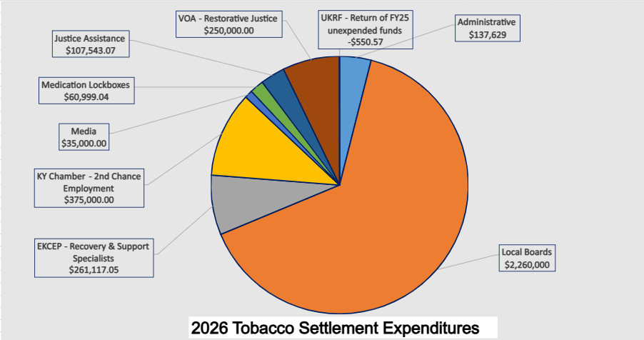
KY-ASAP SFY2026 Program Expenditures

Slide 8
KY-ASAP Local Boards Projects & Programs
Prescription Drug Disposal
  Units, disposal costs, marketing, and awareness
Naloxone
  Naloxone kits and training for community members, schools, first responders, and health departments
Syringe Exchange Programs
  Program supplies and supports, marketing, and peer training
Prevention/Education
  School and community assemblies and meetings; awareness campaigns; school resource officers; prevention curriculum and materials; teen conferences; e-cigarette campaign; smoke-free campaign; Lifeskills; Sources of Strength; Social Host campaign; Lunch and Learn; capacity building; Girls Empowerment; Early Intervention Program; Too Good for Drugs; surveys/needs assessments; scholarships; PSAs; and community resource fairs
Treatment
  Celebrate Recovery; AA/NA; recovery residences; tobacco cessation; drug testing; drug recovery program for inmates; MAT; treatment vouchers; drug court support; quit line promotion; Casey’s Law support; transportation vouchers; 7 Challenges; Celebrating Families; and GED support
Enforcement
  Portable breathalyzers; training; evidence collection and interdiction resources; RX Drug Summit; crisis intervention; K-9 Support; and minor alcohol sales checks

Slide 9
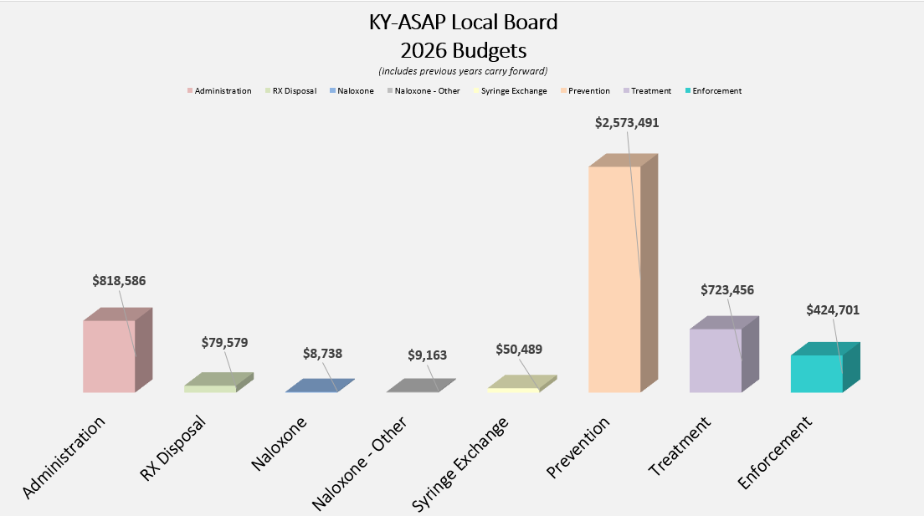
KY-ASAP Local Boards Spending Plans

Slide 10
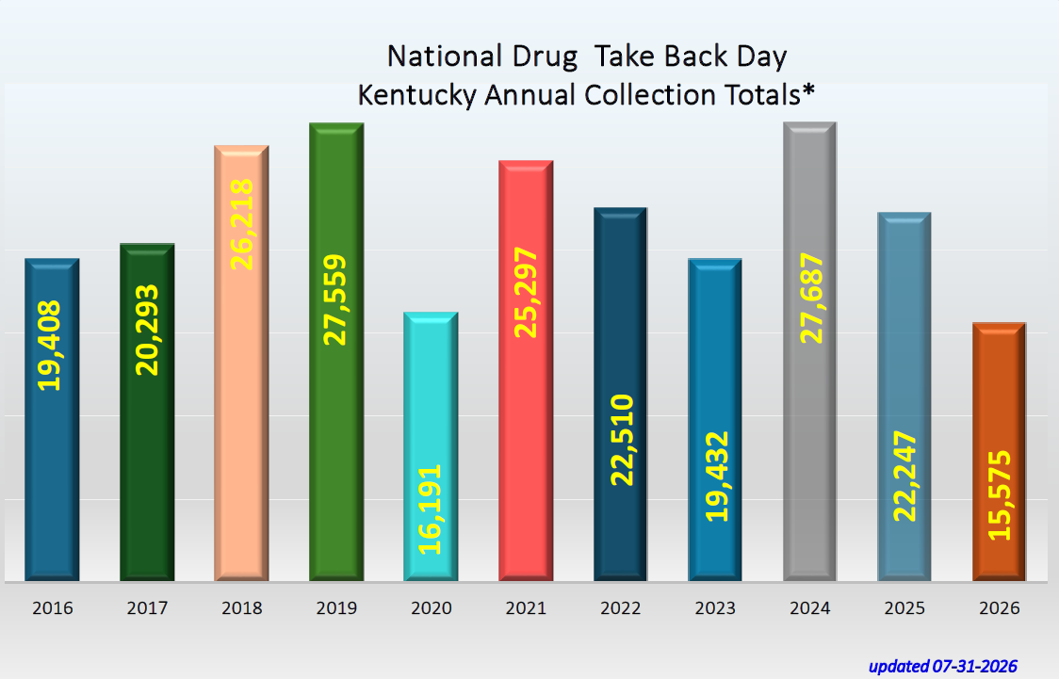
National Drug Take Back Day
¹weight in pounds
²2016 through 2025 totals includes April & October collection data. 2026 total includes only April 2026 collection data

Slide 11
QUESTIONS
Van Ingram, Executive Director – van.ingram@ky.gov
Amy Andrews, KY-ASAP Program Administrator – amy.andrews@ky.gov
Logan McChesney, KY-ASAP Program Coordinator – logane.mcchesney@ky.gov
Office of Drug Control Policy
Justice & Public Safety Cabinet
125 Holmes Street
Frankfort, Kentucky 40601
502-564-9564
502-564-6104 (fax)
1-888-414-ODCP
www.odcp.ky.gov

