Slide 1
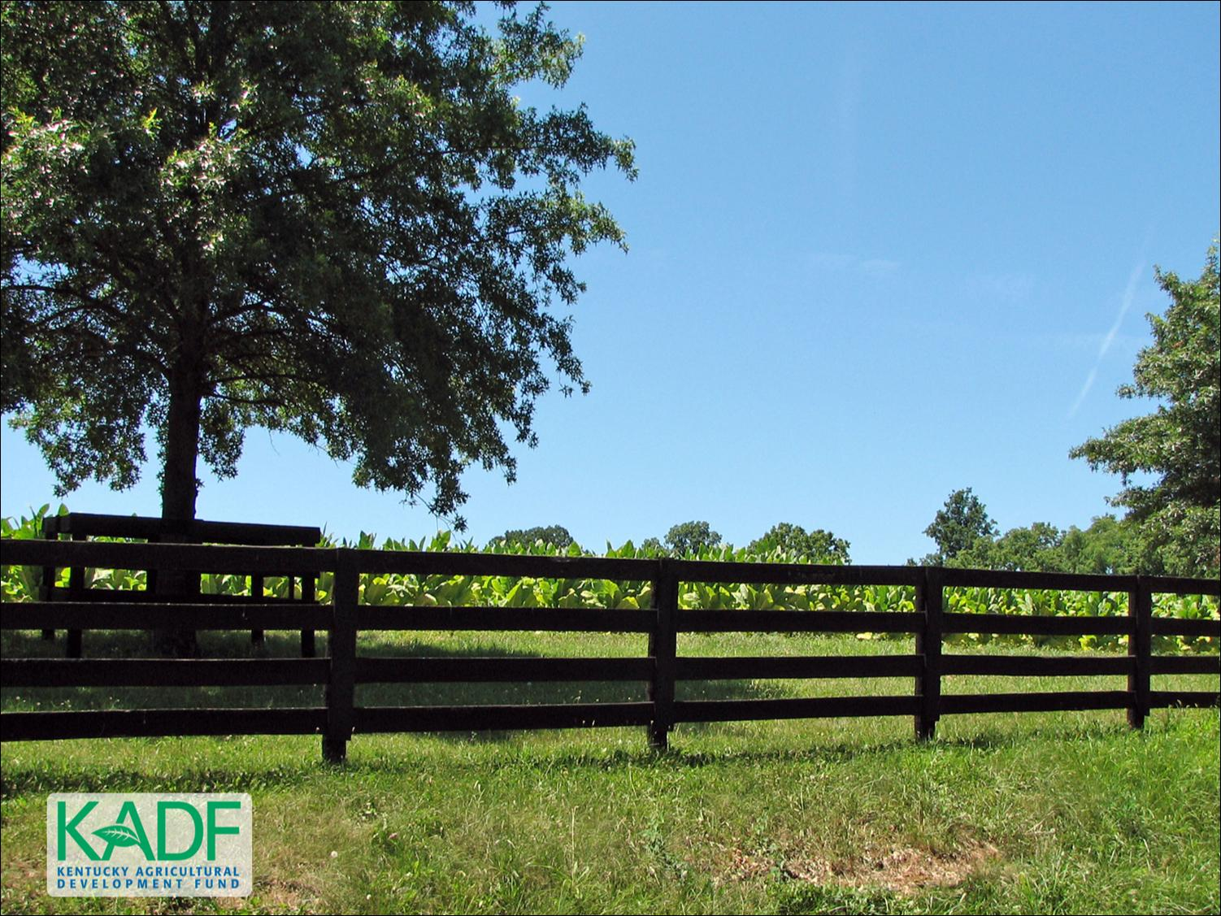
KOAP’s Report of
December 2025 – May 2026

Slide 2
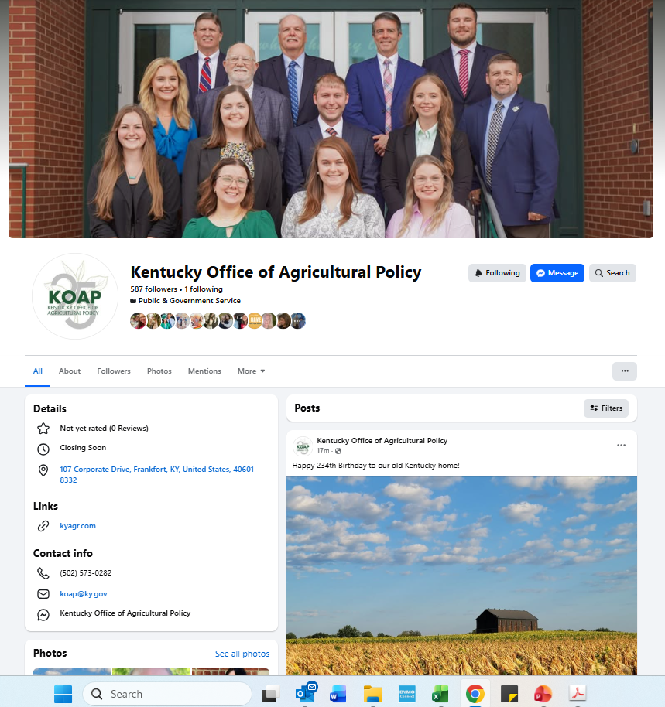
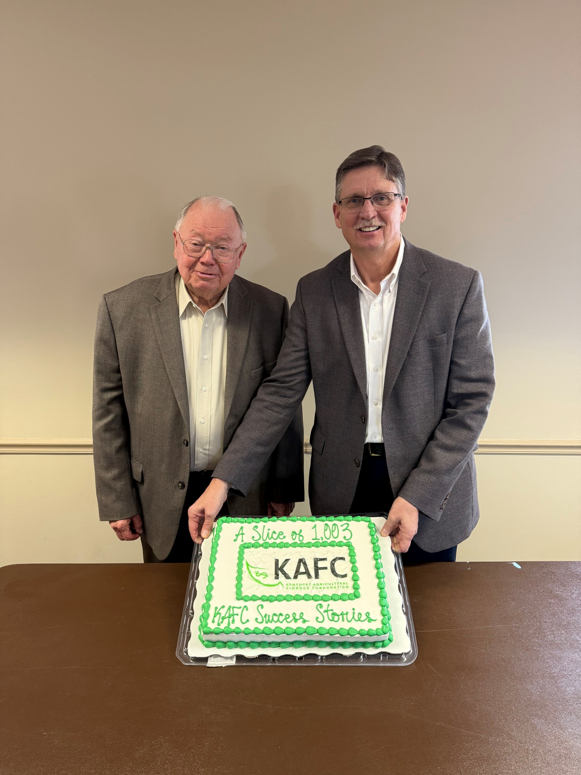
Kentucky Office of Agricultural Policy
Sent from my iPhone

Slide 3
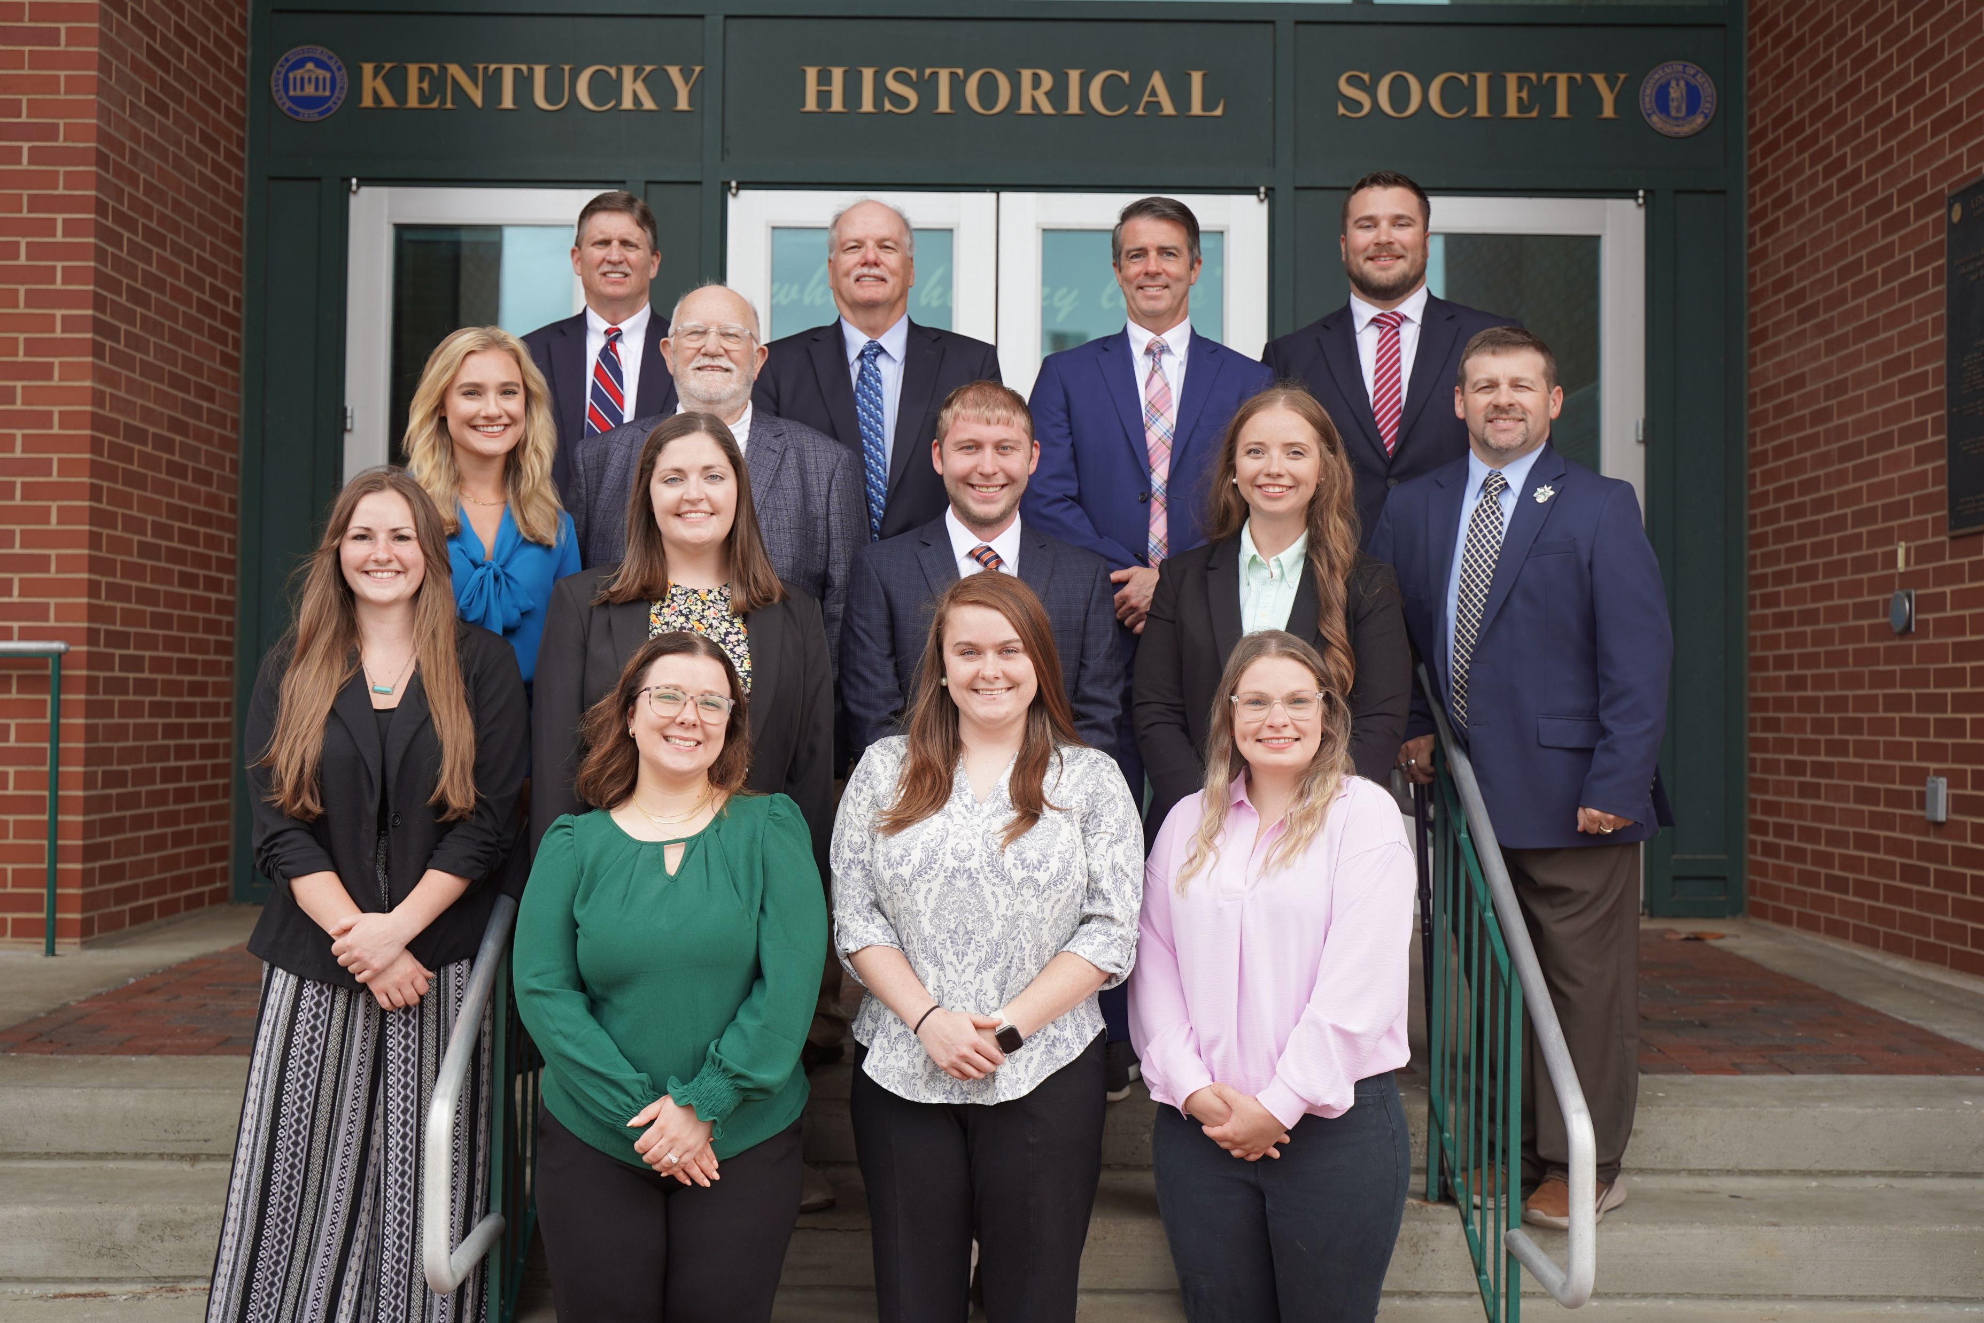
KOAP Staff
Brandon Reed
  Executive Director
Bill McCloskey
  Deputy Executive Director
Bill Hearn
  Fiscal Officer
Brian Murphy
  General Counsel
Chelsea Smither
  KAFC Loan Programs Manager
Hannah Sharp-Johnson
  Boards & Special Projects Manager
Alexis Scheidt
  KADF Regional Manager
Jeff Parman
  KADF Field Compliance Manager
Landon Peach
  KAFC Loan Programs Manager
Rachel Cowherd
KADF Regional Manager
Bailey Siry-Crowder
  KADF Compliance Manager
Rebecca Besok
  KAFC Loan Programs Manager
Sarah Charles
  KADF Programs Manager
Jesse Moore
  KADF Regional Manager
Savanna Hill
  KADF Regional Manager
Alandria Lee
  KAFC Loan Programs Manager

Slide 4


Monthly Board Approvals:
December:
KADB
$600,000
January:
KADB KAFC
$1.5 MM $4.0 MM
February:
KADB KAFC
$700,000 $3.7 MM
March:
KADB KAFC
$1.0 MM $2.9 MM
April:
KADB KAFC
$1.0 MM $2.4 MM
May:
KADB KAFC
$5.0 MM $4.0 MM

Slide 5
KOAP Highlights of October :
  December 2025 – May 2026
  75 County Agricultural Development Councils attended by staff
  31 Site visits conducted by staff
  56 KADF programs cl0sed out
  91 KADF project reports received
  3 KADF program reviews conducted

Slide 6
Bill & Brandon’s Top December-May Picks
    December
(page 5) Farmers Choice, LLC - $250,000 in participation loan
(page 7) Owensboro Catholic Schools -$658 in county funds
January
(page 10) Gate Keeper Cattle Company, LLC -$110,000 in multi-county matched by state funds
February
(page 10) West Liberty Veterinary Clinic Operations LLC - $83,333 in state and $16,667 in multi-county funds
May
(page 15) Grayson County Fiscal Court -$250,000 in state and $10,000 Grayson County funds
(page 17) Casey County Veterinary Services, PLLC -$83,000 in state and $17,000 in multi-county funds
(page 18) Conyea Property Holdings, LLC - $250,000 county matched by state funds as a cost reimbursement grant, with the difference in a forgivable loan

