Slide 2
Overview
Our Mission
Advance veterans into the workforce through targeted business engagement and effective employment services.
Our Vision
Establish networks with employers who understand the value of veterans and are committed to hiring those who have served our nation, and with veterans who are prepared to enter the workforce.

Slide 3
Overview
Kentucky Career Center (KCC) veteran services provide employment assistance to veterans and eligible persons via a Department of Labor (DOL), Jobs for Veterans State Grant (JVSG).
Wagner-Peyser, Transition Assistance Program, and the Workforce Innovation and Opportunity Act also have funding for employment assistance for veterans.

Slide 4
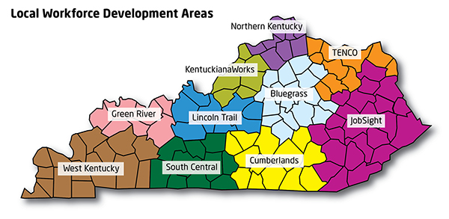
Statewide Staff Support
Find Statewide Contacts at:
https://kcc.ky.gov/veterans/Pages/Kentucky-Veteran-Representatives.aspx

Slide 5
Veterans Employment Services
Veterans receive priority of service from KCC staff.
Disabled Veteran Outreach Program (DVOP) specialists serve only veterans and other eligible individuals most in need of career services because of significant barriers to employment (SBE).
Local Veterans Employment Representatives (LVER) work with employers to highlight the benefits of hiring veterans while working hand in hand with business service teams across the state.

Slide 6
Kentucky Career Center Staff
KCC staff members are the welcoming committee for all veterans employment services.
All non-SBE veterans receive priority of service from KCC staff.
Staff members determine eligibility and refer SBE veterans to DVOPs

Slide 7
Priority of Service
The Jobs for Veterans Act makes priority of service available for U.S. DOL funded job training programs for:
Covered veterans
Eligible spouses of covered veterans

Slide 8
Priority of Service
Priority of Service Programs include:
WIOA Adult and Dislocated Worker Wagner-Peyser Employment Service Trade Act Programs National Emergency Grants Migrant and Seasonal Farm Worker Program Senior Community Service Employment Programs | Indian and Native American Program Job Corps WIOA Demonstration Projects Labor Market Information Grants Career One-Stop Electronic Tools Other internet based self-service tools operated by DOL programs

Slide 9
Eligibility for DVOP Services
Veterans who are:
Receiving VA compensation for a service-connected disability or have a pending claim
Experiencing homelessness or at risk of being homeless
Discharged from the military within the last three years and been unemployed for 27 weeks in the last year
Currently or ever been incarcerated
Between the ages of 18 and 24 years old
A transitioning service member
Lacking a high school diploma or GED
A Vietnam veteran/served during the Vietnam era
Low income as defined by WIOA standards

Slide 10
DVOP Support
Disabled Veteran Outreach Program Representatives (DVOPs):
Provide career services to meet the employment needs of veterans who are economically or educationally disadvantaged, disabled, homeless or facing other barriers to employment.
Assist veterans in overcoming employment barriers through comprehensive case management that may include coordination with workforce training partners and community-based organizations.

Slide 11
DVOP Support
Provides ‘whole person’ approach to veteran
Guides veteran to employability based on comprehensive assessment
Creates relationships to best provide services
Provides direct & referral services to veteran using various resources
Creates a plan of action with LVER
Provides Post-hire follow-up & support
Individual Assessment
LVER/
Employer
Barriers
Partners
Home life
Job Ready
Veteran
Soft Skills
Financials
Interview skills
Competencies
Resume
Job Search Skills

Slide 12
LVER Support
Local Veterans Employment Representatives (LVERs)
Play an integral part on the Business Services Team
Conduct outreach to employers to assist veterans in gaining employment
Coordinate seminars and workshops for employers to highlight the benefits of hiring veterans
Facilitate veteran employment and training services

Slide 13
DVOP and LVER Model for Employment Success
Veteran
Disabled Veteran Outreach Program Representatives (DVOP)
Local Veterans Employers Representative (LVER)
Employer
Veteran
Employer
Specific skills for
Veteran
Specific
Jobs from Employer
DVOP
LVER
Successful
Employment

Slide 14
What Can Employers Do To Hire the Veterans They Need?
Post jobs on Kentucky Career Center employment site.
Provide detailed job descriptions (pay range/shift /benefits)
Provide specific skill gaps that are present at your company (WIOA)
Develop relationship with KCC teams (What you are doing today)
Establish a relationship with your local LVER

Slide 15
Questions?
kcc.ky.gov/veterans

