Slide 1
United States Department of Labor (US DOL) Veterans’ Employment and Training Service (VETS)
US DOL Kentucky State Director
Donietta Hawkey
VETS’ Vision:
Enabling all veterans to reach their full potential in the workplace

Slide 2
VETS' at a Glance
VETS’ Mission (4Ps)
Prepare: Transition Assistance Program
Provide: State Workforce Agencies via Jobs for Veterans State Grant (JVSG), and the AJC Network
Protect: USERRA and Veteran Preference
Promote: Employer Outreach and HIRE Vets Medallion Award
Notes:
VETS, Guard and Reserve Served Last Year by DOL Programs
1. 253,000 served in PY 18 within AJC priority of service
2. 19,946 served via HVRP efforts, PY 18
3. 164334 served via TAP efforts, FY 19
plus 1,272 mil spouses served
4. 34,917 served via compliance efforts, FY 18
33,605 served via DOL call center (24,605) and VETS assistance logs (9,000) (needs to be updated)
932 served via USERRA investigations, 325 served via VET PREF investigations,
~472K total Veterans, Guard and Reserve served last year by DOL as a whole

Slide 3
Veteran Unemployment
Veteran unemployment has increased due to COVID
Pre-COVID
2019: Annual Veteran unemployment rate was 3.1%, the lowest since 2000
In Feb 2020, the US unemployment rate was at a 50-year low of 3.5%.
Post COVID (June 2020):
US unemployment rate 11.1%, veteran rate was 8.8%
KY unemployment rate 4.4%, veteran rate was 10.2%
~775K Veterans are unemployed nationwide
Notes:
There can be misconceptions regarding Veteran demographics, so I want to offer some recent statistics.
The interest in Veteran employment tends to be focused on transitioning service members and young – under 25 years old.
We have to think of Veterans of all ages as the median age of a Veteran is 64 years old. The median age of women Veterans is 51, which is 14 years younger than male Veterans, which is 65.
There are just over 19M Veterans in the US- but only 50% or 9.7M re in the workplace and only 1.8% of these are under 25 years old.
Veteran unemployment rates have been consistently lower than their non Veterans peers.
Of the ~326K unemployed Veterans in 2018, ~60% were ages 45 and over
Around 8% of these older unemployed Veterans are GWII Veterans which means these Veterans served many years ago prior to 9/11.
Less than 6% of the workforce are now Veterans
10% of men in the workforce are veterans
1.5% of women in the workforce are veterans

Slide 4
Employment Services for Homeless Veterans
Homeless Veterans’ Reintegration Program (HVRP) is the only federal program that focuses exclusively on the employment of Veterans who are experiencing homelessness. HVRP provides employment and training services to assist in reintegrating homeless veterans into meaningful employment within the labor force.
HVRP
VETS provided annual funding to 150 grantees in FY 19
Grantees served almost 20,000 homeless veterans in FY 18
Grantees provide services to expedite the employment of homeless veterans
Average annual placement rate is over 60%
Challenges for Kentucky grantees:
Transportation in rural areas
Rural Internet
4
Notes:
VETS serves unemployed and homeless Veterans most in need, many of whom have significant barriers to employment that can be addressed through VETS’ grant programs.
VETS increased the maximum funding in FY 2017 for a Homeless Veterans’ Reintegration Program (HVRP) grant from $300,000 to $500,000 – the first increase since the grant program’s inception.
Homeless Veterans served by an HVRP grant are also enrolled at their local American Job Center to ensure they can access and participate in the training provided through th

Slide 5
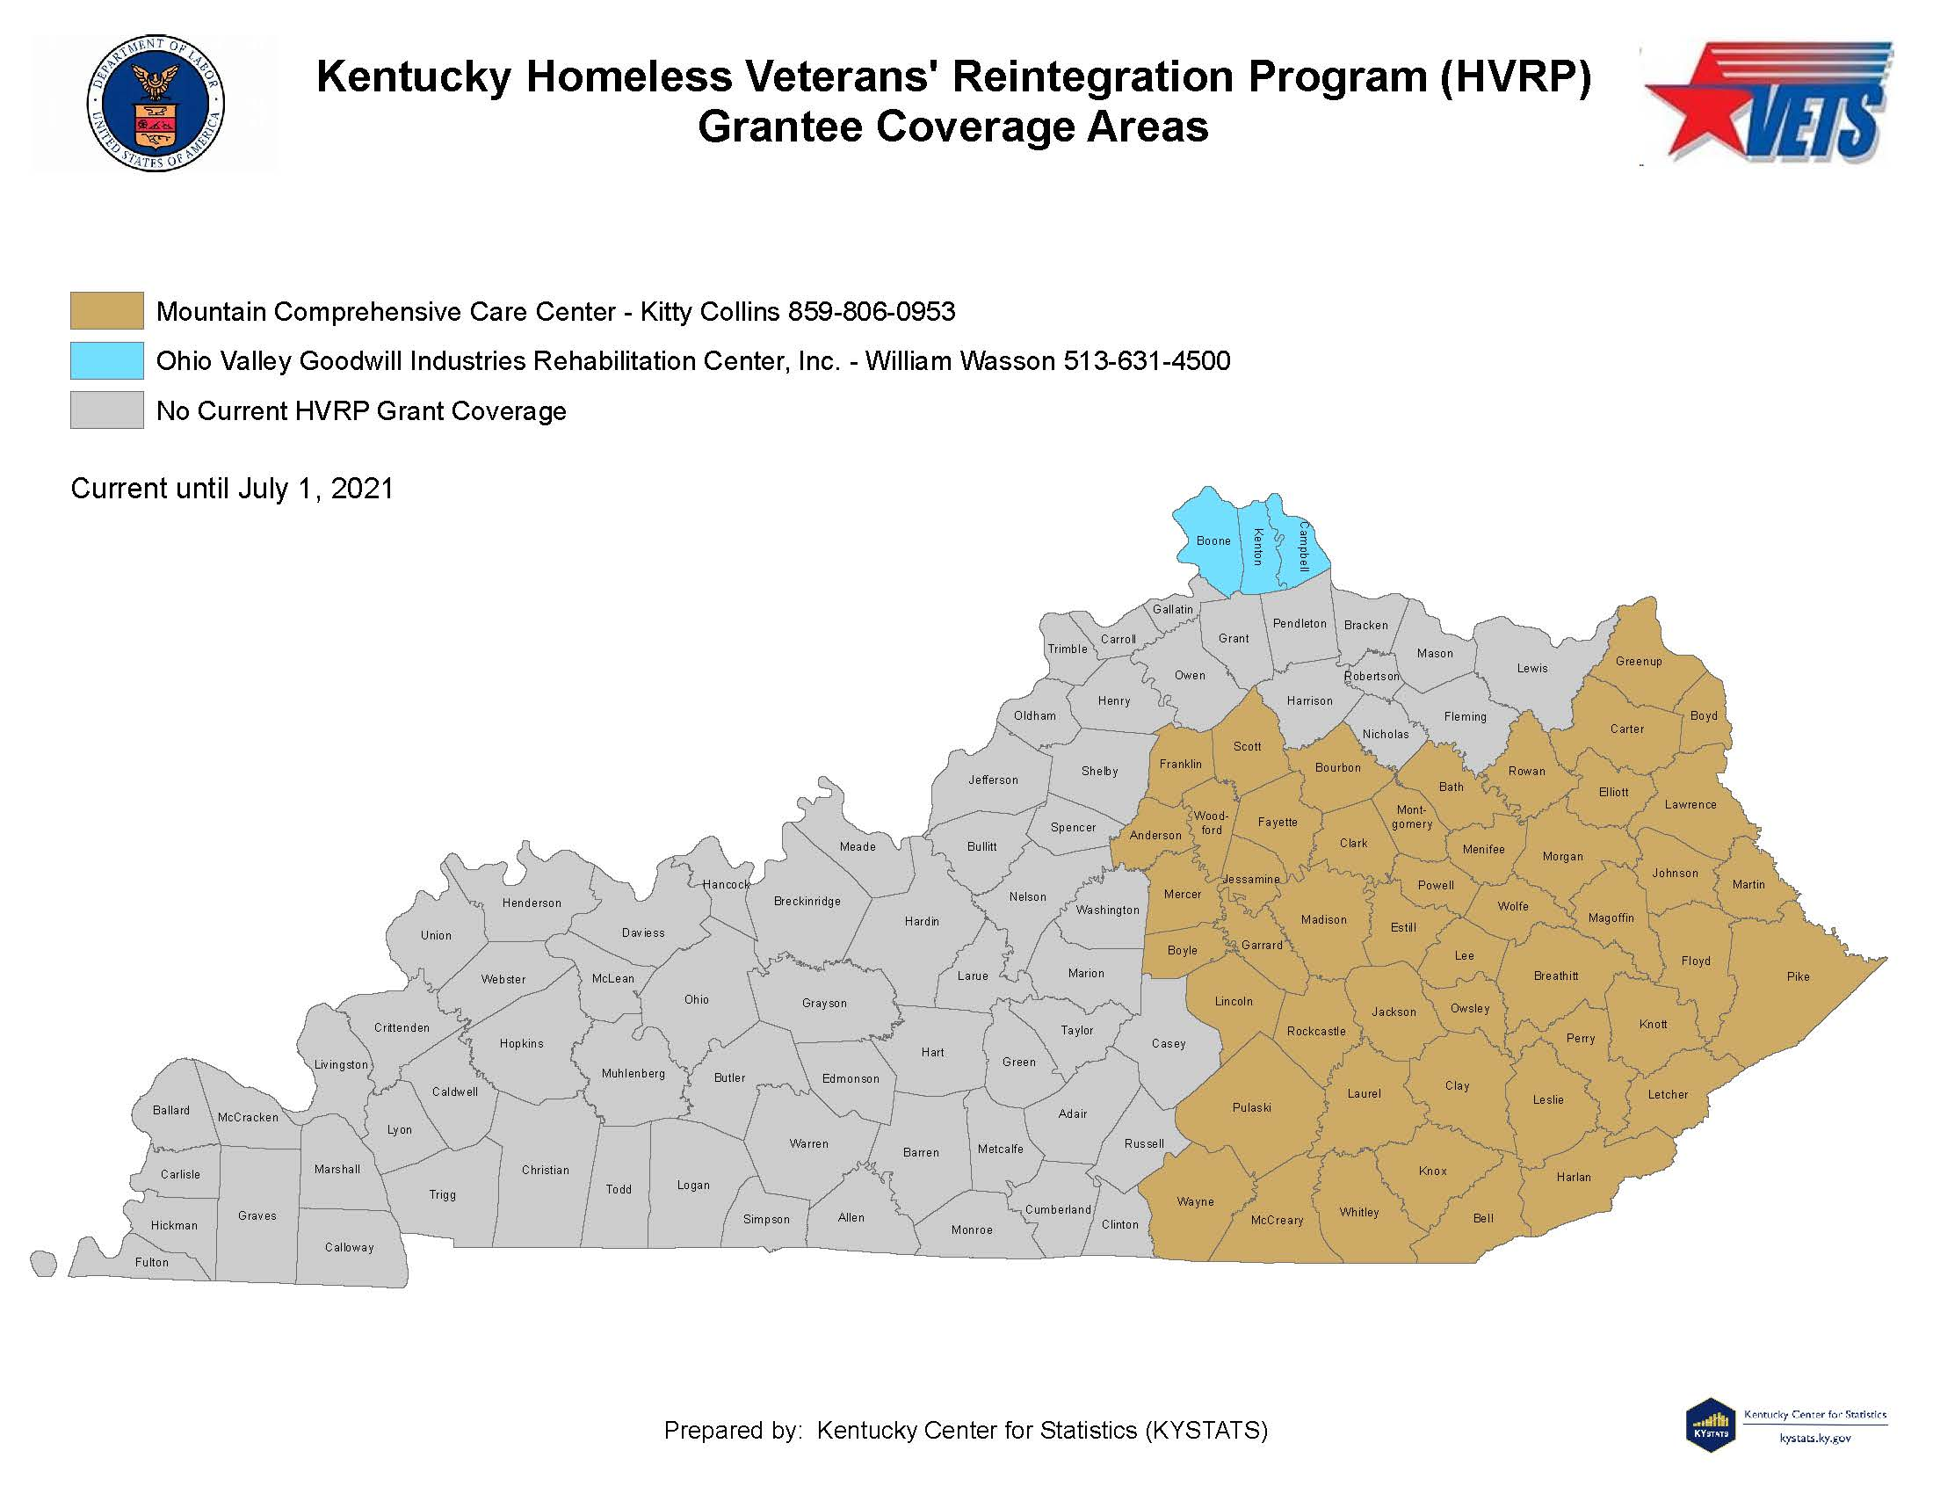
Kentucky HVRP Grantees

Slide 6
Questions?
Donietta Hawkey
Hawkey.Donietta.l@dol.gov

