Slide 1
Overview and Policy Innovations in State Legislatures: Military Veteran Assistance Policies
Jim Reed
Staff to the NCSL Military and Veterans Affairs Task Force

Slide 2
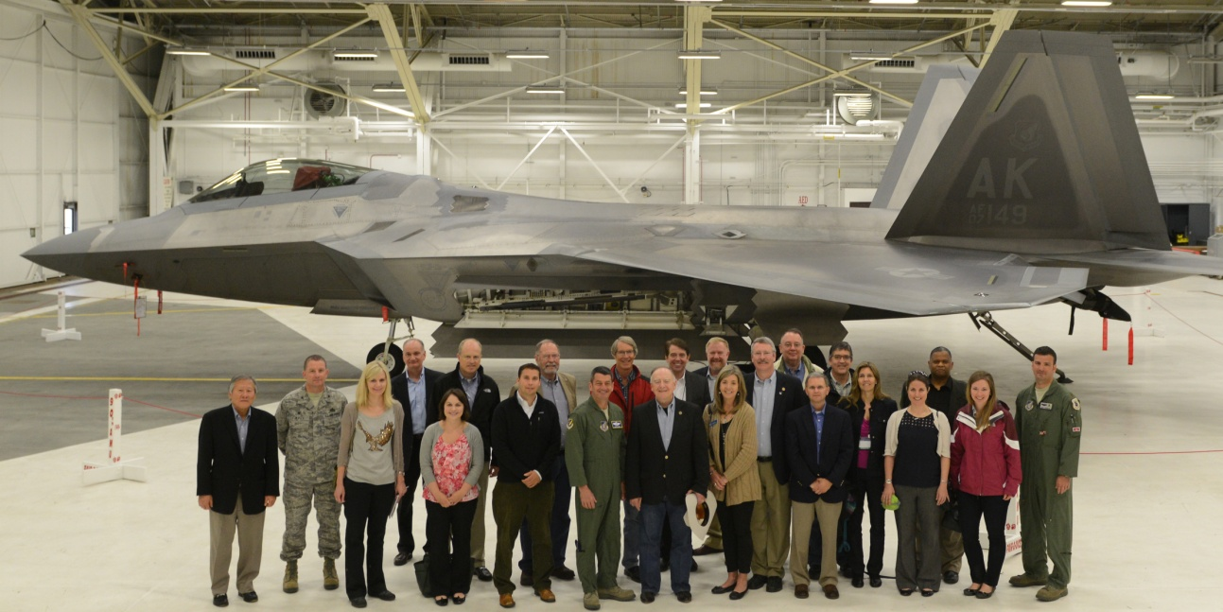
NCSL Task Force on Military and Veterans Affairs
55 members from 27 states and D.C.
Kentucky Members:
Representative Matthew R. Koch
Senator Brandon Smith
Senator Whitney H. Westerfield
Examines issues affecting
military-community relations and
the health and well-being of
service members, veterans and families
Co-chairs: Rep. Tina Orwall (D-WA);
Rep. Dean Dohrman (R-MO)
Notes:
Recent educational programs on justice-involved veterans, suicide prevention, the military economy, veteran quality of life issues.

Slide 3
BLUE STAR FAMILIES 2019 SURVEY OF
IMPORTANT ISSUES FOR VETERANS
Access to military/VA health care 49%
Understanding of military/veteran issues 38%
Military benefits 37%
PTSD/combat/stress/TBI Services 30%
Veteran employment 30%

Slide 4
Policy Overview
Approximately 250 bills enacted every year in state legislatures addressing military and veterans’ affairs.
Trends:
Expediting professional and occupational licenses for veterans and military spouses
Veteran and dependent higher education tuition waivers, in-state tuition, & specialized services
Mental health and suicide prevention initiatives
State veteran assistance transition programs, one-stop state services
Discounts, tax credits & exemptions, & other state benefits for veterans and active duty military service members
Continued expansion of veteran treatment courts

Slide 5
Selected Policy Innovations
Green Alert: Enacted in DE, KY, WI, WV. Introduced in CT, IA, IN, MO, TN
State payment through the univ. system for alternative treatments for veterans such as equine therapy, hyperbaric oxygen therapy: FL
Proactive outreach to veterans who served in combat, relative to suicide prevention: CA, IL
Task Force established to make recommendations regarding veterans' service-related ailments that are not recognized by the U.S. Department of Veterans Affairs, and what may be done to have them recognized: IL.

Slide 6
Resources
NCSL State Help for Returning Veterans webpage
NCSL Report, Barriers to Work: Veterans and Military Spouses (July 2018)
NCSL Report, A Path to Employment for Veterans with Disabilities (July 2019)
NCSL Military and Veterans Affairs State Legislation Database
NCSL Task Force on Military and Veterans Affairs webpage
Jim Reed | jim.reed@ncsl.org

