Slide 1
Demystifying
Defunding the Police
Presented by: Cherie Dawson-Edwards, Ph.D.

Slide 2
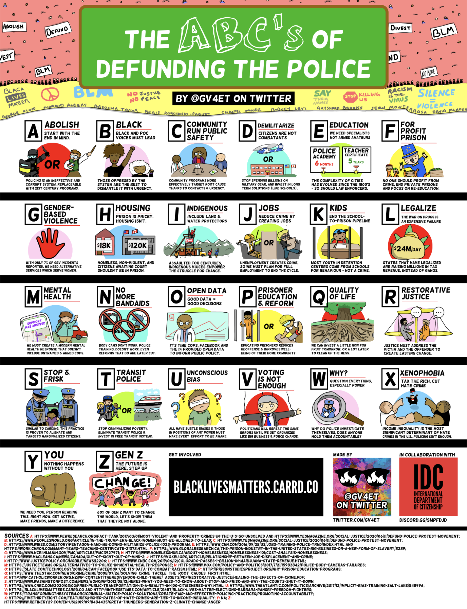

Slide 3
Minneapolis City Council
Bender added that the council is committed to “end policing as we know it and to recreate systems of public safety that actually keep us safe.”
“Safety is being able to decide who supports you. We’re not abolishing help,” Arianna Nason, another member of MPD150, an organization dedicated to shifting “the discussion of police violence in Minneapolis from one of procedural reforms to one of meaningful structural change, added. “We’re abolishing police. That’s very different…We have to do the work to imagine something different and to listen to what people in different neighborhoods and communities want.”

Slide 4
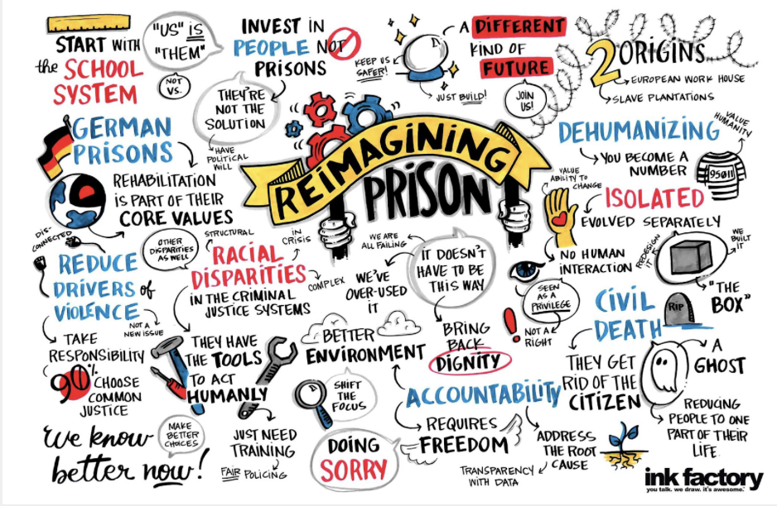
The Carceral State
Refers to the collective group of law enforcement, courts, prisons, security groups...surveillance technology and infrastructure, etc. that use institutional power to confine, surveil, or endanger human lives (Media Kit, 2020)
Prison Industrial Complex:
“The overlapping interest of government and industry that uses surveillance, policing and imprisonment as solutions to economic, social and political problems (Critical Resistance).”

Slide 5
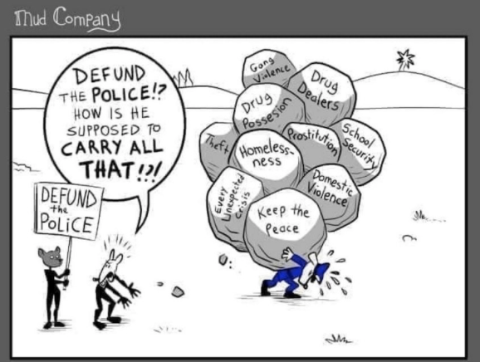

Slide 6
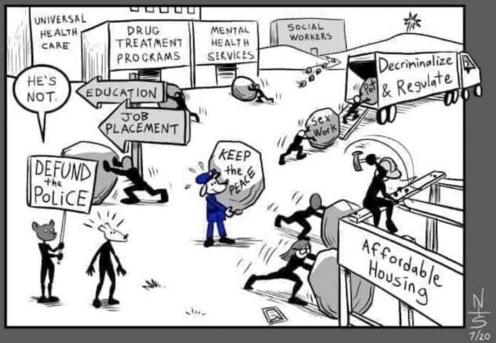

Slide 7
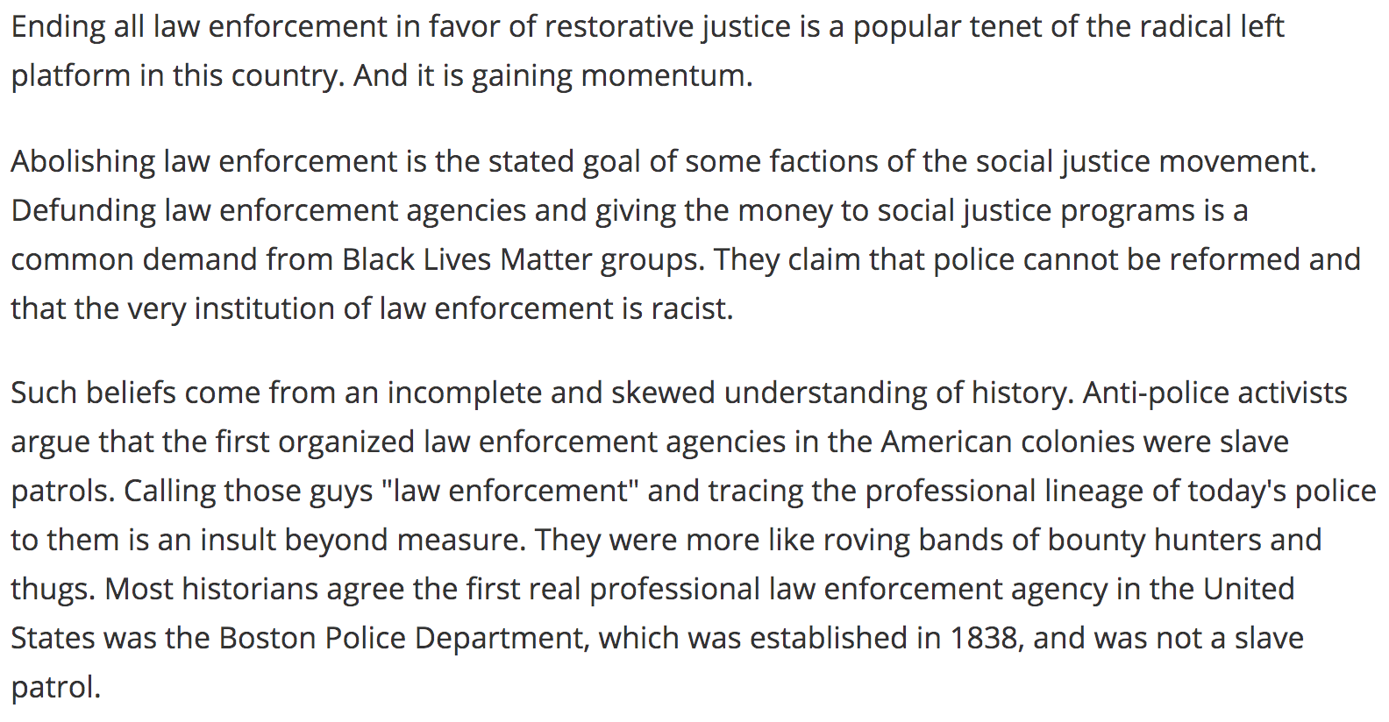
Feb 2020 article in Police Magazine:

Slide 8
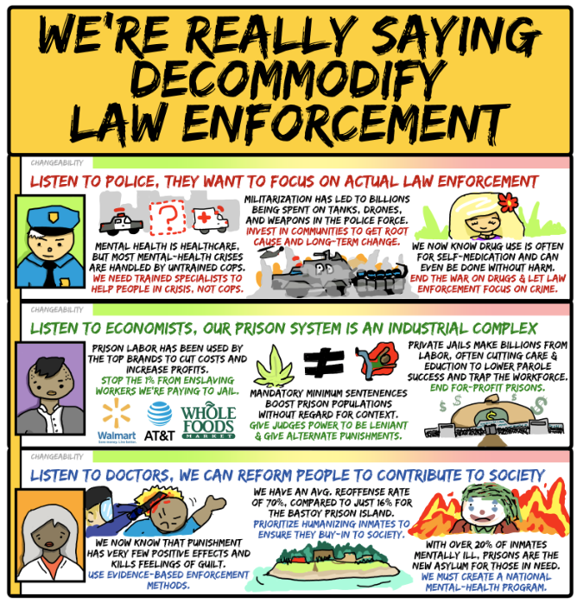

Slide 9
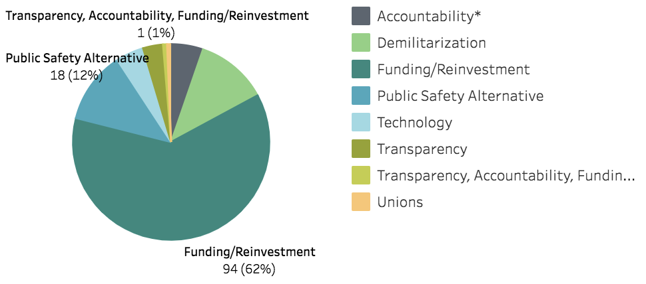
Proposals to Empower Alternatives to Policing
https://www.d4pa.org/?fbclid=IwAR1dQykZ4b3xBAv0XbIIBcoDI8J3ppUHxGaCEusiBfmEcJqnEHxlilV-XVs

Slide 10
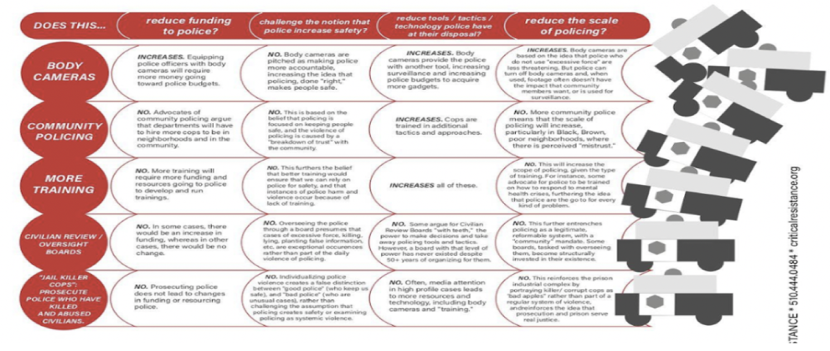

Slide 11
Police Reforms for Systemic Change
1. Are the proposed reforms allocating more money to the police?
2. Are the proposed reforms advocating for MORE police and policing (under euphemistic terms like “community policing” run out of regular police districts)?
3. Are the proposed reforms primarily technology-focused?
4. Are the proposed “reforms” focused on individual dialogues with individual cops? And will these “dialogues” be funded with tax dollars?

Slide 12
THANK YOU!

