Slide 1
Police Social Worker
Kelly Pompilio, Alexandria PSW

Slide 2
WHAT IS A POLICE SOCIAL WORKER
→Highly Specialized Field in Social Work
→PSW acts as a liaison between the Public Service
departments within a city and the citizens
→PSW’s are civilians employed to assist police officers in providing social services as part of community policing
→PSW’s work directly with victims and families within communities in need of crisis intervention by helping to define the problem, examining options, and creating a safety plan

Slide 3
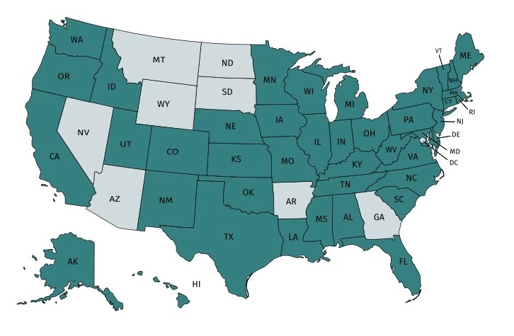
HISTORY
Originated in 1970’s: Several police social service units were funded by a grant and placed throughout suburban Illinois. After the 3 year action-research project. PSW’s continued to operate,completely funded by their communities’ budgets.

Slide 4
KENTUCKY
Alexandria (2016)
Erlanger (2018)
Georgetown
Cynthiana
Berea
Victims Advocates-KSP, Jeffersontown, Louisville, Lexington, Owensboro

Slide 5
APSS
→Association of Police Social Services
(APSS)
→July of 1975
→Consultation and Collaboration
→Over 50 APSS members serve over 40 police departments in the Chicagoland area, as well as in three addition states (Texas, Wisconsin, and Kentucky)

Slide 6
POPULATION SERVED
→Indigent Populations
→Traumatic Incidents and Deaths
→Services for Physically, Mentally, and Developmental Issues
→Domestic Disputes
→Juvenile Cases
→Victims of Violent Crime

Slide 7
WHAT TO EXPECT FROM A POLICE SOCIAL WORK PROGRAM
Creates a “Win-Win” for all who are involved and/or who receive services as well as the community as a whole

Slide 8
BENEFITS TO PUBLIC SERVICES
Police Officers, Fire/EMS, and Codes Enforcement Officers receive hours of training in crisis intervention, mental health, etc. but their exposure to and the services they can provide are limited to the time scene. The nature of their response capabilities creates a hole in the system. PSW’s provide a sense of prevention and organizational community policing

Slide 9
POLICE
Liaison between Cabinet Workers
Reduce Recidivism/Recurring calls
Miniminalization of Police Officer time spent on non-criminal calls
Multidisciplinary approach to difficult and complicated cases
Increase in communication
Assist with transportation
Provides training to officers
Enhanced Victim Cooperation with Investigations
Ability to target special populations and assist with chronic, recurring situations
We believe this will lead to decreased strain on our police resources, reduce risk to our member officers, and better outcomes to the most vulnerable citizens that we serve.

Slide 10
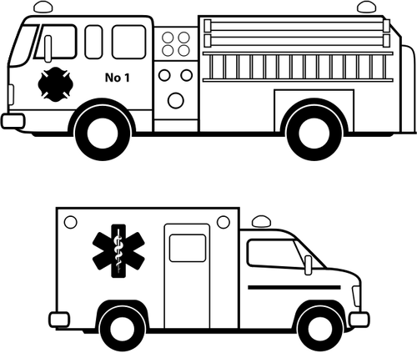
FIRE/EMS
Senior Citizens (Falls, lift assistance)
OD runs
MH Crisis Calls

Slide 11
CODE ENFORCEMENT
Identify people who have code violations and can’t fix them
Recurring yard conditions
Noise complaints/Neighbor disputes

Slide 12
BENEFITS FOR CLIENTS
Acts as an advocate
Assesses needs and provides intervention and referrals

Slide 13
BENEFITS FOR COMMUNITY
Sharp reduction in the number of repeat calls for service
Acts as a liaison
Increase satisfaction among community members

Slide 14
REFERRAL PROCEDURES

Slide 15
RESIDENTS
Family/Friend Referrals
City Council Members/Mayor Referrals
Victims/Witness requests
The Counseling Units of the Campbell Co. School District or Catholic Schools
Outside social service agencies who are dealing with City Residents
Police Reports/Officer Call Responses
Officer Request-Officers
CID Request
Walk-in referrals
Fire/EMS referrals
Code Enforcement Referrals
Community Partner Referrals

Slide 16
NON-RESIDENTS
Request from other PD’s
Victims of crime within the city

Slide 17
FOLLOW UP
PSW’s typically respond the next day when the situation is less volatile. If PSW is familiar with the individual and the scene is secured and safe the PSW may respond with officers.
PSW’s provide 24-hour immediate onsite response that includes needs assessment, crisis intervention techniques and appropriate referrals to other agencies if necessary.
PSW’s prevention efforts are supported by preventive patrols where social workers return periodically to problem sites to monitor client progress
If PSW’s are called to a scene to assist officers, they are not to be primary units unless the call initiated by them

Slide 18
OUTCOMES

Slide 19
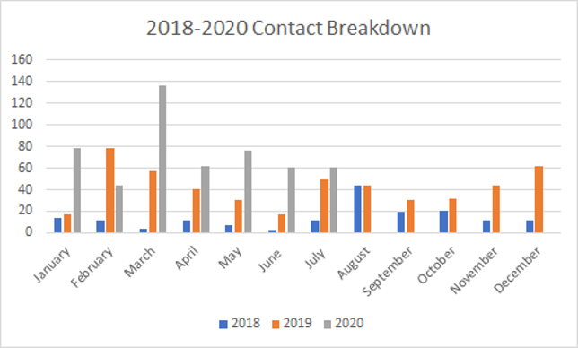

Slide 20
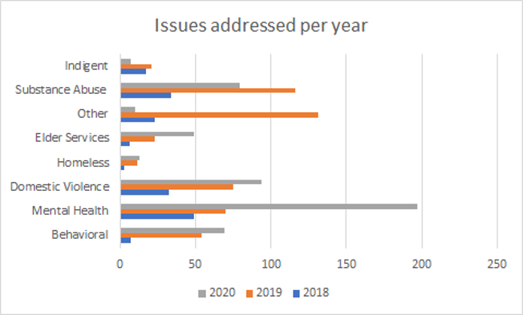

Slide 21
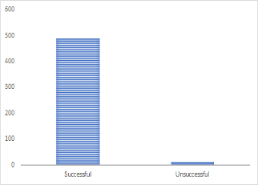
 | 2018 | 2019 | 2020
Successful | 168 | 490 | N/A
Unsuccessful | 3 | 11 | N/A
=
SUCCESSFUL
VS
UNSUCCESSFUL

Slide 22
MENTAL HEALTH
Mental Health Issues
47 years old

Slide 23
911 CALLS
September 2017-November 2018-63 Police Calls
Trouble disturbance
Suspicious activity
Welfare checks
Neighbor dispute
Domestics
Public Intoxication
CIT runs (outside naked, going through yards, talking/yelling at self)
Harassment
Complaints on yard/house conditions

Slide 24
PSW
Arranged for SUN Admission
Court Advocacy
Advocated Mental Health Court then assisted him with navigated through court system
Arranged for Psychological assessment
Chaplain
Transported
Advocated for medication treatment and assisted with medication management
Connected with community service
Assisted with obtaining social security
Symptom management
Connection to AA
Referral to Primary Care Provider and Psychiatrist

Slide 25
NO MORE POLICE CALLS!

Slide 26
CHALLENGES
Software System
Collaboration-HIPPA
Awareness of PSW
Role confusion within community and community partners

Slide 27
MYTHS ABOUT APD PSW’S
Grant Funded/Employment
First Responder
Replace Police
Unsafe

Slide 28
Alexandria Police Department
8236 West Main Street
Alexandria, KY 41001
859-635-4126
KPompilio@alexandriaky.org
CHensley@alexandriaky.org
LCooper@alexandriaky.org

