Slide 1
Reimaging Public Safety
Keturah Herron
Policy Strategist
Keturah@aclu-ky.org

Slide 2
What Is Public Safety
Public Safety
Public safety is a state or local government agency which often has a broad portfolio of responsibilities, which may include some or all of the following:
Police Department
Fire Department
Ambulance and Medical Services
Office of Emergency Management

Slide 3
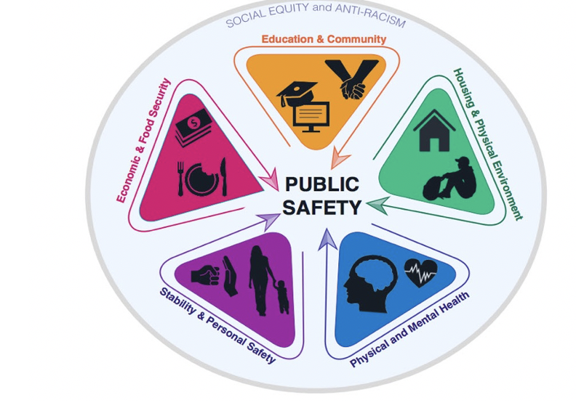
Social Determinants
Increased Crime
Violence
Substance Abuse
Houselessness
Increased Dropout Rates
Davisvanguard.org
Notes:
The foundation of public safety in a community is Economic & Food Security, Education & Community, Housing & Physical Environment, Physical and Mental Health, and Stability and Personal Safety.
When we look at this from a generational viewpoint, we can see the effects of one not having their needs meet. This does not only impact their life, it impacts their children’s lives. This is a domino effect in an individual’s life and the life of a community. Continuously not having your basic met can be detrimental to how a how a community thrives.

Slide 4
Solutions and Policy Suggestions
Increased community led initiatives
Police free schools, full of trained counselors and restorative justice programs
Access to trauma-informed responders for domestic violence and mental health calls
Increase living/minimum wage
Increased substance abuse resources in the community
End qualified immunity for police officers

Slide 5
Solutions and Policy Suggestions Cont.
Increase funding to reentry and community based solutions
Abolish fines and fees from the criminal legal process and calibrate fines to reflect peoples ability to pay
Offer non-carceral responses to behaviors caused by poverty, mental health, or substance use.
Support initiatives that provide training and transitional job opportunities for those impacted by policy change

Slide 6
Keturah Herron
Policy Strategist
Keturah@aclu-ky.org

