Slide 1
Building a BetterKY>
Kentucky Commission on Military Affairs
(KCMA)
19 November 2020

Slide 2
Mission, Vision & Values
The Kentucky Commission on Military Affairs was created to serve as a watchdog for the military community in Kentucky and to be a bridge for bringing programs across the Commonwealth together to benefit military, veterans and their families.
KRS 154.12-203 (1996)
2 full time staff
Membership includes:
Leaders of major Kentucky military installations and units
Governor, senior staff, cabinet secretaries, Attorney General, Chief Justice
Kentucky General Assembly (one Senator and one Representative)
Civilian Aides to the Secretary of the Army
At-Large members appointed by Governor
Chair, Employer Support of the Guard and Reserve

Slide 3
Mission, Vision & Values
Mission: Guided by Kentucky statute, the Kentucky Commission on Military Affairs addresses matters of military significance by advising and synchronizing efforts with key stakeholders; protecting and growing our military installations and activities; expanding its defense-related industry; and improving the quality of life for our service members, veterans, and their families.
Vision: Kentucky achieves its full potential in supporting and partnering with our military while creating enduring economic opportunity for the Commonwealth.

Slide 4
Mission, Vision & Values
Strategic Goals
Protect and Grow DOD Installations and Activities
Expand the Economic Impact of Kentucky’s Defense-Related Industry
Develop and Implement the Model for Transitioning Service Members/Veterans/Spouses
Establish Kentucky as the Most Military Friendly State and Grow Veterans/Retiree Population
Communicate Strategically and Gain Advocacy

Slide 5
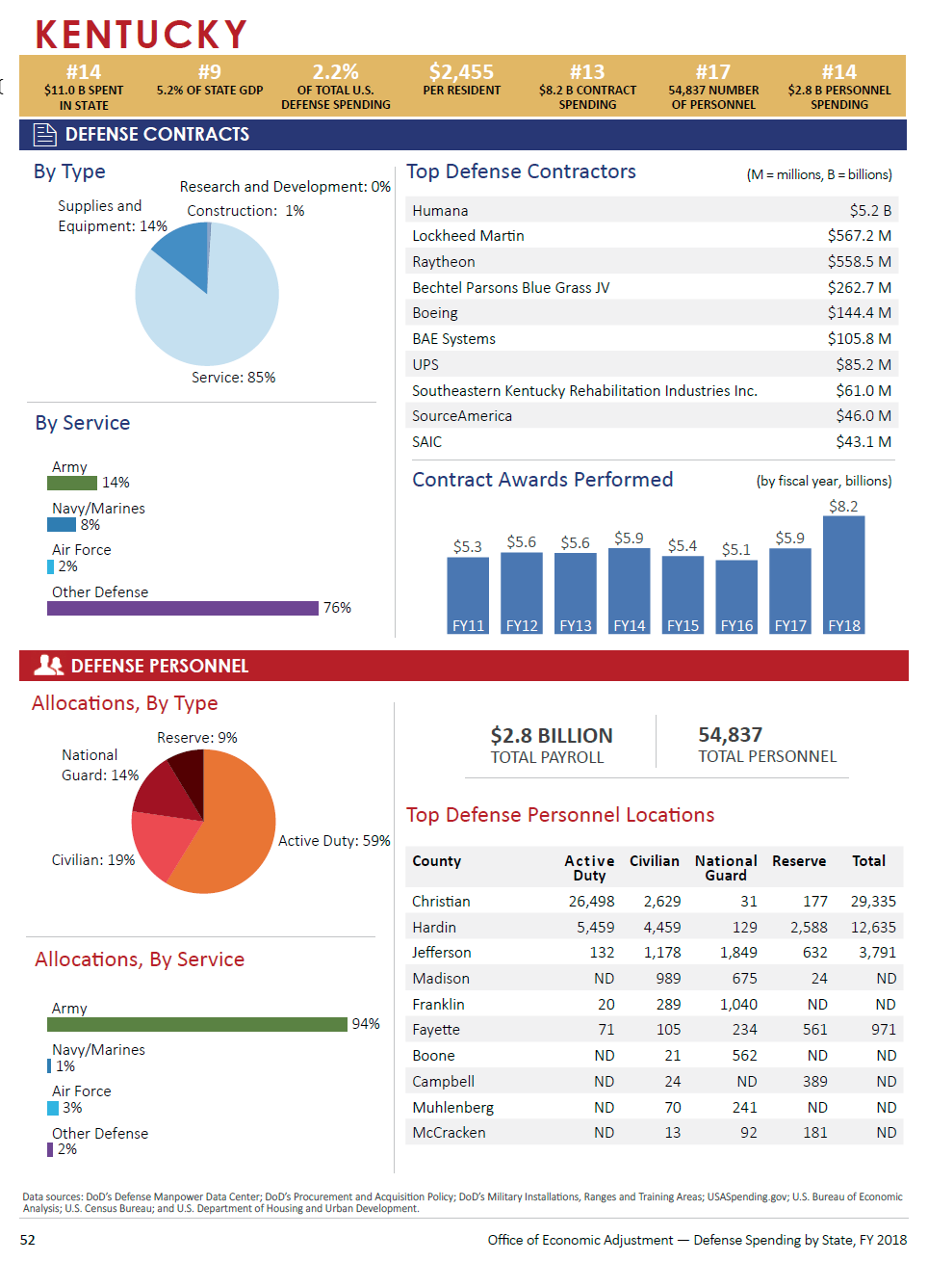

Slide 7
2020 Key Accomplishments
In coordination with Knox Regional Development Alliance (KRDA), established through KMCA and led by KCMA chair Jim Iacocca, our major success is the U.S. Army placing the new V (Fifth) Corps Headquarters at Fort Knox (3-star command/650 soldiers) to manage Army forces in Europe
KRDA earned Association of Defense Communities national recognition this summer creating a website for military spouses to receive proactive career coaching and professional networking opportunities – now we’re developing a similar program for Fort Campbell/Christian County
Worked with the City of Louisville to complete/submit their application for U.S. Space Command Headquarters, vetting Louisville as a qualified applicant and gaining submission approval by the Air Force Strategic Basing Office – announcement of finalists expected November 2020

Slide 8
2020 Key Accomplishments
Won $2M DOD grant to allow the University of Louisville to create a “Cybersecurity, Certifications, Careers and Communities” (C4) program and allow us to hire contract Grant Program Manager, Dr. Dallas Kratzer, to facilitate workforce development for military/spouses/veterans
State Commissioner for Military Interstate Children’s Compact Commission, supporting military families; highlighted HB 266 as a national best practice facilitating school enrollment for military children; working with Communications on video concept to highlight activities
Held first two Christian County Chamber of Commerce Military Spouse Working Group meetings, in coordination with Rep. Walker Thomas, chair of the House Veterans, Military Affairs & Public Protection Committee, and the State Liaison Office, DoD Military Community & Family Policy

Slide 9
2020 Key Accomplishments
Facilitated USO coordination with Greater Louisville Inc. and Louisville Regional Airport Authority to open a USO facility for military, veterans and their families at the Louisville Muhammad Ali International Airport in August 2020; exploring a possible Fort Knox USO facility
Coordinated opportunity for Governor Beshear to personally present the 2020 Secretary of Defense Freedom Award, awarded to the nation's top 15 civilian employers of National Guard and Reserve personnel, to Lexmark International
KCMA Executive Assistant Stacey Shane and I assisted Constituent Services on the Governor’s COVID-19 Hotline March through July, taking over 1,500 direct phone calls and hundreds of emails to help manage our administration’s response to the community

Slide 10
2021 Legislative Priorities
Occupational Licensing Reciprocity
Audiology Speech Language Pathology Compact
Psychology Interjurisdictional Compact
Emergency Medical Services Compact
Top remaining Department of Defense priority occupational licensing reciprocity compacts for military personnel/spouses - Kentucky has already passed two of the five DOD priority compacts and is a member of 39 state compacts, higher than most states
Add military personnel/families to driver’s license exemption
KRS 186.430 states “a person over the age of sixteen (16) who is a United States citizen and who is not a resident of Kentucky may drive in Kentucky for a period of time not to exceed one (1) year from the date the person enters Kentucky.”
College students are currently the only exemption – Transportation Cabinet is on top of this

Slide 11
2021 Legislative Session
Additional Legislative Goals
Authorization/funding for Bluegrass Station airfield (commercial/military)
Establishment of Uniform Deployed Parents Custody and Visitation Act
Inclusion of ASVAB test in school accountability system
Motor vehicle insurance - prohibition of “Patriot Penalty” for military
Consideration of full military retirement income tax deduction
Currently all pensions exempt for first $31,100
To attract senior officer/enlisted retirees to Kentucky
Military income tax exemption already in place (passed in 2009)
Good policy – the challenge for both the Beshear Administration and the General Assembly is the up-front cost in COVID-stressed budget, estimated at ~$3.9M

Slide 12
2021 Vision
Managing our Air National Guard (ANG) C-130J recapitalization effort to modernize the Kentucky Air Guard fleet and ensure their long-term future; proactively countering “threats” to ensure fair selection process, anticipate favorable announcement very soon (approximate value $800M)
Coordinating with Blue Grass Army Depot and the local community regarding the acquisition and repurposing of the 55-acre Chemical Weapons Demilitarization Facility following remediation in December 2026; potential includes Hyper-Scale Data Center development, jobs for 1,900+ displaced contract workers
Building business case for the redeployment of Army forces in Europe, esp. the 6,400-strong 2nd Cavalry Division, to Fort Knox, with our military ranges, strong community support, and expansion capability, should the redeployment actually occur – prepping for strong competition

Slide 13
2021 Vision
Working the assignment of “Future Vertical Lift” aircraft to replace the aging CH-47 Chinook (time frame 2028-2030 but decision process is starting now) and near-term assignment of Army National Guard CH-47s to Fort Campbell – we note the 101st Airborne is the clear choice to be the first recipient of “Future Vertical Lift” and are getting positive feedback
Support to the Cabinet for Economic Development and KRDA in business development initiatives
Great progress partnering our Grant Program Manager, Dr. Dallas Kratzer, with KDVA to develop “Skillbridge” internship opportunities for separating Army "68W/Combat Medics" in communities including Richmond, Bullitt County, Meade County and Jefferson County; related programs under development

Slide 14
Thank You

