Slide 1
CUI
COL Stephen D. Dorris, Commander
Blue Grass Army Depot
Kentucky’s Only Defense Industrial Base Organic Facility
80 YEARS PROVIDING: 1. Joint Warfighter Support
2. Munitions & Material Readiness
3. Surge Capacity to Contingency Requirements
22 September 2021 – Kentucky State Capital
Veterans, Military Affairs and Public Protection (VMAPP)
Controlled by: BGAD Public Affairs
CUI Category(ies): OPSEC, PII
Limited Dissemination Control: FEDCON
POC: Mark D. Henry, mark.d.henry.civ@mail.mil
CUI

Slide 2
BGAD Support Posture
Perfectly Postured to Provide Responsive & Reliable Strategic Support to the Army’s
Premier Power Projection Platforms and Sea / Aerial Ports of Embarkation
Superb Rail & Trucking Network
Centralized Southeast Location
40 Miles from Blue Grass Airport in Lexington
CSX Rail Spur (CSX is 1 of only 2 major U.S. rail carriers)
Depot is postured near Intersection of I-64 (E&W) and I-75 (N&S)
620 miles to eastern seaboard military shipping terminal
Closest Depot to FedEx (Memphis) and UPS (Louisville) World Hubs
Tri-State Trucking Company (has access to ∼700 tractors) operating in close proximity = Capacity to support surge requirements
Proximity to Army GRF and SOF Units
Supporting DA #4 Priority with CL V to FBNC (N+24)
Closest Depot to Forts Bragg, Benning, Campbell, Stewart, Rucker
Primary source for USSOCOM-owned, USA & USAF-managed, non-standard ammunition (NSA) stocks for contingency operations
State-of-the-Art Consolidated Shipping Facility
$15M in FY16 Military Construction/Veterans Affairs Appropriations
Maximizes efficiencies (people, C2, MHE, and space) for surge outload of surface (rail or truck) movement of munitions at scale
Allows consolidation of non-compatible munitions for combat loads
Superior Physical Security
Vetting 100% of Visitors using AIE connection to NLETS
Only AMC Installation meeting Army Access Control Standard Design
SMEs for OPMG/AMC/JMC on training of AIE
Rock Island, IL
526 Miles
Dover AFB
667 Miles
Ft. Knox, KY
130 Miles
Fort Bragg
513 Miles
Ft. Campbell, KY
264 Miles
MOTSU
622 Miles
ANMC, AL
373 Miles
Charleston AFB
508 Miles
Ft. Rucker, AL
508 Miles
Ft Benning, GA
468 Miles
Ft. Stewart, GA
590 Miles
CUI

Slide 3
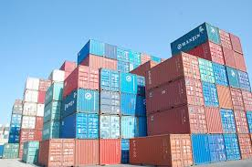
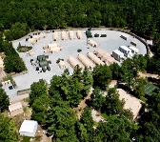
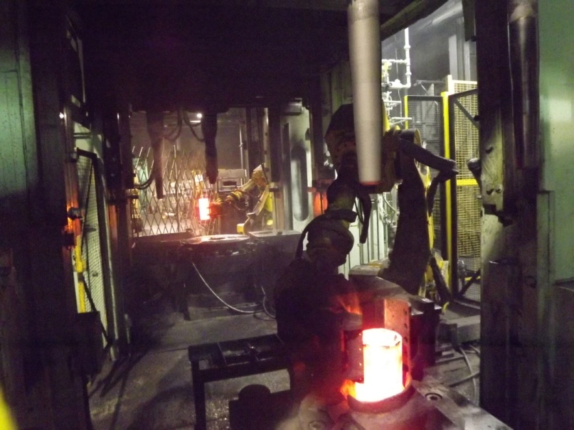
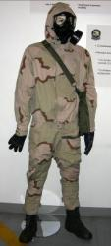
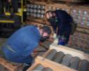
BGAD Core Competencies
769 DA Civilians + 1 Soldier
Over 65% Veteran Workforce
26% - Disabled Veterans
902x Earth Covered Magazines
$122 Million Budget
$70 Million Payroll
Quick Access To I-64 / I-75
14,594 Acres / 22 Sq. Miles
1,228x Total Structures
174x Miles of Road
13x Bridges / 5x Dams
41x Miles of Safe-Haven Rail
Independent Water Source
State of Art Water Treatment Plant
40x Miles of Water Lines
Wastewater Treatment Plant
21x Miles of Sewer Mains
41x Miles of Electrical Distribution
47x Miles of Communication Lines
316x Transformers
22x Generators
33x Loading Platforms
101x Miles of Secure Fence
24x Miles of Gas Line
3x 80T Locomotives
Controlled Airspace to 5000’ AGL
ISO 9001 Registered
OHSAS 18001 Registered
Most secured footprint w/in AMC
Strategic Outload:
Consolidated Shipping Center
Immediate Response Force (IRF) & Global Response Force (GRF)
180+ Containers Per day –
Deployment of Go-To-War Stocks; i.e. CBRN Defense Equip. (CDE); Non-lethal Combat Equip. (NLCE); & APS-1b stocks
Non-Standard Ammo Support:
Non-Standard Ammunition
24/7/365 Responsiveness
Supporting SOCOM
Container Management:
Inspection
Storage
Receipts
Repair
Anniston Munitions Center:
THAAD
Missile Maintenance
MLRS Recycling
Conventional Demil
75th Rangers Support
Core Competencies
Store, Issue, Receive, Inspect, Maintain, and Demil Conventional Munitions
APS-1b - Care of Stocks in Storage (COSIS):
3rd largest Force Provider site
Supports ARNORTH
Supports ARCENT
150-Soldier Camps
75-SOF Camps
Scranton Army Ammunition Plant:
Govt-Owned / Contractor-Operated
Production
155mm M795 Projectile
Navy 5” Projectile
Metal Forge/Press/Finish
Future ERCA Projectiles
Chemical Defense Equipment:
Supporting ARNORTH
FedEx Shipping 24/7/365
Go-To-War Stocks
COTs
Blue Grass Chemical Activity:
Secure Storage
Treaty Compliance
Core Competencies
Supplemental Missions
Blue Grass Chemical Agent Destruction Pilot Plant:
Super Critical Water Oxidation,
Static Detonation
2023 Mission complete
Sunset Missions
CUI

Slide 4
BGAD Economic Impacts
(non chemical)
Employees (500+ veterans / 200+ disabled veterans) 769
FY21 Employee Total Compensation $70M
Avg. FY21 Employee Compensation $91,027
Kentucky Contractors 155
FY21 KY Total Contractor Expenditures $16M
-----------------------------------------------------------------------------------------------------------------
Total Employee Compensation $ 70M
Total Contractor Expenditures $ 16M
Total $ 86M
Total FY21 Economic Impact $151M *
* $80M x 1.75 KCED General Economic Multiplier

Slide 5
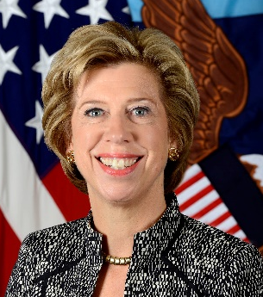
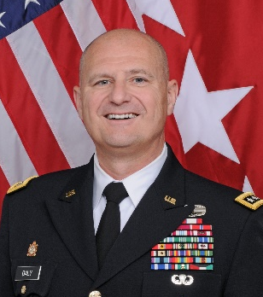
Army Organic Industrial Base
Former Under Secretary of Defense for Acquisition and Sustainment
Ellen M. Lord
Jan 2021 / DoD News (Lord):
“The U.S. must re-shore more of its industrial base.”
“The DoD must also reform and modernize.”
March 2021 / AMC OIB Guidance (Daly):
“…we are at an inflection point and must accelerate our modernization plans. We can’t afford to wait any longer to modernize.”
July 2021 / AMC OIB Summit (Daly):
“…we need to highlight and communicate the equipment and capabilities necessary to support the Army’s modernization efforts.”
AMC Commander
Gen. Edward M. Daly

Slide 6
Questions?
CUI

Slide 7
Back Up
CUI

Slide 8
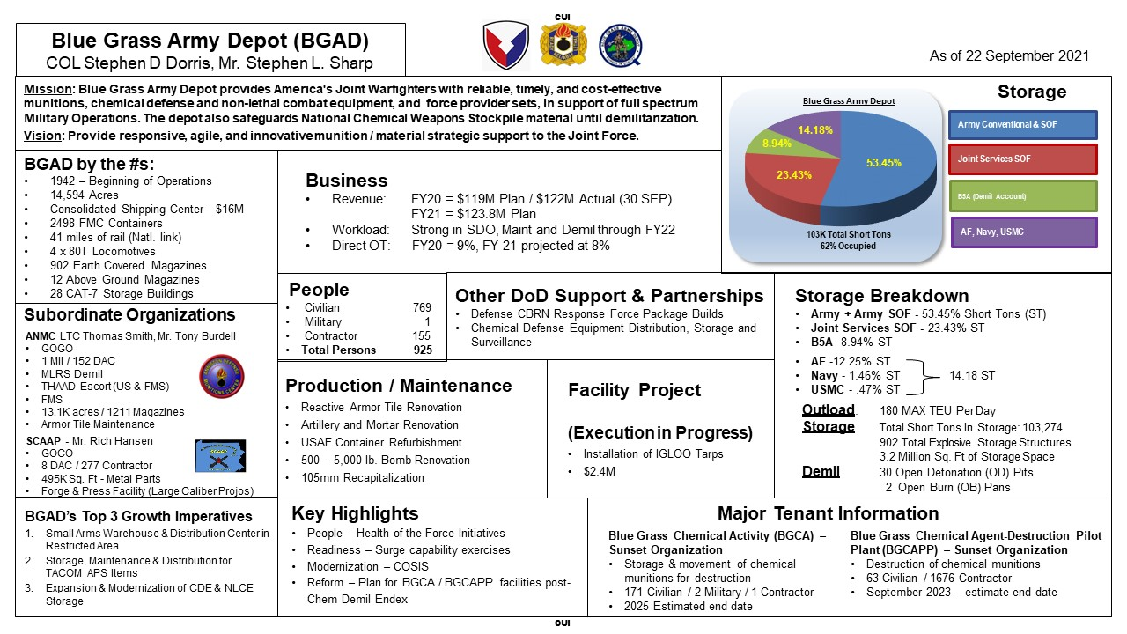
BGAD by the Numbers
CUI

