Slide 1
Addressing Human Trafficking in Kentucky
Presentation to the Interim Joint Committee on Veterans, Military Affairs, and Public Protection
Wednesday, October 20, 2021
Attorney General Daniel Cameron
Notes:
Intoduction
Education
Professional
What CLC does

Slide 2
Challenges
Nationally, more than 63,000 reports of human trafficking since 2007, with a steady year-over-year increase in reports.
Kentucky ranked 9th in the country for new federal human trafficking cases in 2019.
Notes:
Intoduction
Education
Professional
What CLC does

Slide 3
Challenges
Since 2007, more than 700 cases from Kentucky reported to the National Human Trafficking Hotline.
In the 2020 reporting period alone, CHFS noted 206 incidences of human trafficking involving minors.
Human trafficking is widely underreported.

Slide 4
Legislative Changes
2020: HB 2
Closed an important loophole that allowed sex traffickers of adult victims to avoid registering on the sex offender registry.
Broadened the definition of “commercial sexual activity” from prostitution to “any sex act for which anything of value is given to, promised to, or received by any person.”

Slide 5
Legislative Changes
2021: HB 79
Requires background checks for massage therapy licensure.
Ensures that future employers are aware of an employee’s previous criminal behavior related to this industry.

Slide 6
Success Stories
Operation United Front
Multistate human trafficking sting carried out by 29 agencies across Kentucky.
Operations conducted simultaneously in Bowling Green, Elizabethtown, McCracken County, and Northern Kentucky.
Rescued 21 victims, including two minors, and yielded 46 arrests (most of any state).

Slide 7
Success Stories
Public & Private Sector Training
1,263 law enforcement officers, 490 prosecutors, and around 2,400 private sector employees trained through efforts by OAG and DOCJT.

Slide 8
Success Stories
Your Eyes Save Lives
PSA encouraging Kentuckians to be aware of the signs of human trafficking and to report suspected incidences.
Ads targeting the regions of Kentucky reported as having the largest incidences of child trafficking.
39 billboard ads in 22 counties; 1,886 radio ads in 30 counties; TV spots in 36 counties.
Funded by Department of Justice grant.

Slide 9
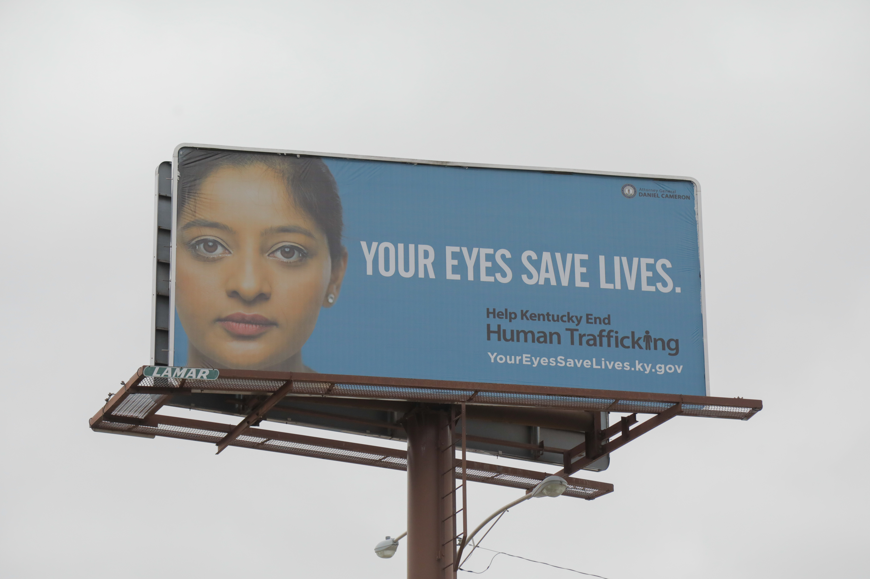
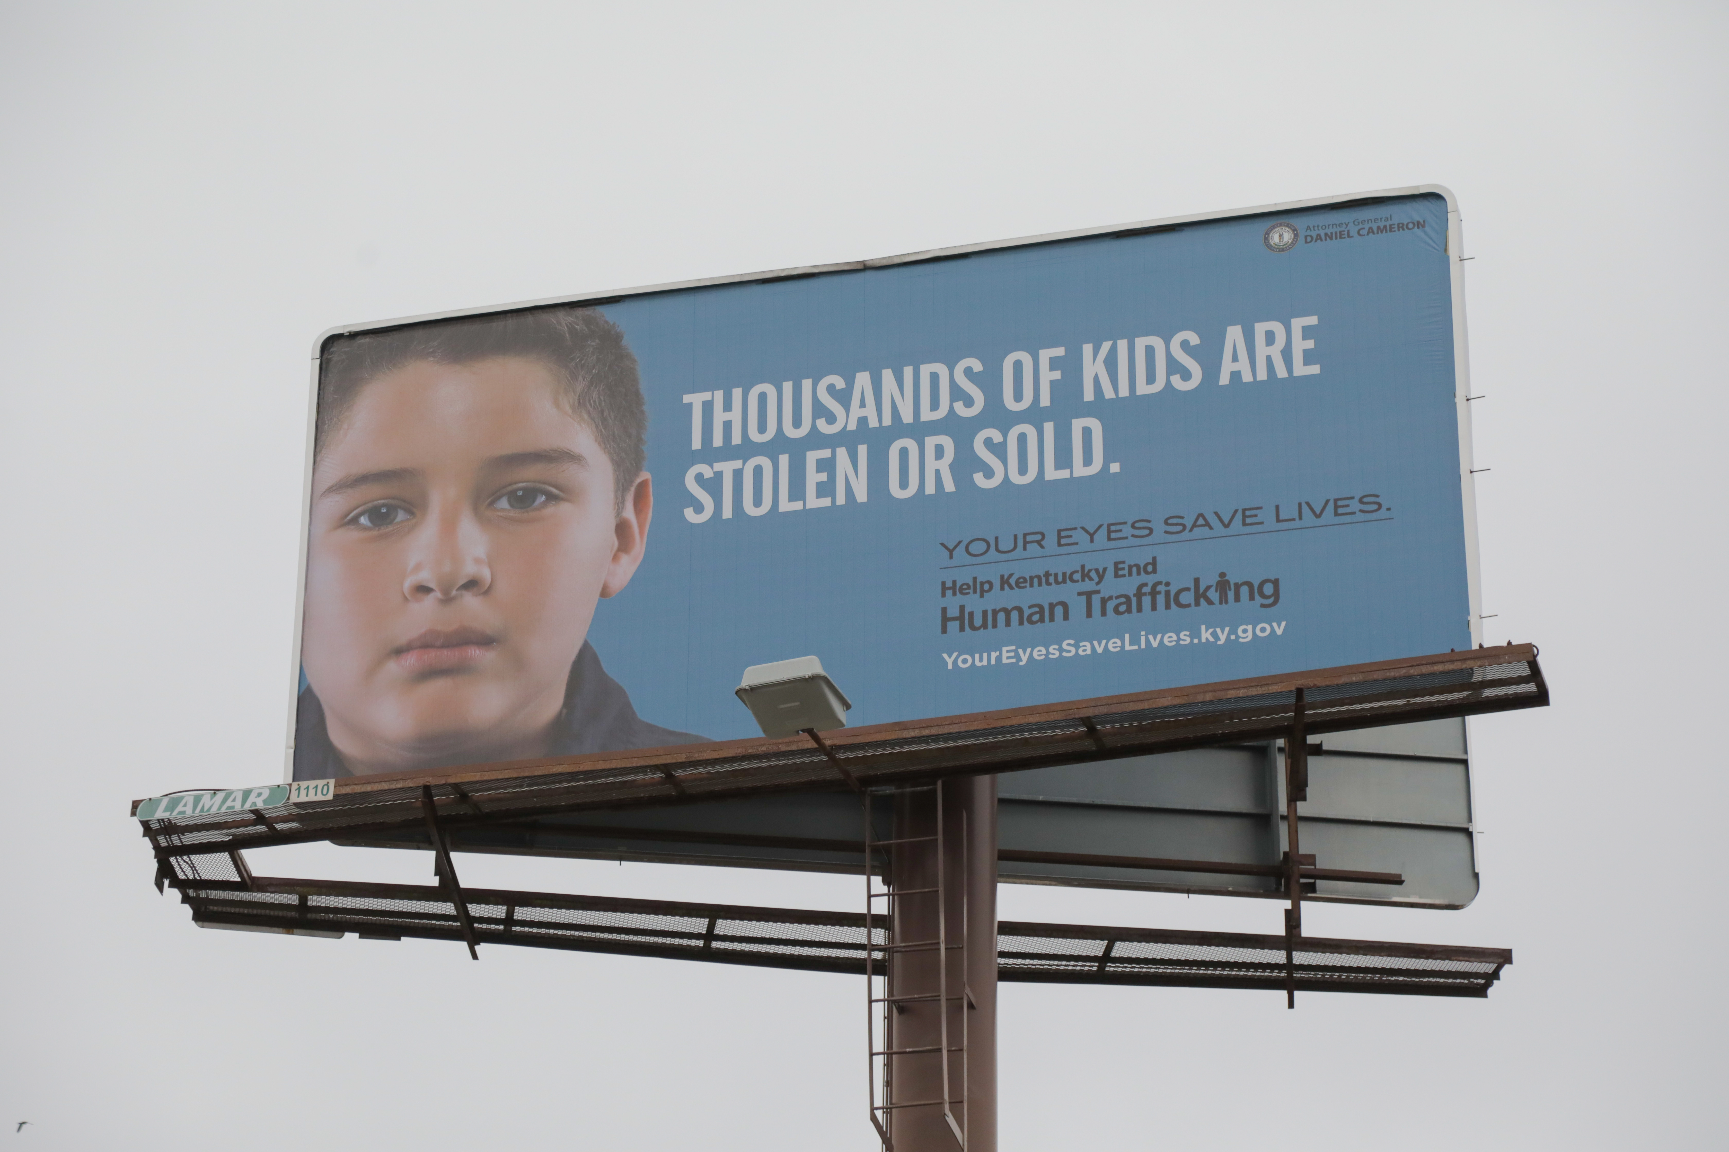

Slide 10
Questions?

