Slide 1
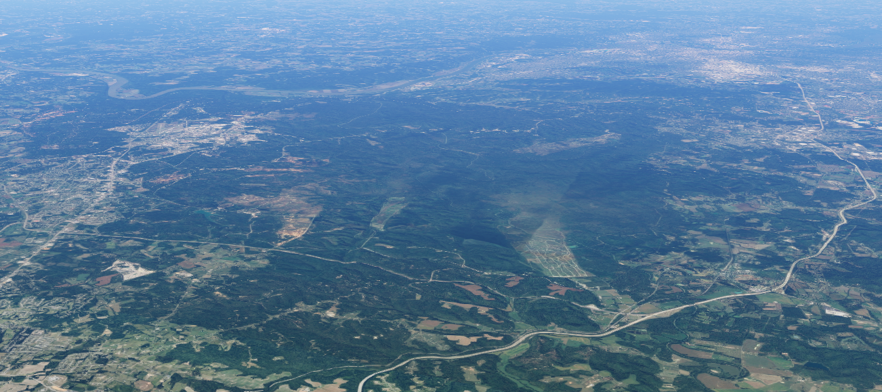
FORT KNOX
COMPATIBLE USE PLAN
Real Estate Disclosures
& Military Installations
23 November 2021
Interim Joint Committee
on Veterans, Military Affairs,
and Public Protection

Slide 2
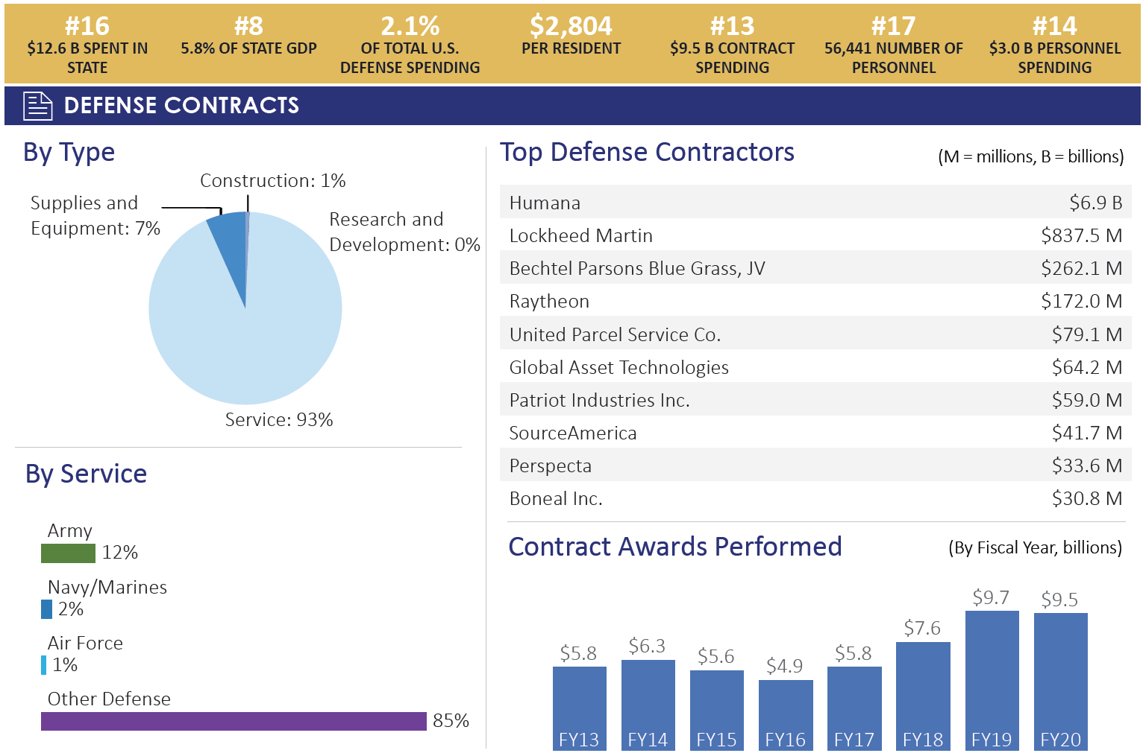
ECONOMICS – DoD FY2020
- KENTUCKY
Notes:
Source: FY2020 Defense Spending KY, "Department of Defense, Office of Local Defense and Community Cooperation“
An analysis of U.S. Department of Defense personnel and contract spending across the 50 states and Washington, DC in FY 2020

Slide 3
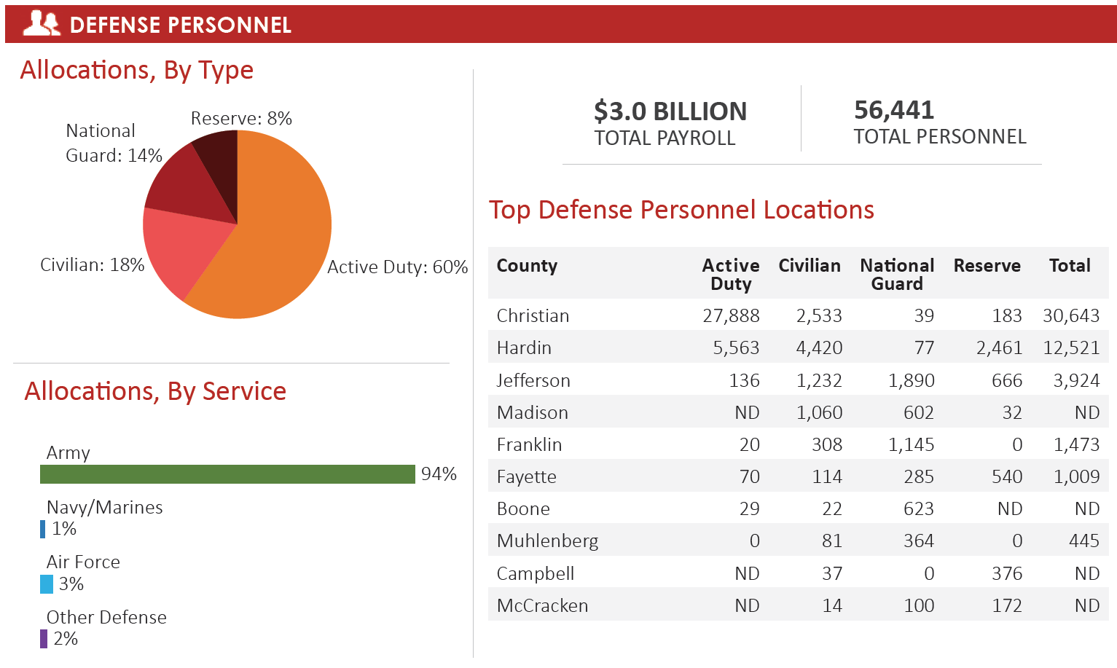
ECONOMICS – DoD FY2020
- KENTUCKY
- KENTUCKY
Notes:
Source: FY2020 Defense Spending KY, "Department of Defense, Office of Local Defense and Community Cooperation“
An analysis of U.S. Department of Defense personnel and contract spending across the 50 states and Washington, DC in FY 2020

Slide 4
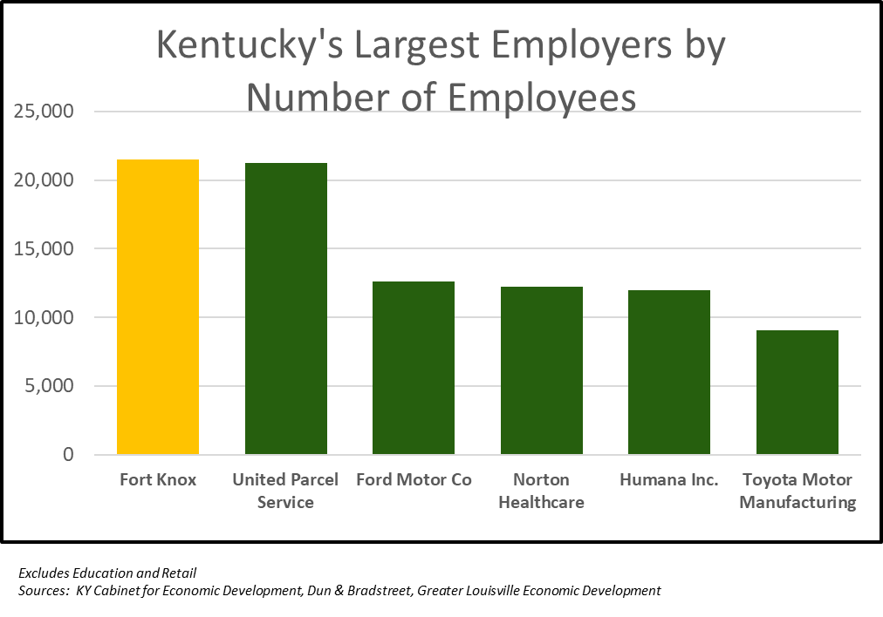
ECONOMICS –
Employment
Welcome & Introductions
FORT KNOX
Annual Expenditures $2.6 Billion,
including $750 Million in payroll.
Notes:
NOTE THESE ARE BUSINESSES THAT HAVE PRIMARILY A SINGLE OR COLOCATED FACILITIES. FOR REFERENCE, THE COMMONWEALTH OF KENTUCKY HAS ABOUT 45,000 STATE GOV. EMPLOYEES, WALMART HAS JUST OVER 30,000 BOTH ARE SPREADOUT ALL OVER THE STATE ASIDE FROM CONCENTRATIONS SUCH AS IN FRANKFORT.

Slide 5
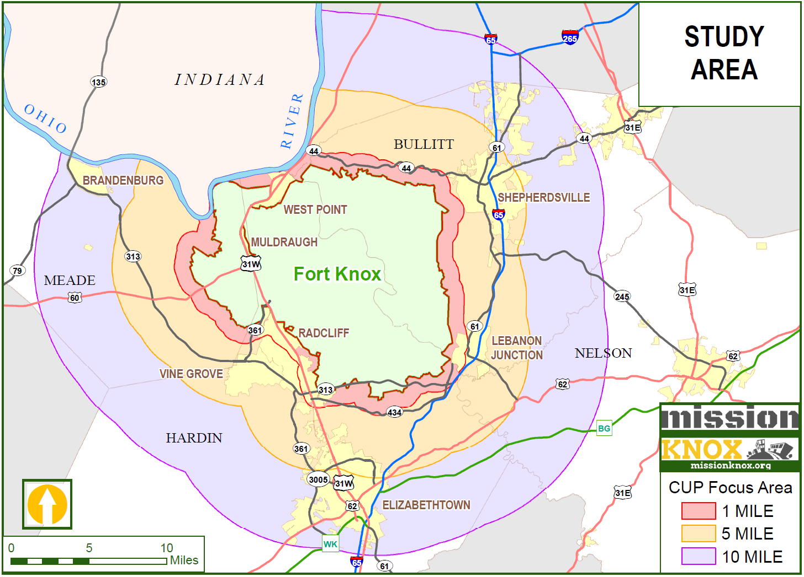
CUP
STUDY
AREA

Slide 6
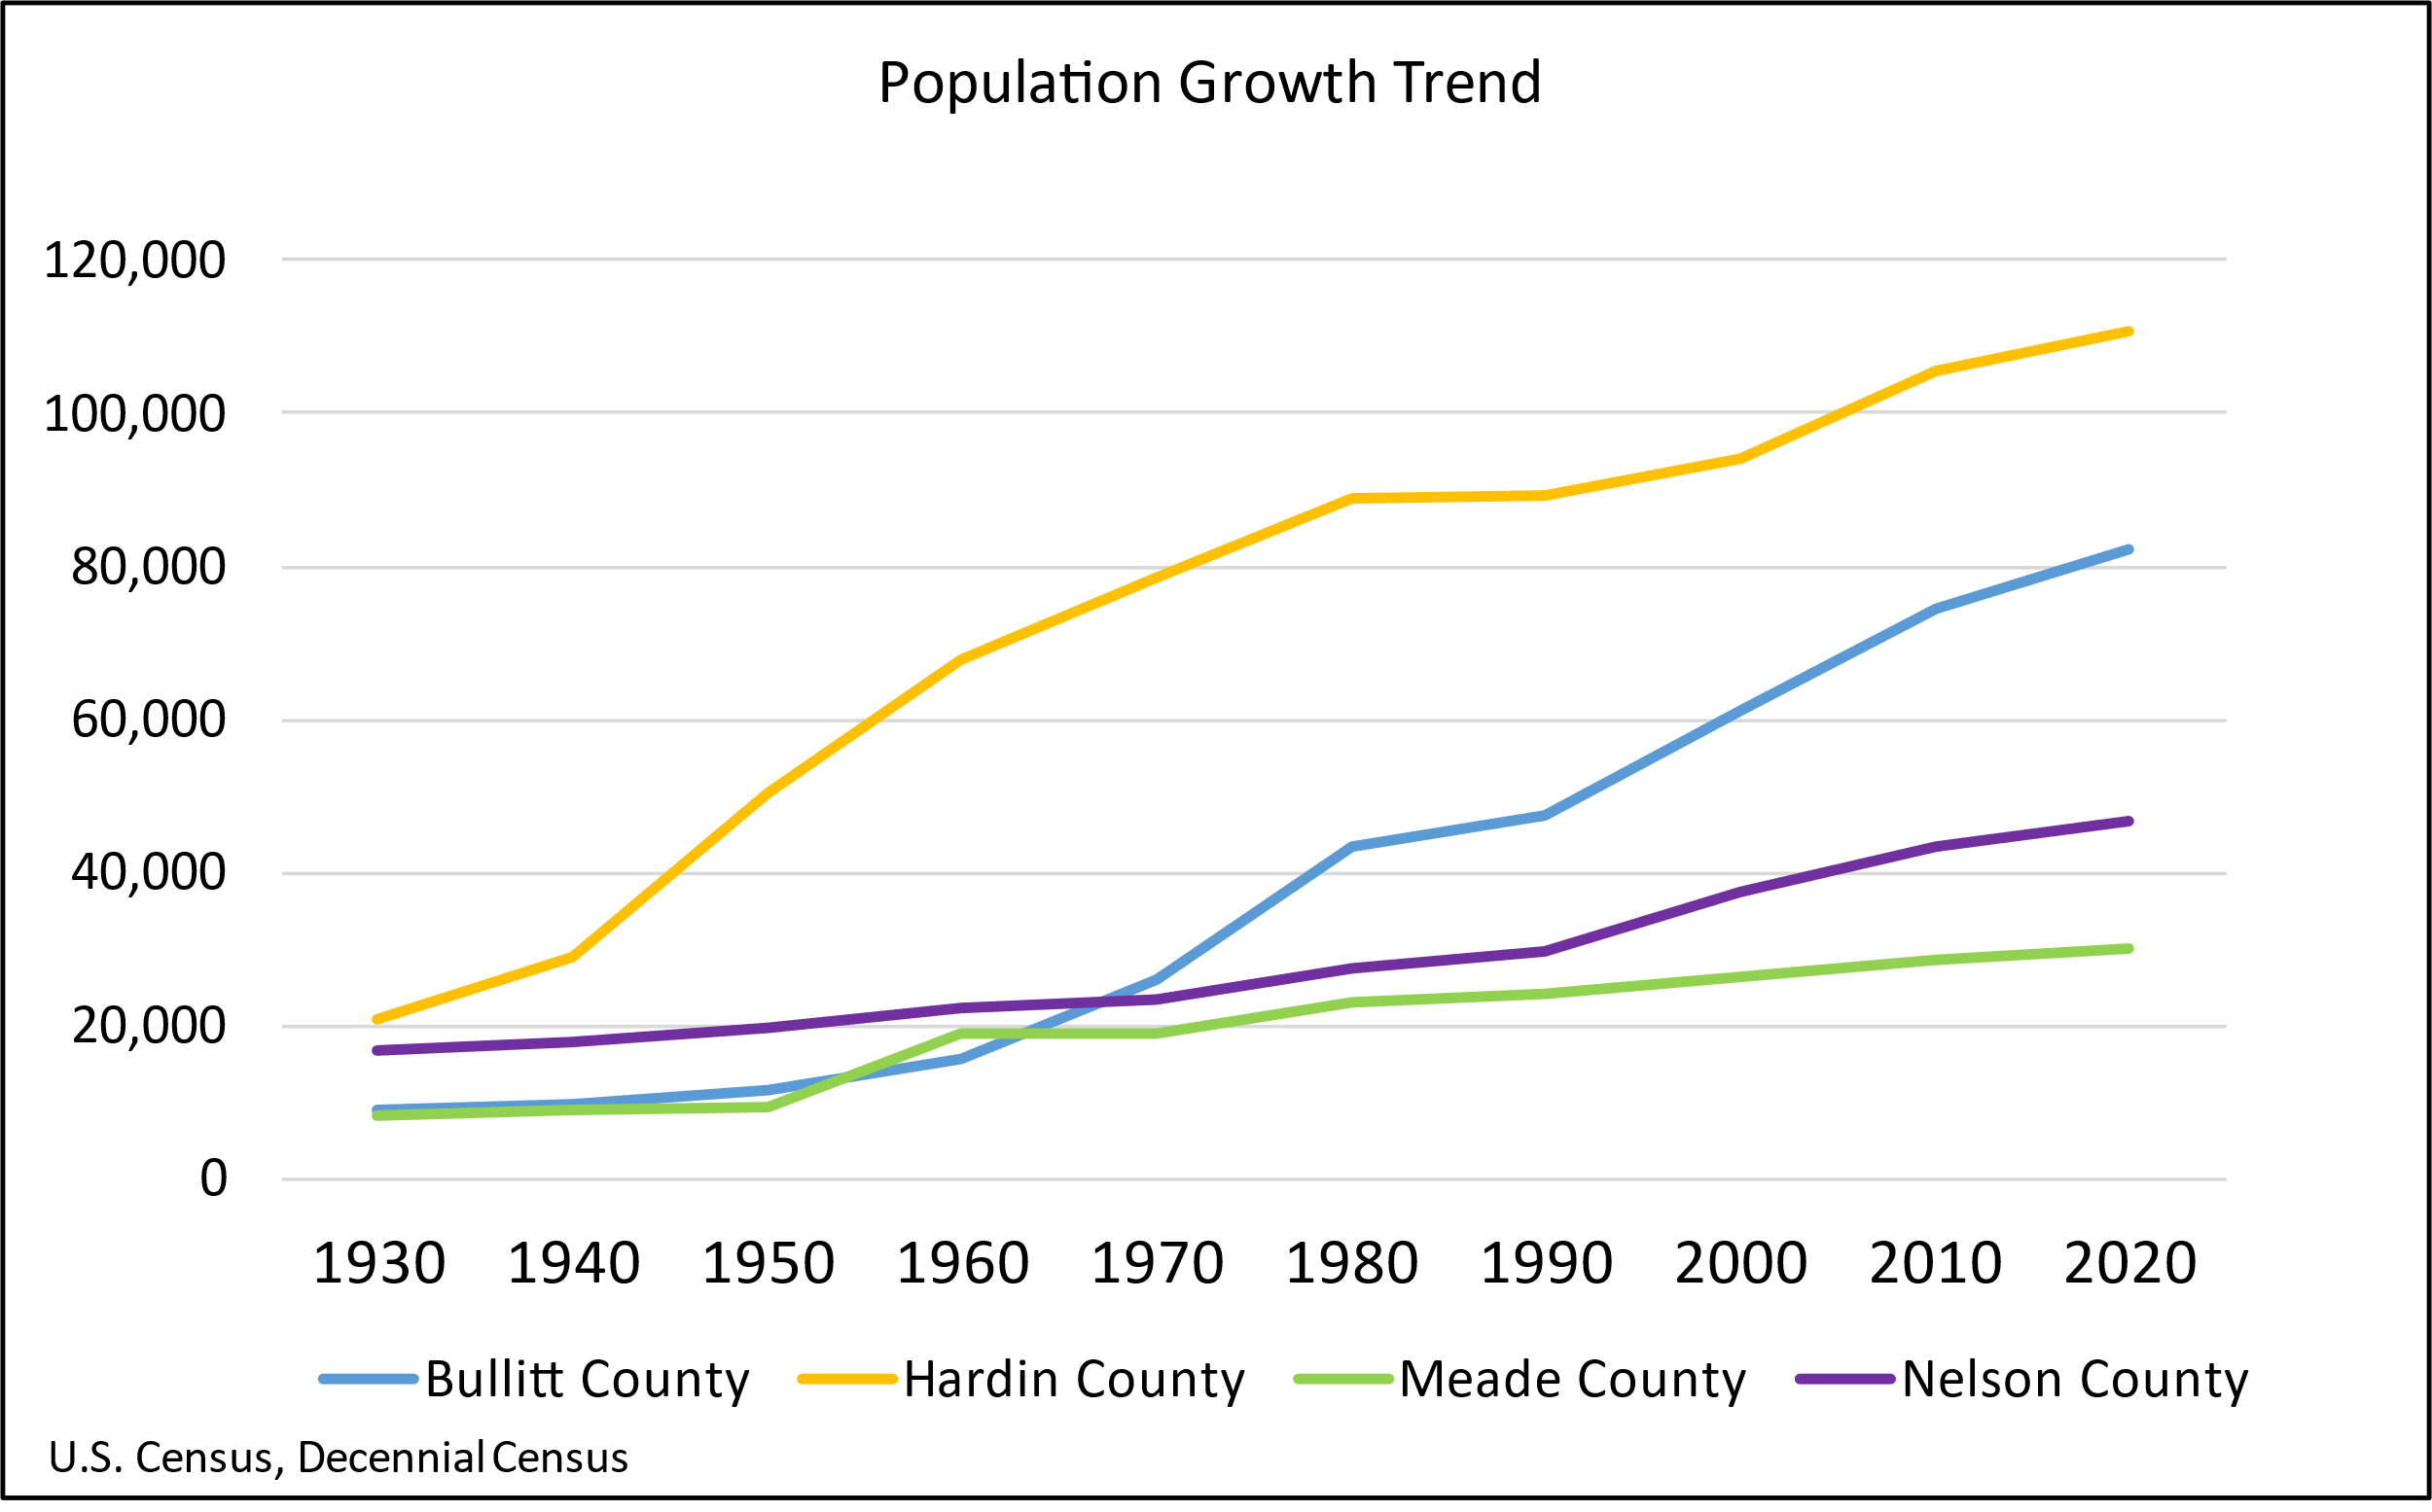
POPULATION –
Four County CUP Study
Welcome & Introductions

Slide 7
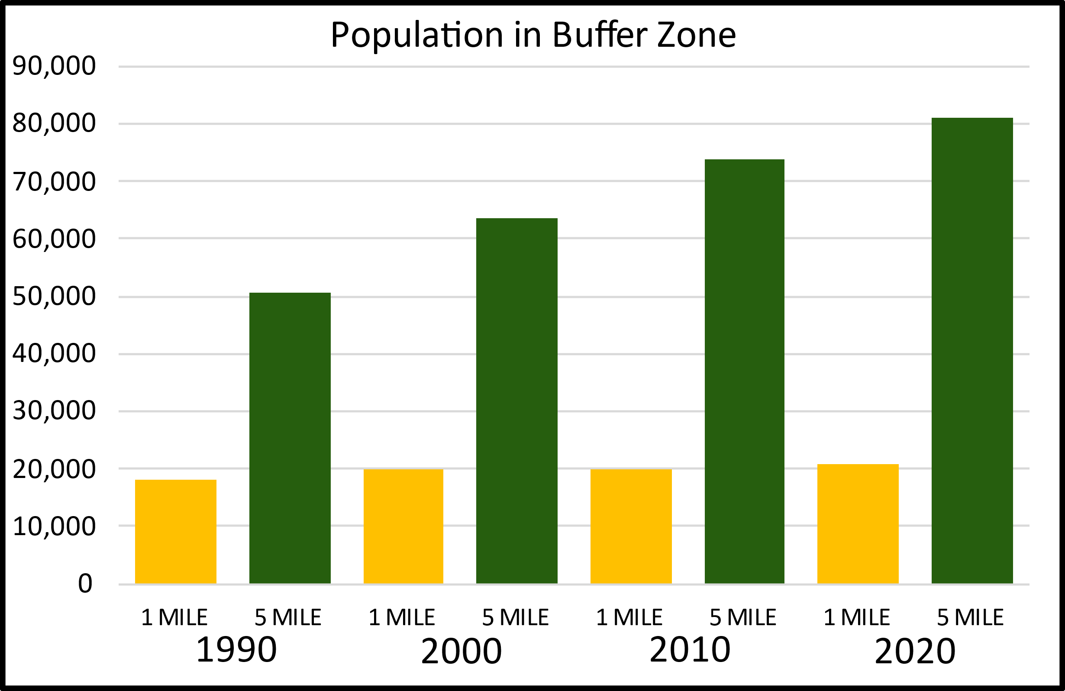
POPULATION –
Proximity to Fort Knox
Welcome & Introductions
Source: U.S. Census, Decennial Census. Selection method block polygon centroid withing buffer zone.
Notes:
2020 – 20,802 persons live within one mile of installation, an additional 81,021 live within five miles.

Slide 8
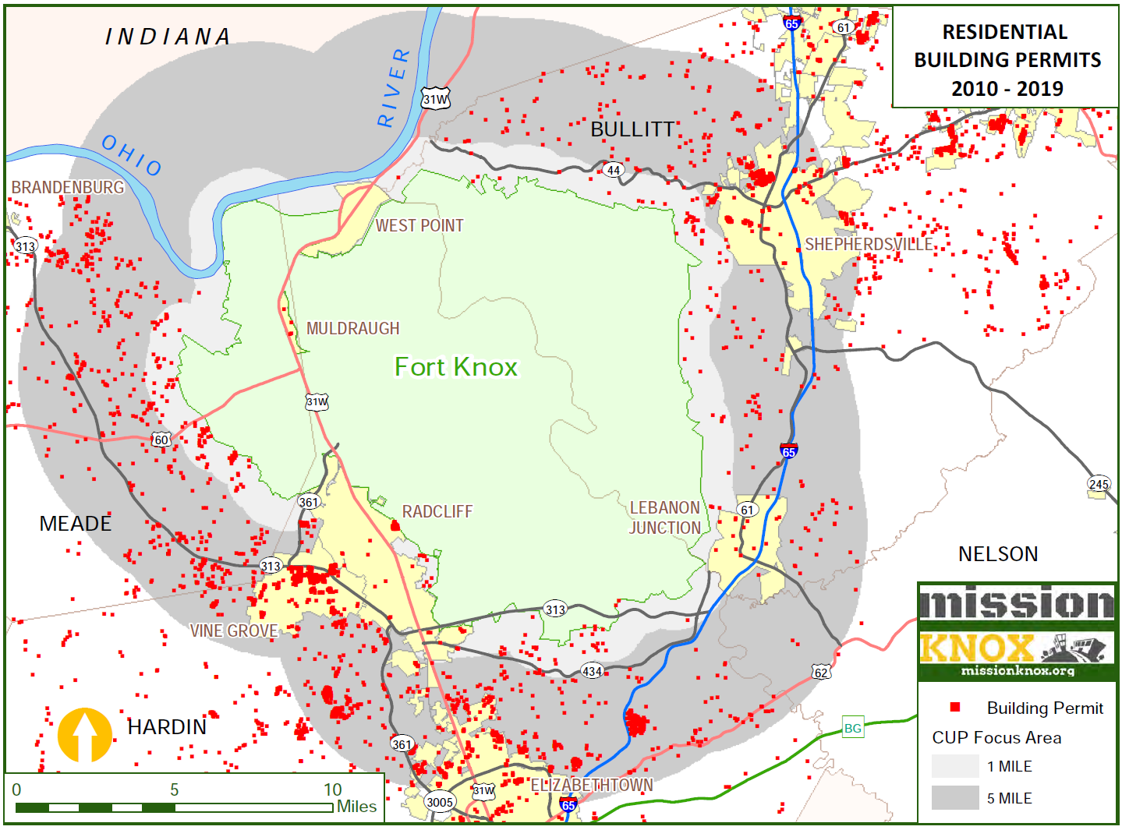
Notes:
Residential Building permits for 2010-2019 (10 years) based on available data.
City Radcliff only reported 2017-2019. No data reported for City of West Point.
All other jurisdictions reported in total.

Slide 9
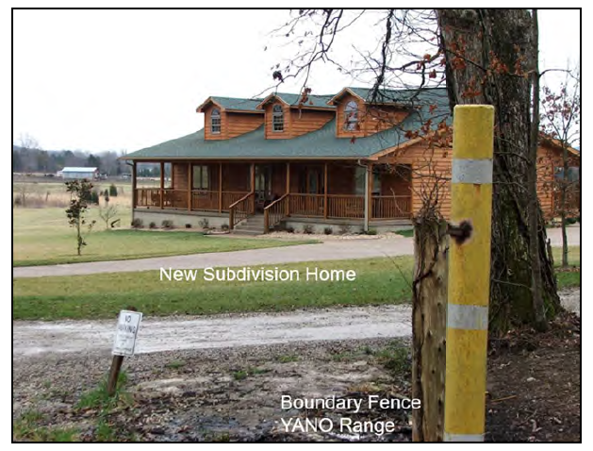
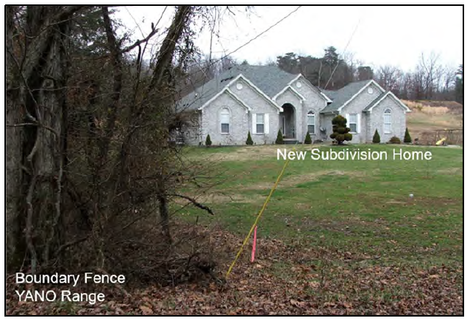
LAND USE CONCERNS –
Building “against the fence”
Welcome & Introductions

Slide 10
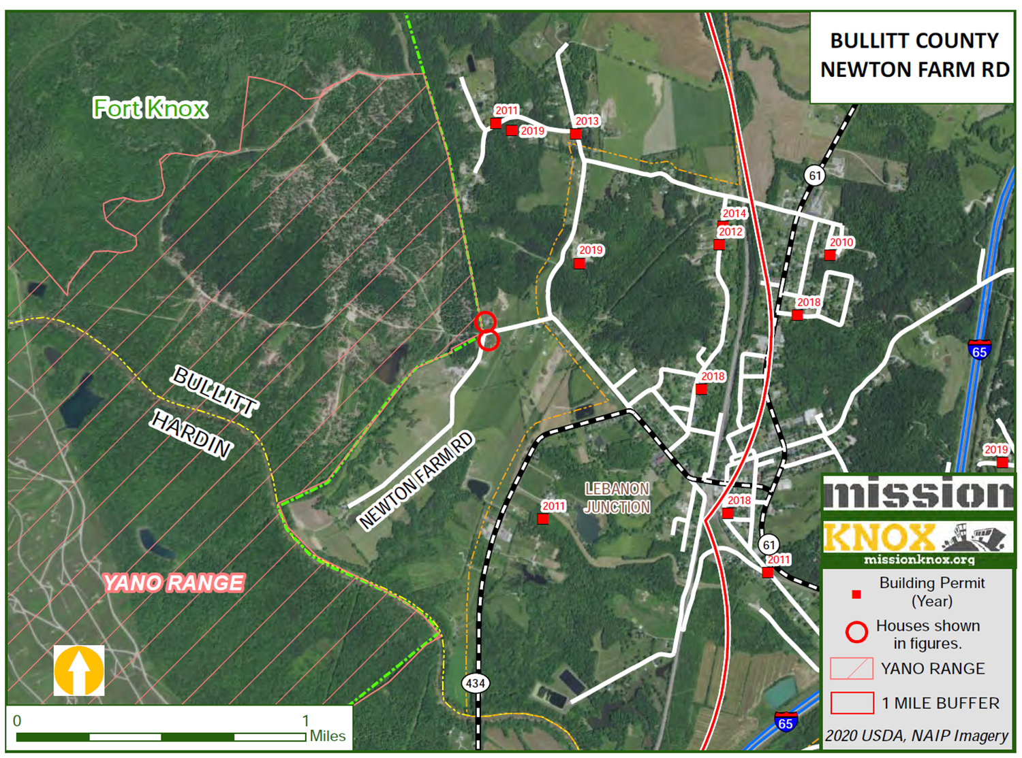
HOMES
ADJACENT TO
FIRING RANGE

Slide 11
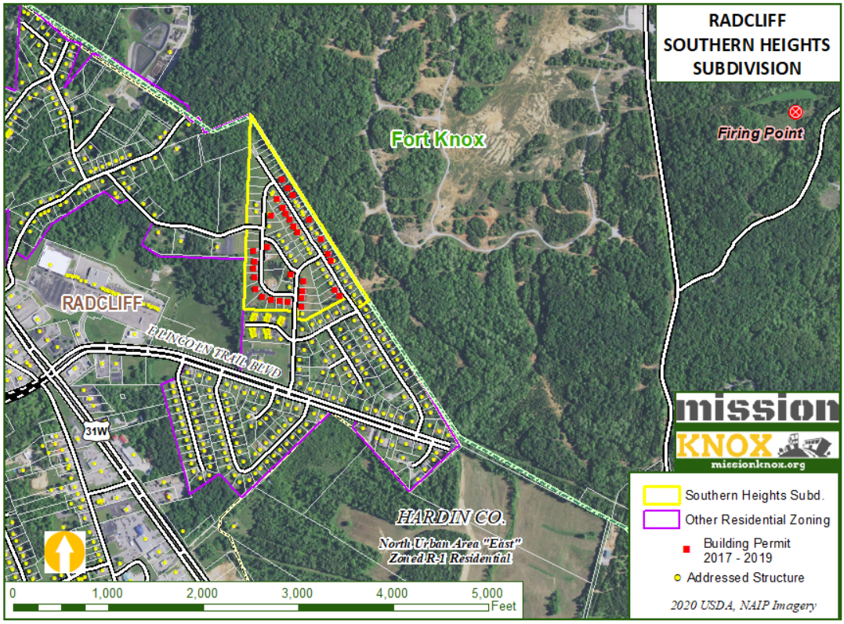

Slide 12
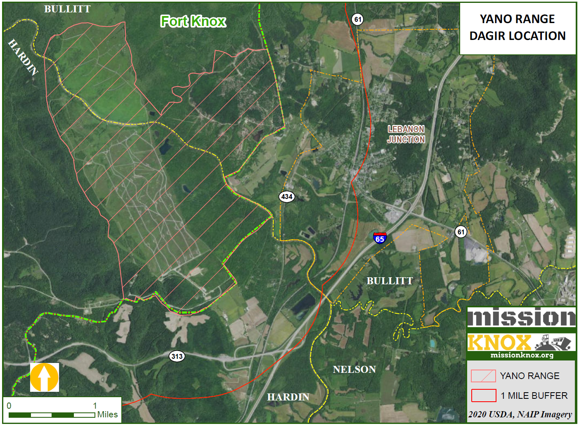
Notes:
$52 Million dollar upgrade to Yano Range coming online in 2023. Using an area of approx. 3,000 ac., the fully computerized range will make it possible for military personnel around the United States to coordinate and practice accomplishing missions from the ground and air simultaneously.

Slide 13
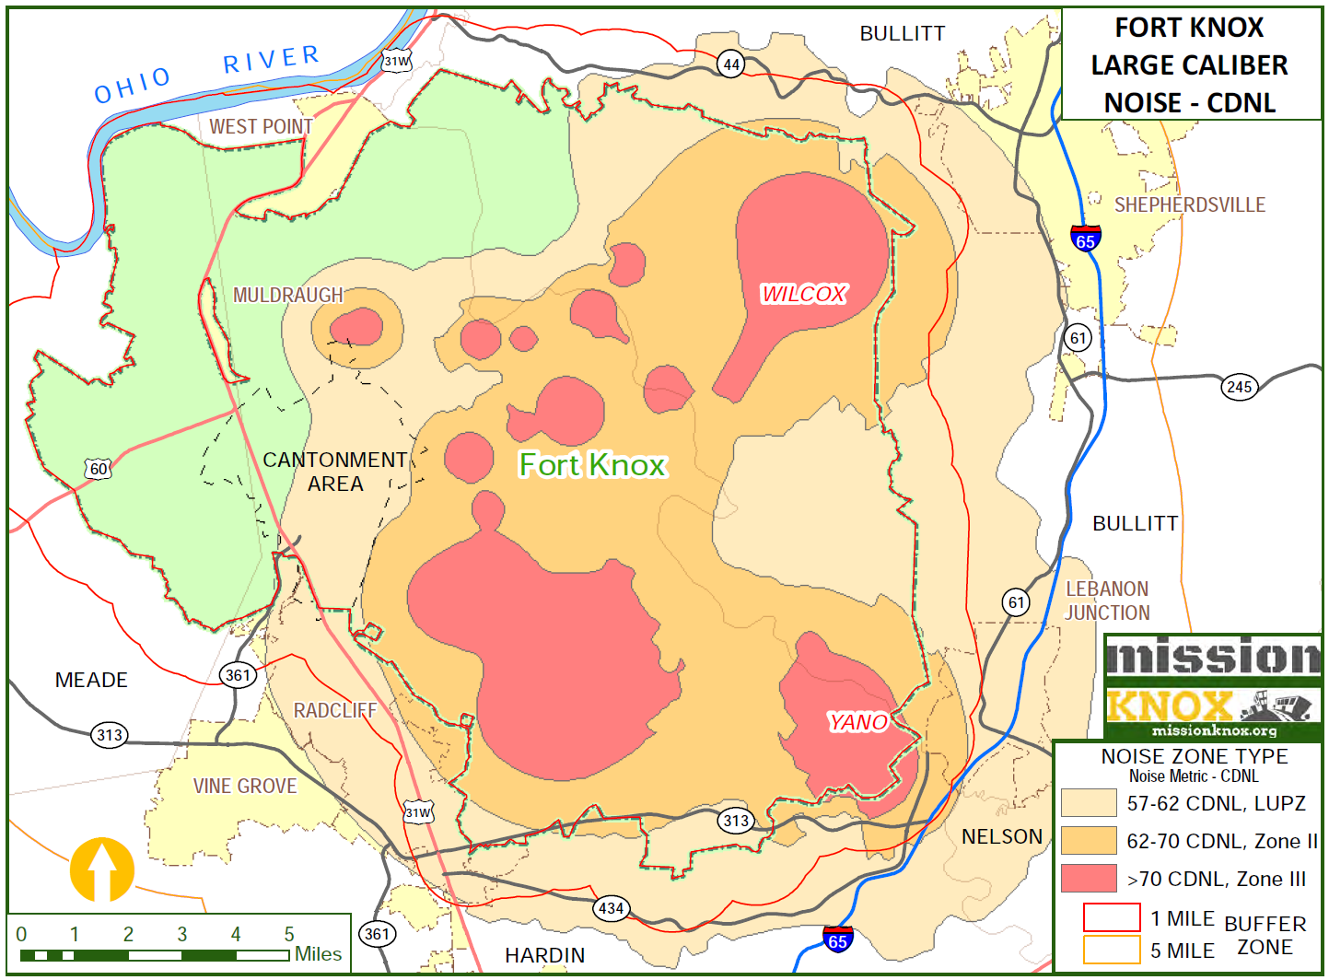
Notes:
CDNL COMBINED DAY/NIGHT LEVEL LUPZ, LAND USE PLANNING ZONE
70 CONSTANT NOT COMPATIBLE WITH RESIDENTIAL HABITATION

Slide 14
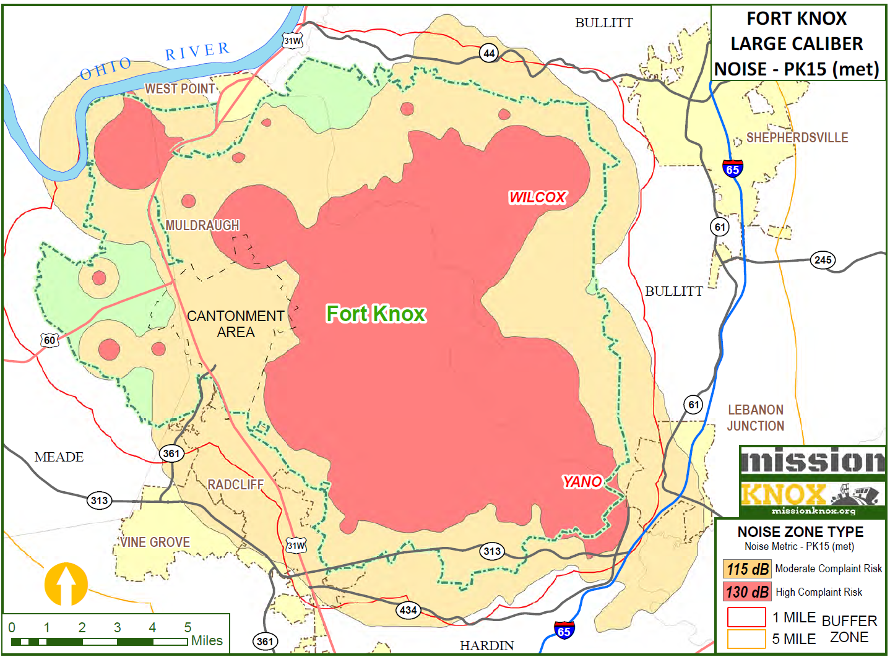
Notes:
PK 15 MET IS A SINGLE BLAST EVENT METRIC, PEAK NOISE EVENT CAN TYPICALLY EXCEED THESE AREAS EXCEEDS 15% OF THE TIME.
Examples: 115 DB EMERGENCY SIREN OR RIVITER,
130 AIR RAID SIREN/JET ENGINE TAKEOFF 140 PERMANANET DAMAGE, LOUDEST RECOMMENDED WITH HEARING PROTECTION

Slide 15
MITIGATION
STRATEGIES
Welcome & Introductions
General Assembly
KRS-324.360 Form for seller’s disclosure of conditions.
(3) The form shall provide for disclosure by the seller of the following:
(a) Basement condition and whether it leaks;
(b) Roof condition and whether it leaks;
(c) Source and condition of water supply;
(d) Source and condition of sewage service;
(e) Working condition of component systems; and
(f) Other matters the commission deems appropriate.
Kentucky Real Estate Commission
FORM 402 - Seller’s Disclosure of Property Conditions

Slide 16
CONTACT
Welcome & Introductions
Mike Burress, Executive Director
mike@ltadd.org
270-982-5207
Mike Robinson, GIS Specialist
mrobinson@ltadd.org
270-982-5255
MISSIONKNOX.ORG

