Slide 1
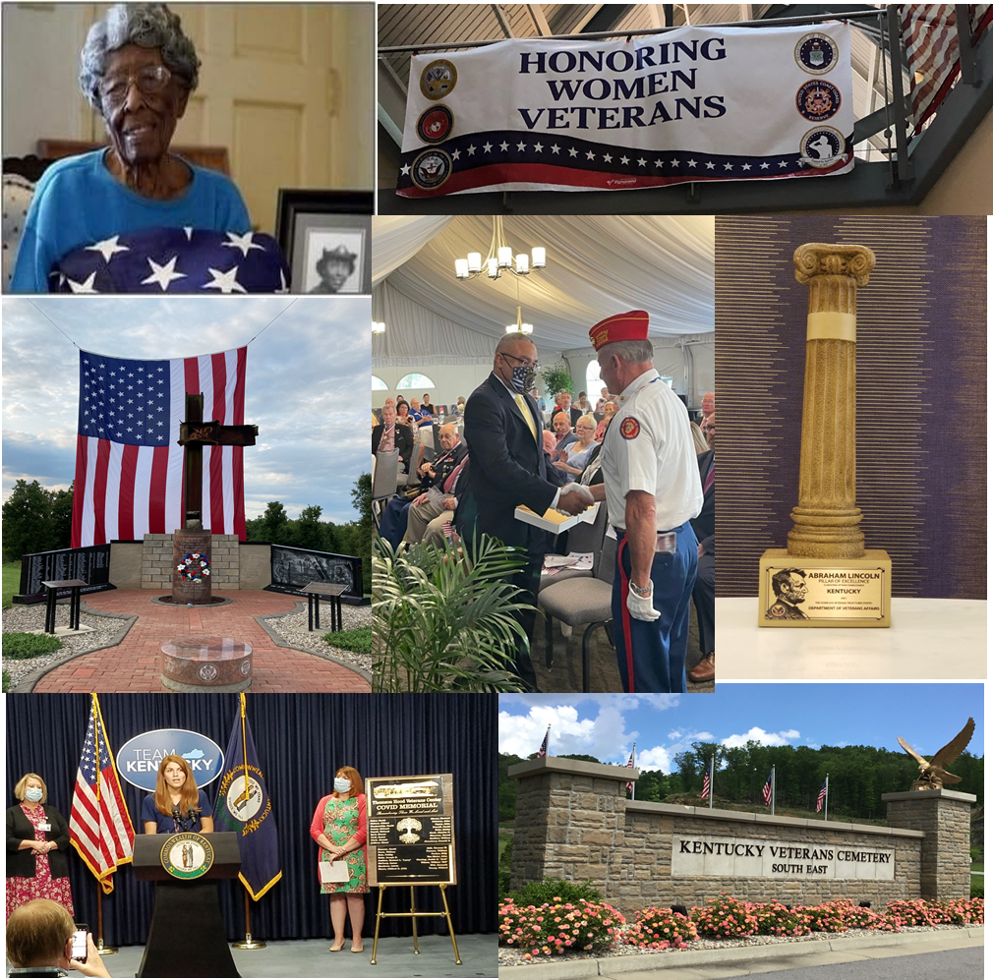
Kentucky Department of
Veterans Affairs
Topic:
Office of Unemployment Insurance Detail
Impact on KDVA’s Operations
Commissioner
LTC Whitney P. Allen
US Army (Retired)

Slide 2
Request for Information
from VMAPP
1. Was there a delay in services to veterans? How many KDVA employees were working on veteran claims prior to COVID and what is the number now?
2. What is KDVA’s processing of benefit claims pre and post pandemic?
3. Detail how many claims were process pre pandemic and what the process like now?
4. KDVA assisted with unemployment insurance claims; is this still happening and did this impact the ability of KDVA to process veteran claims?

Slide 3
Background
Background: On May 1, 2020, KDVA received a call from the Personnel Cabinet requesting employees to assist the Education & Workforce Development Cabinet (EWDC), Unemployment Insurance Branch with processing claims. Kentucky started responding to the COVID-19 Pandemic in March of 2020.
Prior to the pandemic, Kentucky had record low unemployment and only had approximately a dozen unemployment insurance adjudicators. The pandemic caused a record increase in unemployment claims. As the year continued, many people made multiple claims due to being placed off work each time the pandemic surged. This greatly overwhelmed the EWDC Unemployment Insurance Branch, causing the governor to request assistance from other state agencies. KDVA was asked to provide as many employees to assist as possible.

Slide 4
Purpose & Impact
Purpose: KDVA provide employees to assist the Education & Workforce Development Cabinet (EWDC), Unemployment Insurance Branch with processing claims.
Impact: In May, the transfer of 15 employees (13 Field Representatives and 2 Regional Administrators) to the office of Unemployment Insurance (UI) had a profound impact on our ability to serve our veterans and generate claims. This was due to the reduced number of representatives available to prepare claims, the technical challenges in exchanging documents, and the sheer volume of telephone calls that the remaining staff of seven including the Branch Manager were called upon to return. Case loads for the 15 detailed employees were forwarded to teammates that stayed with KDVA.

Slide 5
KDVA Commissioner
Whitney Allen
Lynice Noel
OKVC
Mark Bowman
Martha Workman
OVLS
Legal Counsel
Tamara McIntosh
PIO
Lisa Aug
OKVS
Al Duncan
OKVS HR
John Ostroske
OKVS Budget
Stephanie Belt
Dana Watson
Alma Maxwell
OKVC Budget
Michael Rodgers
Medical Division
Dr. Joy Scott
Dr. Edward Marshall
THVC
J. Gosser
EKVC
W. Lindon
WKVC
L. Scott
RVC
E. Thompson
BGVC
Spring 22
Cemeteries Division
Al Duncan
Benefits Division
Donna Scrivener
State Programs Division
Asst. Dir. (Vacant)
KVCC
Renard
KVCN
R. Miller
Western Region
Ed Day
Appeals Br
Johnny Allen
State Programs Branch
Eileen Ward
Monica Acob
Addie Mattox
Development Branch
(Vacant)
KVCNE
F. Kees
KVCW
K. Ebeling
Eastern Region
Brian Bowman
Tuition Wavier
J. Case
KVCSE
V. Wooten
Central Region
Stephen Buford
“Serving those who have served the Commonwealth and our great Nation”

Slide 6
KDVA Benefits Branch Field Offices
17/23 Field Representatives in 19 Districts
(9)
Patrick Monk 859-391-0325
Wendi Young 859-409-6551
(10) VACANT – posted 10/15/21
Primary Office
(8)
Lisa Pittman 502-356-1551
Thomas Hanner 502-229-6070
VACANT (VAMC Louisville) – posted
VACANT (location TBD) – not posted
Campbell
(15) Ashley Tew
859-409-6485
Boone
Kenton
9
(16) Darrell Ashby
859-432-6121
Bracken
Grant
Pendleton
Gallatin
Green – FOPS
Black – ARNG
Purple - Vacant
Carroll
Lewis
Trimble
Owen
Robertson
Mason
Greenup
(7) Frank Niederriter
502-799-3588
Oldham
Henry
10
Harrison
17
Rickie Hammond
606-585-3833
Oldham
Fleming
Carter
Scott
Nicholas
Boyd
(6) VACANT – posted 10/15/21
8
Franklin
16
Rowan
(5)VACANT- posted 10/15/21
Jefferson
Shelby
Bourbon
Bath
Lawrence
15
Elliott
Fayette
Woodford
Clark
Spencer
Montgomery
Menifee
(18) Christy Burke
606-424-0653
Meade
Bullitt
Anderson
Morgan
Johnson
Hancock
Meade
Jessamine
Powell
Martin
Henderson
Nelson
Mercer
14
Estill
Wolfe
Magoffin
(4) Michelle Rustin
270-399-1618
Breckinridge
Washington
Madison
Floyd
4
Hardin
18
Union
Daviess
7
11
Lee
Pike
Webster
5
6
Larue
Marion
Boyle
Garrard
Breathitt
Ohio
Jackson
(2) Carol Livingston
270-556-0474
McLean
Grayson
Lincoln
Rockcastle
Owsley
Knott
Crittenden
Hart
Taylor
Perry
Hopkins
t
Green
Casey
19
2
Livingston
Muhlenberg
Butler
Edmonson
Clay
Letcher
Caldwell
Pulaski
Laurel
Leslie
(19) Kenny Campbell
606-629-9239
McCracken
3
12
Adair
13
Ballard
Lyon
Warren
Metcalfe
Russell
Harlan
Carlisle
Marshall
Christian
Todd
Barren
Cumberland
Knox
Trigg
Clinton
Graves
Logan
Clinton
Wayne
Whitley
Bell
Simpson
Allen
Monroe
McCreary
Hickman
1
Calloway
(14) Chuck Howson
859-325-8288
Fulton
(1) Larrissa Roach
270-705-6656
(3) Hope King
270-484-7887
(11) Jose Batista
ARNG until 10/1/22
(12) Donald Walbert
270-473-3344
(13) Vivian Taylor
606-344-1003
Revised Nov 22 2021
Notes:
6

Slide 7
KDVA Employees -Detailed to U/I 2020
# | Employee Name | Position Num. | Grade | Date Detailed | Date Reverted | Total Months
1 | Day, Edward | 30006440 | 15 | 5/11/2020 | 6/8/2020 | 1
2 | King , Hope B | 30006437 | 13 | 5/11/2020 | 7/27/2020 | 2
3 | Melton , Jonathan D | 31066470 | 13 | 5/11/2020 | 7/30/2020 | 2
4 | Roach , Larrissa | 31089836 | 11 | 5/11/2020 | 8/15/2020 | 3
5 | Ashby , Darrell | 31101290 | 11 | 5/11/2020 | 8/15/2020 | 3
6 | Buford , Stephen E | 31010882 | 13 | 5/11/2020 | 8/15/2020 | 3
7 | Monk , Patrick M | 31091201 | 11 | 5/11/2020 | 11/14/2020 | 6
8 | Livingston , Carol A | 30006445 | 13 | 5/11/2020 | 11/14/2020 | 6
9 | Tew , Ashley | 31105136 | 13 | 5/11/2020 | 11/14/2020 | 6
10 | Maxwell, Wendi | 31027433 | 13 | 5/11/2020 | 11/14/2020 | 6
11 | Howson , Charles E | 31091170 | 11 | 5/11/2020 | 1/1/2021 | 7.5
12 | Sinay , Jacquelyn | 31105139 | 11 | 5/11/2020 | 1/1/2021 | 7.5
13 | Webster , Shyela | 31105899 | 11 | 5/11/2020 | 1/1/2021 | 7.5
14 | Hanner , Thomas G | 31024845 | 13 | 5/11/2020 | 1/1/2021 | 7.5
15 | Acob, Monica | 30006457 | 15 | 5/11/2020 | 1/1/2021 | 7.5
Notes:
On May 1, 2020, the Personnel Cabinet sent a list of eligible job titles to KDVA that could be trained quickly on the unemployment claims process. KDVA Benefits Branch was identified for sending employees to EWDC. 15 KDVA employees were identified for special duty at the EWDC Unemployment Insurance Branch.
On May 11, 2020, KDVA detailed 15 employees to special duty with the EWDC Unemployment Insurance Branch for up to 90 days.
On August 15, 2020, the KDVA employees were reverted back to KDVA and 9 KDVA employees were detailed a second time to the Labor Cabinet Unemployment Insurance Branch on August 16, 2020, for up to 90 more days. Unemployment Insurance had moved from the EWDC to the Labor Cabinet. The reduction in KDVA employees being detailed was reduced through negotiation with the Governor’s Office, to allow KDVA to handle veteran benefit claims.
On November 14, 2020, the KDVA employees were reverted back to KDVA and 5 KDVA employees were detailed a third time to the Labor Cabinet Unemployment Insurance Branch on November 14 2020, for up to 90 more days. The reduction in KDVA employees being detailed was reduced through further negotiation with the Governor’s Office, to allow KDVA to handle veteran benefit claims.
On January 1, 2021, the KDVA employees were reverted to KDVA

Slide 8
KDVA Employees -Detailed to U/I
(Fraud Task)
2021
# | Employee Name | Position Number | Grade | Date Detailed | Date Reverted | Total Months
1 | Howson, Charles | 31091170 | 13 | 4/14/2021 | 5/14/2021 | 1
2 | Hanner, Thomas | 31024845 | 13 | 4/14/2021 | 5/14/2021 | 1
3 | Tew, Ashley | 31105136 | 13 | 4/14/2021 | 5/14/2021 | 1
4 | Livingston, Carol | 30006445 | 13 | 4/14/2021 | 5/14/2021 | 1
5 | Monk, Patrick | 31091201 | 13 | 4/14/2021 | 5/14/2021 | 1
Notes:
On April 14, 2021, the governor’s office requested that other state agencies assist the Labor Cabinet Unemployment Insurance Branch, with a high volume of fraudulent unemployment claims. In order to help eliminate fraudulent claims, all access was deleted to the unemployment system and claimants had to set up a new pin number for access. KDVA employees assisted claimants with this process by detailing 5 employees to special duty for one month.
On May 14, 2021 the KDVA employees were reverted back to KDVA.

Slide 9
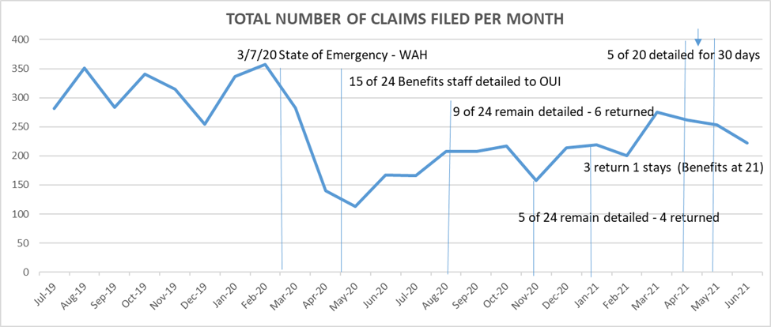
Benefits Claims History
Notes:
The decreased manning during the OUI detail definitely took a toll on our customer service. It was virtually impossible to return all telephone calls in a timely manner with over 63% of our Benefits staff detailed to OUI. That challenge was compounded by the fact that one of our KY National Guard Field Representatives was recalled to active duty in March 2020 and remains on active duty for another year. Our Admin Specialist III was on extended maternity leave for most of the same period. The timeliness of our responses to calls and emails has steadily improved as personnel were returned to KDVA.
d. Finally, the reduction in workforce has created delays and a backlog of fully developed claims being filed. Although a VA Form 21-0966 (Intent to File a Claim for Compensation and/or Pension, or Survivors Pension and/or DIC) is usually filed during the first veteran engagement with a Field Representative, a fully-developed claim can take hours or days of research and preparation. The intent-to-file process allows KDVA and the veteran additional time to collect all of the information needed to support their claim while protecting the earliest possible effective date for any award of benefits or increased benefits resulting from the claim. The date the Veterans Benefit Administration (VBA) receives the VA Form 21-0966 will be protected as their claim effective date as long as the application is completed and submitted within 1 year. While the effective date of the claim is protected, the consequence of this waiting period is a delay in potential compensation being awarded to the veteran.

Slide 10
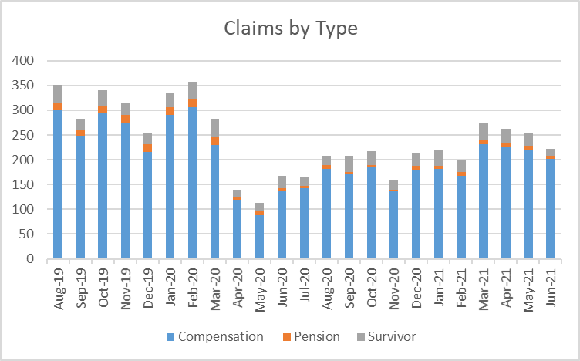

Slide 11
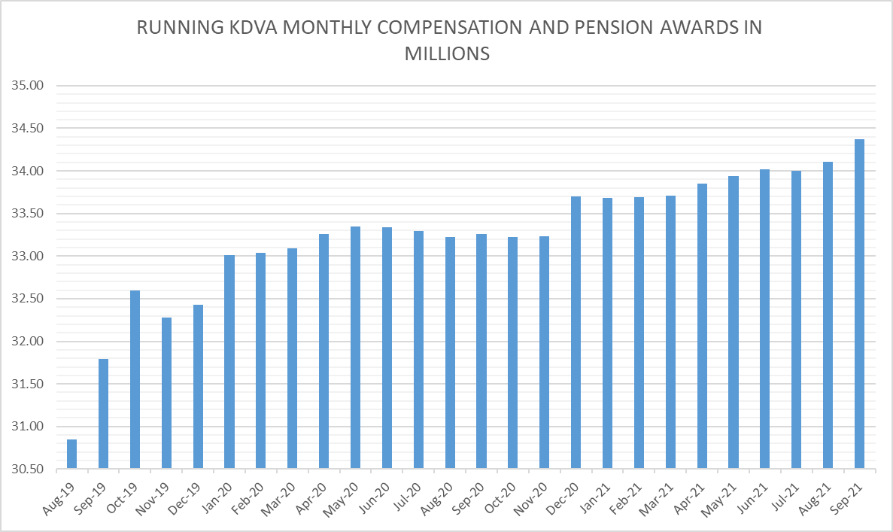
Monthly running compensation and pension awards from KDVA claims (in millions)

Slide 12
Request For Information
from VMAPP
1. Was there a delay in services to veterans? Yes How many KDVA employees were working on veteran claims prior to COVID: 18 and what is the number now? 17
2. What is KDVA’s processing of benefit claims pre and post pandemic?
Pre: In person w/travel to multiple outstations Post: Virtual when possible; no more outstations … See Graph for more details
3. Detail how many claims were process pre pandemic and what the process like now? See Graph for more details
4. KDVA assisted with unemployment insurance claims; is this still happening: No and did this impact the ability of KDVA to process veteran claims? Yes

Slide 13
Proudly Serving Kentucky’s Veterans
Questions?
Notes:
The CUB/staff meeting is the Homeless Veterans Program Manager’s opportunity to raise any issues to the Commissioner and staff. However, discussion should focus on issues affecting the Commissioner’s ability to carry out the department’s mission.
Program Manager covers key events and activities scheduled for the <30 days, 31-60 days, and 61-90 days that will affect the mission (positively or negatively). Examples of positive events – public events, employee events, outreach activities, volunteer opportunities, funding shortfalls, Operation Victory events, etc. Negative events may be anything that could involve potential media inquiries, Congressional or Legislative inquiries, or other actions which will reduce mission accomplishment.
Note that the intent of the CUB is to capture lead measures or activities of the program in order to optimize the positive and mitigate the negative. The CUB is not about lag measures or review of past events.

Slide 14
Kentucky Department of Veterans Affairs (502) 564-9203 veterans.ky.gov

Slide 15
Back Up Slides

Slide 16
Kentucky Department of Veterans Affairs
(Benefits Division)
Assistant Director
Donna Scrivener
1
Kentucky Veterans Benefits West Region
Kentucky Veterans Benefits Central Region
Kentucky Veterans Benefits Region East
Kentucky Veterans Benefits Operations
West Region Rep
Ed Day
Central Region Rep
Stephen Buford
East Region Rep
Brian Bowman
Appeals
Johnny Allen
Field Rep
Larrissa Roach
Field Rep
Lisa Pittman
Field Rep
Vivian Taylor
Tuition Wavier
Jennifer Case
Field Rep
Carol Livingston
Field Rep
Thomas Hanner
Field Rep
Charles Howson
2
Field Rep
Hope King
Field Rep
Field Rep
Ashley Tew
Field Rep
Wendi Young
Field Rep
Darrel Ashby
Field Rep
Michelle Rustin
Field Rep
Patrick Monk
Field Rep
Cynthia Burke
Field Rep
Field Rep
Jose Batista
Field Rep
Frank Niederriter
Field Rep
Kenny Campbell
Field Rep
Field Rep
Field Rep
Rickie Hammond
Field Rep
Donald Walbert
6/8
8/8
Field Rep
7/10
As of: October 27, 2021
23 of 29
I

Slide 17
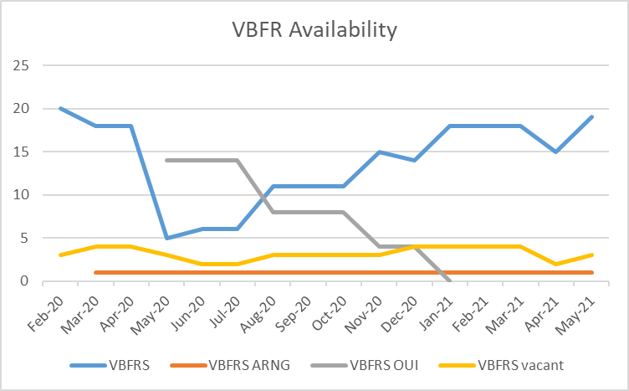
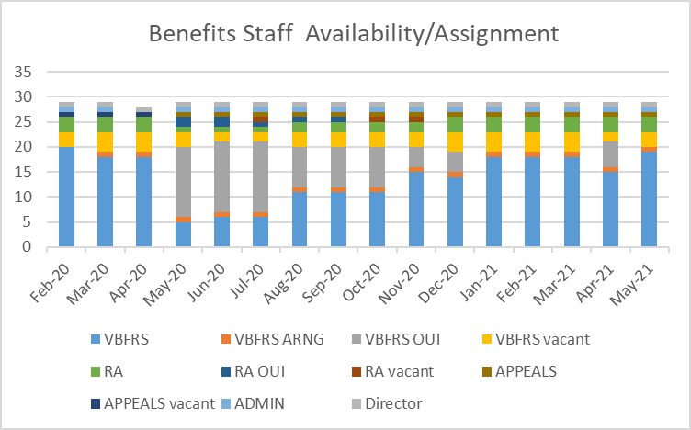
Employee Assignment History

