Slide 1
Cybersecurity, Certifications, Careers, and Communities (C4)
Jeffrey C. Sun, JD. Ph.D.

Slide 2
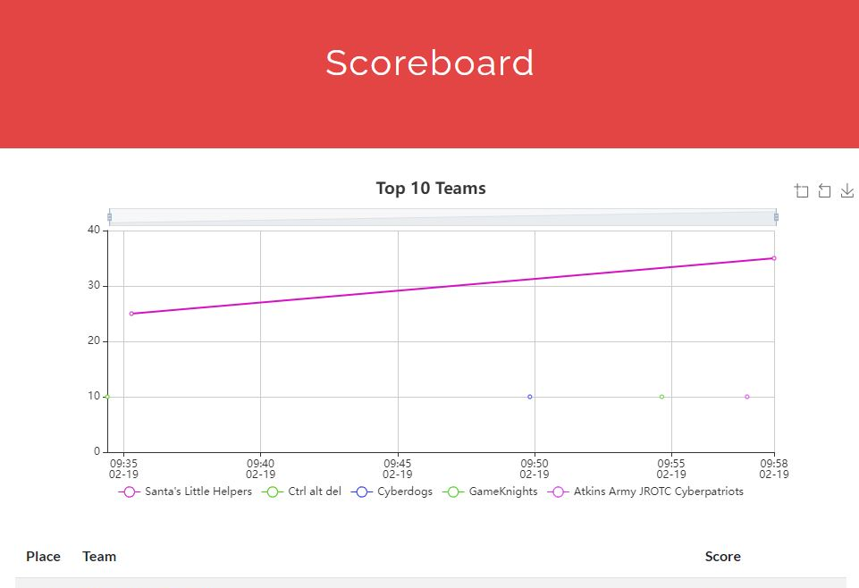
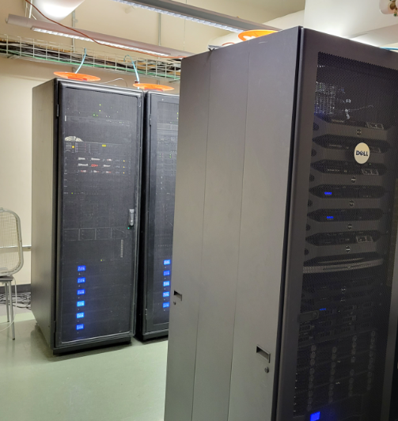
Certification Workshops
IT Fundamentals
SEC+,
CAN
CEH
Cyber Experiences
Cyber Range
CardHax, Capture the Flag
Military veterans as learning coaches
Career Community
Advisory Board
Developing partnerships with DIB industry
217 workshop completers
157 CardHax participants

Slide 3
