Slide 1
OUR MISSION:
To provide post-9/11 military veterans, service members, and their families with financial assistance and post service skills training to create a foundation for long-term stability.
WHY WE DO THIS:
Our services improve the quality of life
for veterans and their families and
reduce potential factors that can
contribute to veteran suicide.

Slide 2
VETERAN SUICIDE ISSUES
22 military members/veterans commit suicide every day
Veterans find transition difficult
Loss of identity and sense of purpose
Feeling alone, isolated
Loss of control of life

Slide 3
During our military conflicts since 9/11, approximately 7,057 service members have lost their lives in combat operations.
Conservatively, we have experienced 30,177 suicides by post-9/11 service members and veterans.
“The actual number of post-9/11 veterans who have died by suicide is likely higher than the V.A. records indicate. The difficulty in coming to the actual number stems from the V.A. not differentiating veteran suicides by their time of service, and they have inconsistently measured suicides since 2001 and have yet to report the actual number of post-9/11 veterans who have committed suicide.”
(Source:https://watson.brown.edu/costsofwar/files/cow/imce/papers/2021/Suitt_Suicides_Costs%20of%20War_June%2021%202021.pdf)

Slide 4
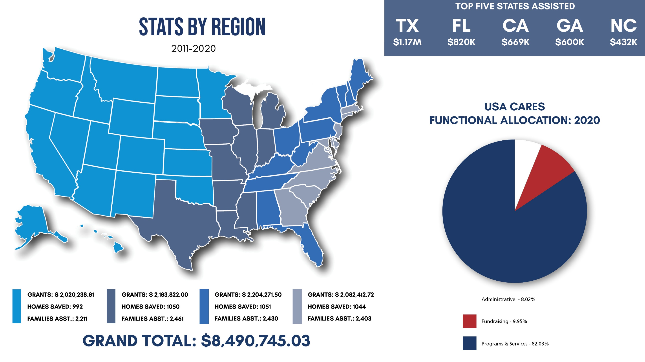
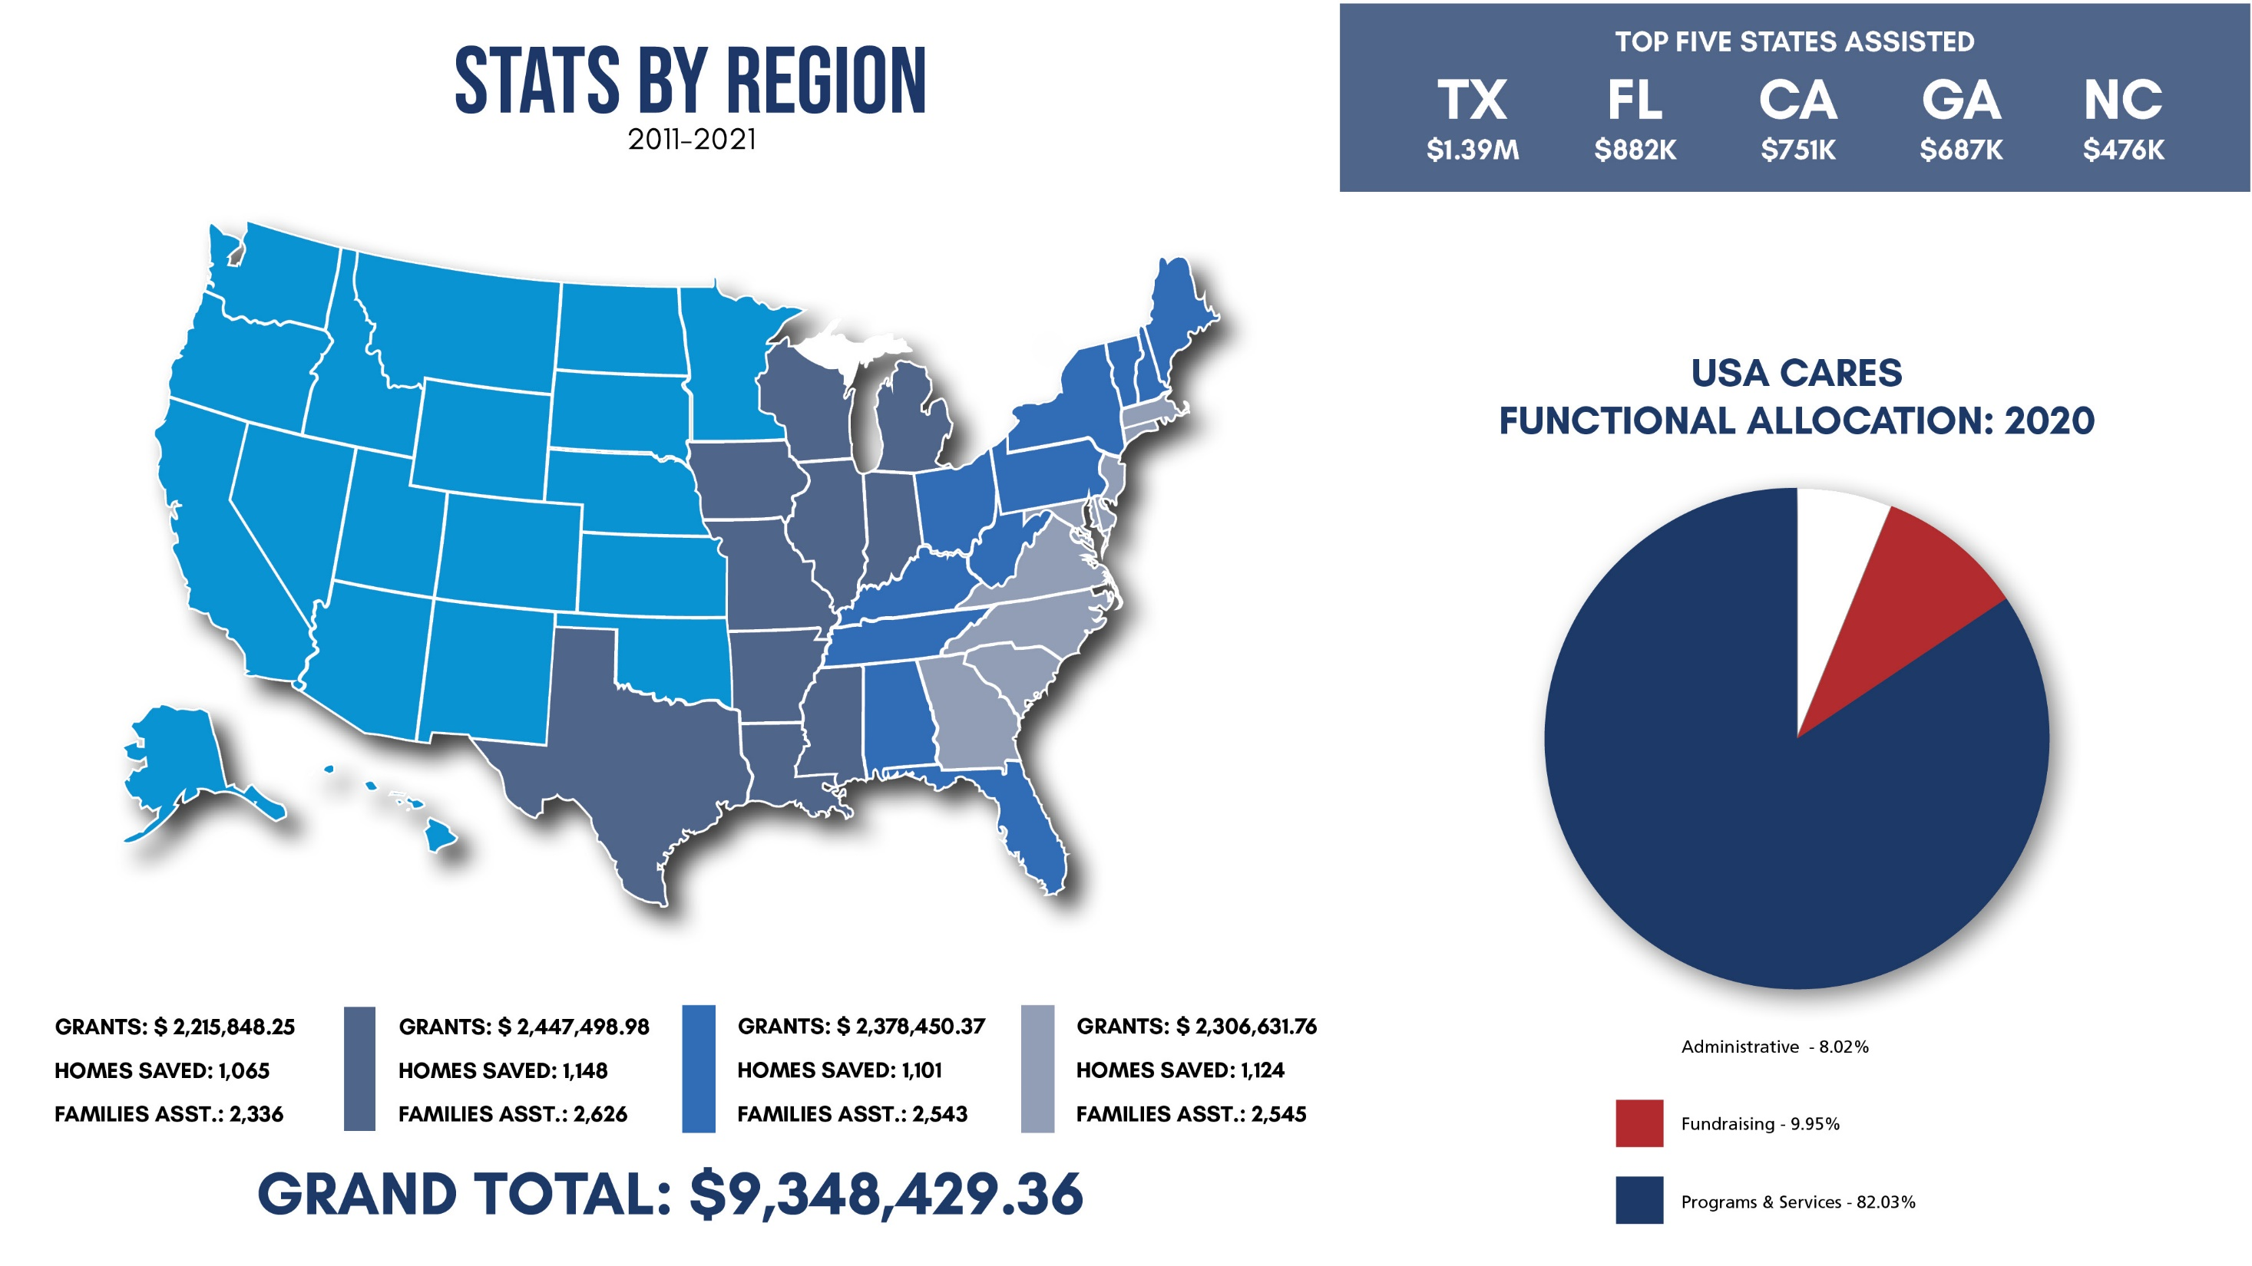

Slide 5
OUR PROGRAMS
How did veterans hear about us?
2021 Referral Sources
COMBAT INJURED
American Legion: 126
Army Emergency Relief: 113
Disabled American Veterans: 333
Military One Source: 343
Navy-Marine Corps Relief Society: 46
Operation Home Front: 59
Red Cross: 73
United Way: 80
USAA: 157
VA Hospital: 546
VFW: 108
Volunteers of America: 46
Wounded Warrior Project: 293
This program pays basic expenses for veterans diagnosed with post-traumatic stress disorder (PTSD), traumatic brain injury (TBI), and military sexual trauma (MST) while he or she receives treatment.
HOUSING ASSISTANCE
When a veteran's bills are past due as a result of a military service-related incident, we directly pay the landlord or mortgage lender to reduce any extra financial burdens from the veteran or the veteran's family.
EMERGENCY ASSISTANCE
This program pays immediate, essential bills, including food and utility bills, that are necessary to the health and well-being of the veteran or the veteran's family.
CAREER TRANSITION
This program helps pay an individual's essential expenses while they train for a new job, relieving any financial barrier that keeps them from getting a new job or career. Additionally, this program provides individuals with tools and resources to better prepare them for the hiring process and refers qualified candidates to corporate organizations with open positions of employment specific to their skillsets.

Slide 7
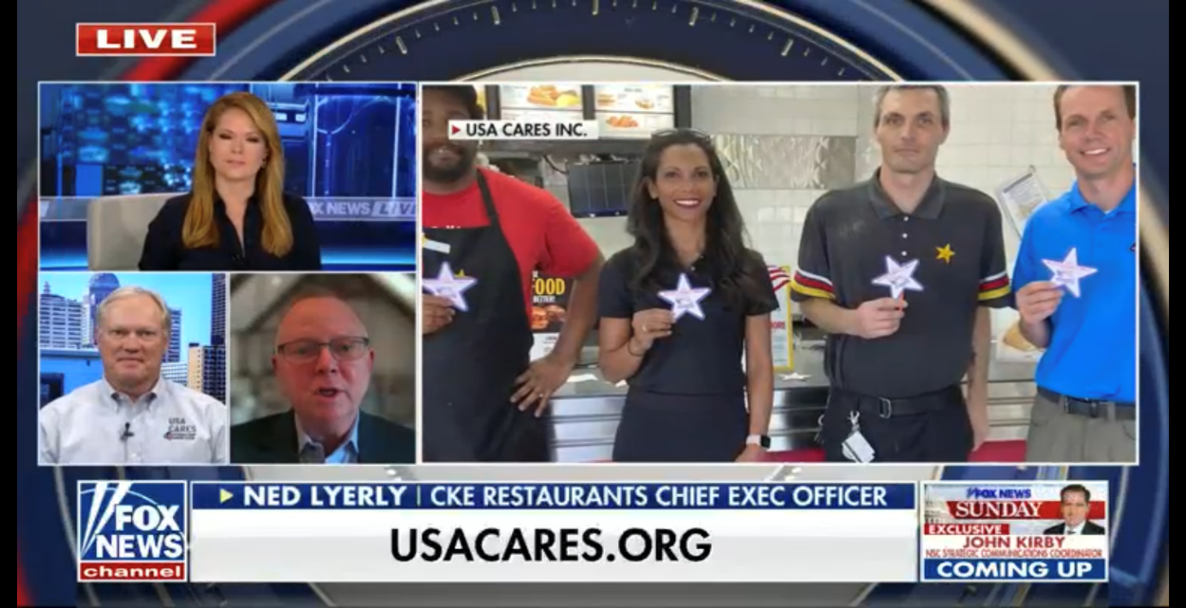
FOX NEWS
FOURTH OF JULY CELEBRATION 2022

Slide 9
COMMONWEALTH IMPACT
2011 - 2021, USA Cares has provided $795,164.41 in financial assistance to 729 struggling Kentucky military families. With these funds, we were able to stop 174 evictions and foreclosures, 196 auto repossessions, 140 utility disconnections, and 171 Kentucky families received food assistance.
2019 - 2021, USA Cares, Career Transition program has partnered with Ft. Knox Transition Assistance Program and has established the Senior Leader Corporate Fellowship Program.
63 senior leaders have gone through the program; 59 have stayed and became employed in the Commonwealth of Kentucky.

Slide 10
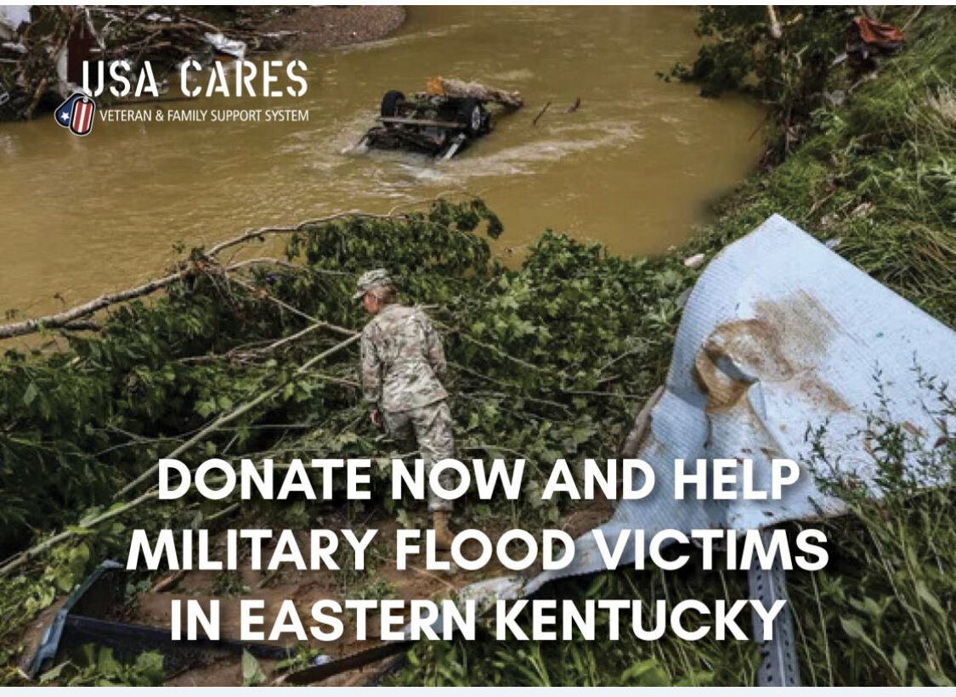

Slide 11
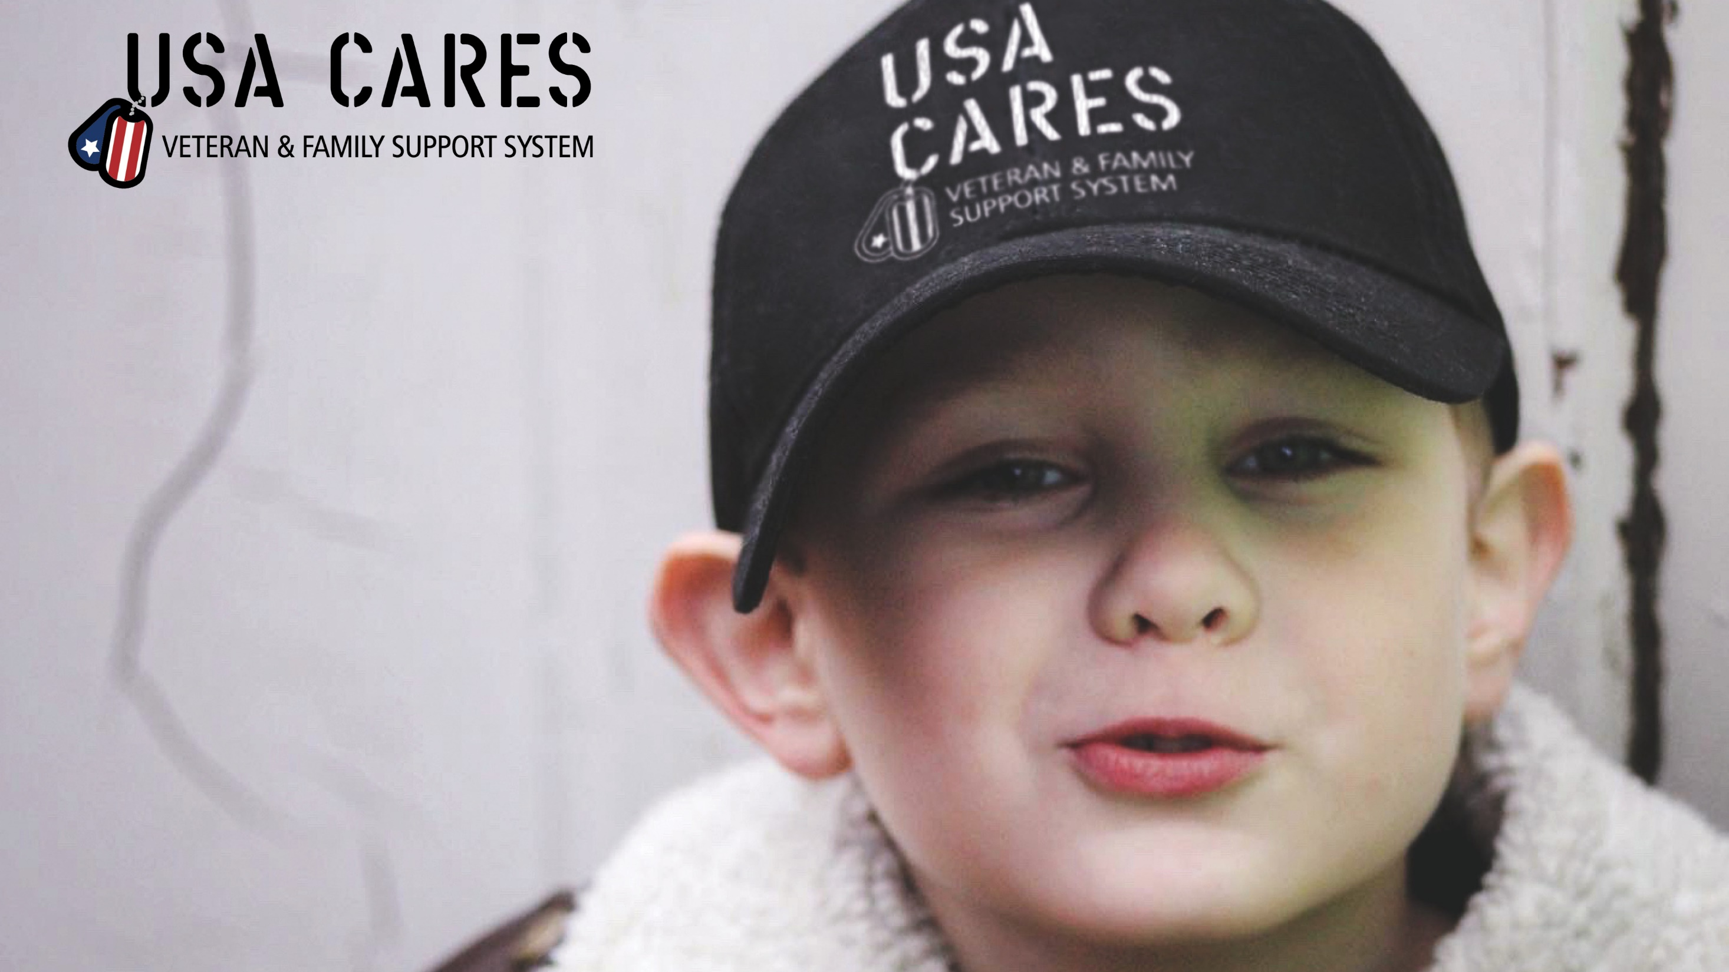
IMPACTING LIVES - 2021
IMPACTING
LIVES
2022
11760 Commonwealth Drive, Louisville, KY 40299
Office: (800) 773-0387 www.usacares.org

