Slide 1
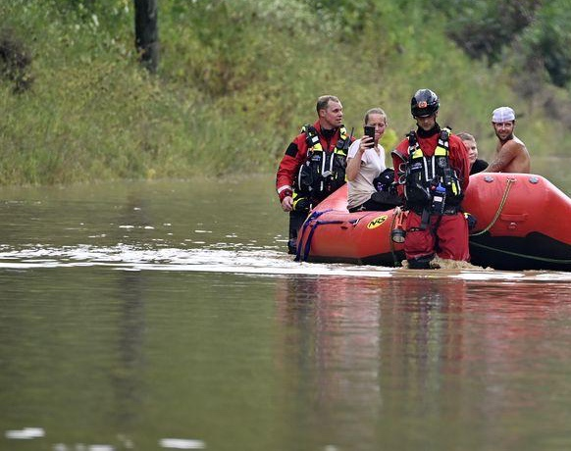
Kentucky Urban Search and Rescue Initiative
2022
Hwy 15 at Lost Creek, Breathitt County Eastern KY floods

Slide 2
Introductions
Captain Ryan Hogsten
Rescue Company 1
Lexington Fire Department
Lieutenant Doug Hargreaves
Executive Officer of Special Operations
Lexington Fire Department
-30 Years with Kentucky Fire Service
-22 years with Special Operations-Urban Search & Rescue
-17 years with OH-TF1 (FEMA Urban Search & Rescue)
-Multiple National/Statewide deployments including Hurricane Ian, Surfside FL, Candle Factory Mayfield KY, Mudslide/Collapse Stanton KY, Eastern KY Flood, Hurricanes, etc.
-12 years as Structural Collapse Leader for Lexington Fire Dept.
-Presented on the behalf of Kentucky at 2022 SUSAR Conference
-30 years with Kentucky Fire Service
-18 years with Special Operations-Urban Search & Rescue
-5 years with OH-TF1 (FEMA Urban Search & Rescue)
-Multiple National/Statewide deployments including Hurricane Irene, Candle Factory Mayfield KY, Clay City Flooding, Mudslide/Collapse Stanton KY, Eastern KY Flood, etc.
-Statewide Operations Manager during Eastern KY Floods

Slide 3
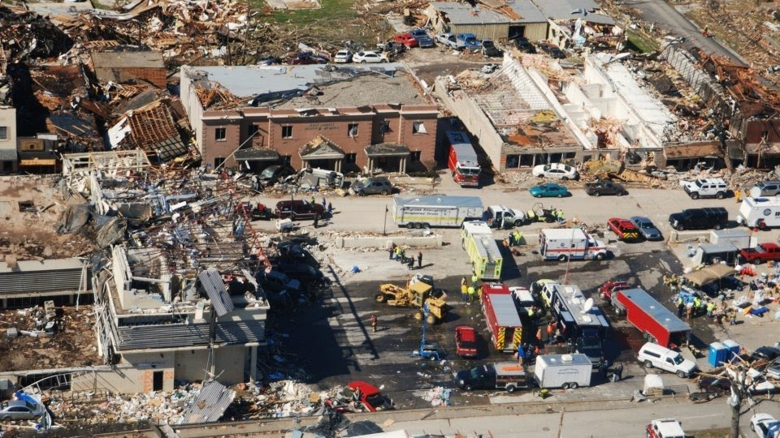
Urban Search and Rescue in Kentucky
What is Urban Search and Rescue?
Why does Kentucky need a USAR team(s)?
How would a USAR program work in Kentucky?
How much will this cost to fund a program?
When would Kentucky expect to see deployable teams?
West Liberty KY Tornado 2012

Slide 4
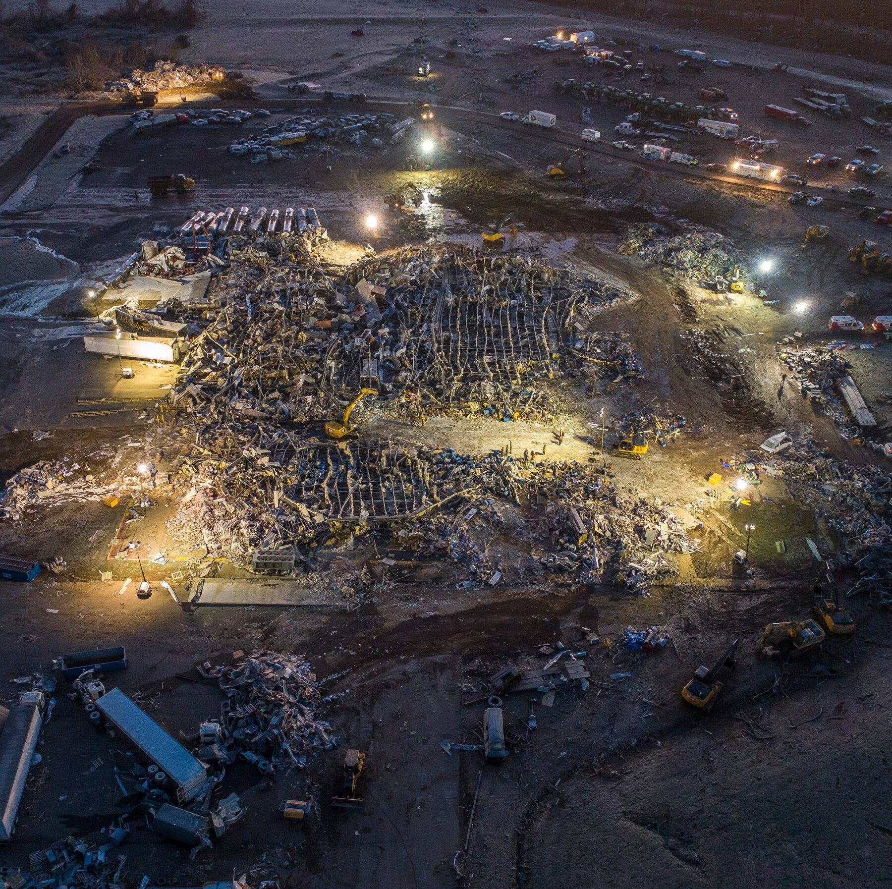
What is Urban Search and Rescue in 2022?
Urban search and rescue is a type of technical rescue operation that involves the highly trained and organized teams.
These teams can locate, extricate, and provide initial medical stabilization of victims trapped in an urban and rural areas.
Once described as mainly a team for structural collapses due to natural disasters, war, terrorism or accidents. Teams today are used for all type of disasters.
They are known as an organized All-Hazards Team that follows FEMA guidelines
Candle Factory, Mayfield KY
Western KY Tornado

Slide 5
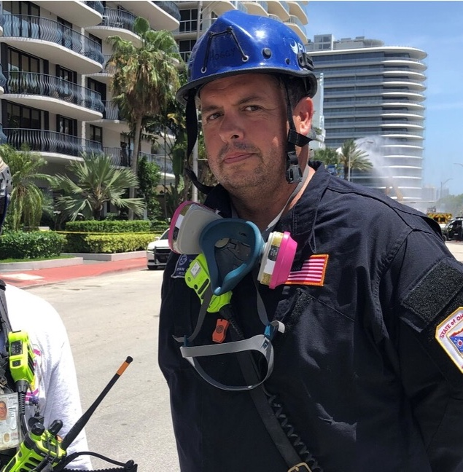
What are the capabilities of a Task Force?
Physical search and rescue operations in damaged/collapsed structures
Emergency medical care for entombed survivors, task force personnel and search canines
Reconnaissance to assess damage and needs, and provide feedback to local, state, tribal, territorial and federal officials.
Assessment/shut-off of utilities to houses and other buildings
Hazardous materials surveys/evaluations
Surfside FL, Condo Collapse

Slide 6
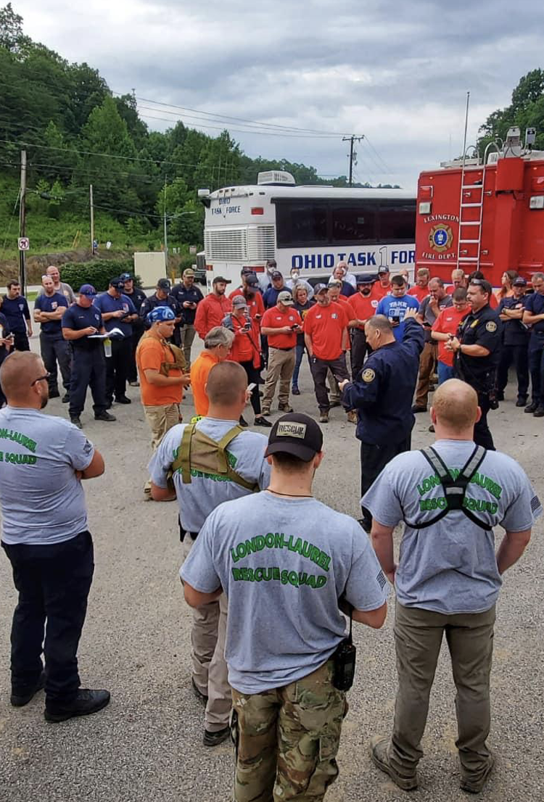
What are the capabilities of a Task Force?
Structural/hazard evaluations of buildings needed for immediate occupancy to support disaster relief operations
Stabilizing damaged structures, including shoring and cribbing operations on damaged buildings
Hazardous Materials Equipment Push Packages for operations in a contaminated environment
Search and rescue operations in a water environment
Breathitt County Morning Operational Brief

Slide 7
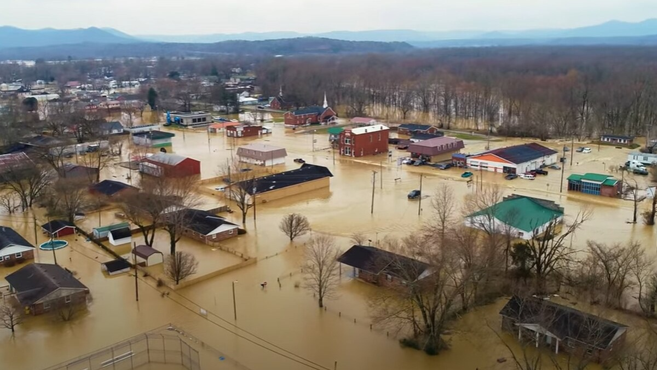
Why Urban Search and Rescue?
Flooding
Tornados
Earthquakes
Hurricanes
Ice Storms
Infrastructure Collapse
Clay City Floods of 2021

Slide 8
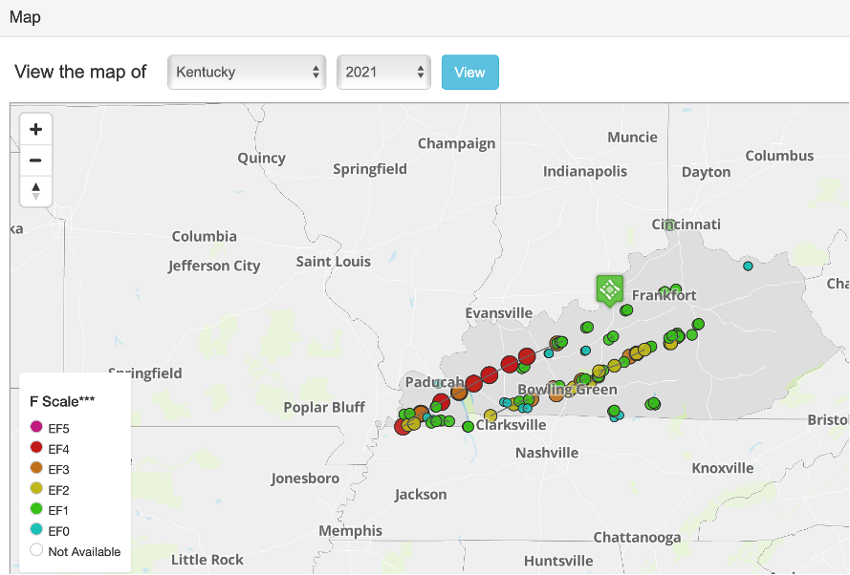
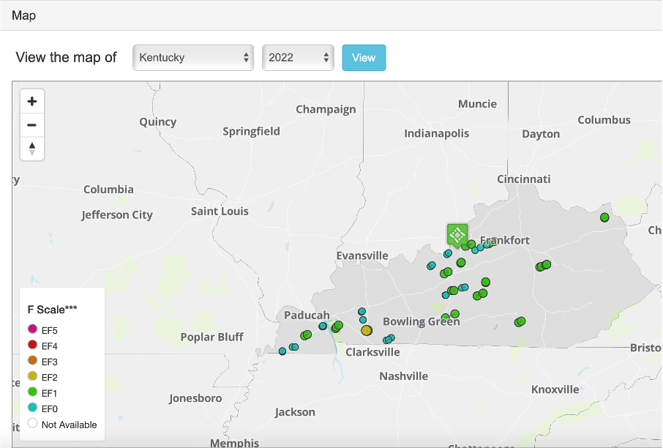
Interesting Facts
The trend of these tornados is to start in the southwest part of Kentucky.
Travel northeast through Bowling Green, Louisville, Lexington and Frankfort
2021
2022

Slide 9
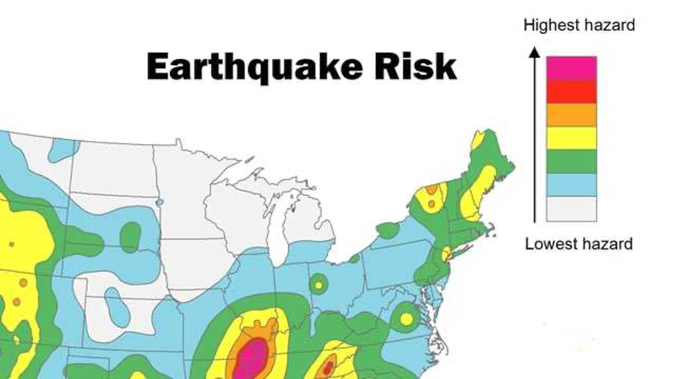
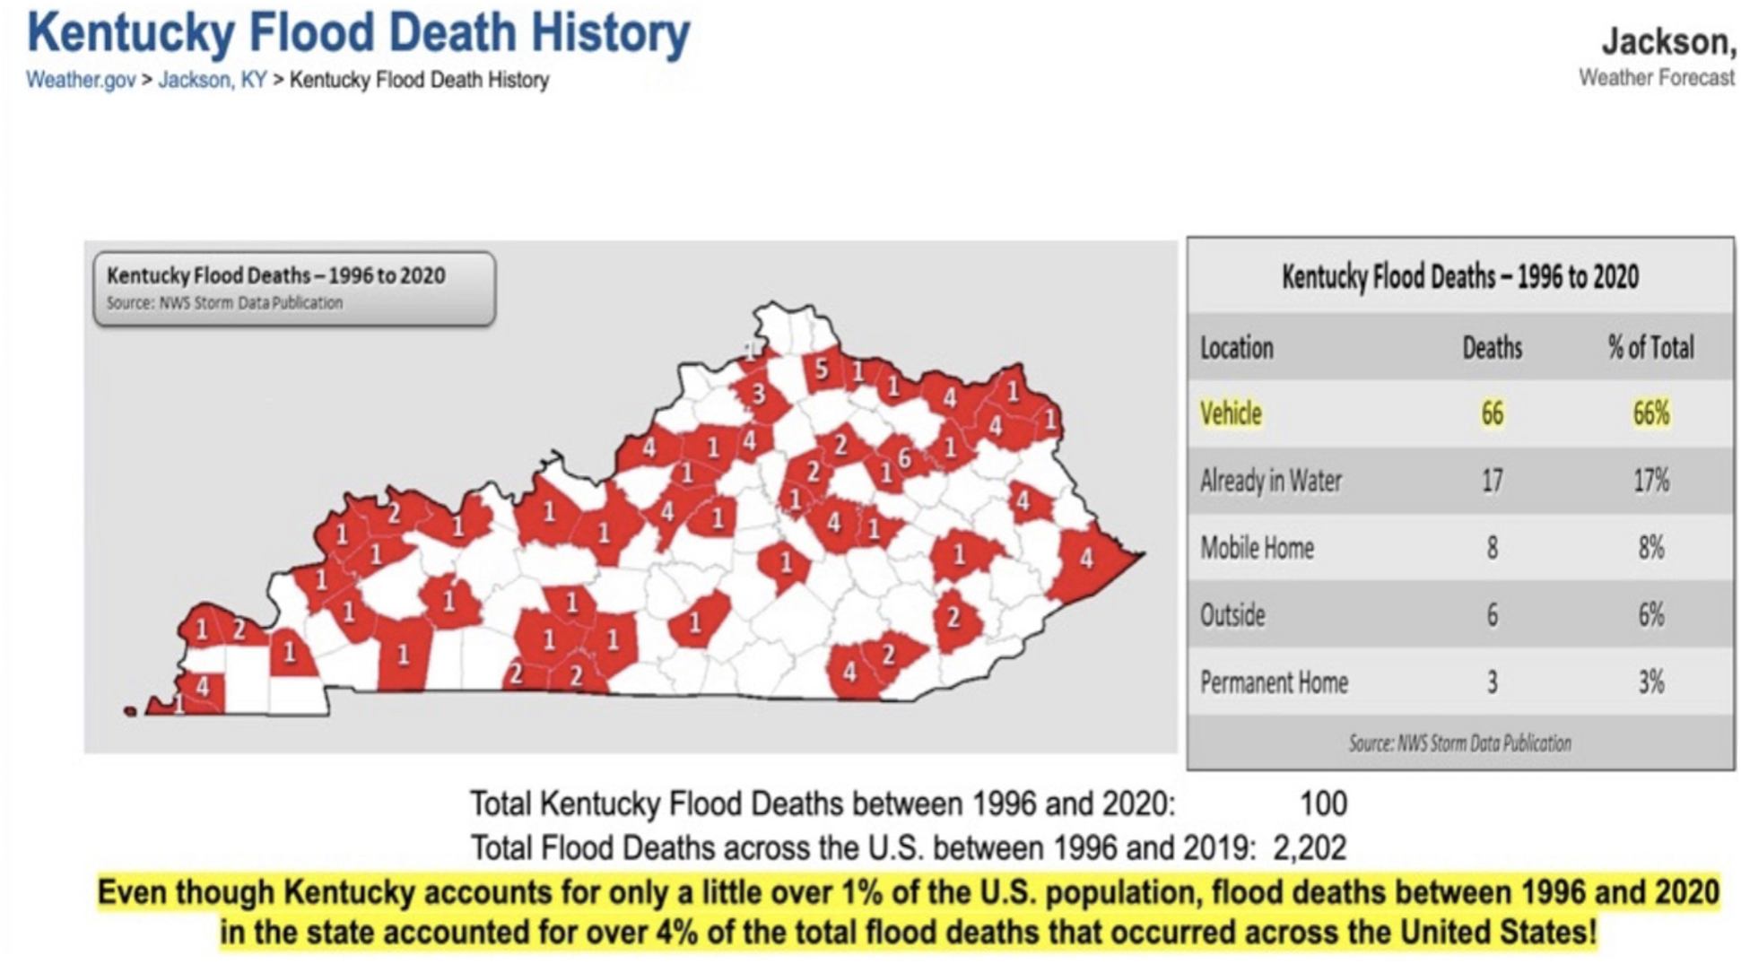
Interesting Facts
New Madrid Fault
Capstone 2014 (Liquefaction of Western Ky)
Flooding deaths 1996-2020
Ranked 5th in the United States

Slide 10
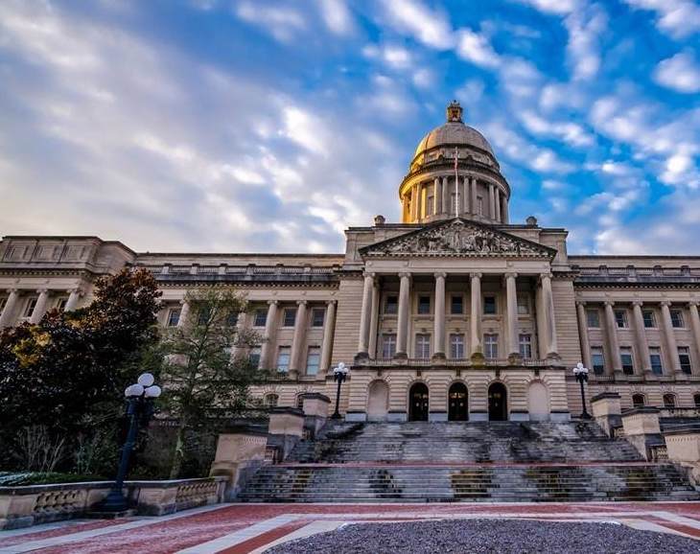
History of USAR in Kentucky
Since 2010 it is estimated that over 180 firefighters have received this highly skilled certification
These firefighters stretched from across the state. These include cities from Paducah to Ashland and Louisville to Campbellsville.
A committee was formed and tried for 5 years (2012-2017) to make this much needed statewide team a reality.
First responders travel to connecting states and join their federal or state teams.
In the last 12 months Kentucky has had 2 historic disasters that were the largest tornado in Kentucky's history killing 80 and a 1000-year flood killing 39.

Slide 11
State/Federal Urban Search and Rescue teams in the country
All States that border Kentucky have state and regional teams
Federal teams that border Kentucky:
OH-TF1
MO-TF1
TN-TF1
IN-TF1
VA-TF1 and VA-TF2

Slide 12
How would a USAR program work in Kentucky?
Evaluation of the current and past Kentucky response systems. This has been an ongoing process ever since September 11, 2001.
Define a mission statement
Develop an accredited program that should be a stand-alone division under the umbrella of a larger entity.
The most ideal spot would be under Kentucky Emergency Management. However, it could fit under any agency that has a responsibility of response.
Develop accredited response teams that are strategically placed throughout the state with different levels of training, and capabilities.

Slide 13
Kentucky USAR Mission Statement
The mission of the Kentucky Urban Search and Rescue Program is the coordination, development and maintenance of the state effort to provide resources to locate and extricate victims entrapped by man-made or natural disasters as well as to conduct other life-saving operations with integrity, courage, and dedication maintaining unified leadership within a sustainable organizational structure.

Slide 14
Accredited USAR Program and Teams in Kentucky
Emergency Management Accreditation Program (EMAP)
EMAP, is the voluntary standards, assessment, and accreditation process for disaster preparedness programs throughout the country, which fosters excellence and accountability in emergency management and homeland security programs.
During the development stages the USAR program would follow the 44 standards that apply to USAR Resources as they relate to EMAP certification.
The Urban Search and Rescue Standard covers:
Program Management
Finance
Planning and Procedures
Incident Management
Alert and Mobilization
Training and Exercises
Resource Management and Logistics

Slide 15
How would a USAR Program work in Kentucky?
The Kentucky USAR Program would have oversight of the regional teams and task forces.
It would provide financial responsibility over Task Forces and Regional Teams
It would provide uniformed training for each of the teams. This organizational component would allow the entire state to be trained as one.
It would allow standardization on what equipment is purchased, how it is distributed, and would be consistent.
This would allow volunteer and paid departments a resource for assistance and expertise
This would allow for state-wide response teams at the hands of the Governor, KY Emergency Management, local Emergency Managers, and others to call upon when disasters strike.

Slide 16
How would a USAR Program work in Kentucky?
Positions
KY USAR Program Director
KY USAR Program Asst. Director of Operations
KY USAR Program Asst. Director of Planning
•(4) Part Time Training Officers
KY USAR Program Asst. Director of Logistics
•(4) Part Time Logistics Officers
KY USAR Program Finance Officer
KY USAR Program Administrative Assistant

Slide 17
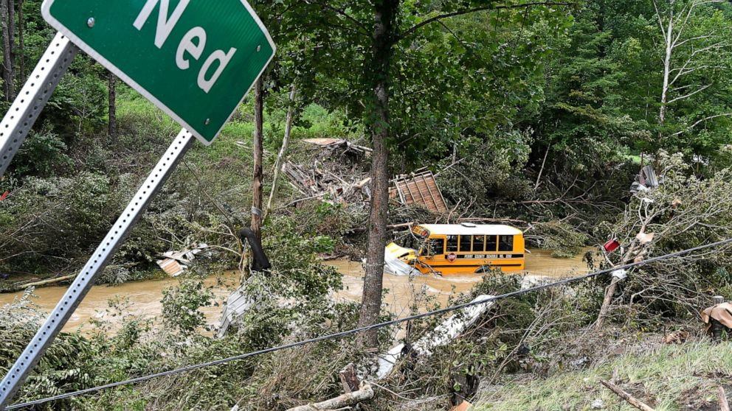
How would a USAR Program work in Kentucky?
Establish a Type 1 team that would consist of several areas of responsibility
Search
Rescue
HazMat
Medical
Planning
Safety
Canines
Highly skilled Structural Collapse and All-Hazard Rescue for 24hr work cycles
Deployed for up to 14 days and 3 days self sufficient
FEMA model is 70 personnel for a Type 1
The Type 1 Task Force would be three deep in these positions.
Located in Central Kentucky/ Lexington area
KY Floods, Ned KY

Slide 18
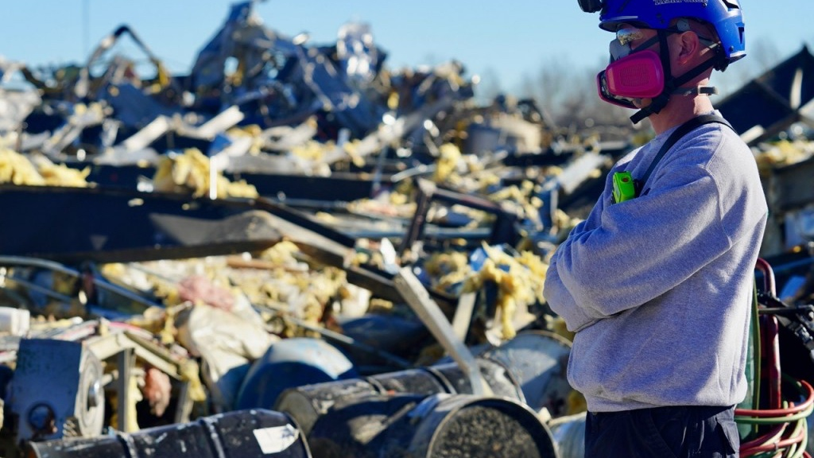
How would a USAR program work in Kentucky?
Establish a Type 3 team that would consist of several areas of responsibility
Search
Rescue
HazMat
Medical
Planning
Safety
Canines
Highly skilled Structural Collapse and All-Hazard Rescue for 12hr work cycles
Deployed for up to 14 days and 3 days self sufficient
FEMA model is 35 personnel for a Type 3
The Type 3 Task Force would be three deep in these positions.
Located in Jefferson County/ Louisville area
Candle Factory, Mayfield KY

Slide 19
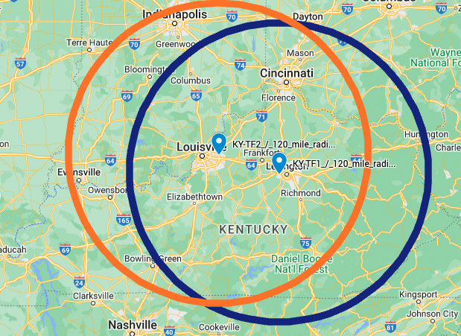
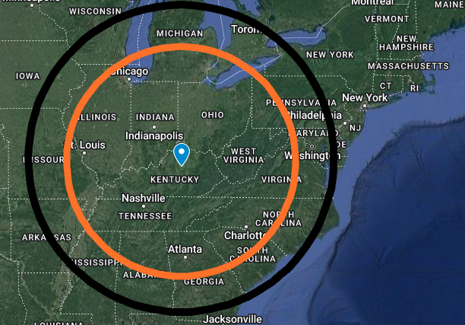
Task Force Response Times
2-hour Response Times
(120 Mile Radius )
6-hour and 8-hour response times
(360 Mile Radius)
(480 Mile Radius )

Slide 20
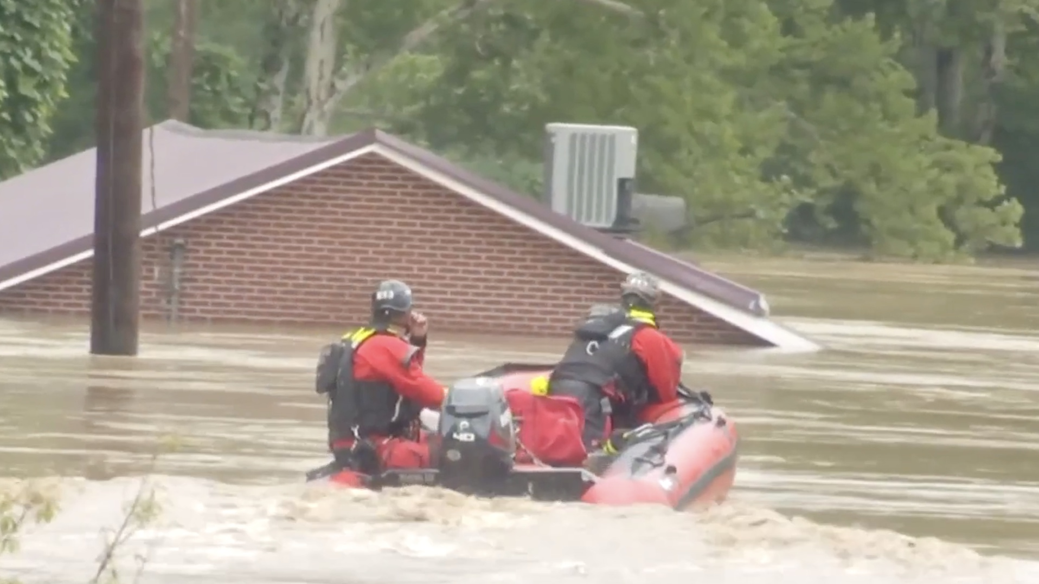
How would a USAR program work in Kentucky?
Establish (10) Regional teams that would consist of several areas of responsibility
Search / Rescue (Type 1 Heavy Rescue Team)
Swiftwater Rescue Team (Type 2 Swiftwater Team)
Highly skilled All-Hazards Responders for 12hr work cycles
Able to respond very quickly
FEMA model is 12 personnel for this type of team.
A Regional Team would be three deep in these positions.
Located in each of the 10 current Emergency Management Regions
Lost Creek, KY Floods

Slide 21
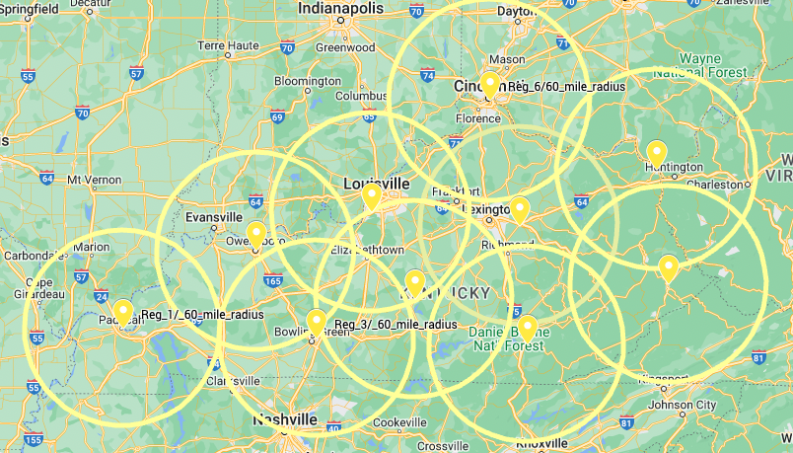
Coverage of 10 Regional Teams
Each circle is having a 60-mile radius

Slide 22
How much would a USAR Program cost the Commonwealth of Kentucky?
We took into the consideration the following:
FEMA, SUSAR, NFPA, and EMAP guidelines
Realistic times for developing, and training.
Equipment and Fleet
Current supply chains
Geographics of Kentucky
Overall cost to fund a Kentucky USAR program
Year 1 $12,875,000
Year 2 $12,959,000
Year 3 $ 3,149,000
Year 4-10 $ 3,024,000

Slide 23
When would Kentucky expect to see deployable teams?
Projected timeline Kentucky USAR program
Year 1
Establish the USAR program.
Establish 5 deployable regional teams.
KY-TF1, and KY-TF2 would be deployable on a limited basis.
Membership advanced training
Year 2
Establish the remaining 5 deployable regional teams.
KY-TF1, and KY-TF2 would be fully deployable.
Membership advanced training.
Start annual 3-day state mobilization exercise.

Slide 24
Scenario 1
A tornado has touched down in the western part of the state.
The local jurisdiction responds and determines that they need are assistance from their regional team.
The State EOC is notified, and they issue a state incident number. The State EOC along with the regional team notifies the KY USAR command staff of an incident.
Once the regional team arrives on scene, team leadership will perform a size up of the incident and request additional regional team(s) and task force(s) if needed.
KY USAR command staff will then have regional teams and task forces dispatched to the appropriate areas.

Slide 25
Scenario 2
There are reports from local and state meteorologist that potential heavy rains and flooding are issued for a part of the state.
KY USAR would place regional teams in that part of the state and closest task force on alert. They would start to pre-roster a team.
Local and regional EM directors may request for type 2 water rescue regional team(s) to stage in an area. This will prevent delays in a response. A state incident number would be created.
Once the local jurisdiction has become unable to support the mission then they can request for response from a regional team

Slide 26
Scenario 3
A Category 4 hurricane is predicted to make landfall in 3 days.
The state of Alabama has requested the following from the state of Kentucky through EMAC:
(1) Type 3 USAR team
(4) Type 2 Swiftwater teams
State of Kentucky accepts their request and deploys the needed resource to assist their state needs

Slide 27
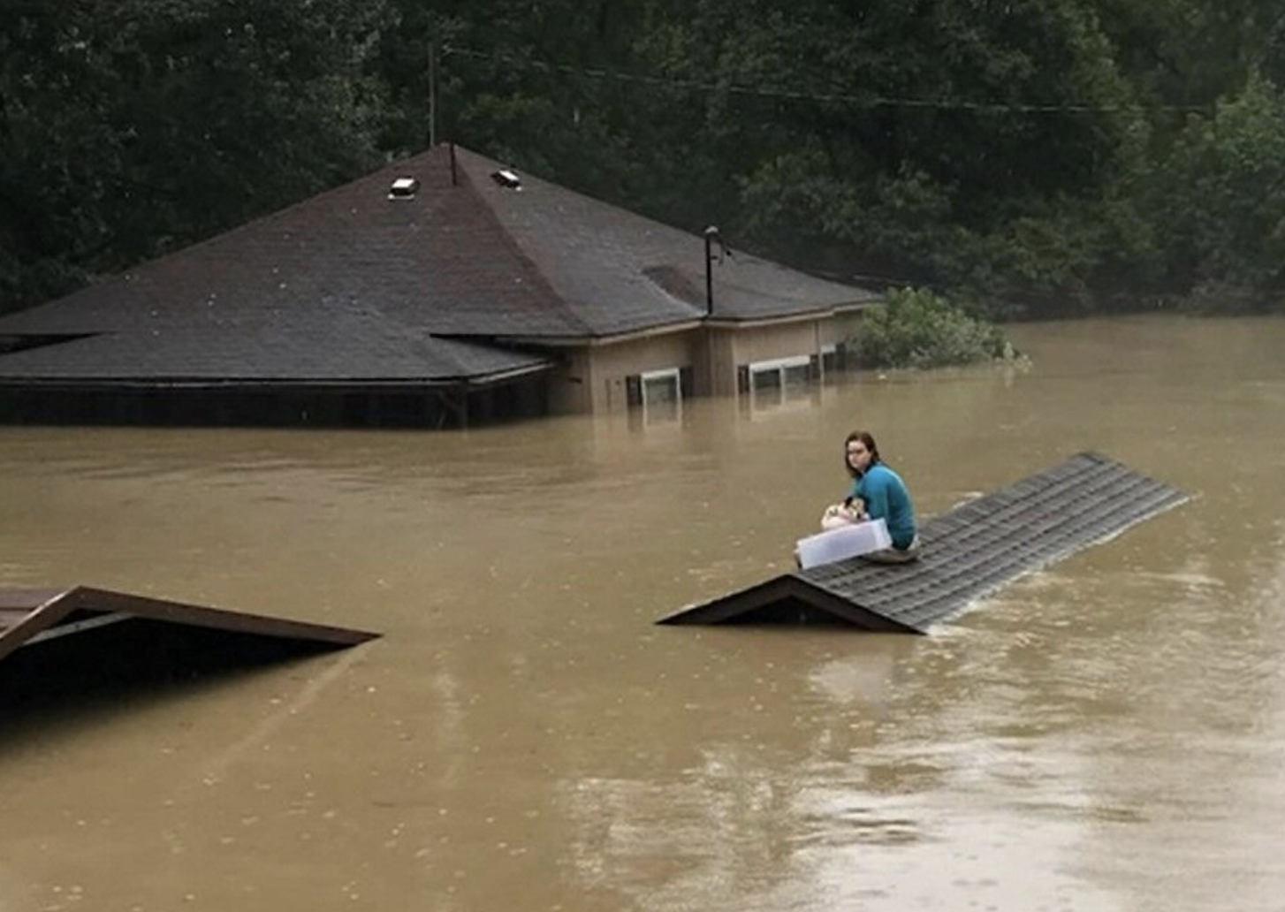
Thank you Any Questions?
The time is now to prepare, equip, and train our first responders to respond to Kentucky's next disaster.
A Kentucky USAR program is the right choice
Eastern KY Flood

