Slide 1
How do we PREVENT Veteran suicide???
CW4 US Army Special Forces (Retired)
Michael Carmichael
Check A Vet
President, Founder, and CEO

Slide 2
Introductions
Me
Check A Vet
Check A Vet will prevent Veteran suicide by raising public awareness and calling upon American citizens to meaningfully and routinely engage Veterans.
Team
The Honorable Christopher Miller
Faye Grund, PhD, PMHNP
Dave Wilson, Secretary and Treasurer

Slide 3
Keys to Success
State prevention efforts
Raise awareness
Call to action
Education
Community prevention
Peer-to-peer support groups
Veterans
Support base

Slide 4
1. Raise Awareness
How many
Who
Where
When
State
Prevention
efforts

Slide 5
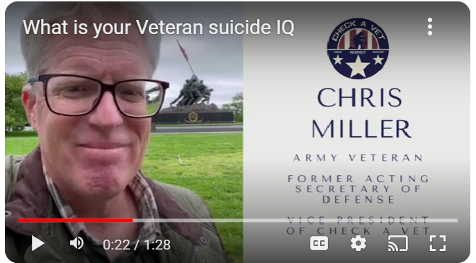
What is your Veteran Suicide IQ

Slide 6
How many?
State
Prevention
efforts
Google Search:
30,177
Brown University study (1) by Thomas Howard Suitt, III. Suitt is Ph.D. in Theology and is a recent graduate of the Graduate Program in Religion at Boston University. Only includes post-9/11 era Veterans. The problem with the data. Post 9/11 era Veteran Population 1.3 million (2) in 2021. Veteran population in 2021 16.5 million.
VA reporting:
Has the VA published the number of Veteran suicide since 9/11? Not that I have ever been able to find.
Does the VA have a number?
127,560 (3). After 18 months of looking, I found an appendix with all of the years listed. It is buried under five layers of VA web pages.
Operation Deep Dive:
VA’s number is underreported by a factor of 2.4x, not reporting Self Inflicted Mortality
306,151 This is at a rate of 44 per day.
* 377,587 Actual number is higher due to excluded groups and lack of information.

Slide 7
Who; Where; How; Special Circumstance
State
Prevention
efforts
Who
White Veterans account for 87%, black Veterans are the lowest with 6%
Male Veterans account for 96%
35 and over account for 86%
35-54 26%
55-74 36%
75+ 24%
Where
In Rural areas, the Veteran suicide rate of 33.3 vs 29.1 in urban areas.
How
Firearms 66% , Suffocation 22%, Poisonings 7%, Other 5%
Special Circumstance
VA’s crude rate of Veteran suicide in 2020, was 31.7
VA’s crude rate of Veteran suicide among Veterans that seek healthcare from the VA is 41 or nearly 25% higher

Slide 8
2. Call to Action
State
Prevention
efforts
Give hope
Pay attention
How many people are susceptible to suicide
Team approach

Slide 9
3. Education
State
Prevention
efforts
What do you do if your veteran is in imminent danger of succumbing to suicide?
Suicide safety plan
Engagement strategies
Start simple
Subtle signs
Risk and protective factors
Veterans need to know that its okay not to be okay

Slide 10
Myths and misconceptions (education cont.)
State
Prevention
efforts
Old vs. young
Combat vs. non-combat
Worst time of year
Mental illness
Presidential priorities
Lethal means safety
Enhancing crisis care
Increasing access to effective care
Addressing upstream risk and protective factors
Increasing coordination, data sharing, and evaluation efforts

Slide 11
Peer-to-peer support groups
Community
Prevention
efforts
In the style of Alcoholics Anonymous for Veterans
In the style of Al-anon for the base of support
Cost to develop the Proof of Concept
VA SSG Fox Grant $600,000 +
VA cost-prohibitive constraints
Sabotaging constraints
Only ten months of employment
Start the process off again from scratch each year
State or independent investor expense $900,000
Built to succeed with no VA constraints
12 months of employment
Success equals continuation
Minimal const to spread and sustain
Cost effective after the program is established

Slide 12
Summary: Keys to Success
State prevention efforts
Raise awareness
Call to action
Education
Community prevention
Peer-to-peer support groups
Veterans
Support base

Slide 13
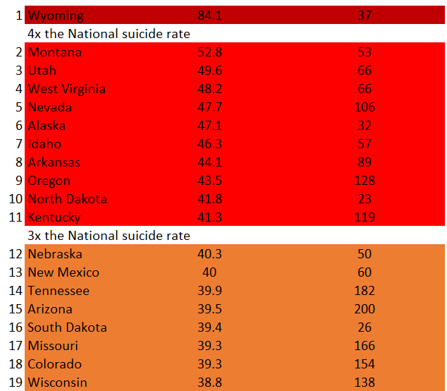
How bad is Kentucky???

Slide 14
Questions?

Slide 15
Sources
(1) Brown University study: https://watson.brown.edu/costsofwar/papers/2021/Suicides
(2) Post 9/11 era Veterans in 2021: https://www.statista.com/statistics/250279/us-veterans-by-period-of-military-service/
(3) 2001-2020 National Data Appendix: https://view.officeapps.live.com/op/view.aspx?src=https%3A%2F%2Fwww.mentalhealth.va.gov%2Fdocs%2Fdata-sheets%2F2020%2F2001-2020-National-Data-Appendix_508.xlsx&wdOrigin=BROWSELINK
(4) Operation Deep Dive: https://e55c5558-502f-457d-8a07-a49806f5ff14.usrfiles.com/ugd/e55c55_1cd5b99bea734bb295762263a003e767.pdf
(5) National Library of Medicine: https://pubmed.ncbi.nlm.nih.gov/32915350/
(6) Analysis of Methods of Suicide Among US Military Veterans https://cdn.jamanetwork.com/ama/content_public/journal/jamanetworkopen/938906/zld220087t1_1651174064.36344.png?Expires=1689099596&Signature=TbIrtbZN9d0G4FglvvfxAaKuqn7Lz3uDdiNMNQhT9xRxLe4bqr4q5rOBe1ZnHl1n6WtRGWXxLyRi-LYivgsZG8BJLWymnepb39JhQpIiwpNHWY7nCP9oeHE4kftOCAn9Y24vDsoxBSVvzVqr~xVE~gPSDCoO6BC0cudxs7M2i3bKqtZh40zfEttnBlX0Wzhne4R~GSULHId~B2lfDWlaxso4orKQdw-Yg32nMH8971~krHPDl1elpx9IRaITfb60DWLvOJCyVXM4jfkX6Rbtf58rNWdajCzH6ubc5bt7wuzOM1ij2BIWhtz950PXFMiQ0U9XZJbWpUZsZDnIGB-szQ__&Key-Pair-Id=APKAIE5G5CRDK6RD3PGA

