Slide 1

A PARTNERSHIP BETWEEN STATE, COMMUNITY HEALTHCARE PROVIDERS, FOR PROFIT AND NON- PROFITS TO MIGRATE HBOT HEALTHCARE UNDER KRS 217.930-942 FOR THE BENEFIT OF VETERANS AND FAMILIES
HEAL BRAINS, STOP SUICIDES, RESTORE LIVES
Notes:
Mr. Chairman, Vice Chairman, Committee Members, video guests, thank you for meeting with us. My name is Eric Koleda, 10-year Vietnam Era Air Force Veteran, 26-year UPS Airline Management startup team member and retiree, TreatNOW National Legislative Director, and Co-Founder and Director for HBOT4KYVETS, Inc.
This body enacted HB 64, The Colonel Ronald D. Ray Traumatic Brain Injury and Treatment Act in 2018.
My brother-in-law Ron is no longer with us, succumbing to his Vietnam combat invisible wounds in July 2020. Untreated TBI post-mortem brain analysis confirmed CTE for “The Colonel” .
Which is why I am here today to speak with you about helping those Veterans like Ron who suffered the long-term effects of untreated TBI before it is too late.
I am here asking to finish the work we began in 2018 and help fund treatments like five other states have done to date.

Slide 2
Kentucky TBI/PTSD Veteran Economic Impact
Estimated $484.2M annually economic impact to Kentucky
$40,186 per KY Veteran per year over an estimated 40-year life span, estimated $19.3B for 12,050+ mTBI/PTSD KY Veterans
2016 Medicare Average annual reoccurring cost per mild TBI patient is $19,945 ($24,933 in 2023, If all 12,050 TBI Veterans under CMS $300.4M Yr. (HHS Public Access, Med Care May 2021)
Seeking $750K per year ($1.5M) non-lapsing over reoccurring 2-yr budget cycle, 100% towards pre/post testing and treatments, 100-120 Veterans estimated treated in 2 YR, $12.5-15K average one-time cost per Veteran is ½ the annual reoccurring Medicare cost not taking into account any other costs
The Economic Impact of TBI/PTSD Veterans in Kentucky Report, June 21, 2023
Notes:
We distributed our 24-page report on “The Economic Impact of TBI/PTSD Veterans in Kentucky” to the Speaker of the House and members previously which contains all the detail data on how we derived the estimated economic $484.2M cost.
Will cover the cost in greater detail on slide 15/16. We are asking for $1.5M over two-year period or $750K per year with an average cost of $12-15K per Veteran.
The 2023 KY population is 4.5M, federal Medicaid/Medicare funding is $9,145 per resident, 4th highest in the country
Approximately $15K in CMS state funding per resident.
If TBI Veterans return to work, it is approximately 50% return on your investment ($12.5K/$25K ) in the first year and 100% second year.

Slide 3
TBI/PTSD: The “Signature Injury”
20-Yr Iraq and Afghanistan Wars
Over 70,000 Improvised Explosive Devices (IEDs)
Kevlar helmets and jackets are saving Veterans in combat: 7,057 total combat deaths but 877,450 invisible wounded returned home
Rand Corp-23% of desert Veterans with TBI, our estimate 12,050+ in KY
The National Brain Wounded Veteran Brain Drain, Googlebooks.com, Oct 2021
Notes:
Dr. Daniel Perl, DoD study published in Lancet Neurology, reported in The New York Times, June 16, 2016, stated,
“The injury is “physical” and not just emotional but it is treated as psychological injury.”
7,057 deaths and 877,450 TBIs represent an average of 29 combat deaths every month versus 3,656 TBIs per month over 20 years
It is reported 53% Army and 18% Marines comprise of 71% of all Veteran TBIs based on their mission of “boots on the ground” for 20 years

Slide 4
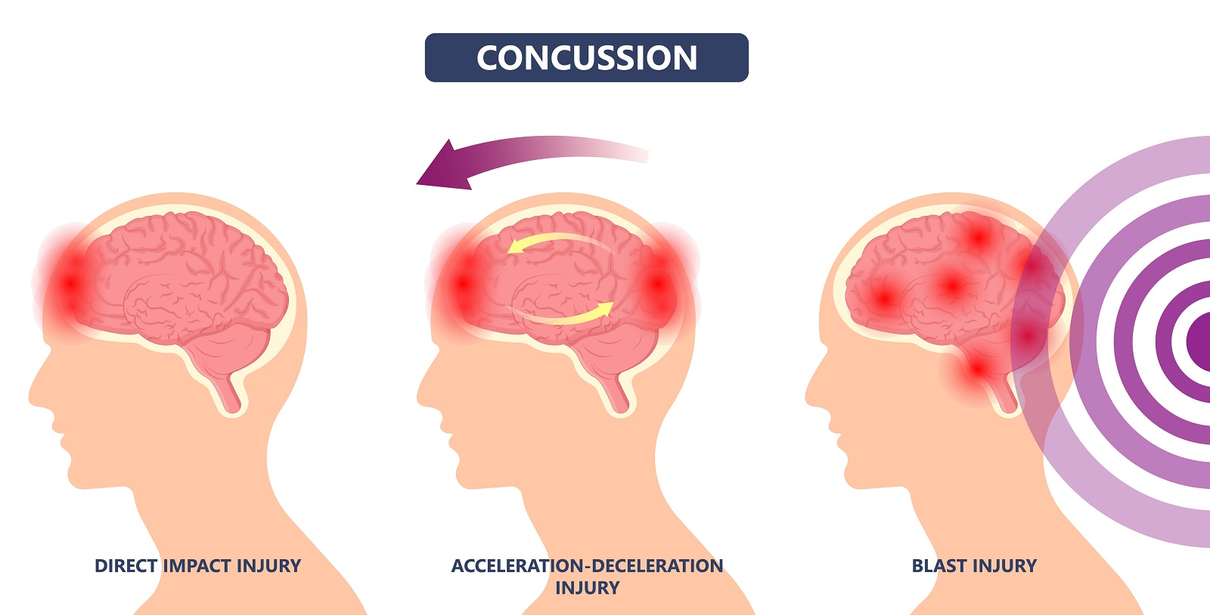
Three Most Common Types of mTBI/Concussions
80% of Veteran TBIs are Mild
Notes:
Here are the three most common types of TBIs
80% of Veterans are diagnosed with Mild TBIs
4th type of TBI is Penetrating which is not depicted here

Slide 5
Over 220,000+ TBI/PTSD Veteran suicides and opioid overdose deaths since 2003
The VA Veteran suicide trend rate has not improved in 15-years with “treat the symptom” protocol, estimates of 47 deaths per day with opioid and suicides combined
1,300+ failed suicide attempts per year
The National Brain-Wounded Veteran Brain Drain, Googlebooks.com, October 2021
Notes:
40% of Iraqi and Afghanistan vets diagnosed with “mental illness” – AND that’s just 49% of Veterans who are enrolled in VA
51% of Veterans deployed to Iraq and Afghanistan were National Guard and Reserves, who are now back in your Kentucky communities
20 suicides per day equates to 7,300 per year X 20-years = 146,000
VA number of 17 per day equates to 6,205 X 20 years = 124,100 (the VA stopped reporting Guard and Reserve suicide numbers)

Slide 6

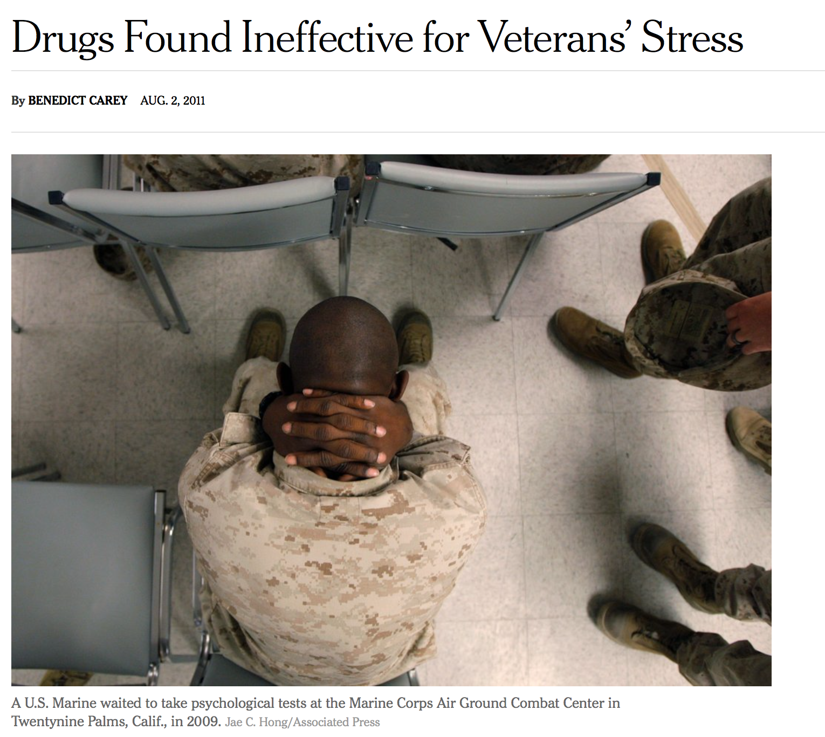
We have surpassed all Vietnam combat deaths with Post 9/11 Veteran suicides. The prescription protocol treating TBI symptoms is NOT working!
No FDA approved drugs prescribed for TBI, Over 847 million opioid pills (DEA.gov) distributed by the VA 4 of 8 CMOPs from 2006-2014 resulting in 679,000+ OUD Veterans in 4Q2012 (VA.gov)
Notes:
Zoloft & Paxil are the only FDA drugs approved for PTSD
847M opioids delivered to 4 of 8 CMOPs over 8-year period impacting over 679K Veterans, approximately 156 opioid tablets for every OUD Veteran per year
Per the Journal of Clinical Psychiatry in Nov 2011 the VA spent $717 million on Drugs that do not work!!!

Slide 7
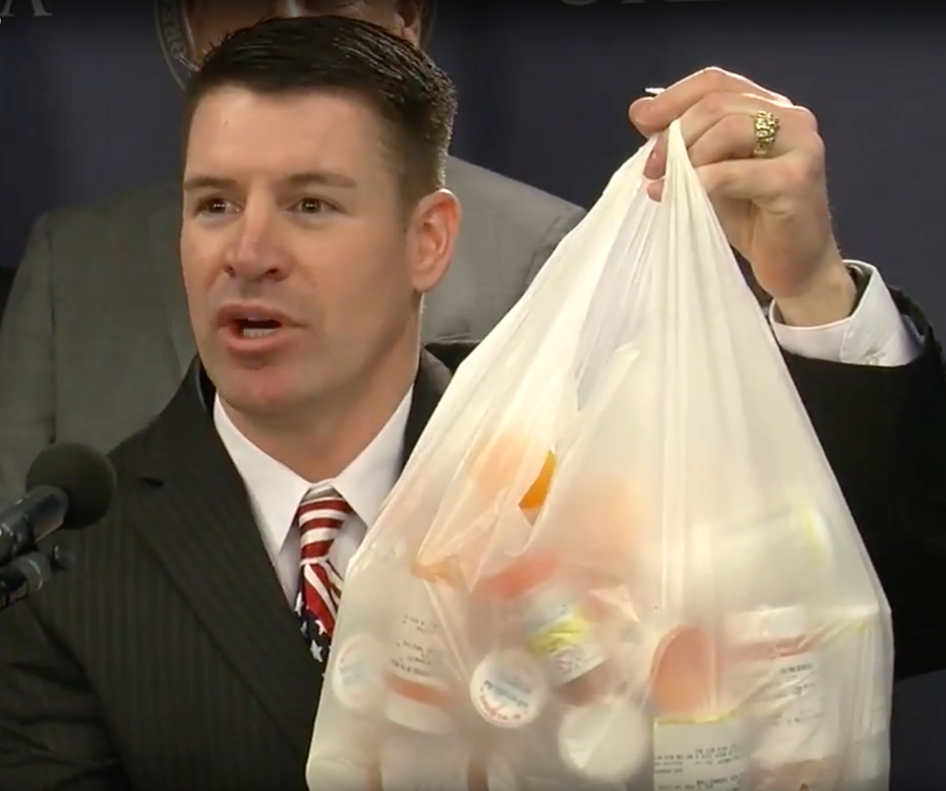
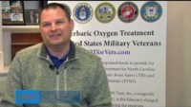
2014 Press Conference with Gregg, Army Veteran
Oklahoma State Rep/Marine Chaplain and TBI Survivor
John Bennett Shares his HBOT Story
An average of 10-30 daily prescription medications per Veteran
Over 30 Veteran testimonials here https://www.youtube.com/@treatnowdotorg/videos
Notes:
2014 OK first state to enact HBOT for TBI/PTSD Veterans
In most cases opiates are/were prescribed to treat the pain experienced by Veterans with TBI/PTSD
Nearly all of the anti-depressants carry “FDA Black Box Warnings” urging caution in 17-24 year-old's because of the increased risk of suicide, yet they are all still prescribed today
Here is a 2minute testimony of Gregg, and Army Chaplain and TBI survivor because of HBOT

Slide 8
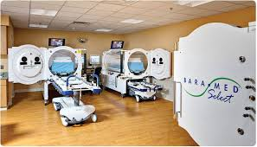
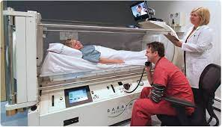
A SOLUTION: WHAT IS HBOT?
HYPERBARIC OXYGEN THERAPY
A SCIENTIFIC APPROVED AND PROVEN PROTOCOL FOR WOUND HEALING
15 CMS/13 FDA/11 Tricare Approved Indications
Notes:
100% oxygen is delivered at 1.5 ATA pressure which delivers 700-1100% more Oxygen to the blood as the next slide will show
Veterans receive 40 treatments, One (1) hour per day, 5 days per week, over 2-3 month period
Safety and efficacy validated worldwide for over 2 decades as a wound healing treatment
6 similar FDA approved treatments which include delayed radiation injury, compromised grafts and flaps, acute thermal burns, crush injuries, gas gangrene, and Diabetic Foot Ulcers
4 facilities under contract, 3 hospitals, 1 clinic, UofL Health is only one of a few hospital Wound Care HBOT centers for dive duty support of EMS, Police, Navy, Coast Guard and FBI divers in our state.
If it is safe enough for our police, Coast Guard, FBI, why is it unsafe for Veterans? It is NOT. Hundreds of thousands patients have received FDA, CMS or Tricare approved HBOT

Slide 9
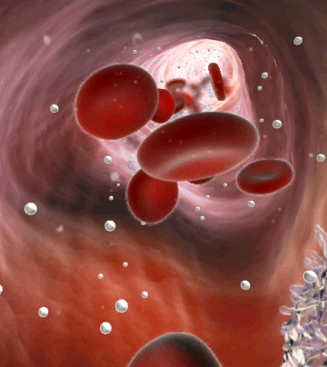

It’s About Oxygen Saturation-AT CELLULAR LEVEL
The blood is saturated with 100% oxygen at 1.5 ATA, 700-1100% more oxygen, promotes cell and tissue growth which accelerates wound healing with an approved medical drug-”Oxygen”
(PRE) BLOOD OXYGEN SATURATION (POST)
Before HBOT
After HBOT
Image Courtesy of Dr. Stoller
Notes:
Here is a pre and post HBOT blood sample slide which depicts the oxygen saturated blood. The main reason HBOT is a proven accelerated wound healing treatment as it promotes cell and tissue growth as a result of the oxygen “rich blood”
I am going to warn the committee members and viewers,
The next slide is a very graphic slide of a Diabetic Foot Ulcer (DFU), one day before scheduled amputation, if you don’t want to view it, please look away.

Slide 10
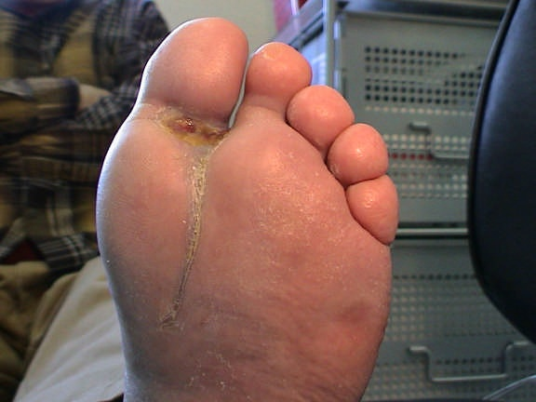
DFU: Unresponsive to Conventional Therapy-
HBOT HEALS WOUNDS-FDA/CMS/Tricare Approved
1 Day Prior to Scheduled Amputation
Hyperbaric Oxygenation prevents
Approximately 74% of Lower Limb Amputations (LLA’s) in diabetic patients. VA Average 36,000+ AMPUTATIONS Per Year Since 2001, Over 796K died Post 3-Yr LLA, The VHA does not operate any HBOT Chambers in over 1,100 facilities nation wide
50 HBOT Treatments
Notes:
10
This exact type tissue healing occurs with concussions/TBIs, its just not visible without brain scans as will show in the next slides
2.2 million diabetic Veterans in VA healthcare network, 94% of VA DFU Veterans are not informed or provided access to HBOT that heals 74% of DFUs and eliminate LLAs, saving lives
The VA does not operate a single HBOT chamber in all their national 1,100+ facilities
If you want to learn more, you can request a copy of our 50-page report to the US Congress on this issue

Slide 11

Example of Severe TBI-HBOT Brain Healing Case Study
(“Case Report” published in Psychology Progress in 2013)
80% of Iraq and Afghanistan Invisible Injuries were Mild TBI
45-yr old male soldier, 15 months post Loss of Consciousness
Two separate TBIs in Iraq, 1st mortar attack and Loss of Consciousness (LOC), second LOC in Humvee on patrol
Ft Carson, Washington diagnosis with no medical records: “Conversion Disorder (CD);” sent to VA, CD is person who experiences physical and sensory problems with no neurological pathology
Revaluated in New Orleans by Dr. Paul Harch, 16 pieces of shrapnel ID in his arm, diagnosis severe Persistent Post Concussion Syndrome (PPCS), PTSD. With SPECT scans, VA resends psychiatric diagnosis, Ft Carson refuses to change medical diagnosis position on Conversion Disorder
SPECT; Single-Photon Emission Computed Tomography, nuclear 3D color imaging which detects blood flow to the brain, OR NOT
Notes:
Ladies and Gentlemen, there is unorthodox medicine being practiced, but HBOT is not a part of it, case in point----

Slide 12
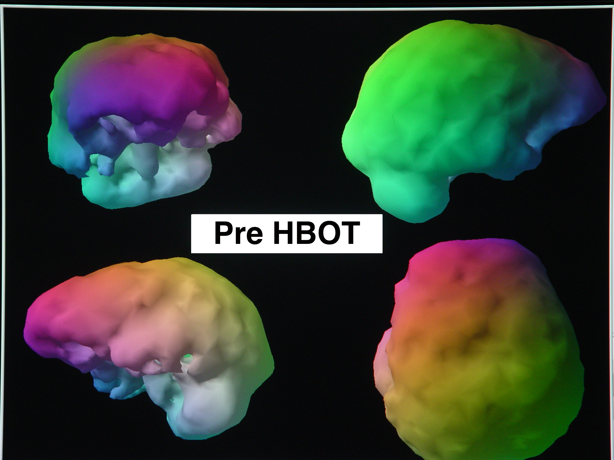
LSU IRB #7051: Paul G. Harch, M.D., Edward F. Fogarty, M.D.
BILATERAL FRONTAL AND TEMPORAL LOBE DEFICITS
DIFFUSE SCALLOPING
Notes:
LSU clinical IRB trial conducted in 2013 by Dr. Paul Harch with his comments on this “Case Report” and I quote:
“The brain scans are amongst the most revealing and shocking that I have ever seen in scanning patients for 34 years and thousands of scans.
You never see a global reduction in blood flow to an entire brain hemisphere except in stroke and even then, it is not like this.
The psychiatrist who saw Rusty told him that they had too many patients/soldiers with TBI,
so he was giving him a diagnosis of “conversion disorder.”

Slide 13
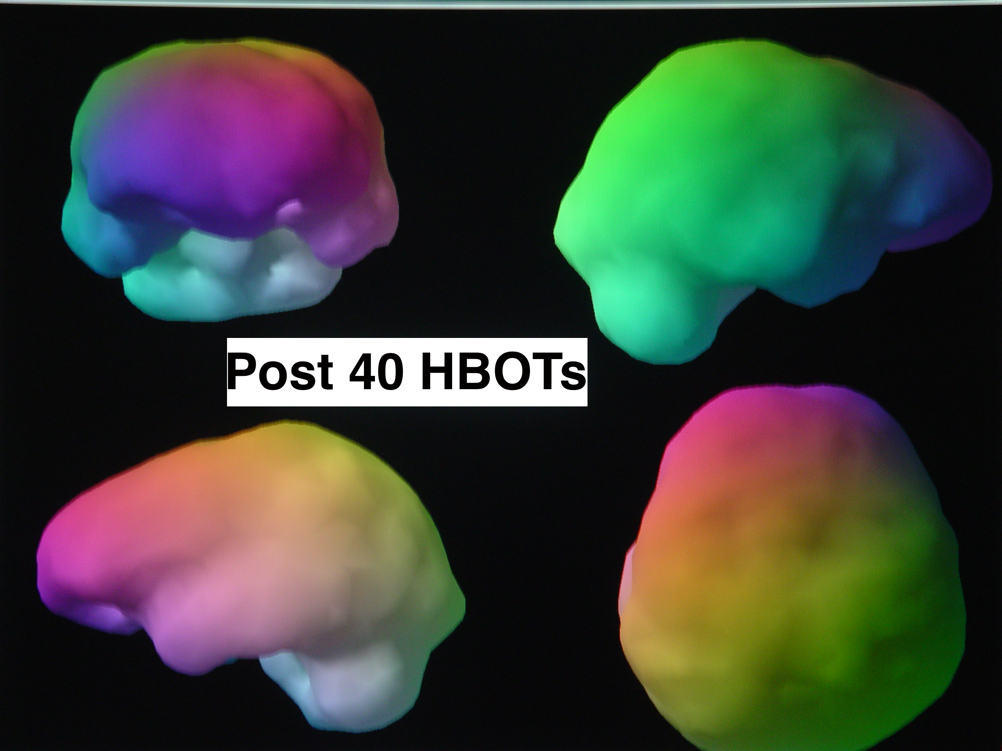
LSU IRB #7051: Paul G. Harch, M.D., Edward F. Fogarty, M.D.
Lobe Deficits Greatly Reduced
Diffuse Scalloping Greatly Reduced
Notes:
This Veteran experienced symptomatic, physical, cognitive, and quality of life improvement, reduction in anxiety and depression, and suicide ideation was eliminated
Since 2007,12 of 20 national clinical HBOT IRB trials completed had patients with SPECT scans pre and post treatments demonstrating compelling medical evidence of brain wound healing on over 730 Veteran patients

Slide 14
National Brain Injury, Rescue, and Rehabilitation (NBIRR) Study: Post HBOT Results
Nearly 15-point IQ Increase (difference between
H.S. drop out and college graduate)
51% Reduction in Depression with “ virtual elimination” of “Suicide Ideation” , 30% improvement in PTSD symptoms
39% Reduction in PCS /87% headaches reduced
64% had reduced need for prescriptions
100% showed sustained improvement on neuropsychological test 6 months post HBOT
96% Functional Emotional Improvement
Significant reduction in Anger Issues!
Ncbi.nim.nih.gov
Notes:
20 Independent clinical IRB trials since 2007 with over 730 positive results that marry up to what you see here
Is every single treated TBI Veteran healed after 40 HBOT dives, the answer is NO
Many variables affect the number of treatments required including the number of TBI’s, their severity, length of time since the TBIs have occurred, Veterans post service health condition, alcohol and OUD addiction, PTSD severity, etc.
However, the 40-dive protocol is where on average we see the biggest improvements overall with all the TBI Veterans who have been treated, especially with eliminating suicide ideation
Brain scans and Cerebral Blood Flow Change or CBF is depicted in the lower third of the slide to the right.

Slide 15
Kentucky TBI/PTSD Veteran Economic Impact
  Annual Report to KY Governor, Committee Chairs, VA Commissioner, JECVO on cost and Veteran treatment results
  The cost to treat and heal all KY TBI wounded warriors with HBOT is less than 0.79% of the lifetime $19.3B costs to leave them untreated.
  Five TBI Veterans treated to date-1 drop out, 4 successful, 2 returned to work, 1 lost contact, 1 recently completed treatments, validation of treatment efficacy
  The KY $484.2M society cost is high but with HBOT treatment there is a ROI/cost reduction:
  Unemployment (30.1%) Caregivers (49.3% ) (79.4% Total)
The Economic Impact of TBI/PTSD Veterans in Kentucky Report, June 21, 2023
Notes:
If funded, we will deliver an annual report providing comprehensive overview of each year results and financial accounting based on contractual agreements
5 Veterans treated to date (3 Army, 1 Marine/USAF, 1 SEAL), 4 successful, 1 Vietnam Veteran removed himself due to stroke condition prior to HBOT, affecting his right ear clearing while in the chamber after 3 dives
Treatment numbers limited by funding, we self funded the first $30K to to kick-start the treatment program aided with $8K from KY Veterans Program Trust Fund, and a sister non-profit providing treatments through Americas Might Warriors, which is founded and sponsored by Debbie Lee, the mother of a fallen Navy SEAL Marc Lee
Of the $484M societal economic impact cost, approximately 80% is comprised of unemployment and caregiver cost

Slide 16
Service and Sacrifice of Military Caregivers
5.5 million Americans serve as military and Veteran caregivers
Caregivers provide nearly $14 billion worth of voluntary care, mostly spouses, parents or close relatives
Post-9/11 caregivers are 4 times more likely to suffer depression than civilian caregivers (secondary impact)
Post-9/11 caregivers on average miss 348 hours of work (8.7 weeks) yearly due to caregiving, resulting in $6 billion of lost productivity each year
http://www.rand.org/health/projects/military-caregivers
Rand Report: Hidden Heroes; Americans Military Caregivers, March 31, 2014
11,311 TBI/PTSD Unemployed-KY state income loss $32.7M
The Economic Impact of TBI/PTSD Veterans in Kentucky Report, June 21, 2023
Notes:
Military Caregivers have more health problems, strains in family relationships, and PTSD versus civilian caregivers
37% of post-9/11 caregivers are under the age of 30 years old, resulting in long term financial and economic impact
$40,186 X 50 TBI Veterans untreated =$2M economic impact. If 50% return to work, potential $1M return on investment-$750K treatment = $250K positive cash flow to the state
Unemployed Veterans equals $32.7M / 11,311 = $2,890 per TBI Veteran x 50 TBI Veterans = $144,500 State Income Revenue

Slide 17
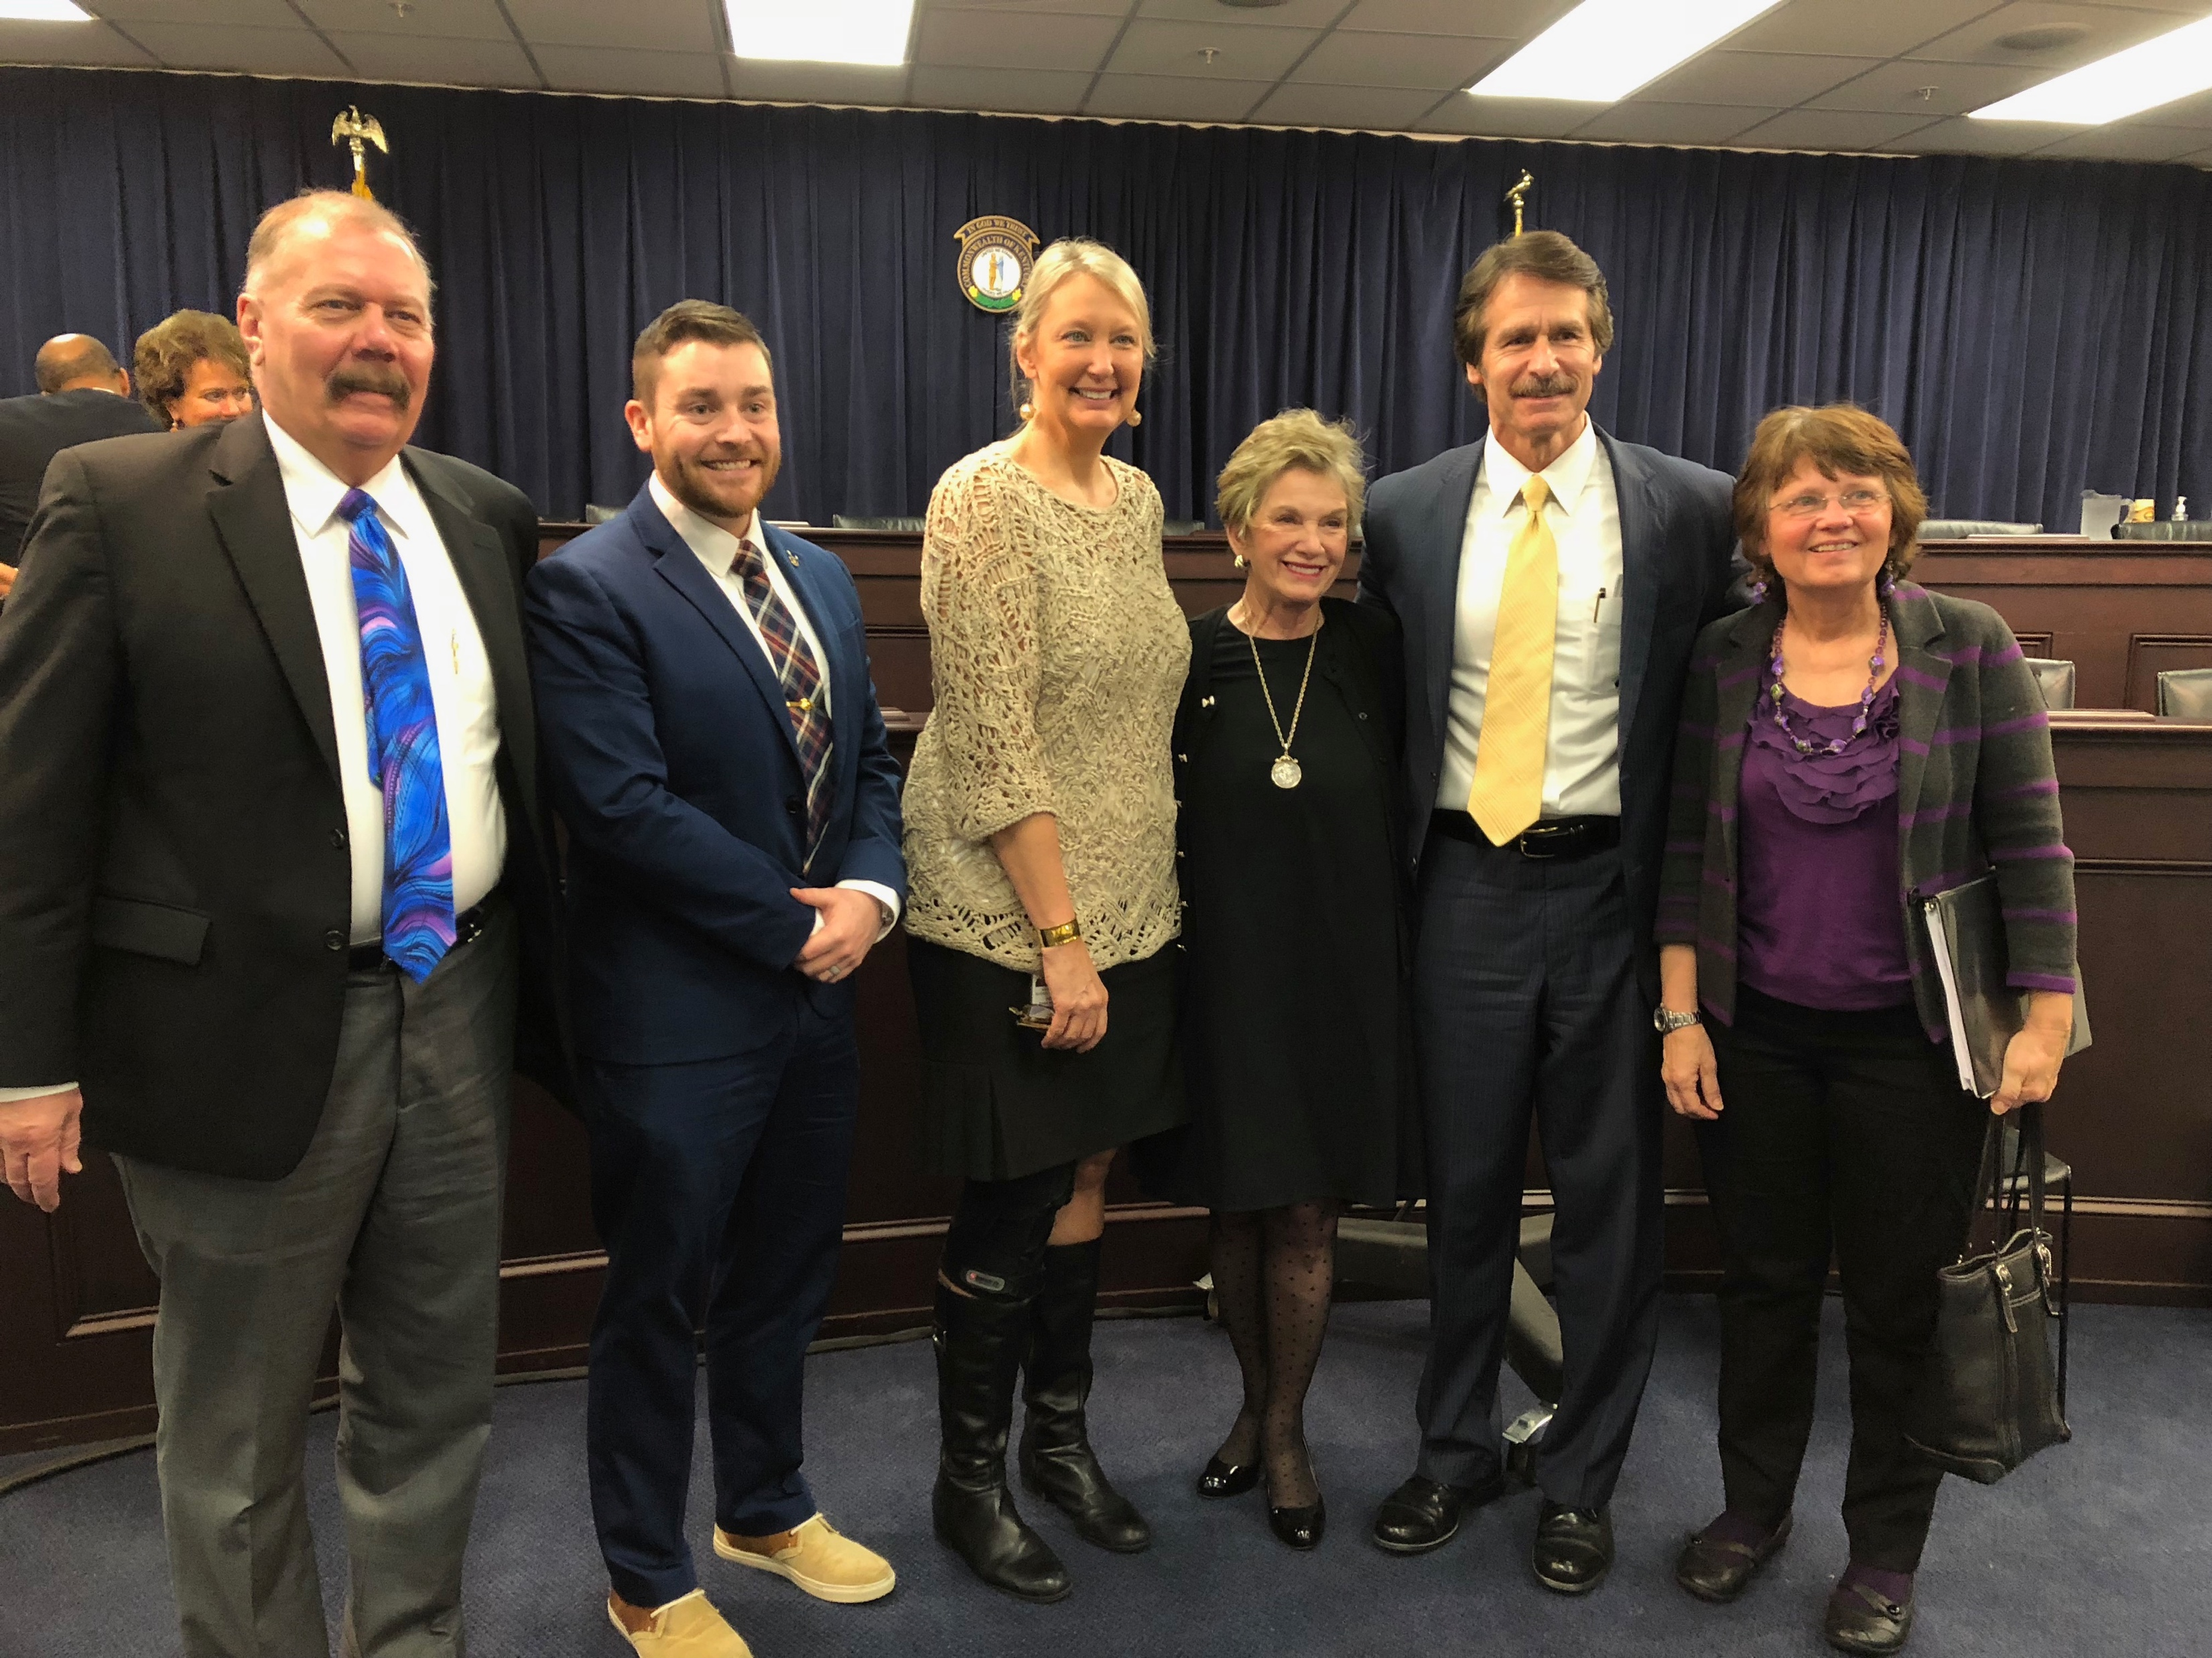
HBOT LEGISLATIVE ACTIONS FOR TBI/PTSD VETERANS
1924 The US Veterans’ Bureau War Risk Insurance Act
(potential state reimbursement submittal with multiple state AGs)
2018 KY HB 64 (KRS 217.930-942) Unanimous Bi-partisan Support
2022 KY House Concurrent Resolution 40 (100% JECVO Supported)
Ten states have HBOT enacted to date: OK, AZ, TX, IN, KY, NC, FL, MD, VA, WY
6 funded over $2.9M to date, $4.6M additional proposed in 2023, $8K by KY Veterans Program Trust Fund in 2021
Senators Hoeven and Cramer (ND), Congressman Murphy, MD (NC), Andy Biggs (AZ) drafting legislation (NONE WITH FEDERAL FUNDING)
2018 HB 64 Enactment
Notes:
Three primary bills supporting treatment and funding
Ten states have HBOT enacted, 6 have funded over $2.9M to date
6 states drafting or discussing HBOT legislation in this current year sessions
WE NEED HBOT AS A STANDARD OF CARE TREATMENT FOR TBI/PTSD VETERANS
WE NEED NATIONAL FUNDING LEGISLATION
WE NEED YOUR HELP IN MIGRATING THIS EFFORT FORWARD BY MIGRATING HCR 40 WITH OUR WASHINGTON CONGRESSIONAL LEGISLATOR TEAM
UNTIL ALL THIS HAPPENS, OUR TBI/PTSD VETERNS NEED STATE FUNDING SUPPORT NOW
Rep Stan Lee and Julie Raque Adams during HB64 enactment (Eric Koleda, Alex Nauret, Eunice Ray, Dr. Linda Jeffrey
KY State VA Commissioner Whitney Allen supported HBOT treatments for TBI/PTSD Veterans as did former Commissioner Ben Adams
6 states drafting/discussing legislation: MO, CO, IA, MI, OH, NV

Slide 18
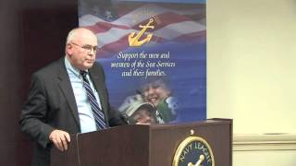
One TBI/PTSD Veterans Story of “Invisible Injury” and Return to Normal With HBOT
Army Brig. General Patt Maney
Blown up with IED in Afghanistan on August 31, 2005
After 20-months at Walter Reed Hospital, “he looked alright, could walk and talk, but did not know how to pump gas into his vehicle”
120 HBOT dive hours later returned to work as District Court Judge (retired), now Florida Legislator, an advocate of HBOT for TBI Veterans
https://treatnow.org/success-stories/video-gallery/veterans
Notes:
Notes on slide

Slide 19
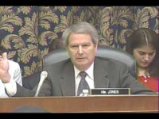
2014 US Congress Testimony of
Marine Commandant Conway and
Navy Admiral Roughhead
Over 877,450 Veterans with “Invisible Wounds”, NO VETERAN SHOULD BE LEFT BEHIND
Notes:
This is a 2:26 minute video of NC Congressman Jones with senior DoD leadership advocating for HBOT since 2014 or over the past 9-years.
Both advocating on the use of HBOT, several Marines received treatment with successful outcomes, we should be providing HBOT for our Veterans if its working

Slide 20
Five Barriers to HBOT for KY TBI/PTSD Veterans
Significant profit reductions for Pharmaceutical industry (VHA 2017 $4.8B spend on pharmaceuticals (GAO.Gov)
VA 20-Yr treatment protocol is focused on “symptom suppression” versus “brain wound healing”
Ignorance of compelling HBOT TBI/PTSD medical evidence by the American medical community as a whole
Total US Congress Veteran members serving have declined from 73% in 1973 to 18% in 2023 (Veteran Priorities Diminished)
The US Congress/VA unwilling to fund TBI/PTSD Veteran clinical trials in HBOT enacted states (2008-2020 average $7.7B VA mental health and research annual budget)
Notes:
$7.7B on mental health and research annually, no change in the suicide rate, but no funds for a treatment with 16-year history demonstrating safety and efficacy with documented results

Slide 21
Summary of Cost Benefits
$40,186 per KY Veteran per year over an estimated 40-year life span, estimated $19.3B for 12,050+ mTBI/PTSD KY Veterans
Medicare Average annual reoccurring cost per mild TBI patient is $25K in 2023, if all 12,050 TBI KY Veterans under CMS estimated $300.4 Million Yr.)
5.5M Caregivers cost $6B annual lost productivity ($1,090 per), $14B voluntary care ($2,545 per) across US
KY 11,311 unemployed Veterans $32.7M state income loss ($2,891 per)
Validated treatment safety and efficacy now in 4 HBOT treatment centers in high density Veteran population centers in Lexington and Louisville
$12.5-15K average one-time HBOT treatment cost per Veteran is 40-60% of the annual reoccurring Medicare cost per TBI Veteran
Notes:
The 20 clinical IRB medical trials healing over 730 Veterans since 2007 with compelling medical evidence is irrefutable
Over 21,000 TBI patients treated, approximately 6,500 Veterans in 140 private clinics across the US since 2005 through TreatNOW.org
The financial economic impact measures provided in the formal report are sound and reasonable
We are asking for reasonable consideration for funding these treatments

Slide 22
HBOT IS THE ISRAELI STANDARD OF CARE FOR TBI/PTSD VETERANS
THE BRAVEST HEARTS DESERVE THE HELP OF THE BRIGHTEST MINDS- HELP US FUND TREATMENT FOR TBI/PTSD KY VETERANS
Eric Koleda, EWK7405@aol.com
502-938-1300 cell
Notes:
Our effort parallels that of such national issues as:
The cigarette manufacturer's efforts to debunk links between smoking and cancer.
Purdue Pharma and the Sackler family using non-addictive opioids for pain and targeting VA Hospitals
The NFL discounting links between concussions and long term affects of CTE.
The CTE controversies and the spreading awareness worldwide about how concussions, untreated or misdiagnosed, can and frequently do lead to dementia/depression/death.
I belong to a national group of pro-bono Veterans across the country working to interrupt the cycle that has taken the lives of over 220,000 service members and counting. We are here asking for your help to break the cycle besieging our TBI/PTSD Veterans all across the country, but especially here in the Commonwealth.
I would like to introduce Jeff Gantt, former US Marine Sniper, medical retired USAF Pararescue Service member, TBI survivor to share his HBOT treatment experience.

