Slide 1
Kentucky Career and Technical Education Junior Reserve Officers’ Training Corps (JROTC) Dr. Beth Hargis Associate Commissioner Tom Thompson Division Director Kentucky Department of Education Office of Career & Technical Education Edwin L. Chilton COL, AG Deputy Commandant, CST ‘23 Commander, 7th Brigade United States Army Cadet Command
Notes:
Dr. Hargis

Slide 2
JROTC 2022-2023 Enrollment
Total Enrollment 8,038
Notes:
Mr. Thompson

Slide 3
Kentucky JROTC Director of Army Instruction (DAI) Pilot Program
Notes:
Col. Chilton

Slide 4
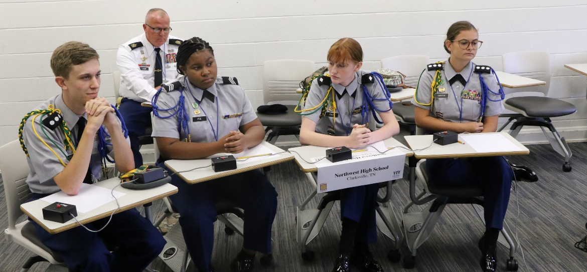
Education and Curriculum Division
Curriculum Framework
JROTC Program for Accreditation (JPA)
Notes:
Col. Chilton

Slide 5
Curriculum Framework as of SY22/23
LET 4
LET 3
LET 2
LET 1
Emerging
Leader
Developing
Leader
Supervising
Leader
Managing
Leader
*Leadership Education Training (LET)
Notes:
Col. Chilton

Slide 6
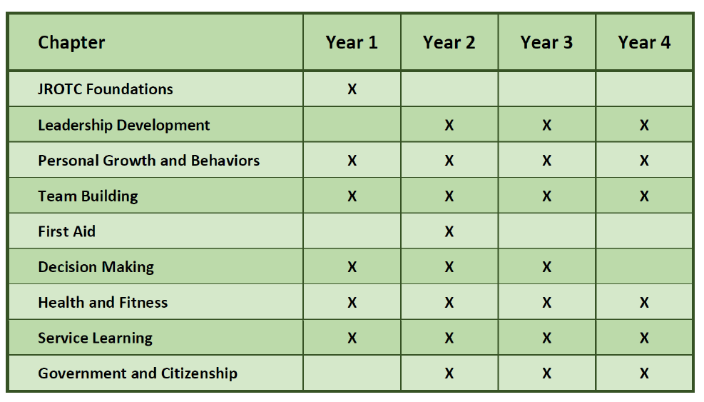
Curriculum Framework
Notes:
Col. Chilton

Slide 7
JROTC Program for Accreditation (JPA)
JROTC Program Assessment:
Each program assessed once every three years to maintain National Accreditation
Assessment includes Academics, Instructor Assessments and Cadet Performance
Recently completed JPA with a score of 368/400!!
Cognia Areas of Key Findings “The foundation of this unique educational program and its instructional design embeds the mission of the Army JROTC.”
JROTC Accreditation Review, May 2022
Notes:
Col. Chilton

Slide 8
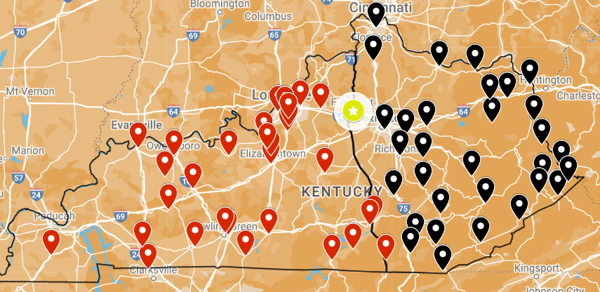
JROTC KY DAI Overview
State DAI Mission Statement: In conjunction with the KY Department of Education and the US Army, provide administrative, logistical and management oversight to Army JROTC programs in KY through organized supervision, approved educational instruction, and integrated systemic processes. Serve as the primary representative and advocate in JROTC matters pertaining to USACC, the state of KY, and the US Army.
State DAI HQs Frankfort, KY
Eastern Kentucky
(30 JROTC programs)
KEY
- State DAI HQs
- Western KY programs
- Eastern KY programs
Western Kentucky
(32 JROTC programs)
Concept:
Provide oversight and command & Control for Kentucky’s 62 stand-alone JROTC programs.
Provide standardization and continuity of curriculum instruction and co-curricular events through coordinated engagements with JROTC programs.
Enhance improved property accountability, cadre management, and Cadet retention & progression for Kentucky JROTC programs.
Notes:
Col. Chilton

Slide 9
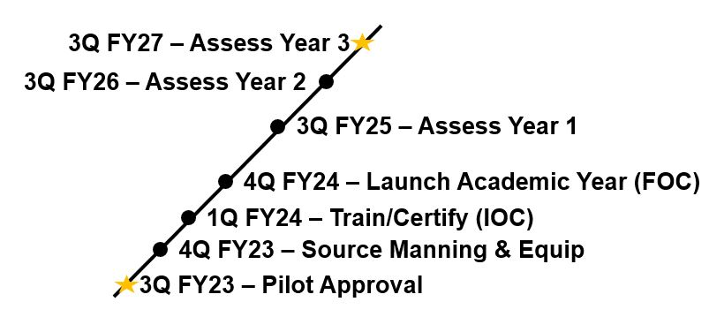
KY JROTC DAI Pilot CONOP
Roles & Responsibilities
Improve oversight, property accountability, logistics, and acquisition processes for KY JROTC programs
Assist schools with recruiting, selecting and retaining the most qualified JROTC Instructor candidates
Serve as the Brigade’s primary POC for JROTC planning and operations, classroom instruction quality and co-curricular event coordination in KY
Assessment
Pre-Pilot: Benchmark Key Performance Indicators (KPIs)
JROTC program accreditation assessment performance
Student enrollment
Co-curricular participation
Instructor vacancies
Misconduct allegations
FLIPLs
3 Year Pilot: Assess KPIs
Decision Point: 3Q, FY27 – Expand, Modify, Terminate
Proposed Cost-Shared Organization
1 x DAI (O5-O6)
1 x SGM (Operations)
1 x ADAI (O4/O5/E8) – Western Region
1 x ADAI (O4/O5/E8) – Eastern Region
1 x Military Property Specialist (MPS)
1 x Military Property Specialist (MPS)
Timeline
Potential Model to Improve JROTC Oversight Nationwide
Notes:
Col. Chilton

Slide 10
Benefits
Consistent JROTC implementation and oversite
High quality instructor recruitment
Enhanced equipment/materials procurement and dissemination
Increased instructor efficacy
Increased instructional rigor and relevance
Increased student achievement
Industry Certification—3 Year Certificate of Training
Increased collaboration between the Office of Career and Technical Education (OCTE) and the Army
Notes:
Mr. Thompson

Slide 11
Funding Need
Per Student Investment $77.61
Fully Staffed Program – Six (6) Full-Time Positions
Base Salaries | FICA | Retirement | Health | Life | Total Salaries
$480,000 | $6,960 | $77,304 | $59,520 | $72 | $623,856
$480,000 | $6,960 | $77,304 | $59,520 | $72 | $623,856
Total Biennium Budget |  |  |  |  | $1,247,712
FY 25
FY26
*The Army Will Provide 50% Cost Sharing on the Military Instructor Pay (MIP) Limited by Rank and Position
Notes:
Dr. Hargis

Slide 12
Notes:
Dr. Hargis

