Slide 2
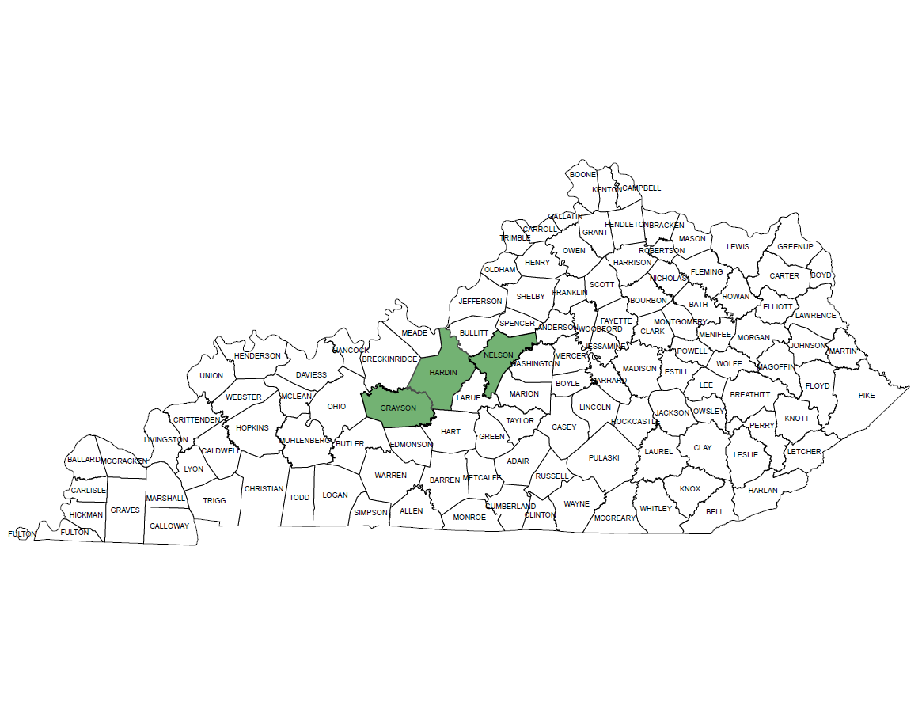
Greater Hardin County Narcotics Task Force 1995
Grayson
Hardin
Nelson

Slide 3
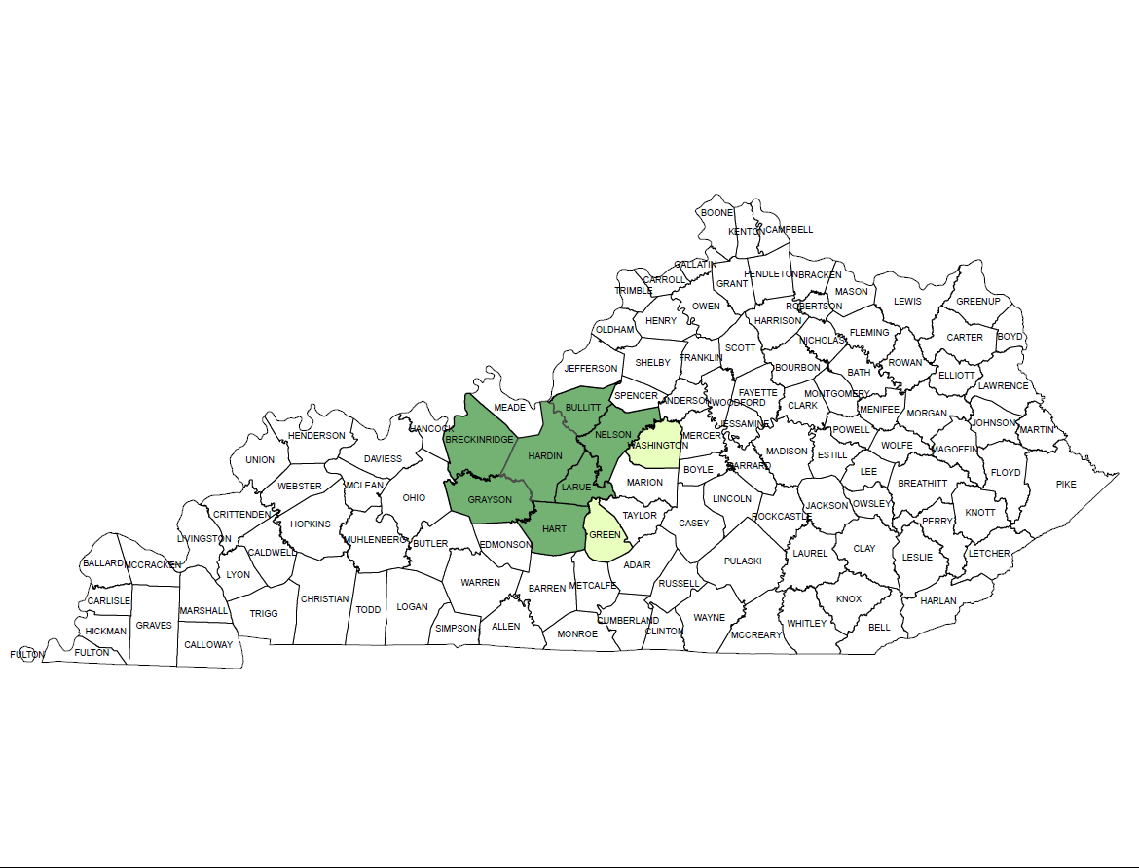
Greater Hardin County Narcotics Task Force 2023
Breckinridge
Bullitt
Grayson
Hardin
Hart
Larue
Nelson
MOUs
Green
Meade (not shown on map)
Washington
**total population served 325,427**

Slide 4
Greater Hardin County Narcotics Task Force Agencies with Agents Assigned
1995
Bardstown Police Dept. (1)
Elizabethtown Police Dept. (1)
Hardin County S.O. (1)
Kentucky State Police (1)
Leitchfield Police Dept. (1)
Nelson County S.O. (1)
Radcliff Police Dept. (1)
7 Agents
2023
Breckinridge County S.O. (1)
Bullitt County S.O. (1)
Elizabethtown Police Dept. (4)
Hart County S.O. (1)
Kentucky State Police (1)
Leitchfield Police Dept. (1)
Nelson County S.O. (2)
Radcliff Police Dept. (2)
Shepherdsville Police Dept. (1)
13 Agents

Slide 5
Kentucky Multi-Jurisdictional Drug Task Forces
Barren River Drug Task Force
Bluegrass Narcotics Drug Task Force
Bowling Green-Warren County Drug Task Force
FADE Drug Task Force
Greater Hardin County Narcotics Task Force
Kentucky State Police
Lake Cumberland Area Drug Task Force
Lexington Metro Police Dept. Narcotics Unit
Northern Kentucky Drug Strike Force
Pennyrile Narcotics Task Force
South Central Kentucky Drug Task Force

Slide 6
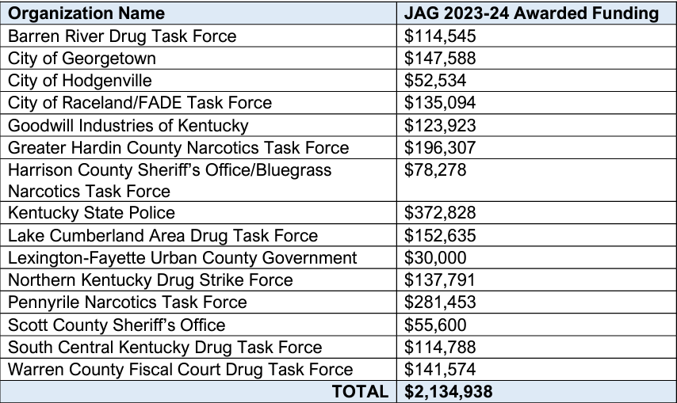
JAG 2023-24 Awarded Funding

Slide 7
2022
*ahidta confidential funds $34,360
*ahidta overtime $110,038
The dollar had an average inflation rate of 2.55% per year between 2000 and 2023, producing a cumulative price increase of 78.30%
according to the Bureau of Labor Statistics consumer price index

Slide 9
No data
Available

Slide 10
**Weights are measured in grams
**Jan – Jun 2023

Slide 11
4610
**Weights are measured in grams
**Jan – Jun 2023

