Slide 1
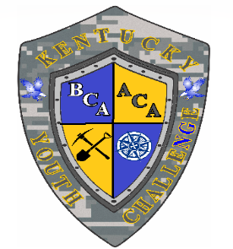
Kentucky National Guard Youth ChalleNGe
In GA23, HB 244 became law designating ChalleNGe Youth Academies as an A5 public school option.
As of July 2023, both campuses are full-service KDE public schools:
Appalachian ChalleNGe Academy, Harlan (established 2012)
Bluegrass ChalleNGe Academy, Fort Knox (established 1999)
To date, the schools have totaled more than 5,512 graduates and issued more than 240 high school diplomas.
The mission of the Kentucky Youth ChalleNGe Program is to intervene in and reclaim the lives of at-risk 15 ½ to 18-year-old students to produce Program graduates with values, skills, education, and self-discipline necessary to succeed as adults.
What is the Kentucky Youth ChalleNGe Program? Is an evidence-based Second Chance Program! Is for students who are failing to progress in traditional school settings! Is for struggling students who demonstrate a desire to change! The results – after 22 weeks the parents, schools, and communities will receive a respectful, vision-filled, on-grade-level student ready to positively contribute to their family, school, community, and the Commonwealth.
How do we accomplish our mission? Through a quasi-military environment utilizing Eight Core Components for getting young men and women academically back on track to return to their parents schools with their classmates: Academic Excellence, Leadership/Followership/Resiliency, Community Service, Job Skills, Responsible Citizenship, Life Coping Skills, Health/Hygiene/Nutrition and Physical Education.
The Academic Excellence Component ensures students have ILPs to get them academically caught up and return to their parent schools with the necessary skills, traits, and resiliency to stay the course to graduate and succeed as young adults.
DOD Cooperative Agreement: 75% DOD Funds / 25% State Funds (NO COST to Parent, Guardian or Parent School)
FY24 Funding: $11.4 M Total -- $8.6 M Federal & $ 2.8M State (State: $670K General Fund / $ 2.3M DMA Restricted Funds)

