Slide 1
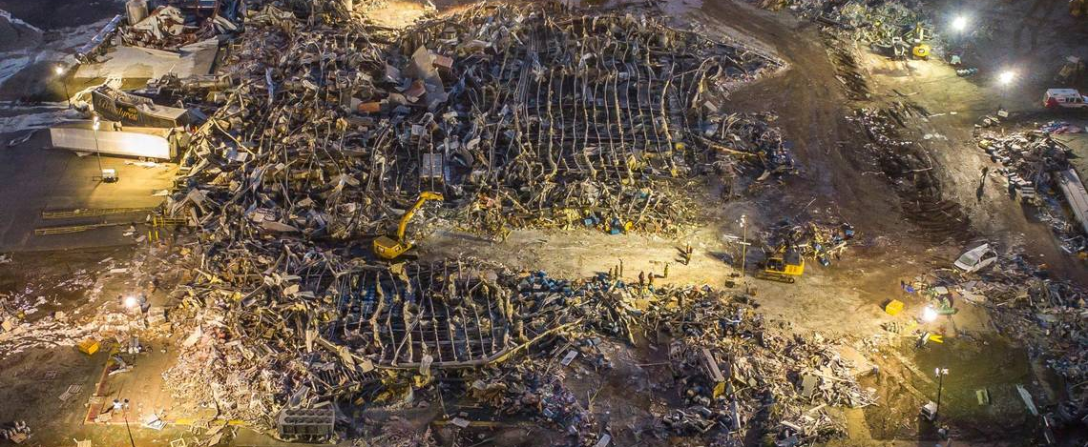
Kentucky Urban Search & Rescue
Proposed Budget FY2025 and FY2026

Slide 2
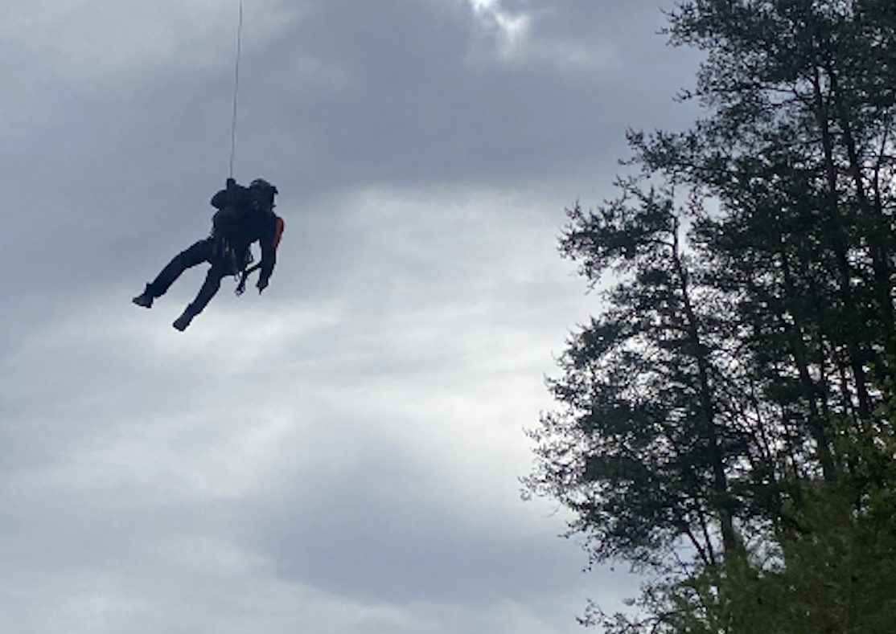
Kentucky Urban Search & Rescue Proposed Budget Request
KY-TF1 Statewide Type 1 Urban Search & Rescue. Two logistical and training locations in the central/east and western parts of the state.
KY-HART- Helicopter Aquatic Rescue Team / Hoist Capabilities with pre-established teams with KYNG and KSP
Rescue Aid Program- This is to improve the current funding to the rescue teams that fall under KRS 39F Training/Equipment

Slide 3
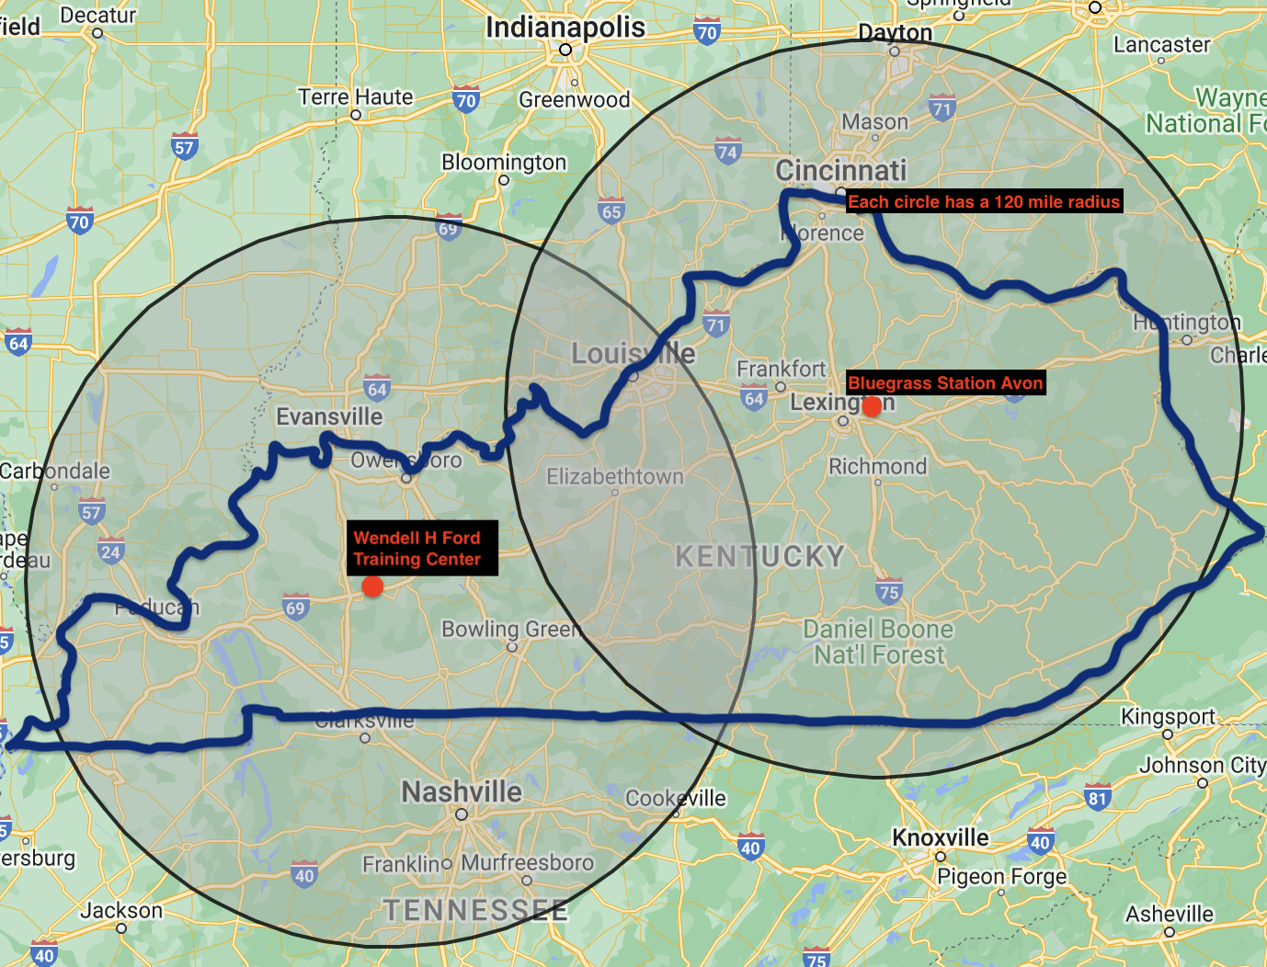
Kentucky Task Force 1 State Coverage
Two locations for KY-TF1
Bluegrass Station Avon
Wendell H Ford Regional Training Center
Both locations on DMA property
Provides approximately 98% coverage to the state within 2 hours after deployment

Slide 4
Initial Budget Ask
FY 2025 Total Budget ask $8,335,000
KY-TF1 $7,590,000
Rescue Aid Program $ 500,000
HART $ 245,000
FY 2026 Total Budget ask $7,840,000
KY-TF1 $7,160,000
Rescue Aid Program $500,000
HART $180,000
Annual Sustainment Cost: $2,750,000

Slide 5
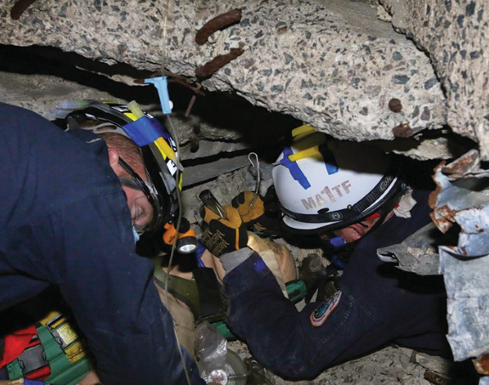
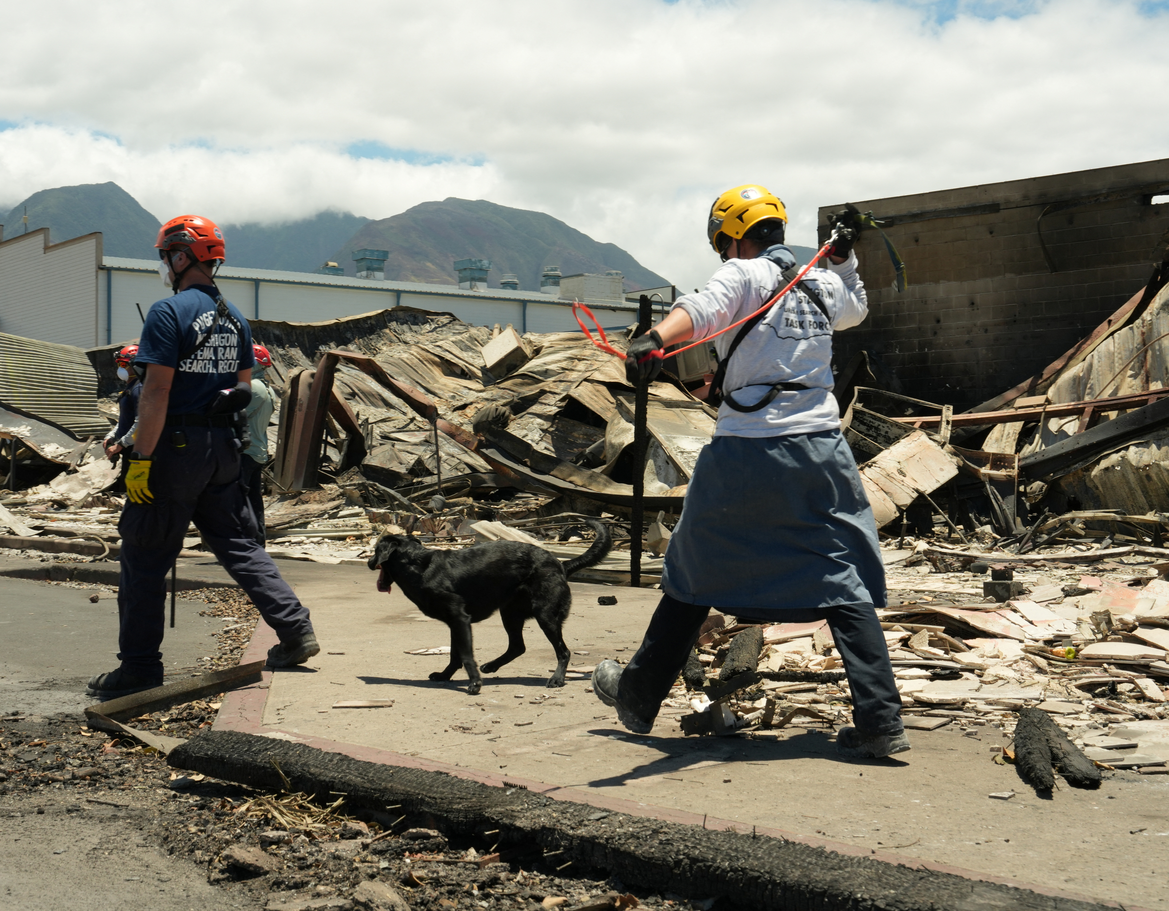
Type 1 US&R Team Capabilities
Is a 70-person multi-disciplined resource which conducts search and rescue response efforts for:
All hazards, including locating, accessing
Medically stabilizing
Extricating victims from light through heavy frame construction damaged structures.
Specialized personnel include rescue, canine search, medical doctors & paramedics, hazardous materials (hazmat), technical search, structural engineers and communications.
Continuous 24-hour operations.
Self-sustaining for 72 hours and deployable for up to 14 days.
Additional capabilities include wide-area search, floodwater/Swiftwater operations, and US&R operations in contaminated environments events.

