Slide 1
Interim Joint Committee on Veterans, Military Affairs, and Public Protection October 25, 2023
Kentucky Commission on Military Affairs
2024 Legislative Agenda
Steven Bullard, Brigadier General (USAF Ret.), Executive Director

Slide 2
2024 KCMA Legislative Agenda
Reintroduction of Omnibus House Bill 63 (Rep. Steve Bratcher)
Passed House unanimously; left off Consent and failed to get vote on final day
Military Interstate Children’s Compact Commission (MIC3) (KRS 156.730/735)
Add National Guard and Reserve families to state protection
Technical Correction on federal statute citation
Add U.S. Space Force to Kentucky military components definition (KRS 40.400)
Update the new name of the U.S. Army Reserve Aviation Command (KRS 154.12-203)
Kentucky Purple Star Schools enabling legislation (Rep. Chris Fugate)
Codifies existing program to credit participating K-12 schools
No cost legislation; admin burden easily absorbed by schools
Department of Defense Priority Military Spouse Occupational Licensing
Emergency Medical Services Compact (Rep. Mark Hart)
Social Services Compact (Rep. Ken Fleming, Rep. Lisa Willner)
Massage Therapy Compact (Rep. D.J. Johnson)
Em

Slide 3
Questions?

Slide 4
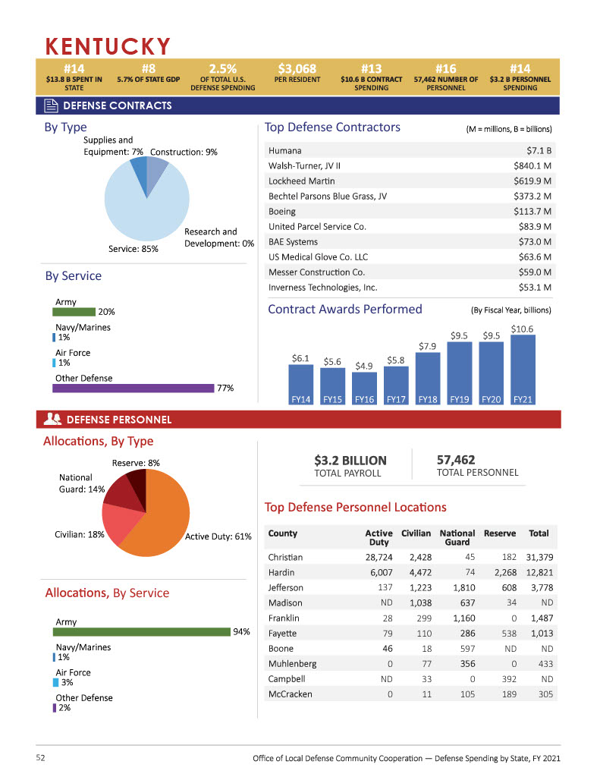
Military Presence in Kentucky

Slide 5
Military Presence in Kentucky

Slide 6
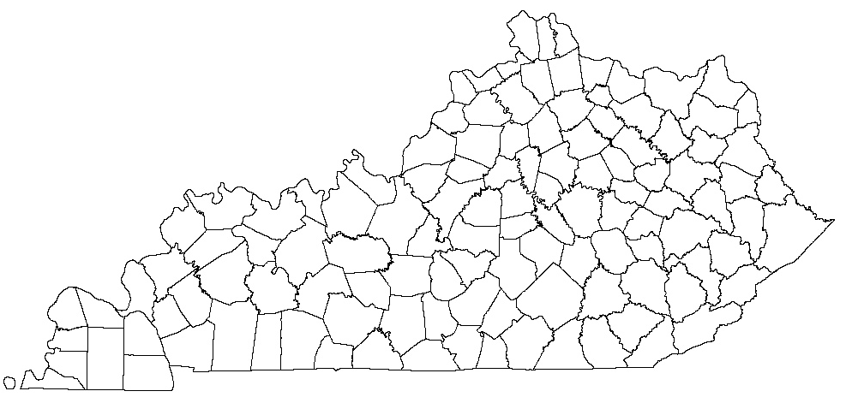
Military Presence in Kentucky
Bluegrass Station (Lexington)
Special Forces Support Activity
Blue Grass Army Depot (Richmond)
Army Logistics Command
Chemical Weapons Demilitarization
Coast Guard Sector Ohio Valley (Louisville)
Navy Reserve Center (Louisville)
Army Corps of Engineers (Louisville)
Fort Knox (Hopkinsville)
Army Human Resources Command
Army Recruiting Command
Army Cadet Command
Fifth (V) Corps
84th Training Command
Army Reserve Aviation Command
First Army Division East
100th Division (Leader Development) USAR
Army Adjutant General Corps
1st Theater Sustainment Command
Coast Guard Sector Ohio Valley (Paducah)
Fort Campbell (Hopkinsville)
101st Airborne Division (Air Assault)
160th Special Operations Aviation Regiment
5th Special Forces Group

Slide 7
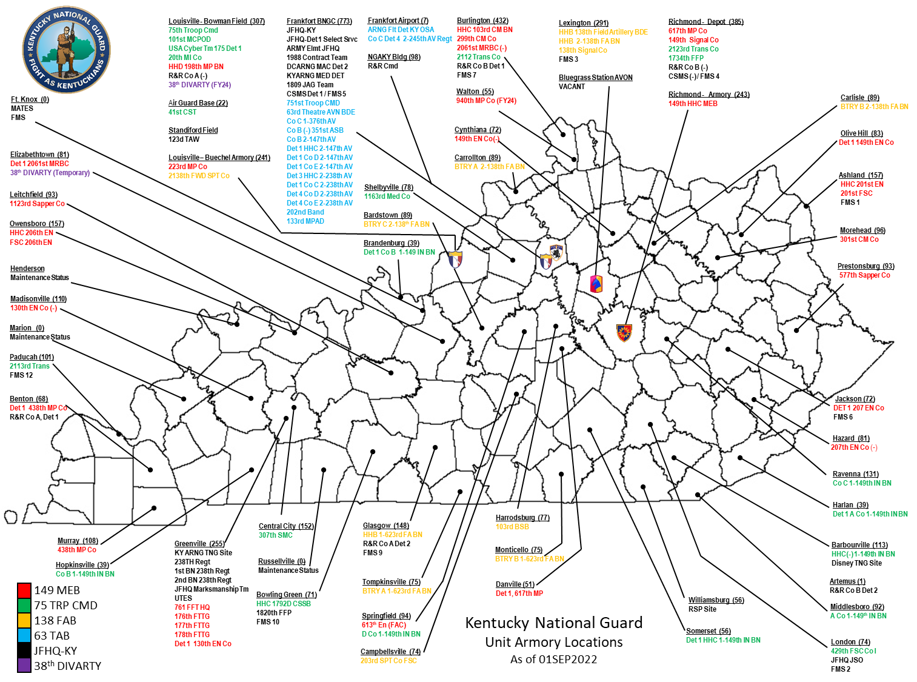

Slide 8
Supporting DOD Priorities
Association of Defense Communities
Similar mission to KCMA on the national level
https://defensecommunities.org/
Chair, ADC State Advisor Council
State Commissioner, Military Children’s Compact
Chair, Kentucky Purple Star Schools Advisory Board
Outstanding Community Partners:
(Fort) Campbell Strong Defense Alliance
(Fort) Knox Regional Defense Alliance
Kentucky Chemical Demilitarization Citizens’ Advisory Commission (CAC)
Chemical Destruction Community Advisory Board
Chambers of Commerce, Area Development Districts, and more …

Slide 9
Supporting DOD Priorities
DOD Defense State Liaison Office (DSLO) Partnership
KY considered a best practice legislative state
Excellent working relationship with DSLO team and DOD Deputy Assistant Secretary of Defense for Military Community and Family Policy Patricia Barron
Military Child Care in Your Neighborhood – PLUS
Ninth state in nation to be DOD certified – January 2023
Up to $1,500 in monthly child care reimbursement for actively serving military families
Provider must be certified by Cabinet for Health and Family Services
Kentucky is a member of eight DOD priority occupational licensing compacts that have a large impact on military spouses

Slide 10
Military Spouse Employment
DOD Military Spouse priority employment compacts (13 total)
• Interstate Teacher Mobility Compact (Member, 2023)
• Cosmetology Licensure Compact (Member, 2023)
• Licensed Professional Counseling Compact (Member, 2022)
• Occupational Therapy Licensure Compact (Member, 2022)
• Audiology/Speech-Language Pathology Interstate Compact (Member, 2021)
• Psychology Interjurisdictional Compact (Member, 2021)
• Nurse Licensure Compact (Member, 2017)
• Physical Therapy Licensure Compact (Member, 2017)
• Emergency Medical Services (EMS) Licensure Compact
• Advanced Practice Registered Nurse Compact
• Dental and Dental Hygienist Compact (new 2023)
• Interstate Massage Therapy Compact (new 2023)
• Physician Associates Compact (new 2023)

Slide 11
Military Spouse Employment
DOD military spouse and installation websites
Fort Campbell Resources
Garrison website: https://home.army.mil/campbell/
Spouse Employment Center: https://home.army.mil/campbell/index.php/sec
Christian County Chamber Military Spouse Working Group
Fort Knox Resources
Garrison website: https://home.army.mil/knox/
The Knox Regional Development Alliance (KRDA) spouse employment website
Nationally recognized by Association of Defense Communities
https://Greaterfortknox.com/jobs
Partnership with Ft Knox, KY Career Center-Lincoln Trail,
Lincoln Trail Workforce Development Board

Slide 12
Kentucky COMPETES
Collaborative Opportunities to Modernize Practices, Engagement, Teams, and the Economy for Success
Comprehensive, systematic investigation to identify modernization and diversification efforts among Kentucky’s defense industrial base (DIB) in manufacturing, aerospace and distribution/logistics
DOD Diversification & Modernization Program for Economic Adjustment Assistance for State Governments
18-month grant period of performance is from September 1, 2023, through February 28, 2025
University of Louisville Research Foundation subrecipient
$1.7M; 90 percent federal funding through the DOD Office of Local Defense Community Cooperation (OLDCC)

