Slide 1
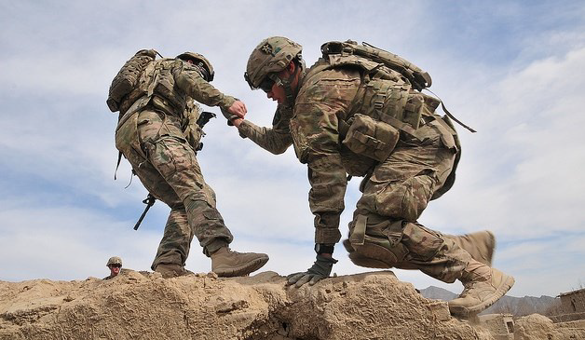
Kentucky National Guard Suicide Prevention
MAJ Tim Olsen, LCSW
Deputy State Surgeon, Director of Psychological Health, KYARNG

Slide 2
Suicide Rates (per 100,00)*
Army National Guard (2021) | 27.2
Army Active Component (2021) | 34
Veteran Population (2020) | 26.6
General U.S. Population (2020) | 16.9
*Age and sex adjusted data shown
Notes:
Data from : Defense Suicide Prevention Office, VA- Age and sex adjusted data shown.

Slide 3
Challenges
Stigma: Greatest enemy in fight against suicide
Guard programs are focused on retaining service members and optimizing health
Common Guard Suicide Risk Factors (CY21)
Relationship challenges/ distress (42%)
Administrative/legal stressors (21%)
Work-related stressors (12%)
Financial distress (10%)
Firearms access (76%+)
Mental health diagnoses (33%)
*National Guard remains understudied population
Mixed access to healthcare
Not all service members use or have access to Tricare
Not all Guard members meet “Veteran” criteria for certain VA resources
Balancing civilian career with military service limits time/funds available for care
Policy and funding limit scope of internal services provided
Unable to offer full mental health treatment internally

Slide 4
KYNG Past and Current Efforts
Increases in internal program development:
Behavioral Health: 6 Full-time and 5 part-time uniformed clinicians
250+ service members actively engaged (15-20% addressing specific suicide risk factors)
Integrated Primary Prevention: Evidenced-based upstream prevention with and program evaluations focused on reducing harmful behaviors.
Military and Family Services:
R3SP: Resilience, Risk Reduction, Suicide Prevention education programs
H2F (Holistic Health and Fitness): Fitness, nutrition, performance, and health education
Soldier and Family Readiness Specialists: 11 staff aid in resource connection, budget counseling, family support programs
Chaplains: 3 Full-time and 19 part-time ministry teams available. Confidential counseling, faith-based support, relationship skills training.
ESGR: Employment support and protection
Community Partnerships:
Governor’s Challenge, VA, Vet Center, KDVA, Department of Behavioral Health (Operation Immersion), research collaboration with UK ($1.1 million grant in 2020)

Slide 5
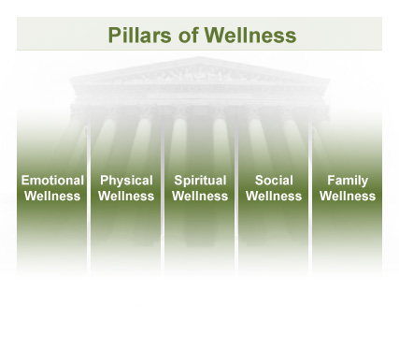
Way Forward: Comprehensive Wellness Early and integrated prevention and intervention
Physical
Family/Social
Occupational
Emotional
Spiritual
Financial
Opportunities:
Suicide prevention as a component of wellness leading to health and retention
Data on efficacy drive policy and evidence-based improvements
Advocacy for increased prevention and clinical intervention staff

