Slide 1
Military Hiring Academy
Ashli Watts
President & CEO,
Kentucky Chamber
of Commerce
Zach Morgan
Project Manager,
Kentucky Chamber Foundation’s
Workforce Center

Slide 2
Initiatives of the Kentucky Chamber
Foundation’s Workforce Center
Key Purpose: address Kentucky’s workforce crisis
Foundation’s Workforce Center programs
Talent Pipeline Management®
Workforce Recovery
Bus to Business®
May 2023: Meeting with Fort Campbell and Christian County stakeholders

Slide 3
The Model: Fair Chance Academy
Provided by the Foundation’s Workforce Center
Process:
Business leaders complete three days of training, gaining knowledge and resources to hire, train, and retain talent from fair chance populations, or individuals in recovery or reentering society
Follow-up processes are in place to ensure businesses are supported and successful
Results:
Certified 80 Kentucky businesses in fair chance business practices, impacting over 50,000 employees across the state.

Slide 4
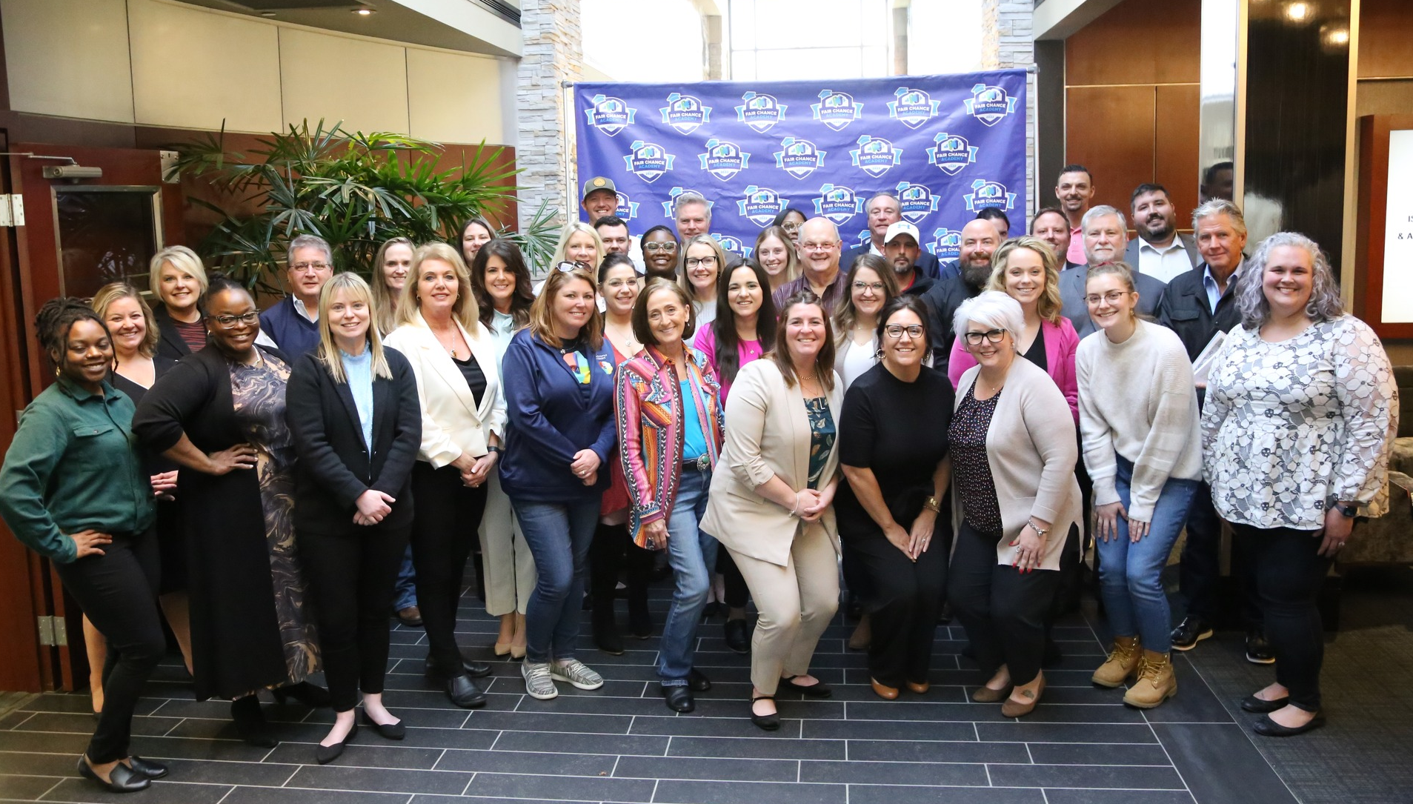
Graduate Testimony:
“I feel so fortunate to have attended the Academy. Prior to this, I felt like I was alone, and this task ahead of me was all on me to do by myself. Now, I feel like I have tremendous resources that I have never had before. It gives me even more confidence that we’re going to be successful in doing something that no one else has ever done. In my industry, no one has ever tried to do this, and now I have a path forward.”
- The Jordan Center CEO David McKenzie

Slide 5
Introducing: Military Hiring Academy
Provided by the Foundation’s Workforce Center
Business Leaders Will:
Attend one day of training to learn about
Service members returning to civilian life, veterans, and military spouses
Best practices for finding, hiring, and retaining this talent pool
Connect with support resources
Federal, state, and non-profit
Complete the Society for Human Resource Management “Veterans at Work” certificate
Attend a military installation job fair
Fort Campbell, Fort Knox, Boone Center

Slide 6
Stay Tuned for More Information
DISCOVER military populations:
Service members returning to civilian life
Veterans
Military spouses
LEARN how to:
Find, hire, and retain military talent
NETWORK with employer supports:
Federal, state, and non-profit
Learn More: Contact Zach Morgan at zmorgan@kychamber.com

