Slide 1
Blockchain Technology Working Group
Annual Report
Presented to Senate Standing Committee on Natural Resources & Energy
January 13, 2021
David Carter, CISO (COT)
Dr. Brian Houillion, Univ of the Cumberlands

Slide 2
Working Group Overview
Nine (9) statutory members defined in KRS 42.747 & subject matter experts appointed by the core team.
Developing an actionable definition of Blockchain aligned to the mission of the working group.
Limiting the scope to key impactful Blockchain use-cases for Kentucky.
Initial research to lay the critical foundation for the future direction of the group.
Report to be submitted annually on December 1st of each year.

Slide 3
What is Blockchain?
Decentralized Digital Ledger
Industry Standard High Encryption
Transactional Trust and Nonrepudiation
Low Latency Peer to Peer Transactions
Public and Private Options

Slide 4
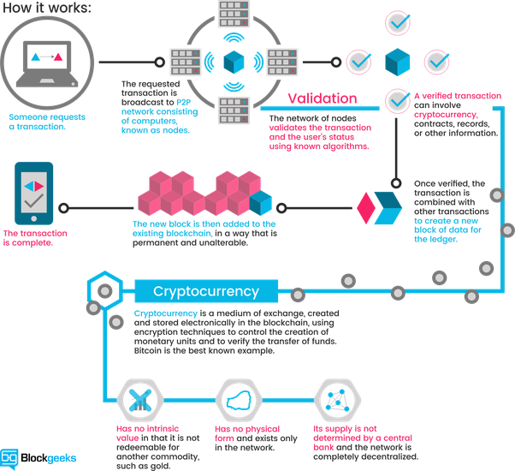

Slide 5
Public Utilities Use-Case
Financial Transactions
Retail consumers and utilities can benefit from timely and secure payments.
Energy Generation and Distribution
Highly regulated by Federal and regional organizations.
Renewable Energy
Blockchain “Renewable Energy Credit” tokens.
One platform to track calculations of carbon emissions.
Infrastructure Management
Needs far more detailed tracking Blockchain can offer.
High Levels of security for complex service delivery infrastructures.
Automated metering infrastructure can integrate Blockchain to gain real-time usage data.

Slide 6
Logistics and Supply Chain Use-Case
Perfect geographical location to serve as a logistics hub
Within 600 miles of 54% of US population
CVG airport is the 8th largest cargo hub (Amazon + DHL)
Blockchain can provide:
Advanced communication flows between untrusted parties
Paired with other technologies, increased data access and reliability
Reduces costly errors, decreases delivery time, lowers overall costs

Slide 7
Healthcare Use-Cases
Data Analytics
Ability to track outbreaks across diverse locations.
Aid in identification of outbreak hot spots, speed response times for containment and share critical data to track community spread of disease.
Rec. 1.9: Explore Blockchain grant opportunities with federal entities such as the CDC.
Medical Research
The Commonwealth is home to leading healthcare research institutions.
Blockchain opportunities can act as a draw Healthcare business within the state.
Controlled Substances
Add efficiency and security to eKasper with National data sharing capabilities
Rec. 1.10: Our group should consult with the Cabinet for Health and Family Services to explore ways to enhance the eKasper program.

Slide 8
Finance Use-Case: Cryptocurrency
Empowers business and trade with highly secure and attestable financial transactions
Removes need for currency conversion and clearing houses, increasing speed and efficiency
Bringing about the “Digital Dollar”
Recommendation 1.0: Explore the benefits of creating a new cryptocurrency to support a closed blockchain system.

Slide 9
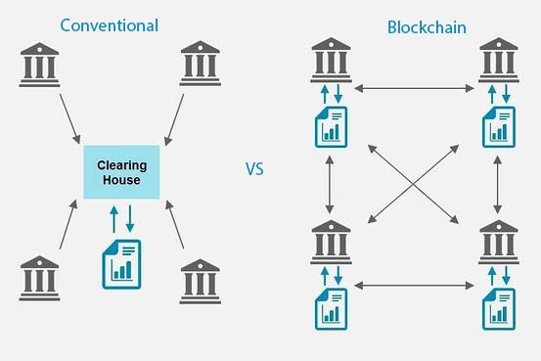
Finance Use-Case: Banking
Wyoming House Bill 74 (2019)
These “institutions are banks that receive deposits and conduct other incidental activities, including fiduciary asset management, custody and related activities.”
Rec. 1.1: Pursue legislation creating charters for special purpose depository institutions during the 2021 Legislative season.

Slide 10
Finance Use-Case: Payment Systems
Crypto will change the “how” of transactions
Intermediaries take their “cut” of transactions, increasing the cost of business
Ohio using Bitcoin to pay state taxes (2018)
Rec. 1.2: Our group should continue to monitor and advise the Treasurer’s Office on Alternative Currency to advance Blockchain adoption.

Slide 11
Finance Use-Case: Public Finance
Current Municipal Bonds:
Too expensive for small investors
Wall Street takes all the profits
Blockchain-based bonds:
Fractionalize each bond
Increased wealth within the community
Ex: Berkeley Fire Truck “minibonds”
Rec. 1.3: Investigate the use of blockchain-based municipal bonds to fund future projects and increase the opportunity to build wealth in communities.

Slide 12
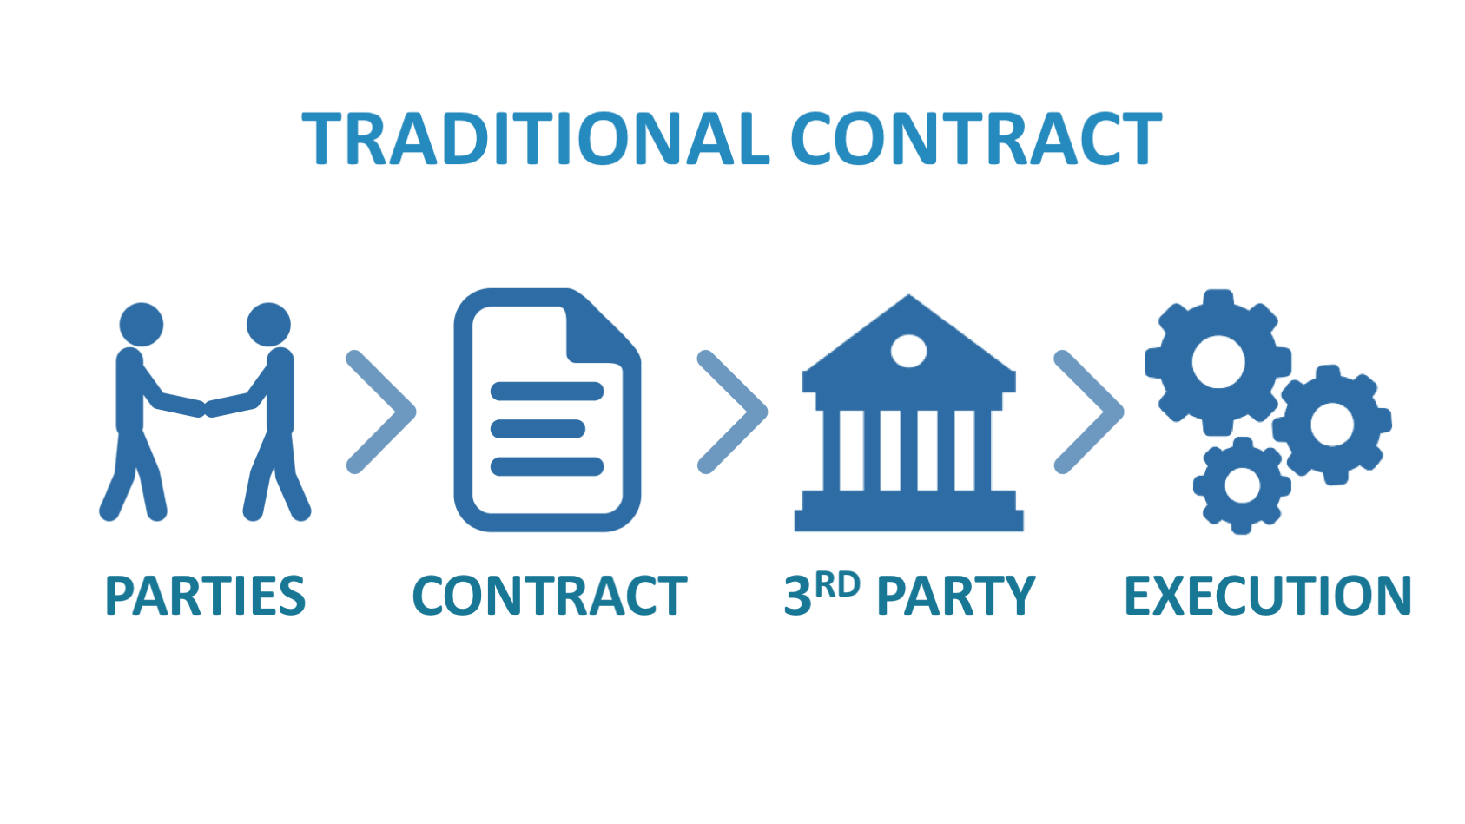
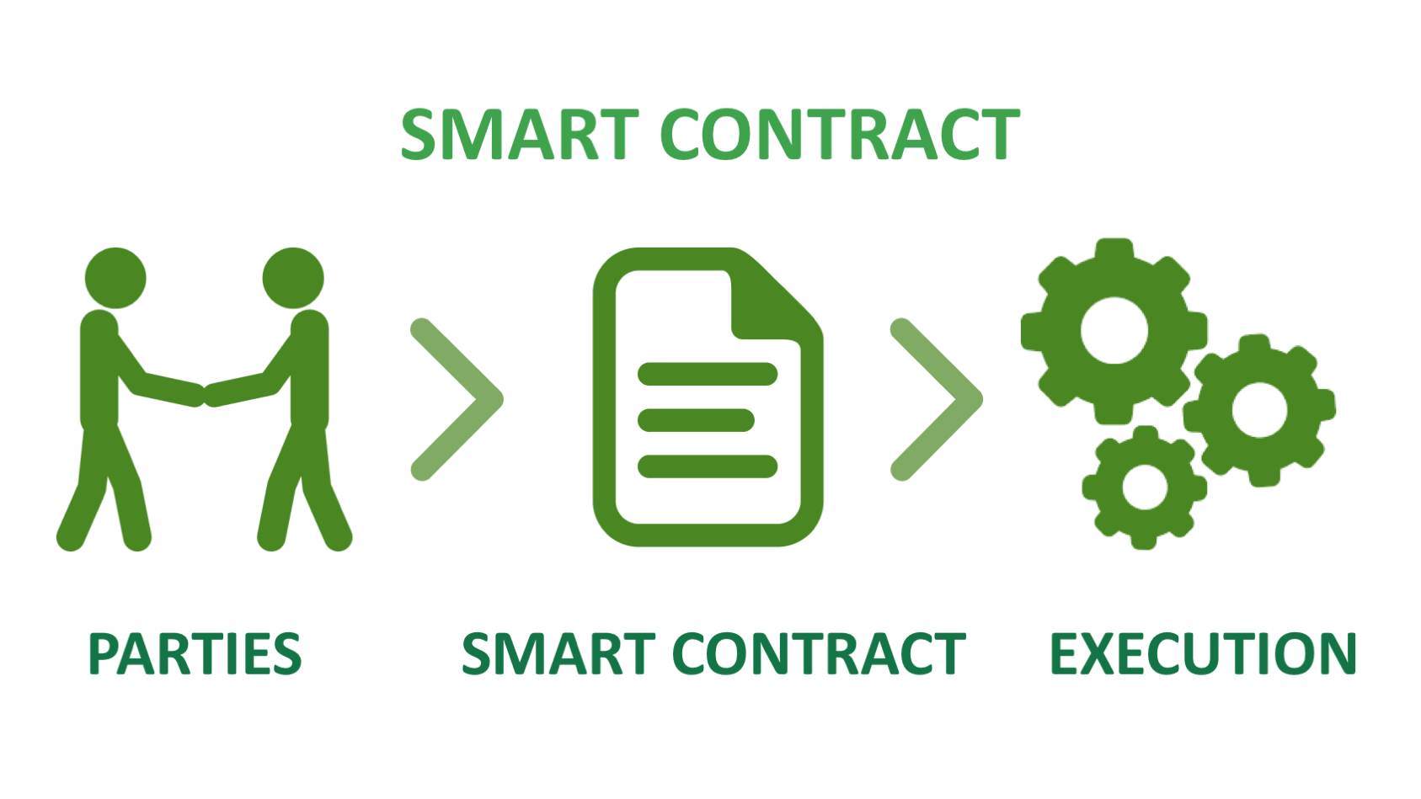
Records Management: Contracts
Physical signatures → Digital Signatures (DocuSign)
Lack of security and trust in the signer
Blockchain Smart Contracts:
Validation of the signer using private keys
Increased security with decentralization
Automate the process

Slide 13
Records Management: Accounting / Auditing
Double-Entry Accounting
No transparency to outside parties
Managed by a single entity that can commit fraud
“Cooking the books”
Time-consuming and costly audits
Blockchain’s “Triple-Entry Accounting” system
Transparent and immutable transaction trail
Interlinking all transactions together
Unable to be corrupted
No need for audits
Rec. 1.4: The Kentucky Auditor’s Office should explore the benefits of implementing
blockchain technology in their auditing processes, especially those that occur annually.

Slide 14
Records Management: Legal Records and Docs
Locally-held records by clerks:
Vulnerable to concentrated cyber-attacks
Loss of information from shut down or corruption of server
Shared through direct database access or email
Decentralized Blockchain Records:
Inability to tamper with records
Multiple copies to prevent loss of information
Shared source of truth with access to only necessary information
Rec. 1.5: Amend legislation to include a member of the Blockchain Working Group on the Task Force on Electronic Recording of Official Documents by County Clerks.
Rec. 1.6: Kentucky Secretary of State should research benefits of blockchain in issuance and/or management of elections and business filings to ensure integrity and accuracy.
Rec. 1.7: Research opportunities to benefit from Blockchain records and document management systems in the state government.

Slide 15
Records Management: Licensing
Interstate Compacts:
Only applies to states that are signed on
Managed by one state in a central location
May create conflicting data and have vulnerability to hacking
Blockchain Record system:
Allows all states access to the system
Less corruption and theft
Access to all licensees that wish to practice in the state
Ability to share information with other states immediately when needed
Rec. 1.8: Department for Professional Licensing, the PPC, and COT should research the benefit of incorporating Blockchain into Kentucky’s licensing systems.

Slide 16
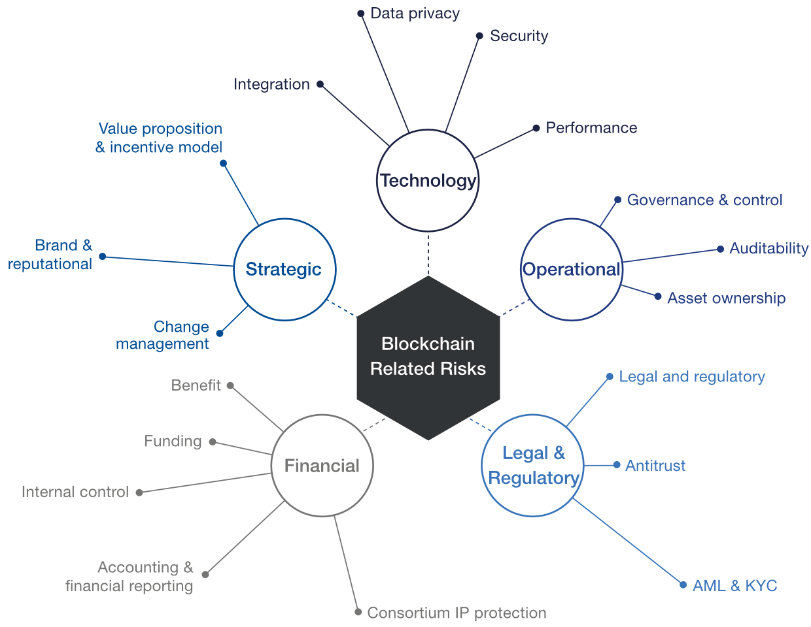
Blockchain Risks
Cost
Lack of Standardization
Lack of Centralization
Regulation
Garbage in, garbage out
Over exuberance
Environmental impacts
Increased cyber threats

Slide 17
Legislative Analysis (2015 - 2020)
Primary legislation – create task forces, working groups, committees, etc.
Secondary legislation – define or identify blockchain transactions within state legislation to “clear the way” for blockchain implementation and utilization in both corporate and governmental operations
Federal and state governments have/are creating comprehensive blockchain acts
Rec. 2.0: Kentucky should explore creating a State Blockchain Coordinator position.
Rec. 3.0: Kentucky should review the legislation adopted or enacted in other states.

Slide 18
Thank you! Questions?

