Slide 1
House Bill 195:
Advanced Notification
Senate Committee on Natural Resources & Energy
February 23, 2022

Slide 2
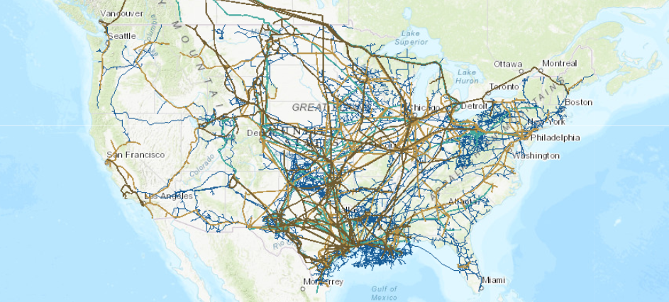
Liquid Pipelines Across the United States

Slide 3
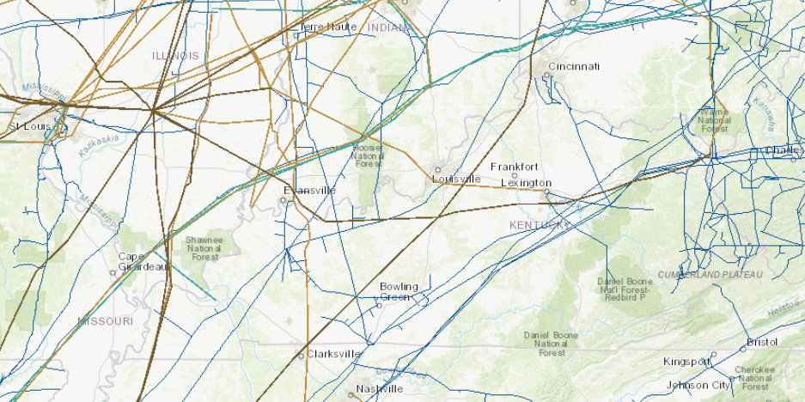
Liquid Pipelines Across Kentucky

Slide 4
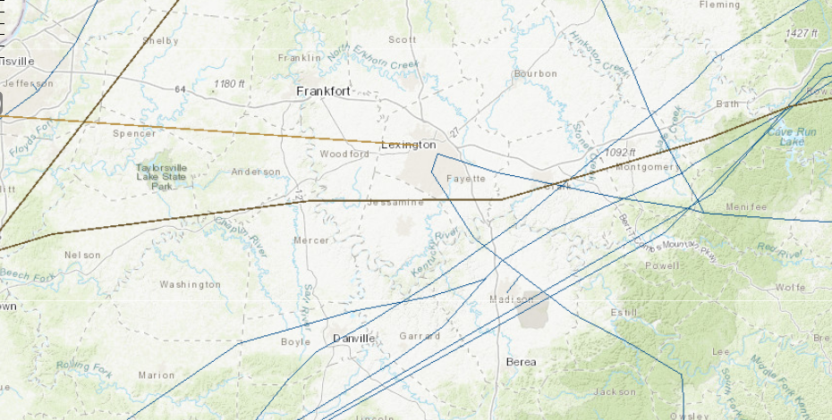
Liquid Pipelines Near Central Kentucky

Slide 5
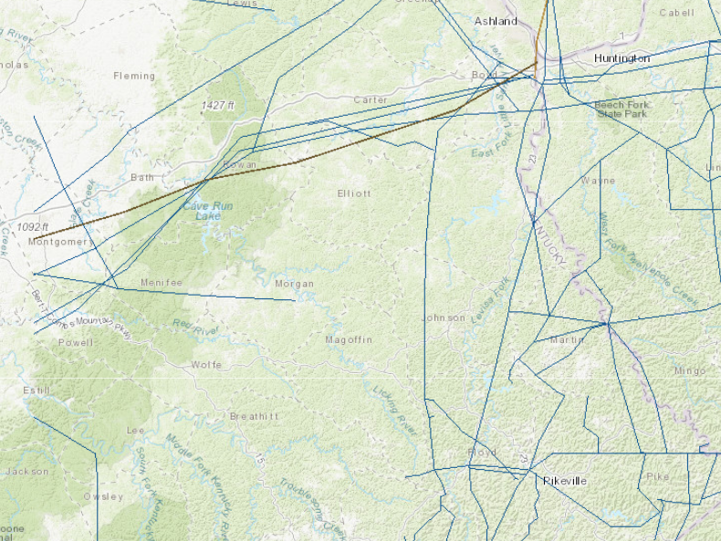
Liquid Pipelines In
Eastern Kentucky

Slide 6
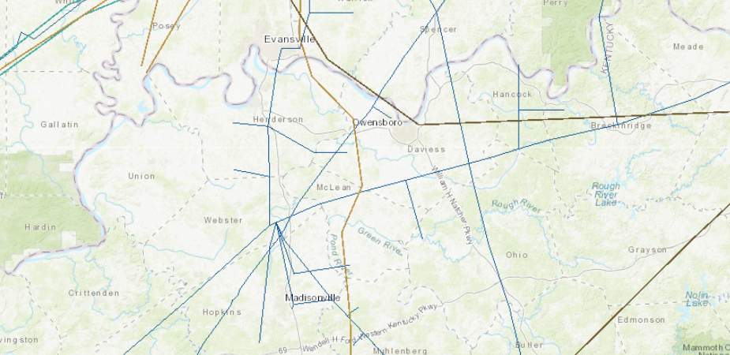
Liquid Pipelines Near Owensboro

