Slide 1
Senate Standing Committee
Natural Resources & Energy
February 8, 2023
Charles Bush, Deputy Commissioner,
Department for Facilities & Support Services
Brian Thomas, General Counsel,
Finance & Administration Cabinet

Slide 2
SB 217, which became effective in April 2022, included a 54,000-acre Conservation Easement to be delivered by the Finance and Administration Cabinet in 18 months.
Our process:
Appraisals, 2 plus a review appraisal
Title Examination with a policy issued in the name of the Commonwealth
Environmental Review
(For this project) Baseline Management Report
Land Contract
Survey of the property
Deed preparation
Closing and filing of deeds

Slide 3
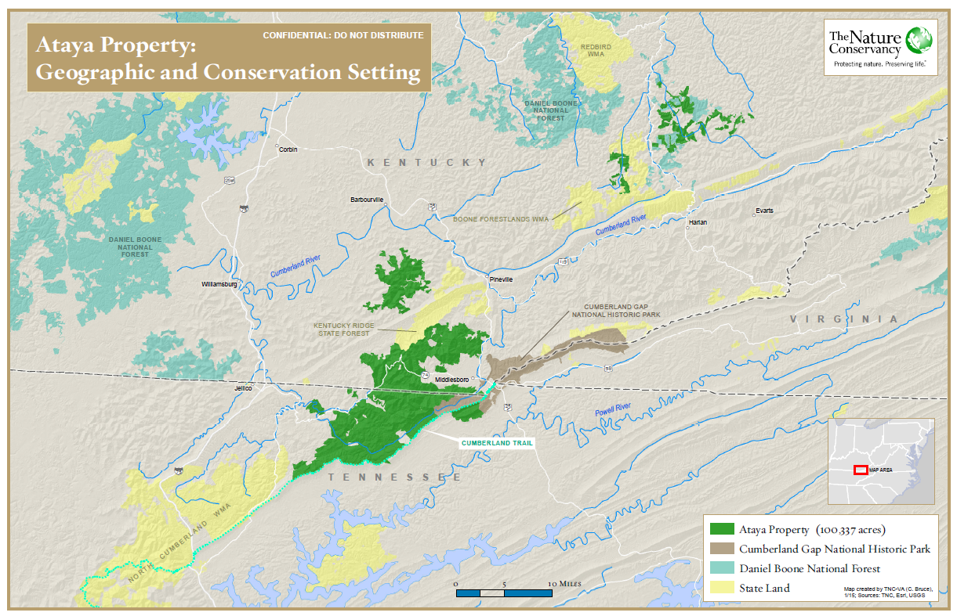
Map used with the permission of The Nature Conservancy

Slide 4
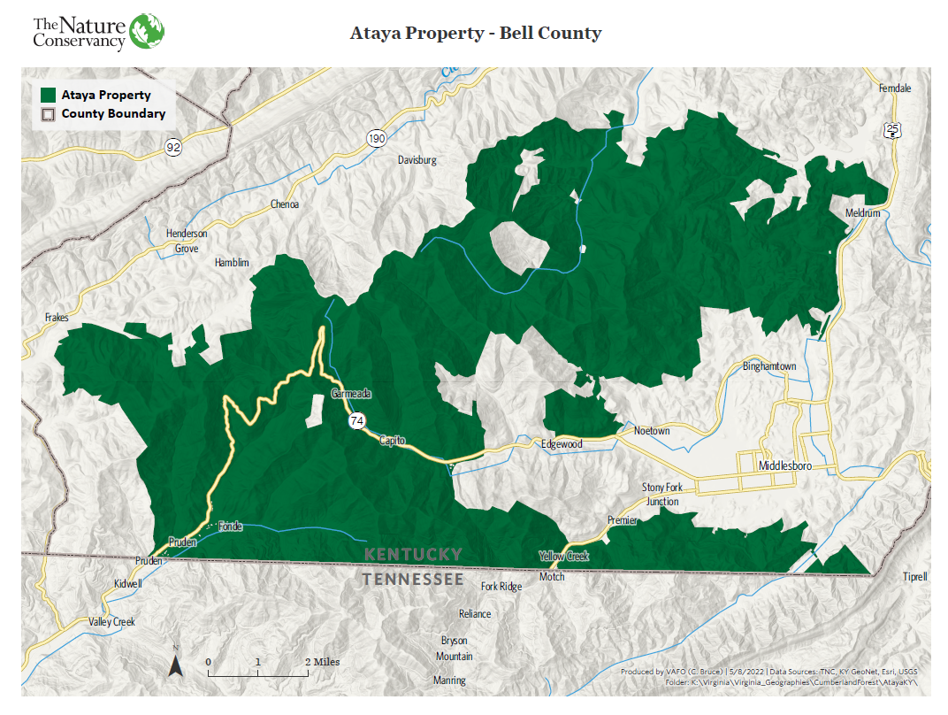
Map used with the permission of The Nature Conservancy

Slide 5
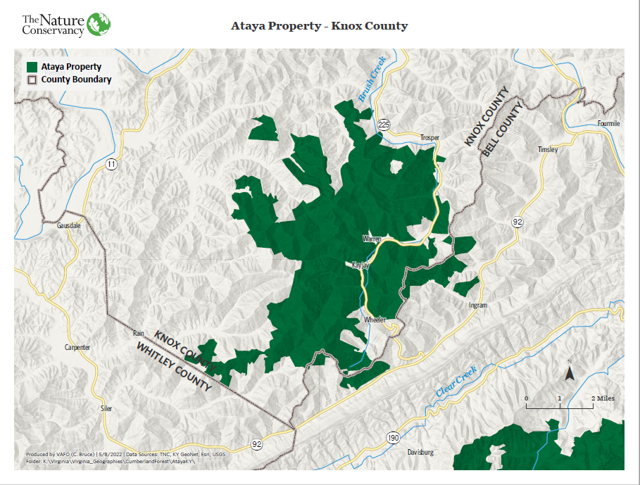
Map used with the permission of The Nature Conservancy

Slide 6
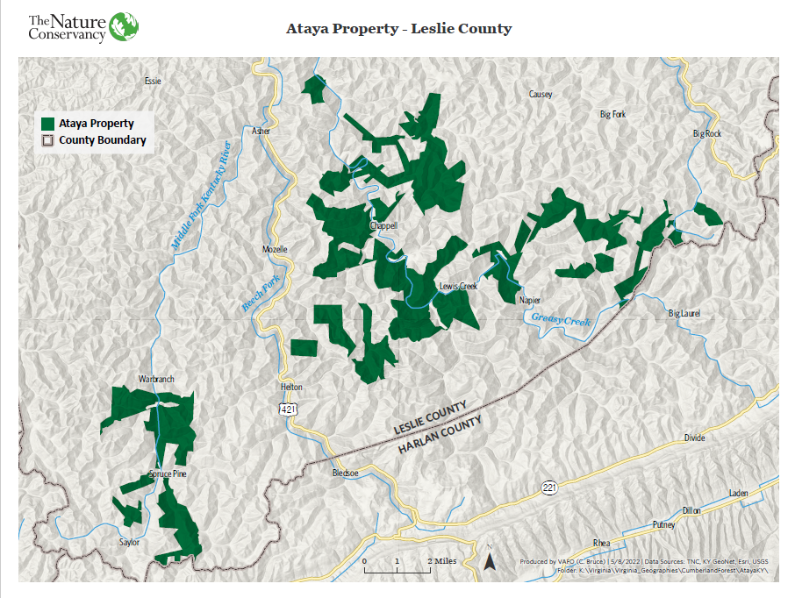
Map used with the permission of The Nature Conservancy

Slide 7
Survey Information:
Project encompasses 54,000 acres in Knox, Leslie and Bell counties. The tracts have an estimated perimeter of approximately 1,677,000 linear feet or approximately 318 miles to be surveyed. If the tract was a perfect square, it’s perimeter would be approximately 37 miles. The difference in perimeter is due to the irregular shape of the tracts that contain inholdings and completely separate tracts.
Tennessee has a similar Conservation Easement of 42,500 acres in the works with TNC. Their survey began in 2021, the perimeter is estimated to be 120 miles and they are 50% complete.

