Slide 1
Senate Bill 245
Comprehensive Securitization: A tool to prevent stranded assets
Brad Viator
Founder
B Strategic
1

Slide 2
About Brad and b Strategic
Brad is a utility expert who specializes in state policy trends, and the structure of the utility business and the design of energy markets. He is a frequent contributor to policy conversations at ALEC, NCSL, The Republican Governors Association, Democratic Governors Association and many other policy forums.
Prior to founding B Strategic Brad was Vice President of External Affairs at the Investor-Owned Utility Trade Association the Edison Electric Institute. In this capacity Brad was regularly the voice for the broader utility industry in media and at policymaker forums.
2

Slide 3
outline Of This Presentation
Review of the regulatory compact?
What is securitization?
How/where has it been utilized by electric companies?
How does it benefit customers?
How does it impact utility bottom lines?
The importance of capital recycling
SB 245 – What does it do?
SB 245 – Why does it matter?
3

Slide 4
The regulatory compact
The regulatory compact was first laid out in the Binghamton Bridge Supreme Court case of 1865. The court stated, “if you will embark, with your time, money, and skill, in an enterprise which will accommodate the public necessities, we will grant to you, for a limited time period or in perpetuity, privileges that will justify the expenditure of your money, and the employment of your time and skill.”
Regulated utilities are entitled to a reasonable opportunity to recover their prudently-incurred costs. This principle was established in the landmark U.S. Supreme Court case, Federal Power Commission et al v. Hope Natural Gas Co. (“Hope”), 320 U.S. 591, 603 (1944).
Regulated utilities are also entitled to earn a fair and reasonable rate of return on their capital investments. This principle was established in another landmark U.S. Supreme Court case, Bluefield Water Works and Improvement Co. v. Public Service Commission of West Virginia (“Bluefield”), 262 U.S. 679 (1923).
4

Slide 5
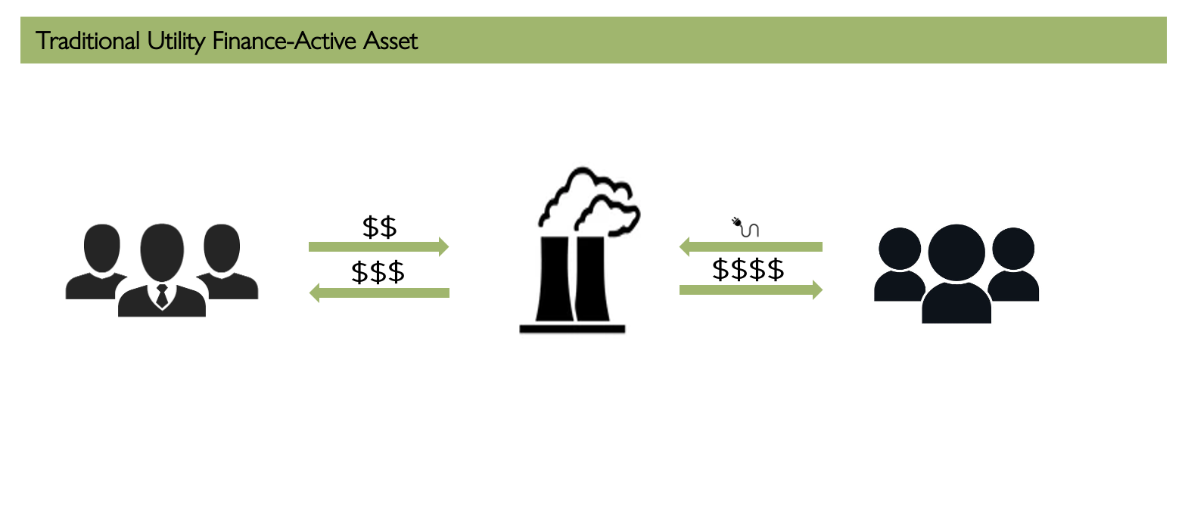
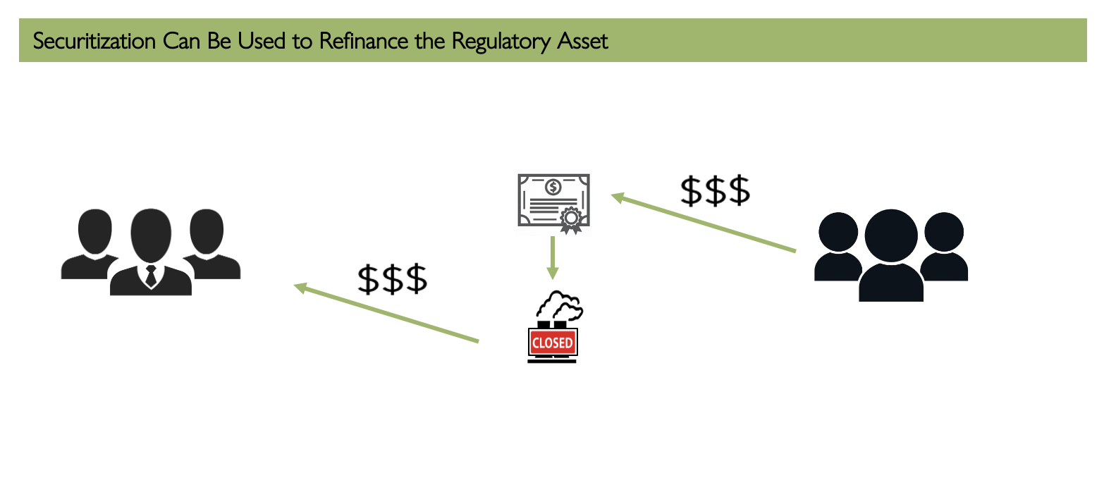
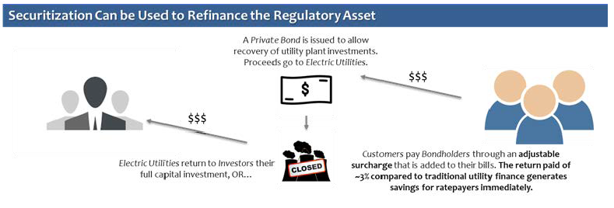
What is Securitization?
5

Slide 6
State Utility Securitization Laws
Stranded Assets | Coal Plant Retirements/ Clean Energy Investments | Storm Costs | Other
California (+ COVID costs) | Colorado (+ just transition) | Arkansas | Idaho
Connecticut | Hawaii | Florida (+ nuclear plants) | Vermont
Illinois | Montana (+ grid modernization) | Louisiana | West Virginia
Maryland | New Mexico | Mississippi | Wisconsin
Massachusetts | Wisconsin | North Carolina | Virginia
Michigan | Michigan | South Carolina | Oklahoma
New Hampshire | Kansas | Texas
New Jersey | Missouri | Oklahoma
New York | North Carolina
Ohio | Indiana
Pennsylvania | Louisiana
Rhode Island | Idaho
Texas
6

Slide 7
How does securitization benefit customers?
Securitization is a tool to spread out costs across a longer time horizon that would have a smaller bill impact.
It’s the difference of paying $150 million immediately across regulated utility customers versus paying that $150 million over 10 years across the same customer base.
While it reduces the cost to customers, utilities are not granted the return they were promised when initial investment in the plant was made.
7

Slide 8
How does securitization impact utilities bottom lines?
Generating facilities in particular are contracts with utility owners for a defined number of years, with return on equity built into those contracts.
Securitizing the closure of those facilities eliminates or reduces the return on equity, meaning the utilities are not making the money they were promised when they built the facility.
8

Slide 9
The importance of capital recycling
As with any facility closure it is necessary that other facilities be built to replace the lost capacity to ensure the grid remains resilient.
Securitized closure is no different, and the opportunity for the utility to build new facilities to replace capacity allows the loss on the original facility to be made up for with a new asset with a longer operating life.
9

Slide 10
SB 245: What does it do? 1/2
Gives the Kentucky Public Service Commission the authority to just and reasonably use securitization to reduce customer costs on assets that are retired prior to the end of their amortization schedule if certain conditions are met. (Sections 1-18)
Allows securitization to be used to finance extraordinary storm costs or other deferred costs (Section 2, part 4)
10

Slide 11
SB 245: What does it do? 2/2
Allows for investment in renewable natural gas infrastructure which utilizes farm waste among other sources. (Sections 19-20)
Allows for state-supported investment in nuclear energy research and development which can serve as a source of reliable, dispatchable carbon free energy. (Section 21)
Requires that 75 percent of the renewable generation required in Kentucky be owned by the utilities. (Section 23)
Expands the length from 1 mile to 10 miles for qualified ordinary investment in high-voltage transmission. (Section 23)
11

Slide 12
SB 245: Why Does it matter? 1/2
SB 245 takes a comprehensive look at the Commonwealth’s Energy future, allowing for narrowly applied securitization of facility closure, and allowing for controlled investment into renewable electricity resources, as well as investment in emerging resources like renewable natural gas and nuclear energy.
12

Slide 13
SB 245: Why Does it matter? 2/2
SB 245 puts the legislature in the driver’s seat of determining which resources should define Kentucky’s future fuel mix, and how to best ensure the affordability of future energy investment.
Narrowly applied securitization of facility retirement, storm damage and ensure the utilities remain healthy investment partners, and customers benefit with lower bills.
13

Slide 14
THANK YOU
Brad Viator
202-257-5394
bviator@bstrategicdc.com
14

