Slide 1
Texas Gas Transmission, LLC Presentation for the Commonwealth of Kentucky Legislature
February 2, 2023

Slide 2
Texas Gas Overview
Major offices in Owensboro, KY and Houston, TX
303 employees in Kentucky
Approximately 1200 employees system-wide and 200 employees in Owensboro
Almost 1500 miles of pipelines in Kentucky
Approximately 78 Billion cubic feet of natural gas storage capacity in Kentucky
Texas Gas contributed over $7.8 Million in ad valorem taxes to Kentucky in 2022

Slide 3
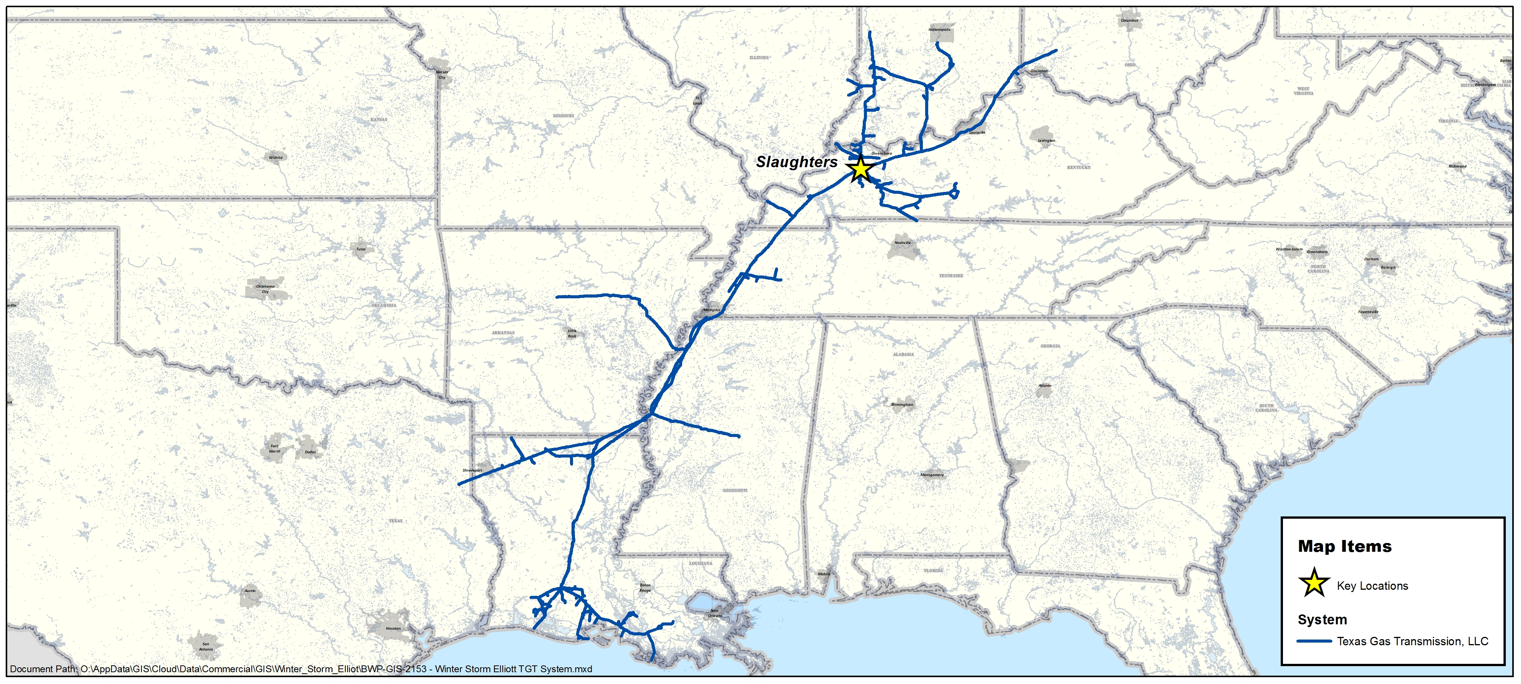
System Map

Slide 4
Services Provided by Texas Gas
Texas Gas performs its transportation services in accordance with customer’s requests, on a daily basis, and is regulated by the Federal Energy Regulatory Commission
Texas Gas Transmission is an open-access, interstate pipeline providing transportation and storage services for customers.
Services for customers
Transporting and storing customer gas
Customers choose type of service
Firm or Interruptible Transportation
Firm or Interruptible Storage
No Notice Service

Slide 5
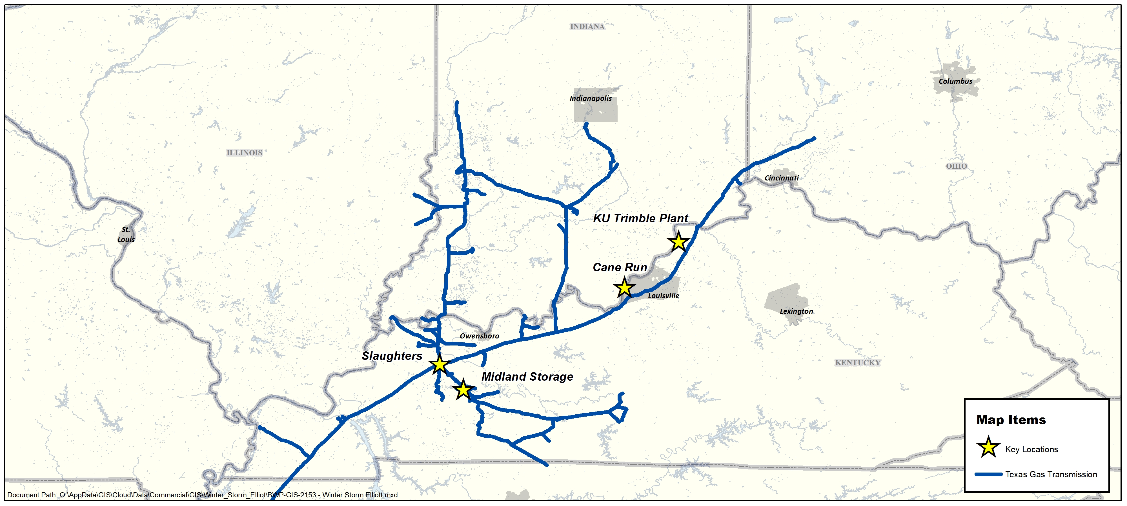
Kentucky and Indiana

Slide 6
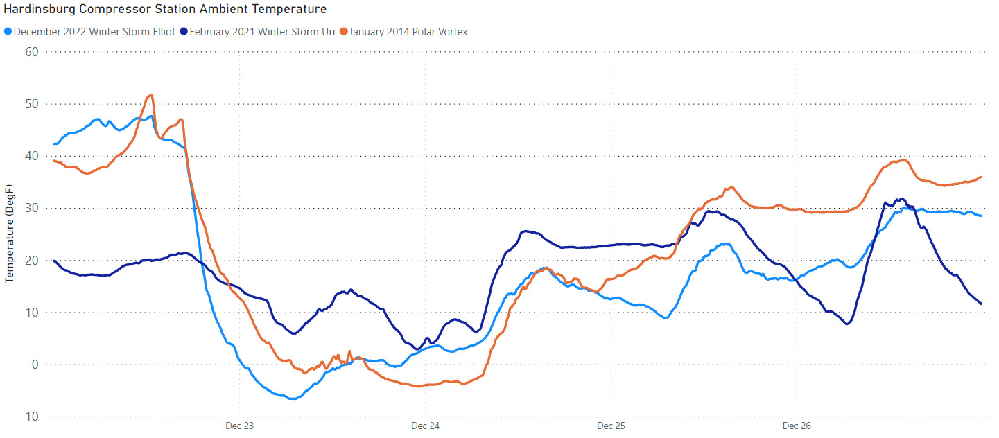
System Performance
Day 1 – Day 5 of each storm - normalized to Dec 2022 Winter Storm Elliot

Slide 7
Preparation and What Happened
Steps taken in advance of the storm
Winterized critical equipment
Added natural gas and pressure to the north end of the system
Manned key compression stations/locations
What happened during the storm
On the morning of December 23, 2022, TXG Gas Control Center requested to start horsepower at Slaughters Station
Control unit on a valve failed due to icing
This affected our ability to deliver gas to KU’s electric generation plants at contractual pressures, which limited their ability to bring on all of their generation.
This component failure did not prevent Texas Gas’ ability to source 1.62 Billion cubic feet per day of storage capacity from storage fields in KY and IN to replace lost supply.

Slide 8
Steps We Have Taken
Immediate near-term action steps across the system
Additional maintenance checks on control and other critical equipment prior to severe winter weather events
Additional temporary covers and heating equipment on critical equipment that is exposed to the elements
Work with our control center to turn on compression and run it in a bypass or unloaded condition so it will be ready for full load when needed
Additional action steps
Fabricate and install permanent structures over certain critical control equipment and include appropriate heat equipment

