Slide 1
Winter Storm Elliott Update
February 2, 2023

Slide 2
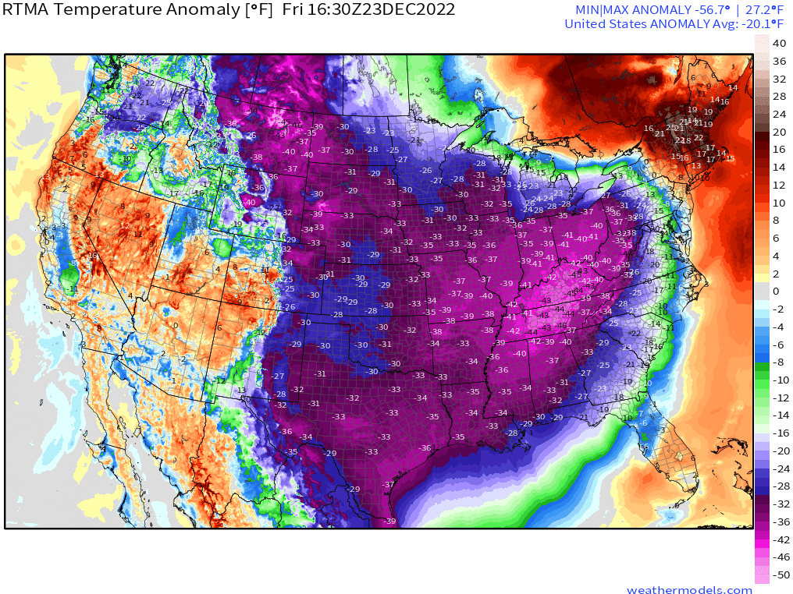
Winter Storm Elliott was Severe and Unique
2
All data/information is approximate as of 1/13/23 and subject to change based on ongoing data analysis.

Slide 3
The Storm Resulted in Dramatic Increases in Demand
3
All data/information is approximate as of 1/13/23 and subject to change based on ongoing data analysis.

Slide 4
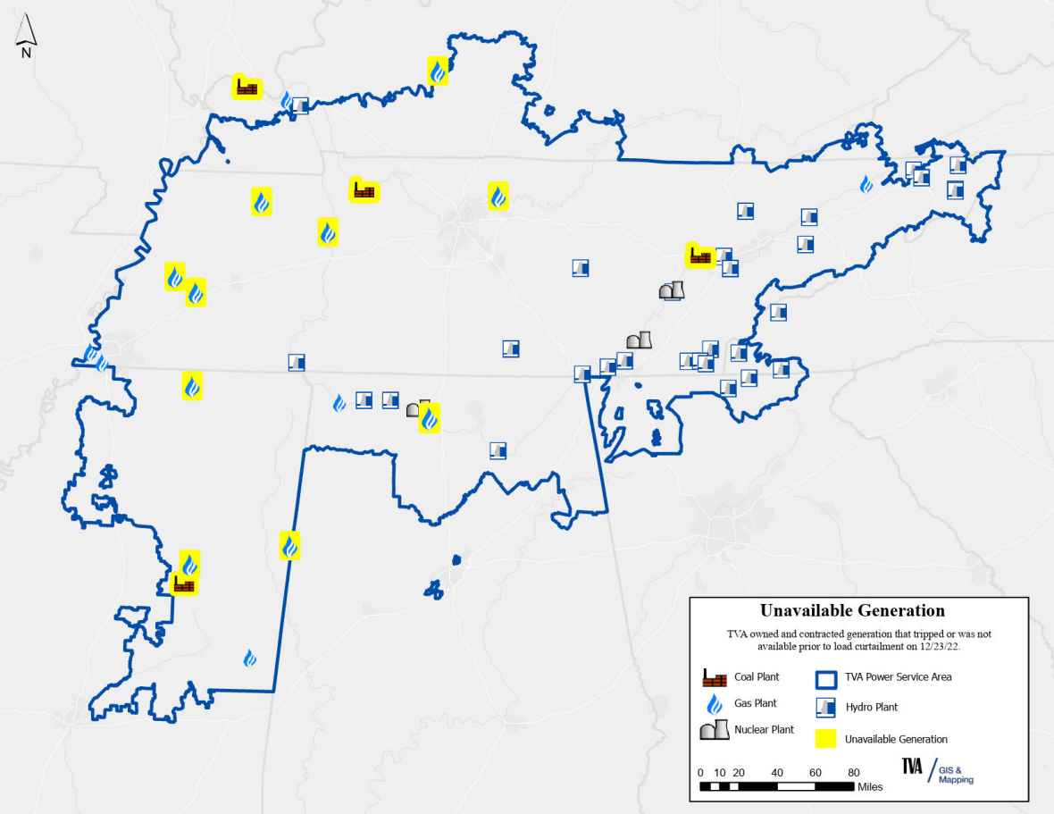
And Negative Impacts to Electricity Supply
Heavy rains, sudden temperature decreases, high winds, and flash freeze impacted equipment at TVA owned and contracted generating facilities.
Cumberland Fossil Plant units were the largest of the impacted units
Critical instrumentation located on the top of the boilers froze, tripping the units
A thorough review is underway and over 200 near-term actions are already complete
4
All data/information is approximate as of 1/13/23 and subject to change based on ongoing data analysis.

Slide 5
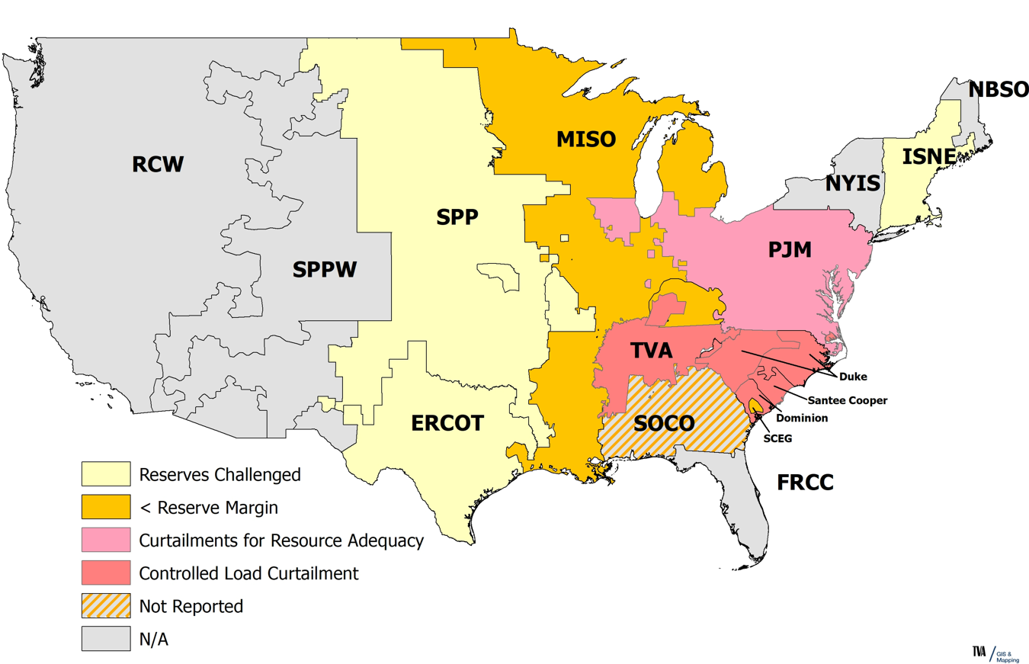
Neighboring Markets Were Also Constrained
Acronyms:
ERCOT – Electric Reliability Council of Texas
FRCC – Florida Reliability Coordinating Council
ISNE – Independent System Operator New England
MISO – Midcontinent Independent System Operator
NBSO – New Brunswick System Operator
NYIS – New York Independent System Operator
PJM – PJM Interconnection
RCW – Reliability Coordinator West
SCEG – South Carolina Electric & Gas
SOCO – Southern Company
SPP & SPPW – Southwest Power Pool
TVA – Tennessee Valley Authority
Sources:
Arctic Blast Roiling Reliability in TVA, MISO, SPP, PJM (powermag.com)
LG&E and KU roll out power outages as cold impacts energy grid | whas11.com
Duke Energy says heavy electricity demand led to rolling Christmas blackouts (msn.com)
Dominion Energy asks customers to conserve power amid high demand (msn.com)
Santee Cooper implements power outages every half hour due to freezing temps in Georgetown (msn.com)
ERCOT expected to make it through rest of Christmas freeze without issue, despite emergency request Friday (msn.com)
ISNE Twitter Feed
5
All data/information is approximate as of 1/13/23 and subject to change based on ongoing data analysis.

Slide 6
We are Conducting a Thorough After-Action Review
TVA is conducting a comprehensive after-action review to understand what happened and why, and actions we can take in the near, medium and long-term to incorporate lessons learned. As part of this effort, we are:
Engaging industry experts and customers for input and feedback
Incorporating independent oversight through our Blue Ribbon Panel
Committed to transparency and sharing our findings and progress
TVA is relentlessly focused on continuous improvement and is taking the time to get this right. We want to know every lesson that can be learned, and are already taking preventative, proactive steps to improve.
Since the storm, TVA employees identified and addressed over 200 near-term actions to improve resilience and performance in advance of the next event
6
All data/information is approximate as of 1/13/23 and subject to change based on ongoing data analysis.

