Slide 1
Eastern Kentucky University
2020-2022 Biennium Budget

Slide 2
EKU is Kentucky’s University
Notes:
EKU grads are a driving force in Kentucky, contributing to local economies and
serving in positions that are vital to quality of life. They become nurses, police
officers, EMTs, teachers, social workers and superintendents.

Slide 3
EKU is #1 in Kentucky
75% OF EKU DEGREE HOLDERS ARE EMPLOYED IN KENTUCKY
That’s the highest percentage of any public, four-year institution in the state.
Notes:
EKU grads are a driving force in Kentucky, contributing to local economies and
serving in positions that are vital to quality of life. They become nurses, police
officers, EMTs, teachers, social workers and superintendents.

Slide 4
EKU ELEVATES KENTUCKIANS
83%
OF EKU UNDERGRADUATE STUDENTS
ARE KENTUCKY RESIDENTS
60%
OF ALL UNDERGRADUATE DEGREE
RECIPIENTS ARE LOW-INCOME,
FIRST-GENERATION OR BOTH
Notes:
Typically every county is represented in the student body.

Slide 5
EKU is Highly Awarded
U.S. NEWS & WORLD REPORT: REGIONAL UNIVERSITIES IN THE SOUTH Ranked in the top tier for 9 consecutive years
MILITARY TIMES: BEST FOR VETS
Top 10 percent in the nation and No. 1 in Kentucky
FORBES: AMERICA’S TOP COLLEGES
Listed for 12 consecutive years
MINORITY ACCESS, INC.: DIVERSITY INSTITUTION AWARD
Awarded for 7 consecutive years
WASHINGTON MONTHLY: BEST BANG FOR THE BUCK COLLEGES
CHRONICLE OF HIGHER EDUCATION: BEST UNIVERSITIES TO WORK FOR

Slide 6
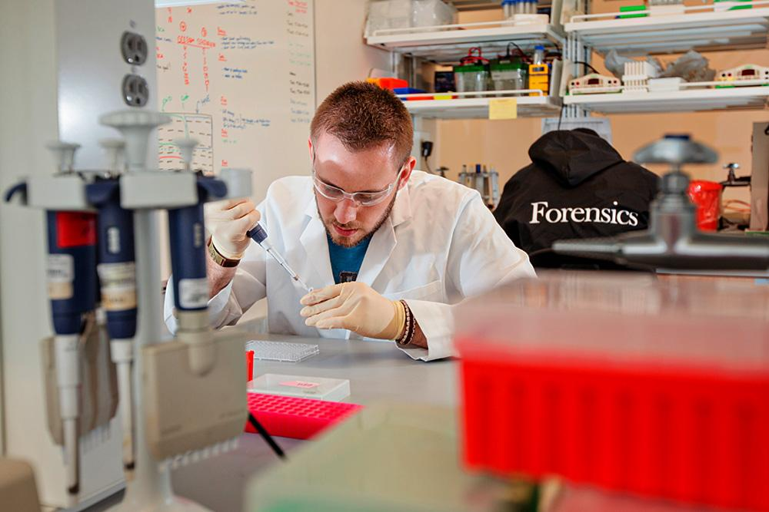
EKU IS A LEADER IN STEM-H
3,386 Kentucky students are studying in a STEM-H field.
EKU awarded 849 STEM-H degrees in May 2019.
Notes:
EKU’s Science Building, completed in 2017, is a premier destination for the best and brightest students in Kentucky. At 326,059 square feet, it is the largest of its type in Kentucky. Besides its many state-of-the-art labs and classrooms, the building itself offers education in sustainability — the second and final phase of the building has earned LEED Gold status from the U.S. Green Building Council.

Slide 7
ACADEMIC DISTINCTION
EKU offers approximately 100 degree programs and 80+ concentrations at all degree levels
Notes:
Psychology
Aviation
Nursing
Occupational Therapy
Criminal Justice
Risk Management & Insurance
Social Work
Education
Computer Science (with options in game design, cybersecurity and more.)
Homeland Security
Applied Engineering
Professional Golf Management

Slide 8
A LEADER IN ONLINE LEARNING
EKU Online offers 40+ programs.
3,382 students are enrolled in EKU Online programs.
63% of EKU Online students live in Kentucky.
U.S. News & World Report ranked:
Top 30 Online Graduate Nursing Programs
Top 100 Online Bachelor’s Degree Programs
Top 100 Online Graduate Education Programs
Notes:
EKU Online offers 40+ PROGRAMS in meaningful disciplines that
positively impact Kentucky communities. Nurses, social workers, teachers,
corrections officers, police officers, safety specialists, first responders,
business professionals and more have all been able to attain their degree,
improve their expertise and advance their careers thanks to EKU’s e-campus.
3,382 students are enrolled in EKU Online programs.
63% of EKU Online students live in Kentucky.
U.S. News & World Report ranks EKU Online in the Top 30 Online
Graduate Nursing Programs, Top 100 Online Bachelor’s Degree
programs and Top 100 Online Graduate Education Programs.

Slide 9
EKU ONLINE PROGRAMS LEAD TO
REWARDING CAREERS
MS in Safety/Security/ Emergency Management | $72,395
MSN in Nursing | $62,508
BS in Occupational Safety | $60,177
BS in Psychology | $41,094
BSN in Nursing | $52,760
Notes:
EKU tracks the careers of thousands of online graduates through Emsi. Here are
the average salaries in some of the college’s most popular online programs.

Slide 10
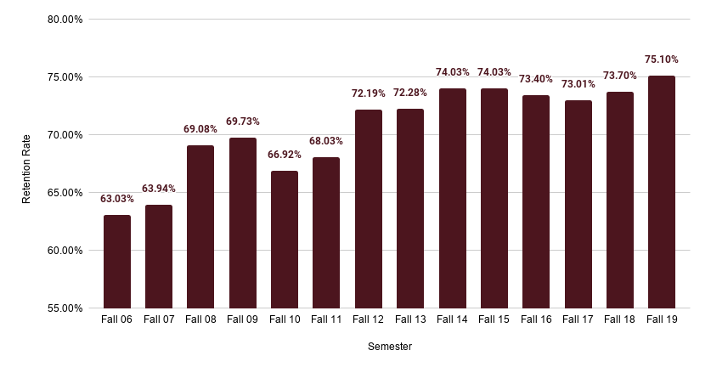
FRESHMAN RETENTION

Slide 11
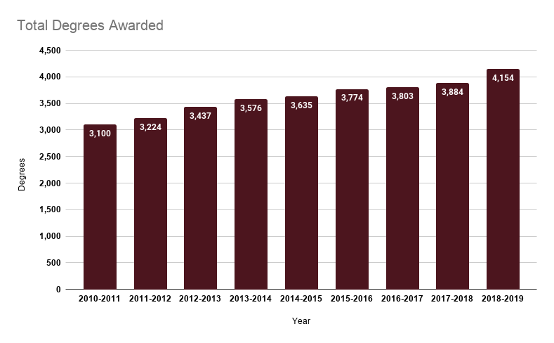
TOTAL DEGREES AWARDED
Notes:
Degrees awarded to low-income students have increased by 58% over the last
10 years.
Degrees awarded to underrepresented minorities have increased by more than
145% over the last 10 years.

Slide 12
MODEL LABORATORY SCHOOL
Notes:
EKU was founded as a teacher’s college, and Model Laboratory School is the
evolution of that cornerstone mission. Thanks to an innovative, interdisciplinary
curriculum that builds creativity, critical thinking and transferable skills, Model
is one of the highest-ranked K-12 institutions in the state. Its location on EKU’s
campus and its leading-edge pedagogy make for an ideal learning environment
— not only for Model students, but for the next generation of teachers and
school administrators studying at EKU. Each year, dozens of future educators
earn their observation and practicum hours at Model.

Slide 13
MODEL LABORATORY SCHOOL
707 K-12 STUDENTS from Madison County and eight other districts.
5-STAR SCHOOL - Model is one of only seven high schools in Kentucky to earn five out of five stars on the KDE School Report Card.
A RESOURCE FOR KENTUCKY EDUCATORS - The Center for Educator Excellence, a new initiative from EKU and Model, provides professional development to the Commonwealth’s teachers. In its most recent session on new social studies standards, more than 67 EDUCATORS FROM 34 KENTUCKY COUNTIES attended.
PILOTING A NEW PERFORMANCE-BASED PAY MODEL - Unconnected to student test scores, Model’s performance-based pay model will reward educators for taking on new projects that enhance the learning environment.
SOLVING THE TEACHER SHORTAGE - Model is prepared to train and award teaching credentials to non-teaching degree holders.
Notes:
Reference to Bill #
Fiscally neutral budget impact to allocate funding to Model.
University investment and value to Commonwealth

Slide 14
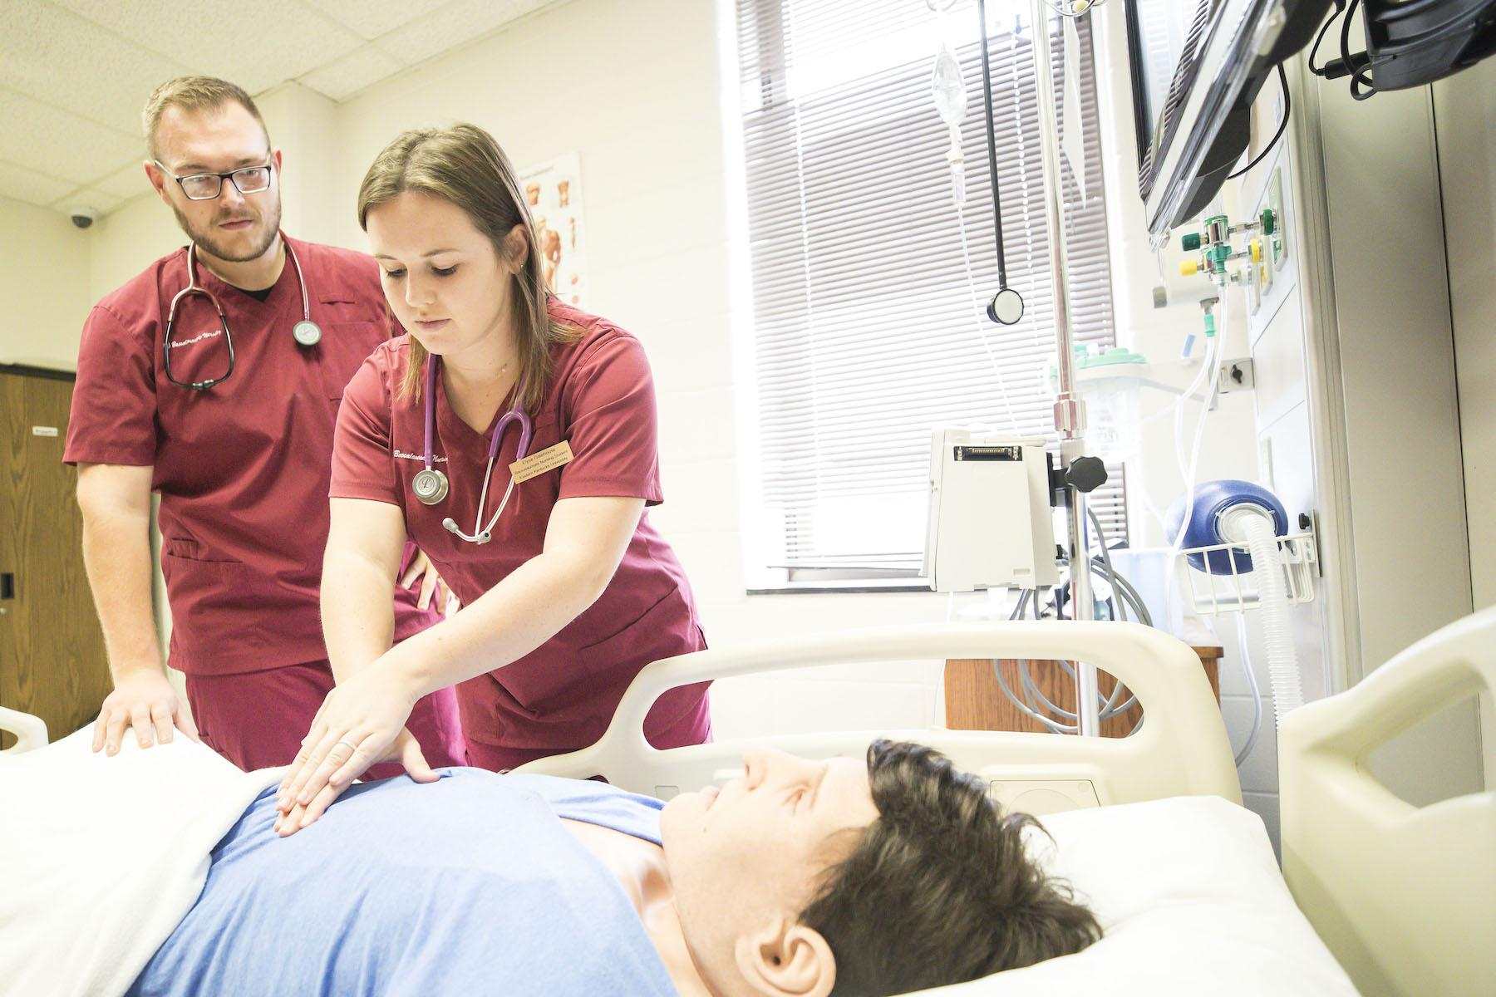
EKU PREPARES KENTUCKY’S NURSES
Notes:
Nursing has long been one of EKU’s most popular programs. Thanks to a
supportive faculty, a challenging curriculum and some of the most advanced
training technology in the state, EKU nurses are highly sought after by employers
for their technical expertise and compassionate care.

Slide 15
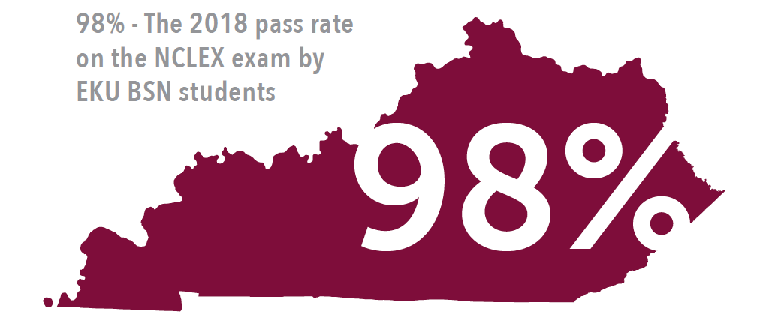
EKU PREPARES KENTUCKY’S NURSES
1,396 nursing students currently enrolled
79% of nursing students from Kentucky
358 nursing students graduated in May 2019, including:
182 Bachelor’s
123 Masters
2 Doctoral
60 students: 2020-21 ASN cohort size
Notes:
Nursing has long been one of EKU’s most popular programs. Thanks to a
supportive faculty, a challenging curriculum and some of the most advanced
training technology in the state, EKU nurses are highly sought after by employers
for their technical expertise and compassionate care.

Slide 16
AVIATORS TAKE FLIGHT AT EKU
Notes:
As the only one of its kind in the state, EKU’s Aviation program is uniquely
positioned to train and develop tomorrow’s aerospace professionals for one
of the most demanding industries in the world. Through a host of industry
partnerships, cutting-edge training, educational outreach and volunteer efforts,
students representing areas across the Commonwealth are graduating with the
experience necessary to compete on both national and international levels.

Slide 17
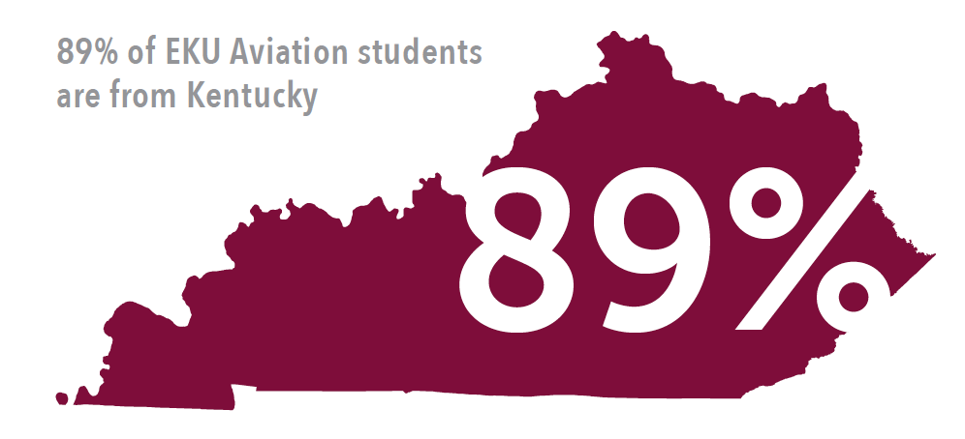
AVIATORS TAKE FLIGHT AT EKU
Aviation Students By Major
262 Professional Flight
38 Aerospace Management
4 Aerospace Technology
Notes:
As the only one of its kind in the state, EKU’s Aviation program is uniquely
positioned to train and develop tomorrow’s aerospace professionals for one
of the most demanding industries in the world. Through a host of industry
partnerships, cutting-edge training, educational outreach and volunteer efforts,
students representing areas across the Commonwealth are graduating with the
experience necessary to compete on both national and international levels.

Slide 18
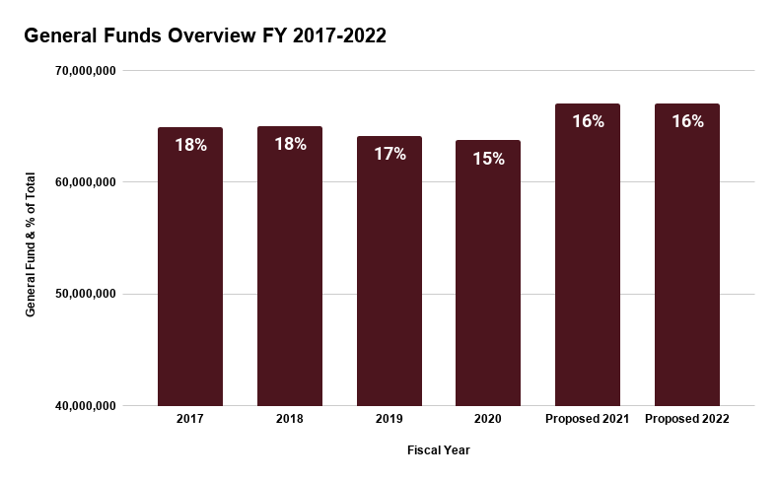
BUDGET OVERVIEW 2017-2022
$64,972,300
$65,045,200
$64,189,000
$63,753,600
$67,075,600
$67,075,600
Notes:
numbers are based on the CPE consensus request and not the Governor’s proposed budget.

Slide 19
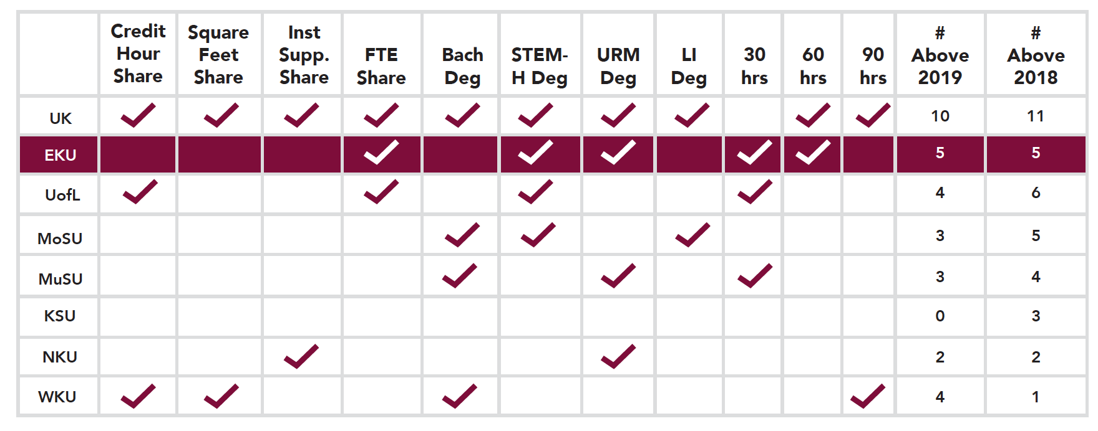
PERFORMANCE FUNDING
Notes:
EKU is No. 1 among regional institutions and second only to the state’s most
prominent research university in the number of performance-based allocation
components met. EKU performed above average in the categories of FTE
enrollment; STEM-H degrees; underrepresented minority degrees; 30-hour
progress; and 60-hour progress.
Extend the current 2% stop-loss provision
Increased funding requests.

Slide 20
PERFORMANCE FUNDING
FY21 | $52.5M
FY22 | $74.9M
Notes:
We support the CPE consensus request
Total CPE Perf pool req:
FY21 $52.5M
FY22 $74.9M
EKU could have received anywhere from $4-6M per year from these pools, based on this request framework and based on prior performance, which would have been added to the current $63.7M GF.

Slide 21
RESURGENCE FUND
Projects totalling $22,471,500, to include:
Roofing & Facade
Doors & Windows
Elevators
Electrical, Heating & Cooling Systems
Total deferred maintenance log in excess of $350,000,000
Notes:
Additional Capital projects

Slide 22
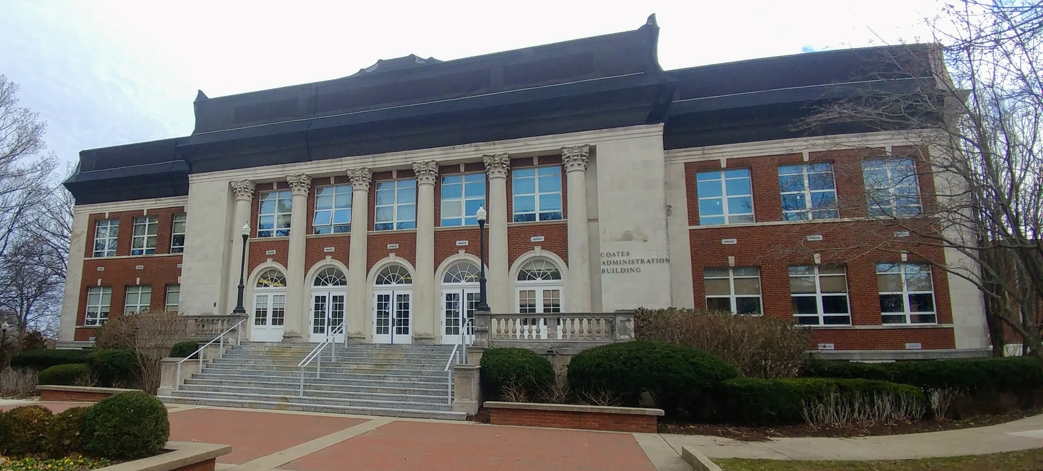
RESURGENCE FUND

Slide 23
www.eku.edu
Questions?

