Slide 1
Budget Review Subcommittee on Postsecondary Education
February 6, 2020

Slide 2
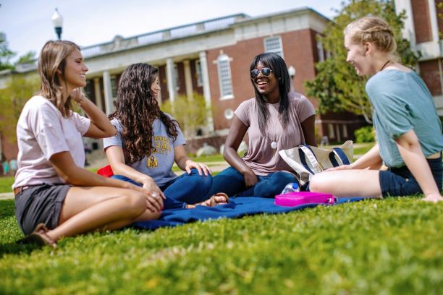
Murray State Quick Facts
Founded in 1922
9,569 students enrolled
79.3% Retention Rate First-Time Freshmen (baccalaureate)
55% Six-Year Graduation Rate
99% First-Time/Full-Time Students Receiving Financial Aid
43% of our students graduate with no federal student loan debt
112 Kentucky Counties Represented
48% of our students are First Generation Students
$117M in Financial Aid and Scholarships Awarded for Fall ‘18 and Spring ‘19
70,000+ Alumni

Slide 3
Nationally Recognized
U.S. News & World Report - 29 Consecutive Years as a Top Tier University
U.S. News & World Report - #11 Top Public Regional University & #24 Best Regional University in the South
Washington Monthly - Best Bang for the Buck
Forbes - America’s Best Colleges (12 Consecutive Years)
Safe Campus - #1 in Campus Safety Initiatives
Safewise - Nation’s Top 50 Safest College Towns
USA Today - Friendliest Small Town in America

Slide 4
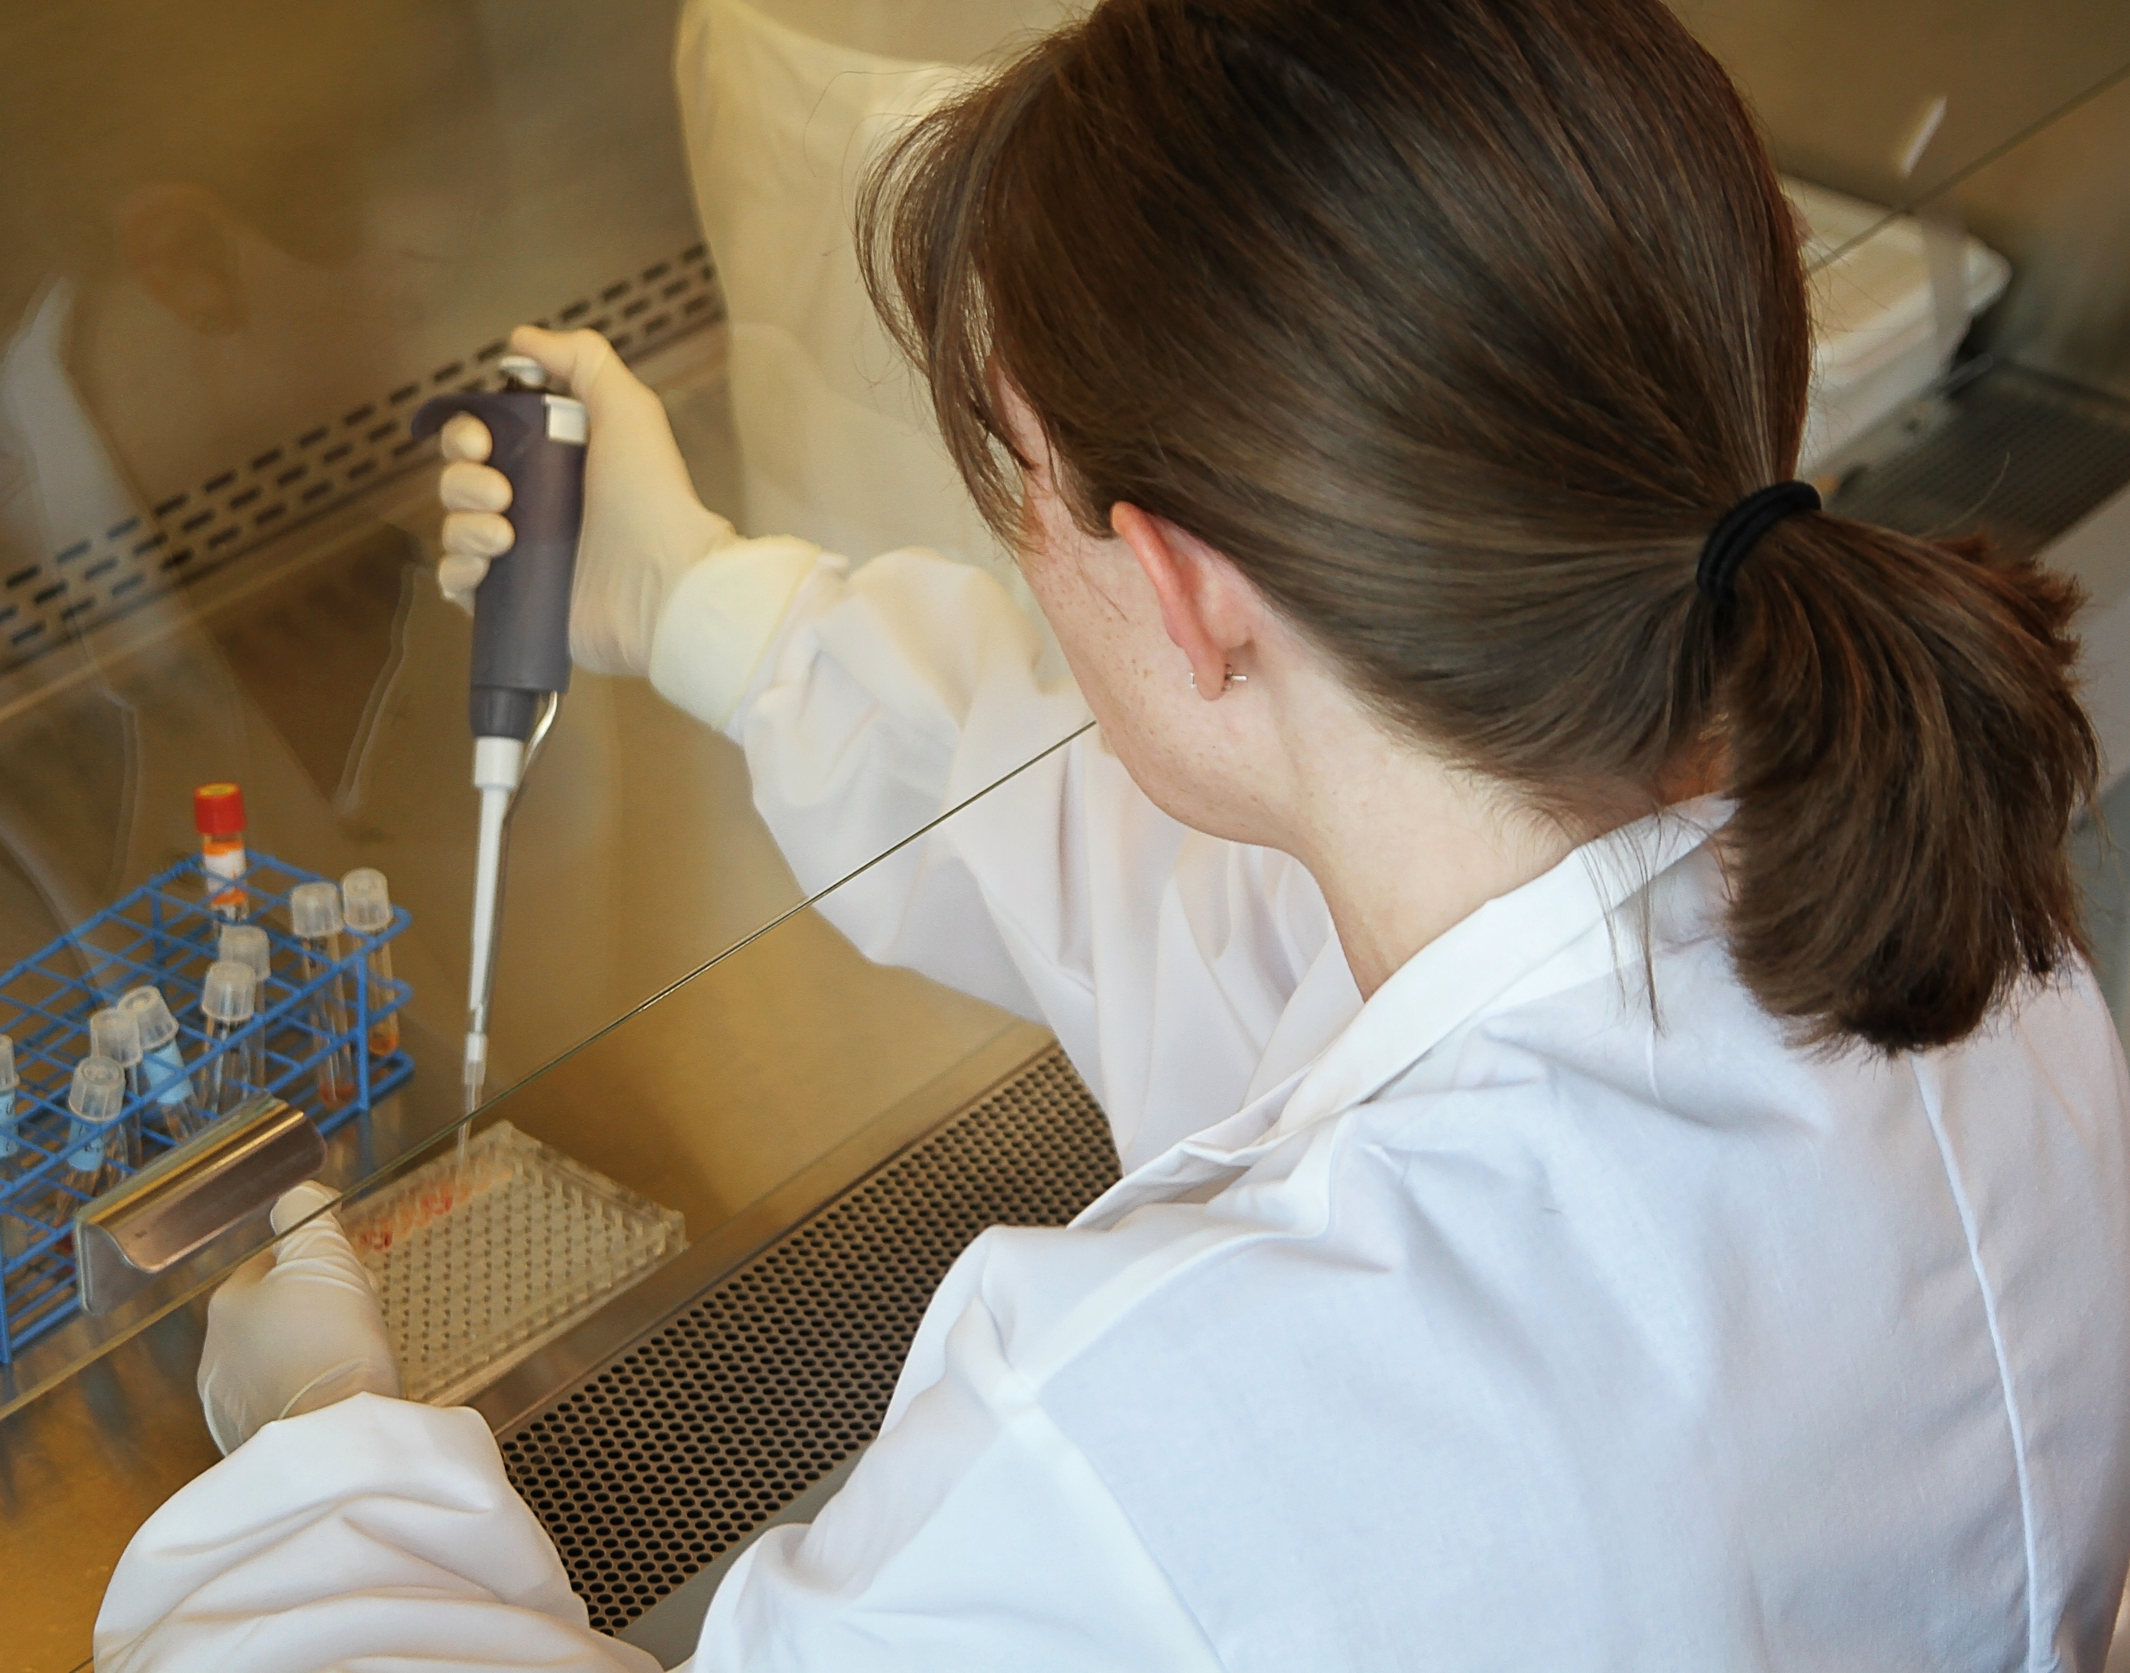
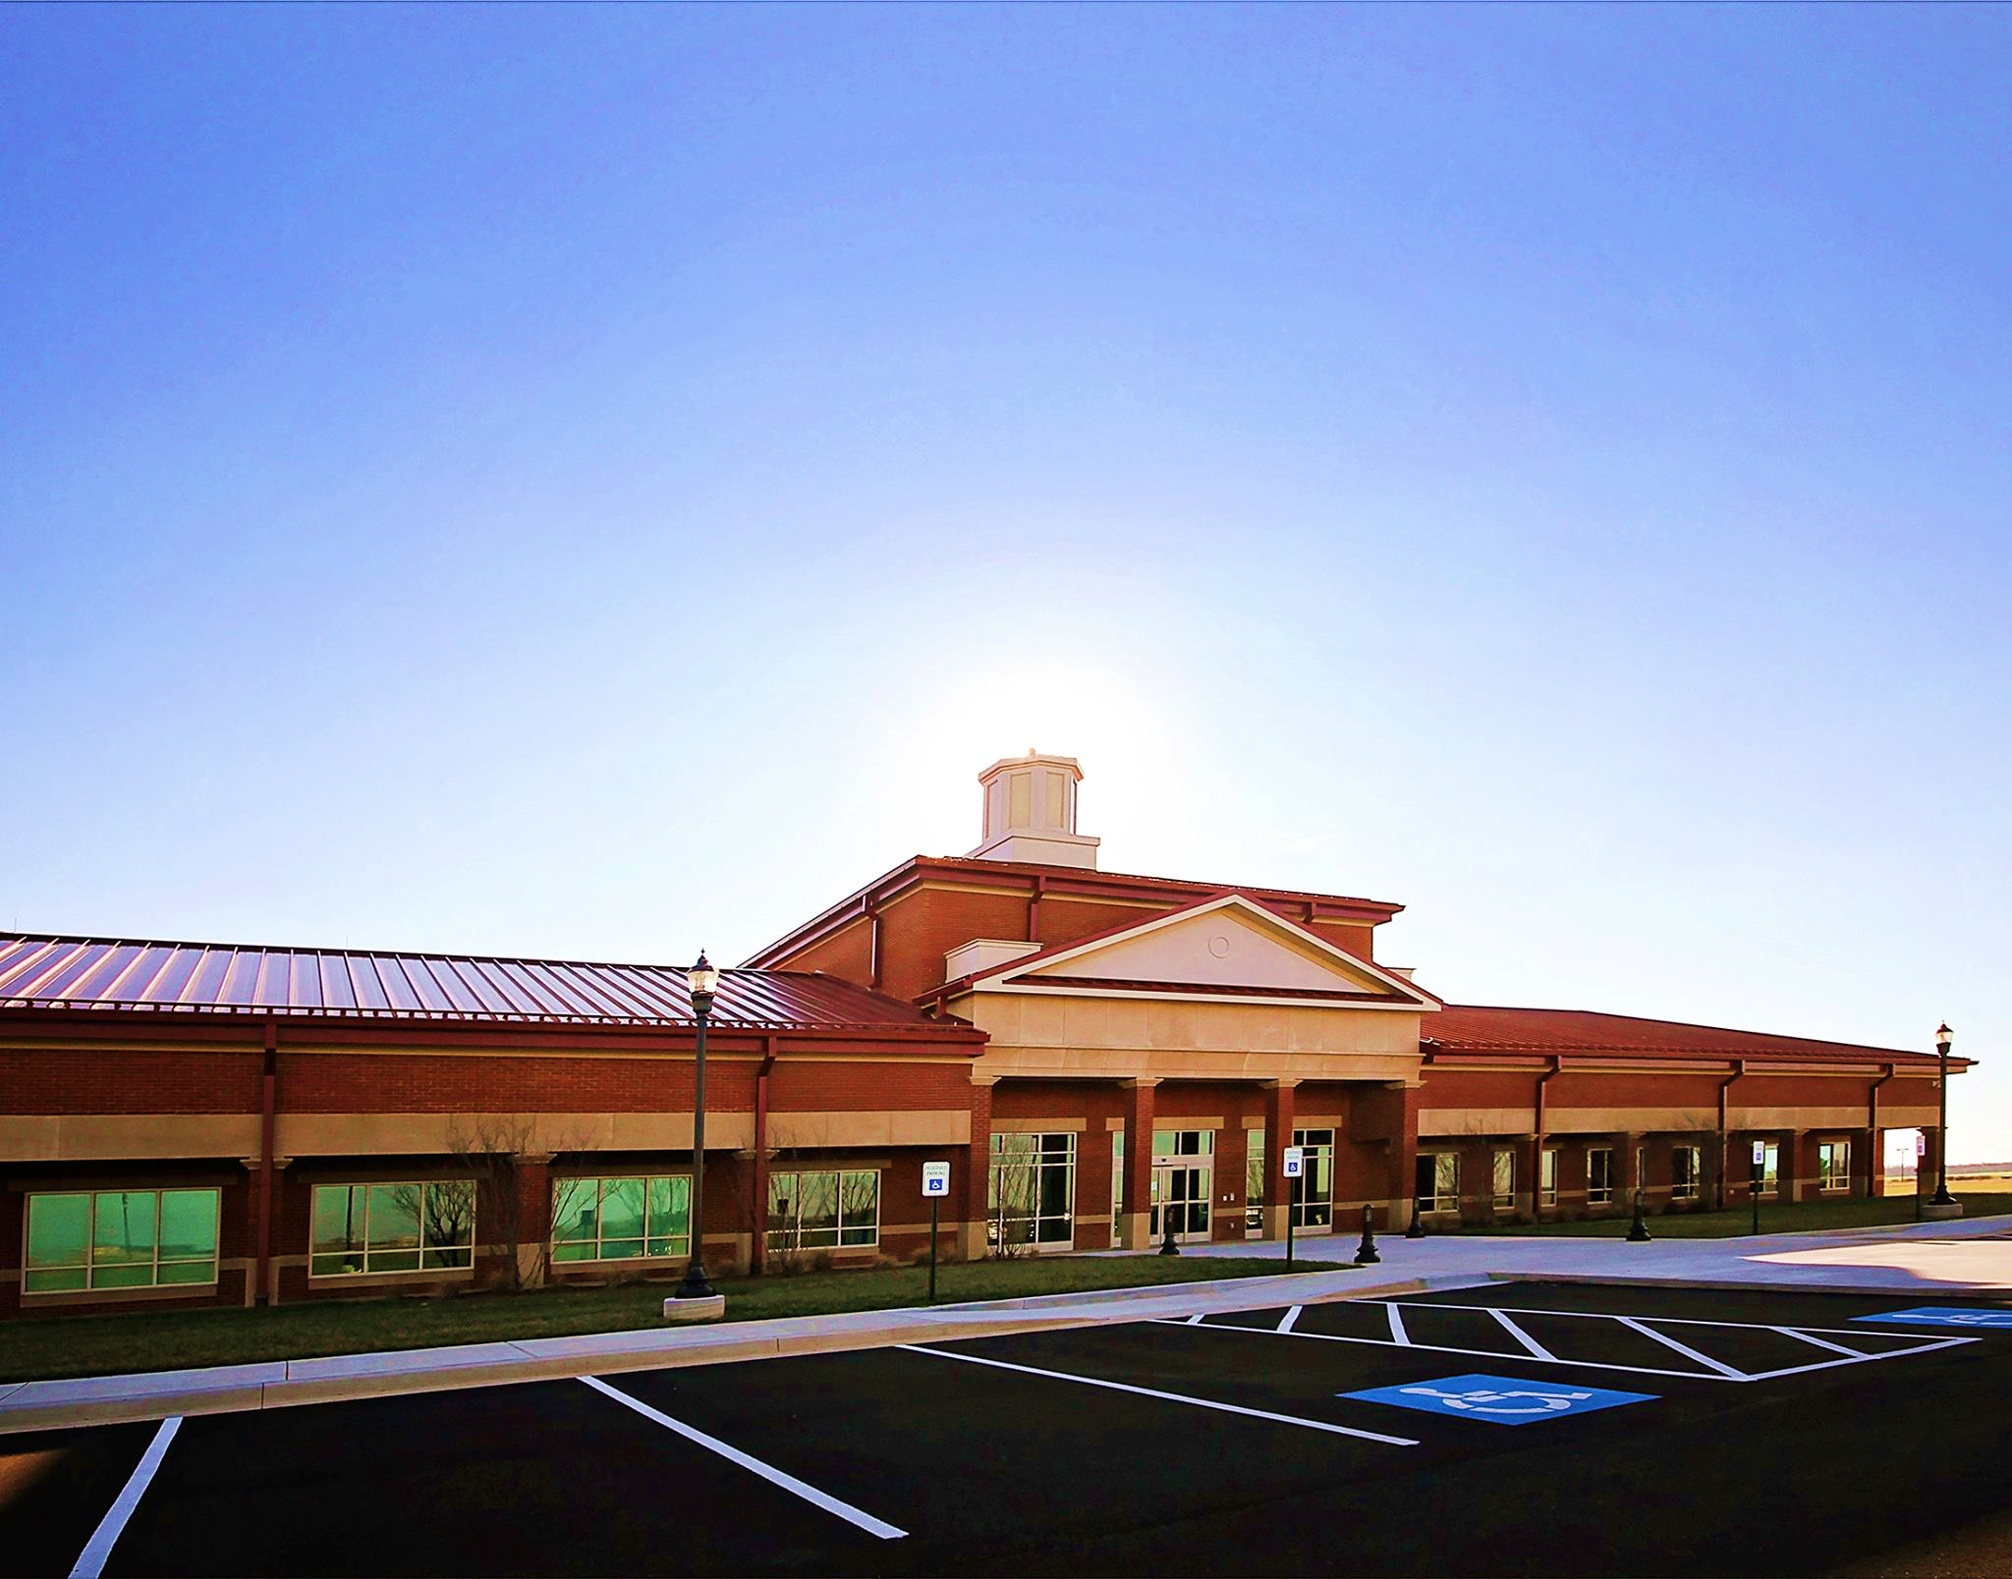
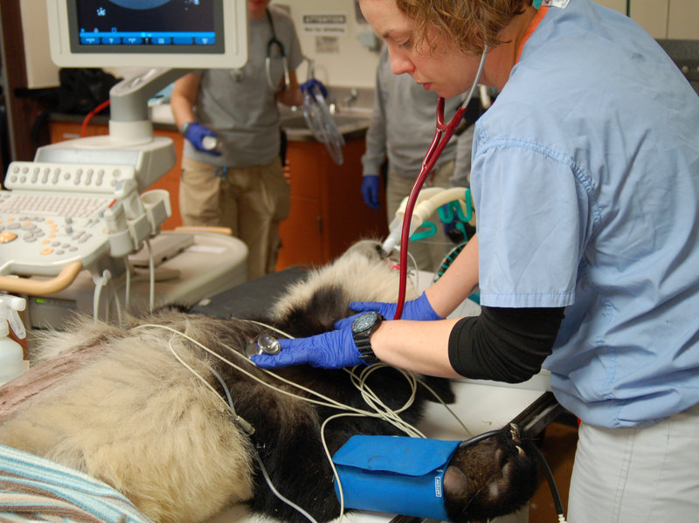
The BVC is a nationally-recognized animal disease diagnostic laboratory dedicated to protecting Kentucky’s equine, livestock, and poultry industries.
The BVC’s Mission includes DIAGNOSTICS, EDUCATION, RESEARCH, and OUTREACH to the entire Commonwealth.
Our BVC facility contains the only veterinary BioSafety Level (BSL) 3 suite in the Commonwealth that can safely accommodate testing for animal diseases such as Avian Influenza or Foot and Mouth Disease. The BVC also safeguards public health through testing for additional diseases such as E. Coli, anthrax, West Nile Virus, and many others.
The BVC receives $3,200,000 in each fiscal year from the General Assembly and is our only mandated program.
Breathitt Veterinary Center (BVC)

Slide 5
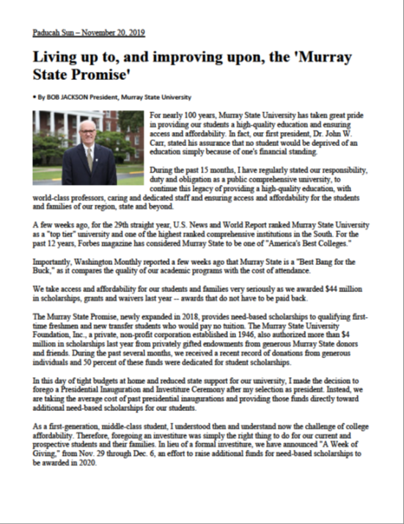
Access & Affordability
The Murray State Promise
Need-based scholarships
Racers Give Campaign
No Presidential Investiture
“Week of Giving” - $200K+ raised instead for need-based scholarships

Slide 6
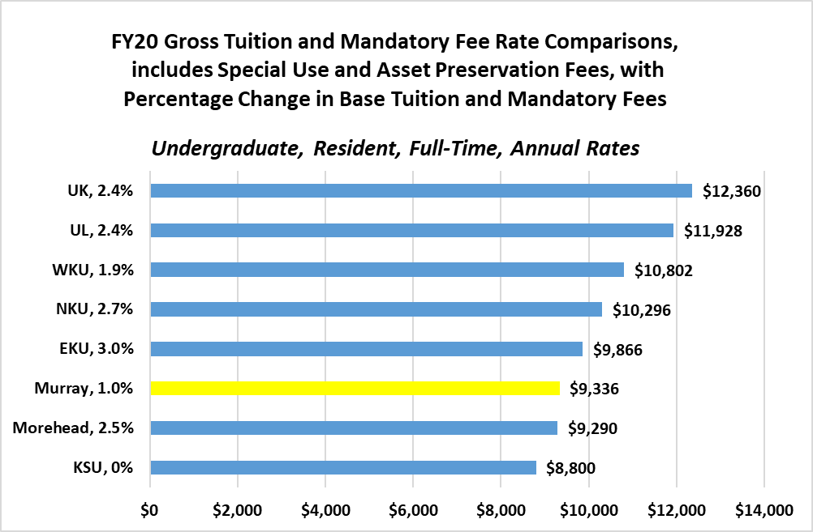
Access & Affordability

Slide 7
Enrollment Update
70% of our budget is enrollment driven
(Percent increase is compared to Fall 2018.)
Fall 2019 FTF – 7.73%
From 2015 to 2018, decline of -10.15%
Fall 2019 FTT – 10.77%
From 2015 to 2018, decline of -11.59%
Fall 2019 FTG – 12.15%
From 2015 to 2018, decline of -29.76%

Slide 8
Deferred Maintenance & Asset Preservation
Capital Project Request 2020-2022
Priority 1 – Deferred Maintenance/Historic Building Preservation (Higher Education Resurgence Fund) ($36.8M)
General Fund 2:1 Match ($24.5M General Fund) + ($12.3M University Agency Bonds)
Need approval for $12.3M of University Agency Bonds
Bonds to be paid with CPE and Murray State University approved asset preservation fee
The pooled deferred maintenance needs include asset preservation, maintenance and modernization upgrades to many historic buildings and our student center (Curris Center).
Request does not include new facilities

Slide 9
Deferred Maintenance & Asset Preservation
Capital Project Request 2020-2022
Priority 2 – Reauthorization: Renovate/Replace Residence Halls ($17.1M)
University (agency) bond authorization for up to $17.1M (same as 2018-20 authorization) for the renovation/replacement of residence halls
Priority 3 – Reauthorization: Residential Housing Facilities Public-Private Partnership (P3) Financing ($66M)
University authorization for P3 Financing projects for residential housing facilities up to $66M (same as 2018-20 authorization)

Slide 10
Performance Funding
Murray State supports a permanent 2% stop-loss enacted into the Performance Funding Model
Murray State fully supports the CPE’s 2020-22 increased funding request for the Performance Funding Model
The Biennial request is $127,481,500 for both publics and KCTCS. For FY21, this means $40,889,100 for the publics and $58,412,900 in FY22 if the net adjusted general fund ratios remain constant.

Slide 11
Performance Funding
Performance Metric | Weightings | UK | UofL | EKU | KSU | MoSU | MuSU | NKU | WKU
Student Success Outcomes | 35% - total
Bachelor Degrees | 9% | ✔ |  |  |  | ✔ | ✔ |  | ✔
STEM+H Bachelor Degrees | 5% | ✔ | ✔ | ✔ |  | ✔
URM Bachelor Degrees | 3% | ✔ |  | ✔ |  |  | ✔ | ✔
Low Income Bachelor Degrees | 3% | ✔ |  |  |  | ✔
Student Progression @ 30 Hours | 3% |  | ✔ | ✔ |  |  | ✔
Student Progression @ 60 Hours | 5% | ✔ |  | ✔
Student Progression @ 90 Hours | 7% | ✔ |  |  |  |  |  |  | ✔
Earned Credit Hours | 35% - total | ✔ | ✔ |  |  |  |  |  | ✔
Operational Support | 30% - total
Instructional Square Feet | 10% | ✔ |  |  |  |  |  |  | ✔
Direct Cost of Instruction | 10% | ✔ |  |  |  |  |  | ✔
FTE Students | 10% | ✔ | ✔ | ✔
Metrics Above Sector Percent Change |  | 10 | 4 | 5 | 0 | 3 | 3 | 2 | 4
FY20 Performance Funding Dollars |  | $14,992,500 | $3,343,400 | $3,578,400 | $0 | $0 | $0 | $4,325,500 | $4,379,100
FY19 Metrics Above Sector Percent Change |  | 11 | 6 | 5 | 3 | 5 | 4 | 2 | 1
FY19 Performance Funding Dollars |  | $9,119,000 | $2,507,100 | $3,387,300 | $0 | $0 | $557,800 | $4,837,200 | $3,748,600

Slide 14
Questions?

