Slide 1
Budget Review Subcommittee on Postsecondary Education
Dr. Jay Box, President
Kentucky Community & Technical College System

Slide 2
KCTCS: Our Unique Mission
To improve the quality of lives and employability of Kentuckians by serving as the primary provider of:
College and workforce readiness
Transfer education
Workforce education and training

Slide 3
KCTCS Fast Facts
16 colleges, statewide footprint with more than 70 locations
Largest provider of postsecondary, online and workforce education in Kentucky
3 transfer programs; 106 technical programs
8th nationally in credentials awarded by public, two-year colleges. 2nd based on population.
292% increase in credentials awarded since we merged
Lowest tuition & fees in the Commonwealth
Annual tuition & fees are $4,263 compared to an average of $10,044 at a KY public university
Source: IPEDS, tuition & fees, 2018-19
Notes:
Open Access: KCTCS is an open access institution meaning we enroll anyone that wants to do so. By statute, we are unable to set admission standards like the universities. Because of this, over half of our students (53%) are unprepared for college-level coursework when they enroll compared to only 14% of university students.

Slide 4
KCTCS Fast Facts
106,874 students (111 % increase since merger)
Enrollment for Spring 2020 is up 3% from Spring 2019
60,070 enrolled in online courses (26,683 online only, 25% total enrollment)
19,660 high school students in dual credit (18% of total enrollment)
High school enrollment for Spring 2020 is up 21% from Spring 2019
39% of our enrollees are Adults 25+
We have bettered the lives of nearly one million Kentuckians since our creation.
Notes:
Student Population: According to a recent LRC report, KCTCS serves a different population than do Kentucky’s state universities. KCTCS students are more likely to be the first person in their family to attend college (55% vs 33%), have dependents (34% vs 8%), and have a household income less than $20,000 (35% vs 18%)

Slide 5
Preparing Kentucky’s Workforce
48% of our students are in a University Transfer Track
52% of our students are in Career & Technical Programs
Top 5 Career & Technical Programs (Systemwide)
Nursing (Associate Degree Nursing)
Advance Manufacturing Technologies
Computer & Information Technologies
Business Administration Systems
Health Science Technologies (Radiography, Respiratory Care, Physical Therapist Assistants, etc.)
Other CTE Programs of significance (Regionally)
Commercial Driving License (CDL—Truck Driving)
Lineman Program

Slide 6
Preparing Kentucky’s Workforce
Award 98% of all short-term certificates in Kentucky
Train 82% of Kentucky’s skilled trades workers
Award 66% of Kentucky’s nursing and allied health credentials

Slide 7
Budget Proposals

Slide 8
Governor’s Proposal
1% increase to the colleges’ base budgets
Approximately $1.7 million increase per year for KCTCS
“Pauses” the performance funding model
$200 million in bond funds for asset preservation with a required 50% match
For KCTCS, $26.2 million (or 13.2%) of the proposed funding based on percentage share of square footage of physical facilities
Pensions: $50 million in each year of the biennia for quais-governmental agencies to moderate their total contribution rate.

Slide 9
CPE Request
An increase to the Performance Funding Pool for all higher ed institutions
A 6.2% ($52.5 million) increase in FY21 and an 8.8% increase ($75 million) in FY22
PFP for KCTCS to increase $11.6 million in FY21 and $16.6 million in FY22
Continue the 2% Stop Loss for both years of the biennium
$400,000,000 for Asset Preservation funds (KCTCS to receive approximately $53 million)
Requires a 50% match from the institution
Only for deferred maintenance – does not include any new construction

Slide 10
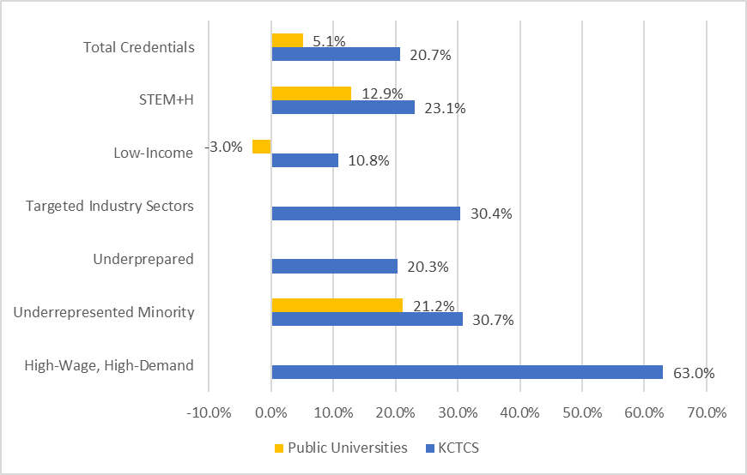
Performance Funding Model
Percent Change in Credentials Produced by Targeted Metric
from 2015‐16 and 2018‐19
$78 million investment to bring all KCTCS Colleges to equilibrium without reallocation from one college to another.

Slide 11
Mandated Programs

Slide 12
Mandated Programs
Adult Ag
Kentucky Board of Emergency Medical Services (KBEMS)
State Fire Rescue Training
KCTCS TRAINS
Notes:
In the past biennium, only Adult Agriculture was a line item, and all other mandated programs were included in our General Fund Allocation.

Slide 13
Mandated Program: Adult Ag
Current Appropriation: $1 million per year.
The Adult Agriculture program began under the Kentucky Department of Education in the 1960s.
When KCTCS was created, Adult Agriculture moved from the Workforce Development Cabinet to KCTCS.
12 full-time, 2 part-time adult agriculture instructors
Provides education in all facets of agriculture production and farm management.
Works closely with farmers to become established as relevant economic entities
2018-2019—12,901 on-farm consultations/farm visits/contacts
Notes:
In 1990 the Kentucky Education Reform Act created a split in the administration of Agriculture Education in Kentucky.
KERA mandated that the Kentucky Department of Education would serve students through grade 12.
All adult education, including the Adult Agriculture Program, was moved to the Workforce Development Cabinet.
It stayed there until 1997 when KCTCS was created and Adult Agriculture Education became a part of KCTCS.

Slide 14
Mandated Program: KBEMS
Current Appropriation: $1,799,700 per year.
KRS 311A provides the legal framework that creates KBEMS.
Certifies and licenses emergency medical personnel, agencies, training institutions, and establishes standards for the education and training.
Ensures quality, competent EMS care through effective oversight, communication, and collaboration.
Notes:
Also grants authority to the Board to license and certify Emergency Medical Service providers and agencies in Kentucky.
The administrative regulations, promulgated by the Board, are the guidelines for putting the statute into effect.
As of 2019, there were 549 Emergency Medical Responders, 8,593 Emergency Medical Technicians, 157 Advanced Emergency Medical Technicians, 3,540 Paramedics and 219 Licensed Services active in Kentucky of which KBEMS is responsible.

Slide 15
Mandated Program: StaTe Fire and Rescue Training
Current Appropriation: $1,869,900 per year
Provides annual training to fire service departments across the Commonwealth.
The primary laws governing the State Fire Rescue Training (SFRT) are in KRS 95A.020.
Coordinates emergency medical courses and industrial fire brigade training.
Courses include driver simulator training, live fire training, Firefighter Survival and Rescue, and Wildland Firefighting Awareness.
SFRT offices provide annual regional fire schools across the Commonwealth and the Kentucky State Fire School.
Notes:
The Commission is also responsible for:
Establishing training standards to our fire fighters;
A Workers Compensation Program;
funding for hepatitis A & B inoculations
Fire Training Facility Grants
Health, Safety, and Wellness initiatives.
The primary laws governing the State Fire Commission and the State Fire Rescue Training (SFRT) are in KRS 95A.020.
Several of the SFRT area offices work with the local colleges to deliver an AAS of Fire Rescue Science Technology program that has several academic certificates included. This program is accredited by the International Fire Service Accreditation Congress. This program includes several job ready type courses to prepare students for entry and leadership positions in fire and EMS departments.
The accredited certification office provides certification testing to firefighters in the Commonwealth. The office works to maintain accreditation also through International Fire Service Accreditation Congress. Currently we certify to thirteen levels. This testing process includes written and practical testing which is all job related and referenced to national standards from the National Fire Protection Association (NFPA).

Slide 16
Mandated Program: KCTCS TRAINS
Current Appropriation: $4,149,700 per year
Funding designated by the Kentucky General Assembly to help companies to invest in workforce development for their employees.
KCTCS TRAINS funds are distributed through KCTCS Colleges on a project basis and require a company cash match of 50%.
Notes:
Since its inception, KCTCS has developed over 2,000 projects for Kentucky’s businesses, providing training to 300,000 Kentucky employees.
For new or incumbent workers.
Majority of training is in advanced manufacturing.
Leadership, supervisory and soft skills training also in demand.

Slide 17
Workforce Solutions: Our ’front porch’ to business and industry.
In FY 2019 KCTCS:
Trained over 47,670 KY workers
Conducted over 73,900 industry assessments
Served over 5,000 KY businesses
Notes:
Like many of the colleges, in the audience, our workforce solutions division is the largest provider of customized workforce training for the state. Since our inception in 1997, this division meets regularly with KY businesses across the state to assess their workforce needs, then builds customized training programs to meet them.
During the FY 2019, this division trained over 47K workers, conducted over 70K industry assessments, and serviced over 5K businesses.
Our colleges believed evolving apprenticeship services to fit squarely within this division across the state as another workforce solution.

Slide 18
History of State support for KCTCS

Slide 19
State Funding Support Per Student
FY2001 was the highest funding year per student with the state allocating 77.2% (or $3,902) of funding per student (adjusted for inflation) thru our state appropriation.
FY2019 saw state funding per student drop to 43.4% (or $1,633).
Over that same timeframe (2001-2019), tuition per student went from $1,221 to $2,127, again adjusted for inflation.
TOTAL INVESTMENT: state appropriation and tuition revenue per student fell from $5,123 in 2001 to $3,760 in 2019.

Slide 21
Questions?

