Slide 1

House Budget Review Subcommittee on Postsecondary Education
Presentation – February 2020
MOREHEAD STATE UNIVERSITY
Dr. Jay Morgan, President

Slide 2
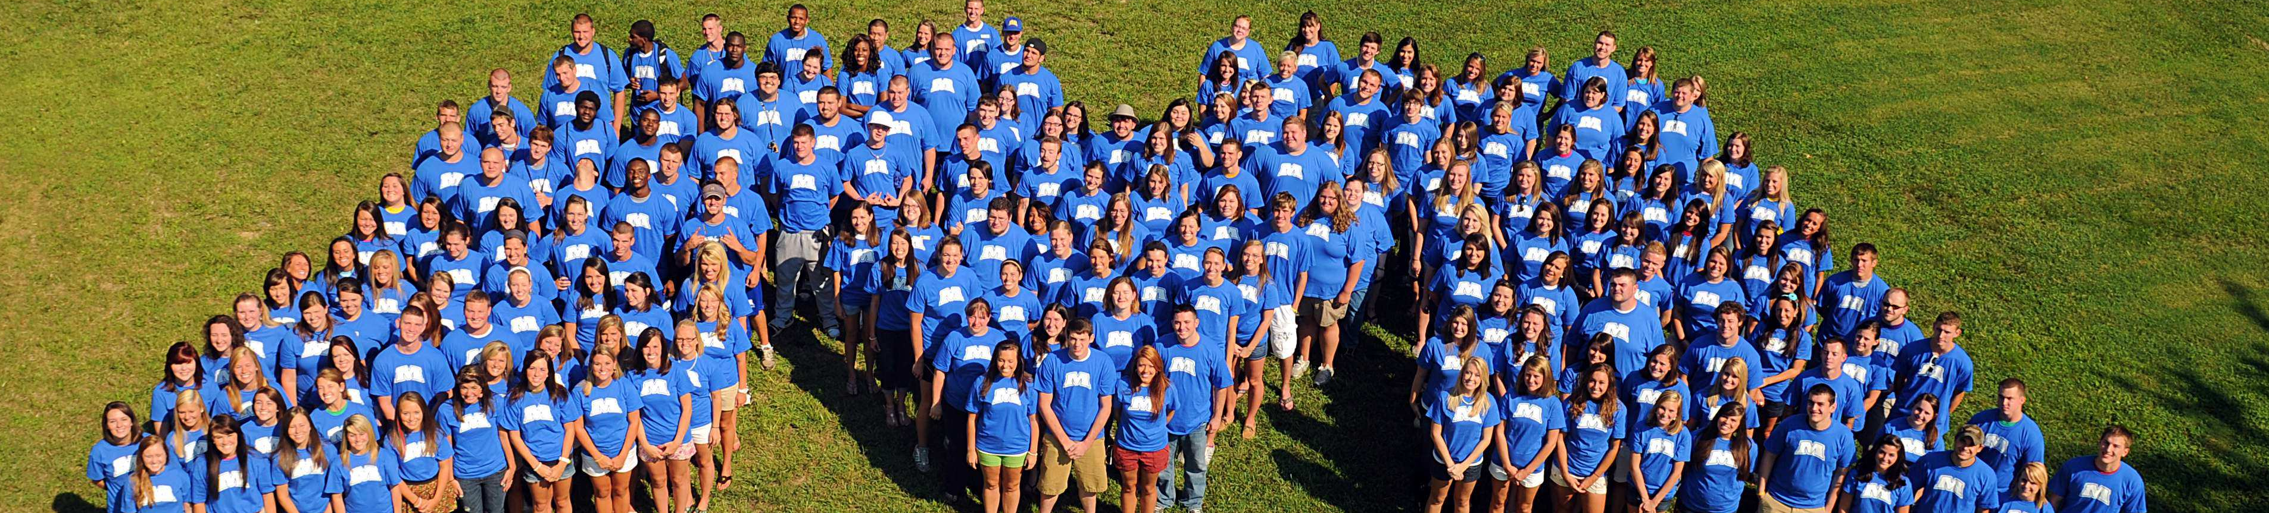
University Profile
Fall 2019 Enrollment 9,660
Retention Rate 73.2%
Graduation Rate 45.9%
Students Living in Campus Housing 2,790
Percentage of Students from Kentucky (FT-UG) 84.4%
Annual Budget $142 million

Slide 3
Rankings
19th Public Regional in the South - U.S. & World Report (#2 in KY)
Top 50 Most Affordable Online Schools – Study.com
Ranked 7th National on Nursing Exam Pass Rates – RN Careers.org
Best of the Best Top Veteran Friendly – U.S. Veterans Magazine
Safest Campus in Kentucky – National Council for Home Safety
#1 in KY on Best Colleges for Financial Aid – LendEDU.com
Top #27 Public Elites High Schools (Craft Academy) – Washington Post

Slide 4
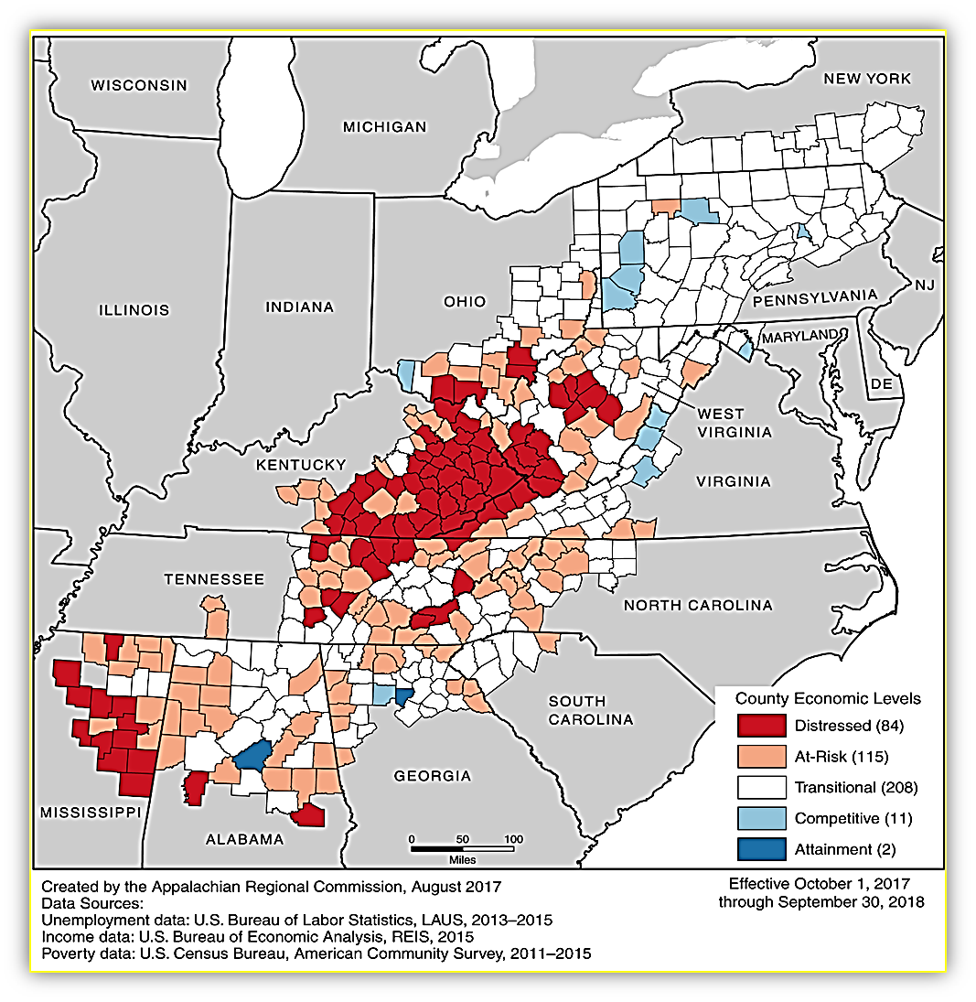
We Serve a Distinct Region of Kentucky

Slide 5
Commitment to Regional Affordability
2nd Lowest Annual Tuition Among Public 4-Year Universities $8,950
Discount Rate 33 - 37%
Percentage of Students Receiving Aid 95% +
Dual Credit Early College High School (Eagle Scholars) 2,700
Percentage of Low Income Students 52 - 54%
Average Faculty Salary $60,000
Froze Tuition in FY 2018-19 at Zero, and FY 2019-2020 at only 2.5%
Froze Housing for Three Years Running
Froze Graduate Tuition Four Years Running

Slide 6
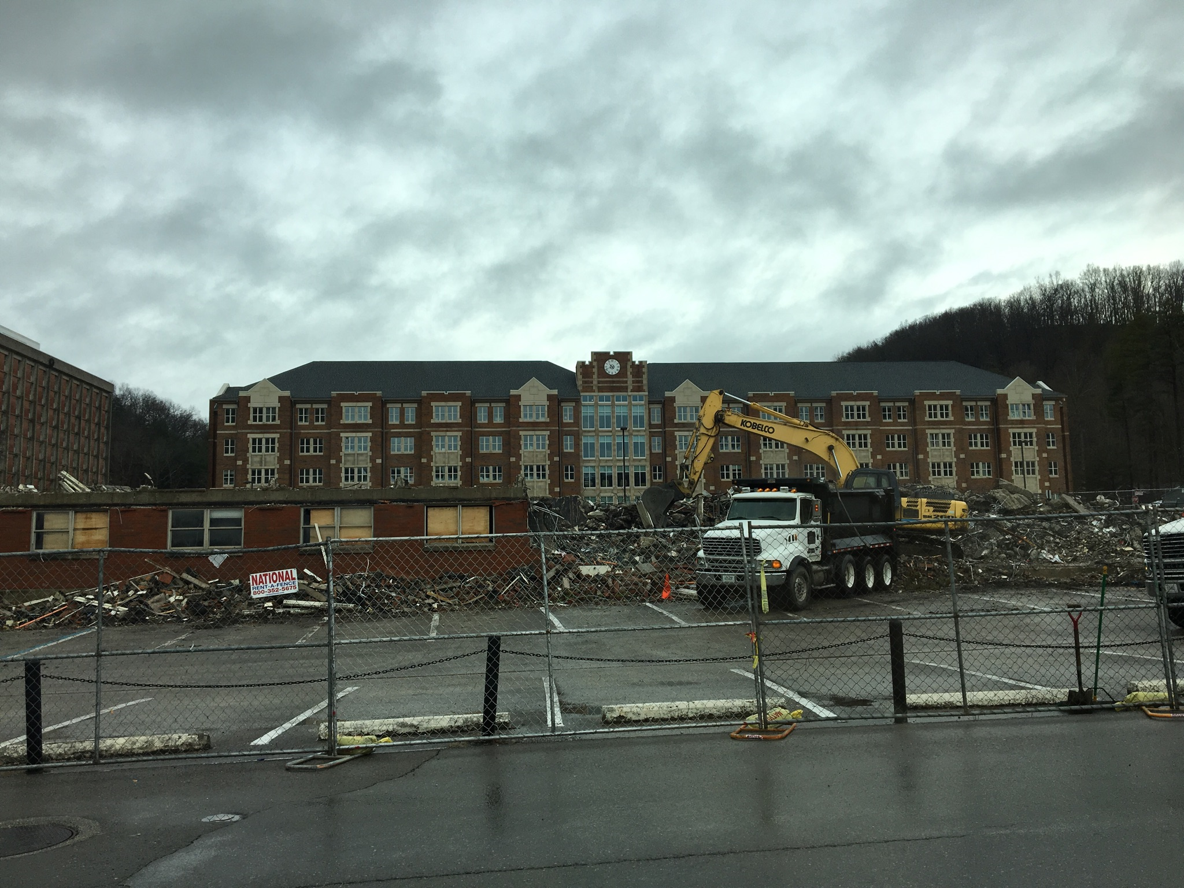

Slide 7
Budget Control Measures
Reduced square footage (demolished 6 buildings)
Leased out properties to other agencies / local government
Reduced faculty and staff
Reduced operating budgets
Renegotiated contracts with discounts
Reduced administrative costs
Streamlined operations in many areas
Delayed deferred maintenance
Refinanced debt

Slide 8
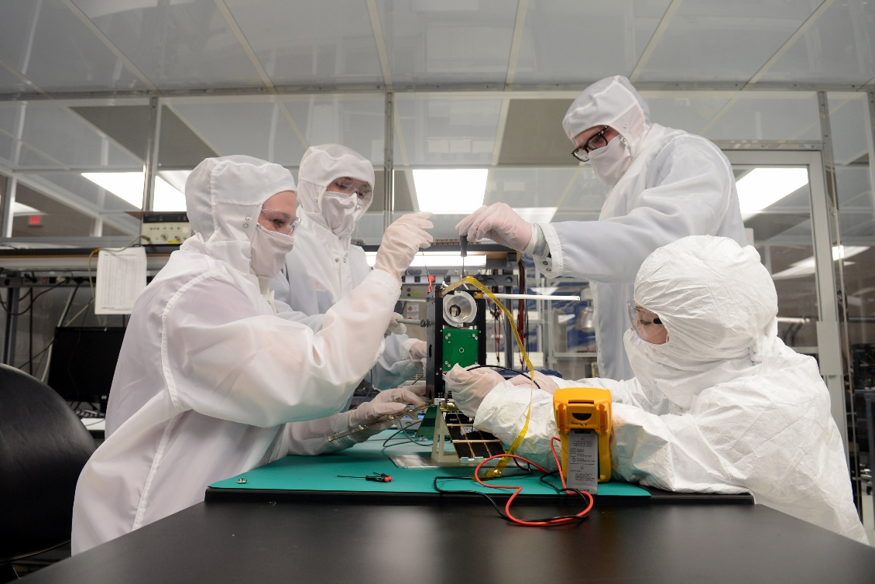
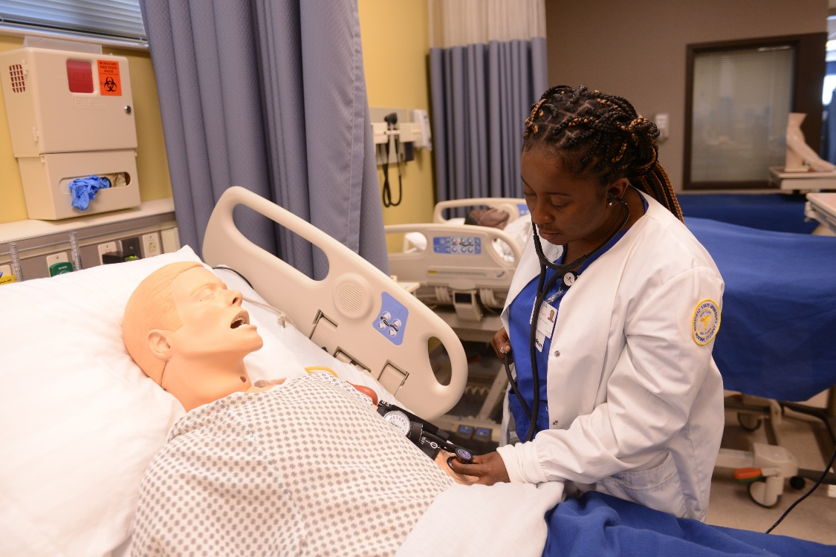
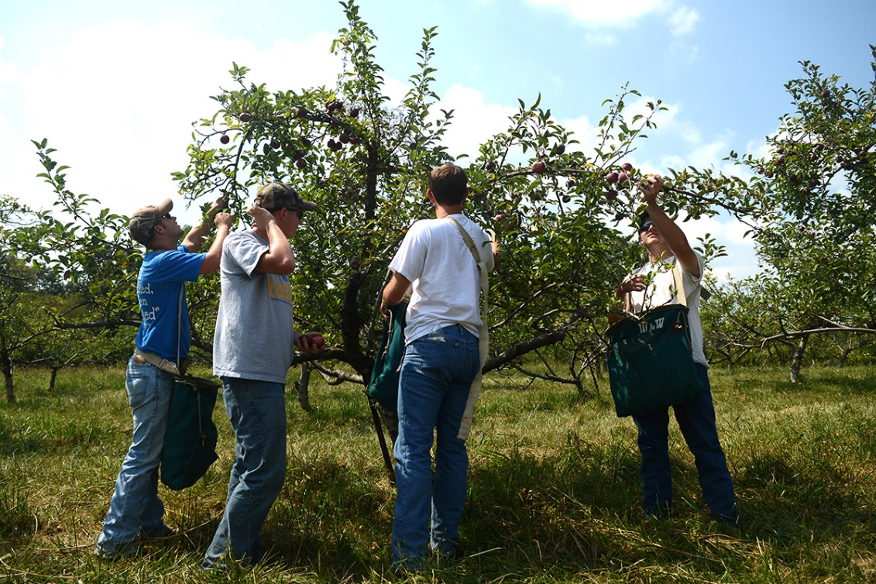
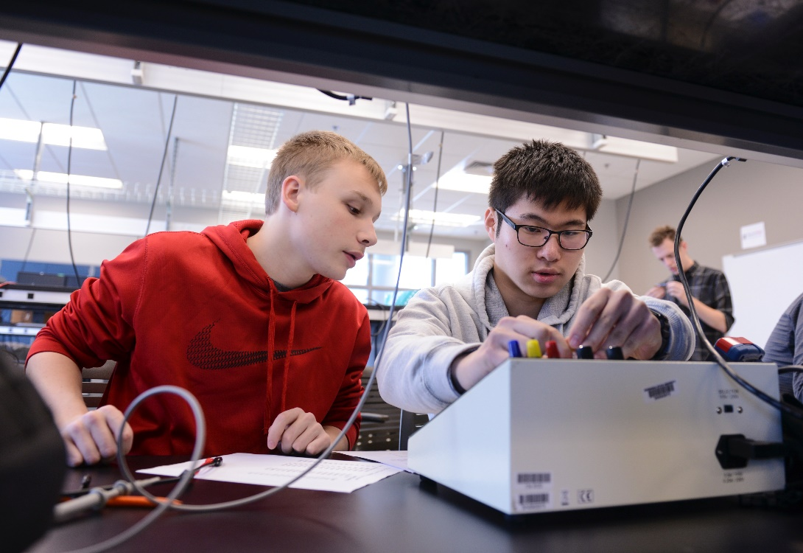
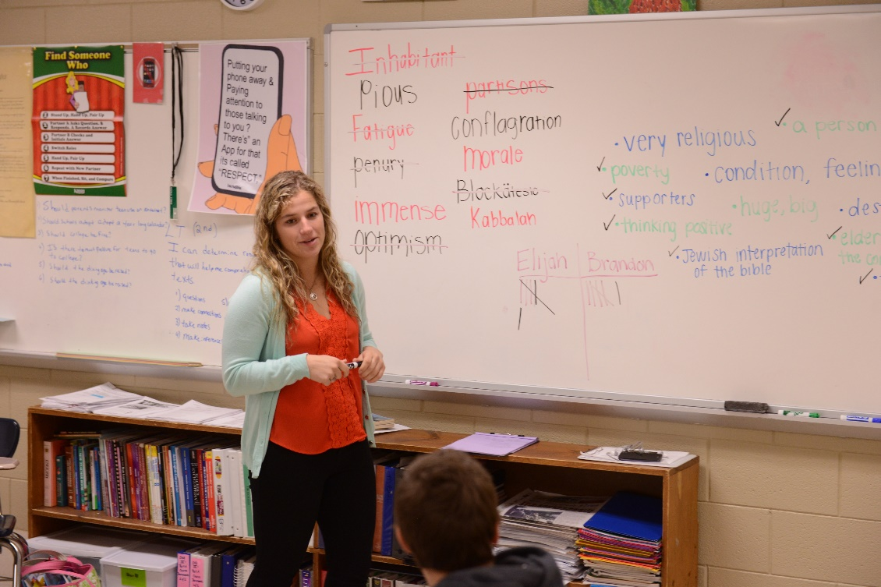
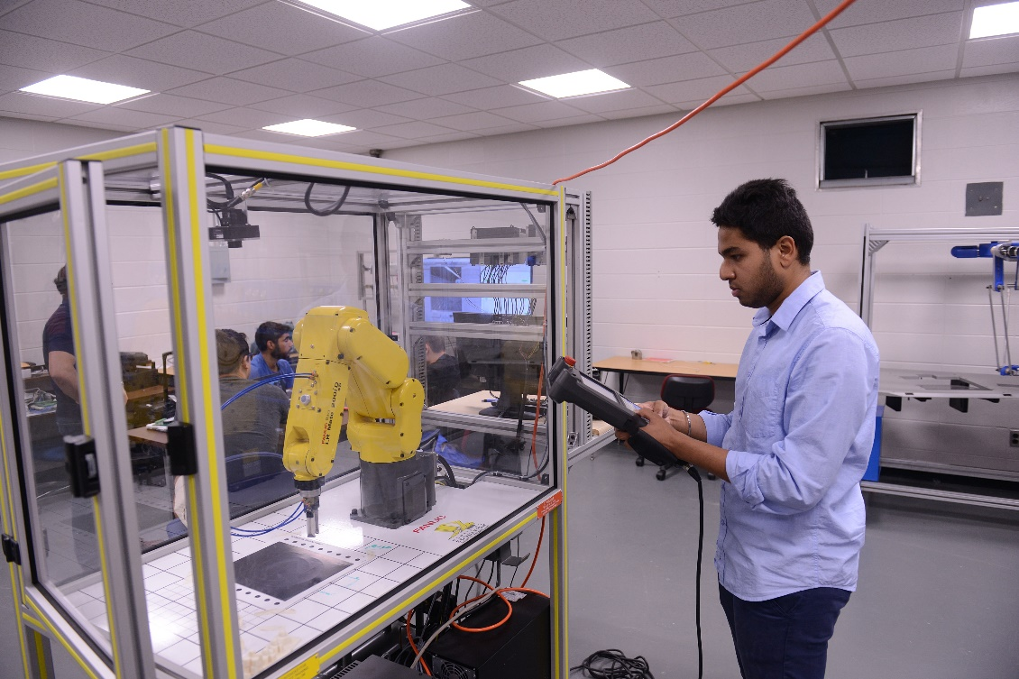
Strong Academic Programs
Serving the Economy and Region
Space Science
Nursing
Agriculture
Craft Academy (STEM+H)
Teacher Education
Engineering Technology

Slide 9
Academic & Student Performance
Retention is up 4% overall in two years
Graduation rates are trending upwards
Student progression is trending positive
STEM degree production is trending positive
Average credits to degree is among the lowest
Private giving and fundraising are significantly up
Average cost of attendance is clustered among the lowest
We are trending positive in most performance indicators

Slide 10
Craft Academy - Mandated Program
Residential high school of 120 students - 60 Jr. & 60 Sr.
Accelerated students in STEM fields
Students complete 2 years of college / 2 years of high school
$2,822,400 annual state appropriation
Dr. Joe Craft and Ambassador Kelly Craft annual support
Goal: Increase from 120 to 148 students over next biennium
Governor Beshear included the increase of students annually in his Executive Budget - 1st Yr - $329,000 and 2nd Yr - $658,000

Slide 11
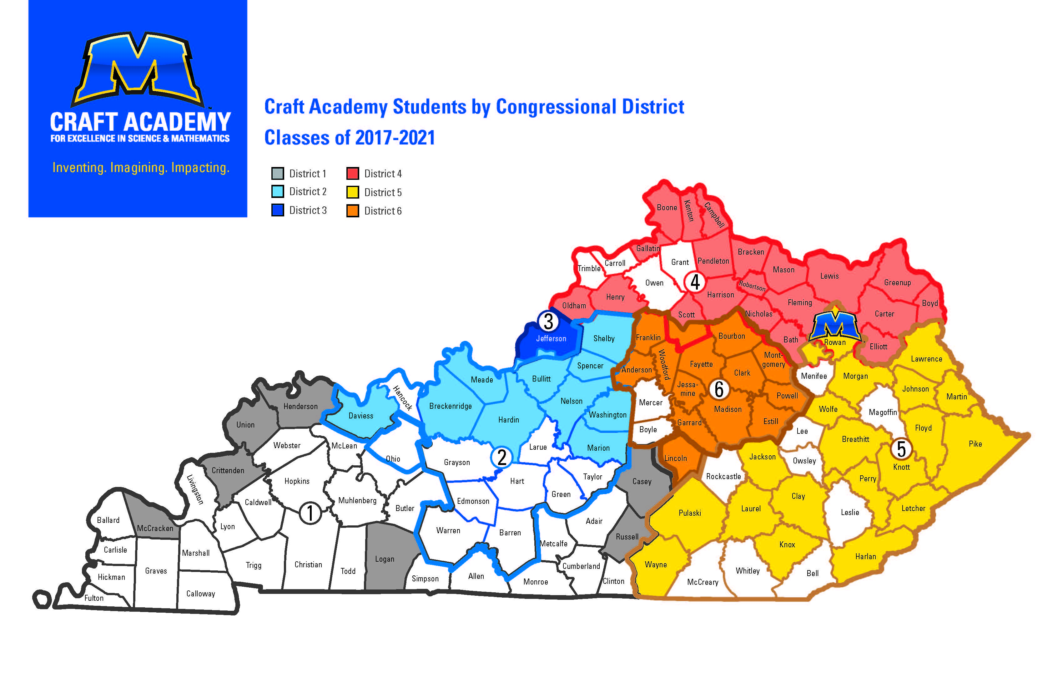

Slide 12
Funding and Legislative Requests
1). Continuing the 2% stop-loss on the performance funding
model for the 2nd year of the biennium (FY 21-22) and beyond
2). New funds to achieve equilibrium within the funding model
(6%+), and/or 1% to each university’s base funding
3). Asset preservation funding for deferred maintenance
4). Mitigation of catastrophic KERS pension costs
5). Additional Craft Academy funding

Slide 13
Funding and Legislative Consideration
MSU is unlikely to cease participation in KERS under HB 1
MSU rates to remain in KERS are 93.01% and to cease participation is 95%, costing an estimated $1.7 million more dollars in FY 20-21
Under HB 171, passed from committee last week, KERS pension rates for MSU would soar to 167%
MSU is scheduled to loose $712,000 from its base appropriation beginning July 1, 2020 due to ‘equilibrium’ in the performance funding model and over $3 million more from its base July 1, 2021
$5-6 million dollar reduction - roughly 14-16% reduction of funds

Slide 14
MSU is the Gateway to Success for Far East KY
Dr. Jay Morgan, President

