Slide 1

Budget Review Subcommittee
on Postsecondary Education
February 20, 2020
President Neeli Bendapudi, University of Louisville

Slide 2

Commitment
  “UofL is to be a premier, nationally-recognized metropolitan research university”
2

Slide 3
Premier Metropolitan University
Mission
  UofL is to be a premier, nationally-recognized metropolitan research university
Strategy
  Implementing our new 3-year strategic plan
  Learn. Work. Invest.
Learn: Serving our students and beyond
  Who we serve
  Accomplishments and successes of student body
Work: Enhancing the research enterprise
  Top tier research university
  Improving the quality of life in the commonwealth
  Employees taking advantage of learning opportunities
Invest: Connecting the university to the city, the commonwealth and beyond
  Serving as a catalyst
    Additional ways UofL can serve the Louisville region and commonwealth
    Innovation and business connections driving growth and success
    Economic ROI
3

Slide 4
Premier Metropolitan University
Recognized as a Carnegie Research I University
  1994 – Classified as Carnegie Research II University
  2005 – Achieved Carnegie Research I (Status extended in 2010, 2015 and 2018)
One of only 69 universities classified as both a Research I (Very High) and
Community Engagement Institution by Carnegie
Significantly increased total research expenditures
  $33.4 Million in 1997
  $151.2 Million in 2007
  $177.6 Million in 2017
  $173.4 Million in 2019
UofL Dental School Ranked 13th in the nation for medical research (highest in the state)
UofL School of Medicine ranking in NIH funding
  #79 in 2001
  #63 in 2018 (most recent update available)
4
Notes:
Slight drop is due to decrease in our internally financed research activity from endowments and gifts. External funding expenditures actually rose from $120 million in 2017 to $125 million in 2019.

Slide 5

Our commitment
5

Slide 6
Cardinal Principles
Community of Care
Respect, irrespective of position
Diversity and Inclusion
Integrity and Transparency
Noble Purpose
Agility
Accountability
Leadership
6

Slide 7


Learn: Student Overview
Enrollment (as of Fall 2019)
    Total: 22,684
Full-time: 16,464
International students: 1,030
Countries represented: 83
First generation college students**: 20.1%
Pell-eligible students**: 39.6%
Underrepresented minorities***: 21.7%
Military-affiliated: 7.5%
*As defined by the Kentucky Council on Postsecondary Education
** Indicates all first-time, full-time, baccalaureate degree-seeking students entering Summer/Fall 2018
*** Per CPE definition of underrepresented minorities.
7

Slide 8
Learn: Student Success
 | 1998 REPORTING YEAR | 2008 REPORTING YEAR | 2017 REPORTING YEAR | 2019 REPORTING YEAR
Freshman ACT score (average) | 21.4 | 24.4 | 25.3 | 25.6
6-year graduation rate | 30.1% | 45.7% | 54.4% | 58.6%
Baccalaureate degrees awarded | 1,734 | 2,298 | 3,010 | 3,049
Doctoral degrees awarded | 76 | 151 | 159 | 166
Specific interventions:
FAFSA
Black Male Initiative
Persistence Grants
“Just in Time” Initiative
8
Notes:
Black Male Initiative – addressing various scholastic and social challenges facing African-American male students, through academic engagement, mentoring, peer connection, and student involvement.
Persistence Grants – designed to provide a safety net for students who may, for financial reasons, be on the verge of dropping out
“Just in Time” Initiative – designed to encourage students who are taking a heavy part-time load to switch to full-time, saving them money and helping them graduate sooner

Slide 9

Work
  Office of Employee Development and Success
  Annual Performance Evaluations
  Climate Study
  Compensation Equity
9

Slide 10
Invest
  Identifying “Grand Challenges”
  Pfizer Vaccines designated UofL as its first Center of Excellence
  IBM Skills Academy
    Center for Digital Transformation to provide curriculum & educational tools
    concentrated on eight fast-growing technology areas
  UofL is partnering with UK as one of just five hubs in the United States selected as a
  Research Evaluation and Commercialization Hub (REACH) by the NIH
  Direct economic return:
    $125 million in state support leads to $2.5 billion output
      Includes newly acquired KentuckyOne assets
10

Slide 11
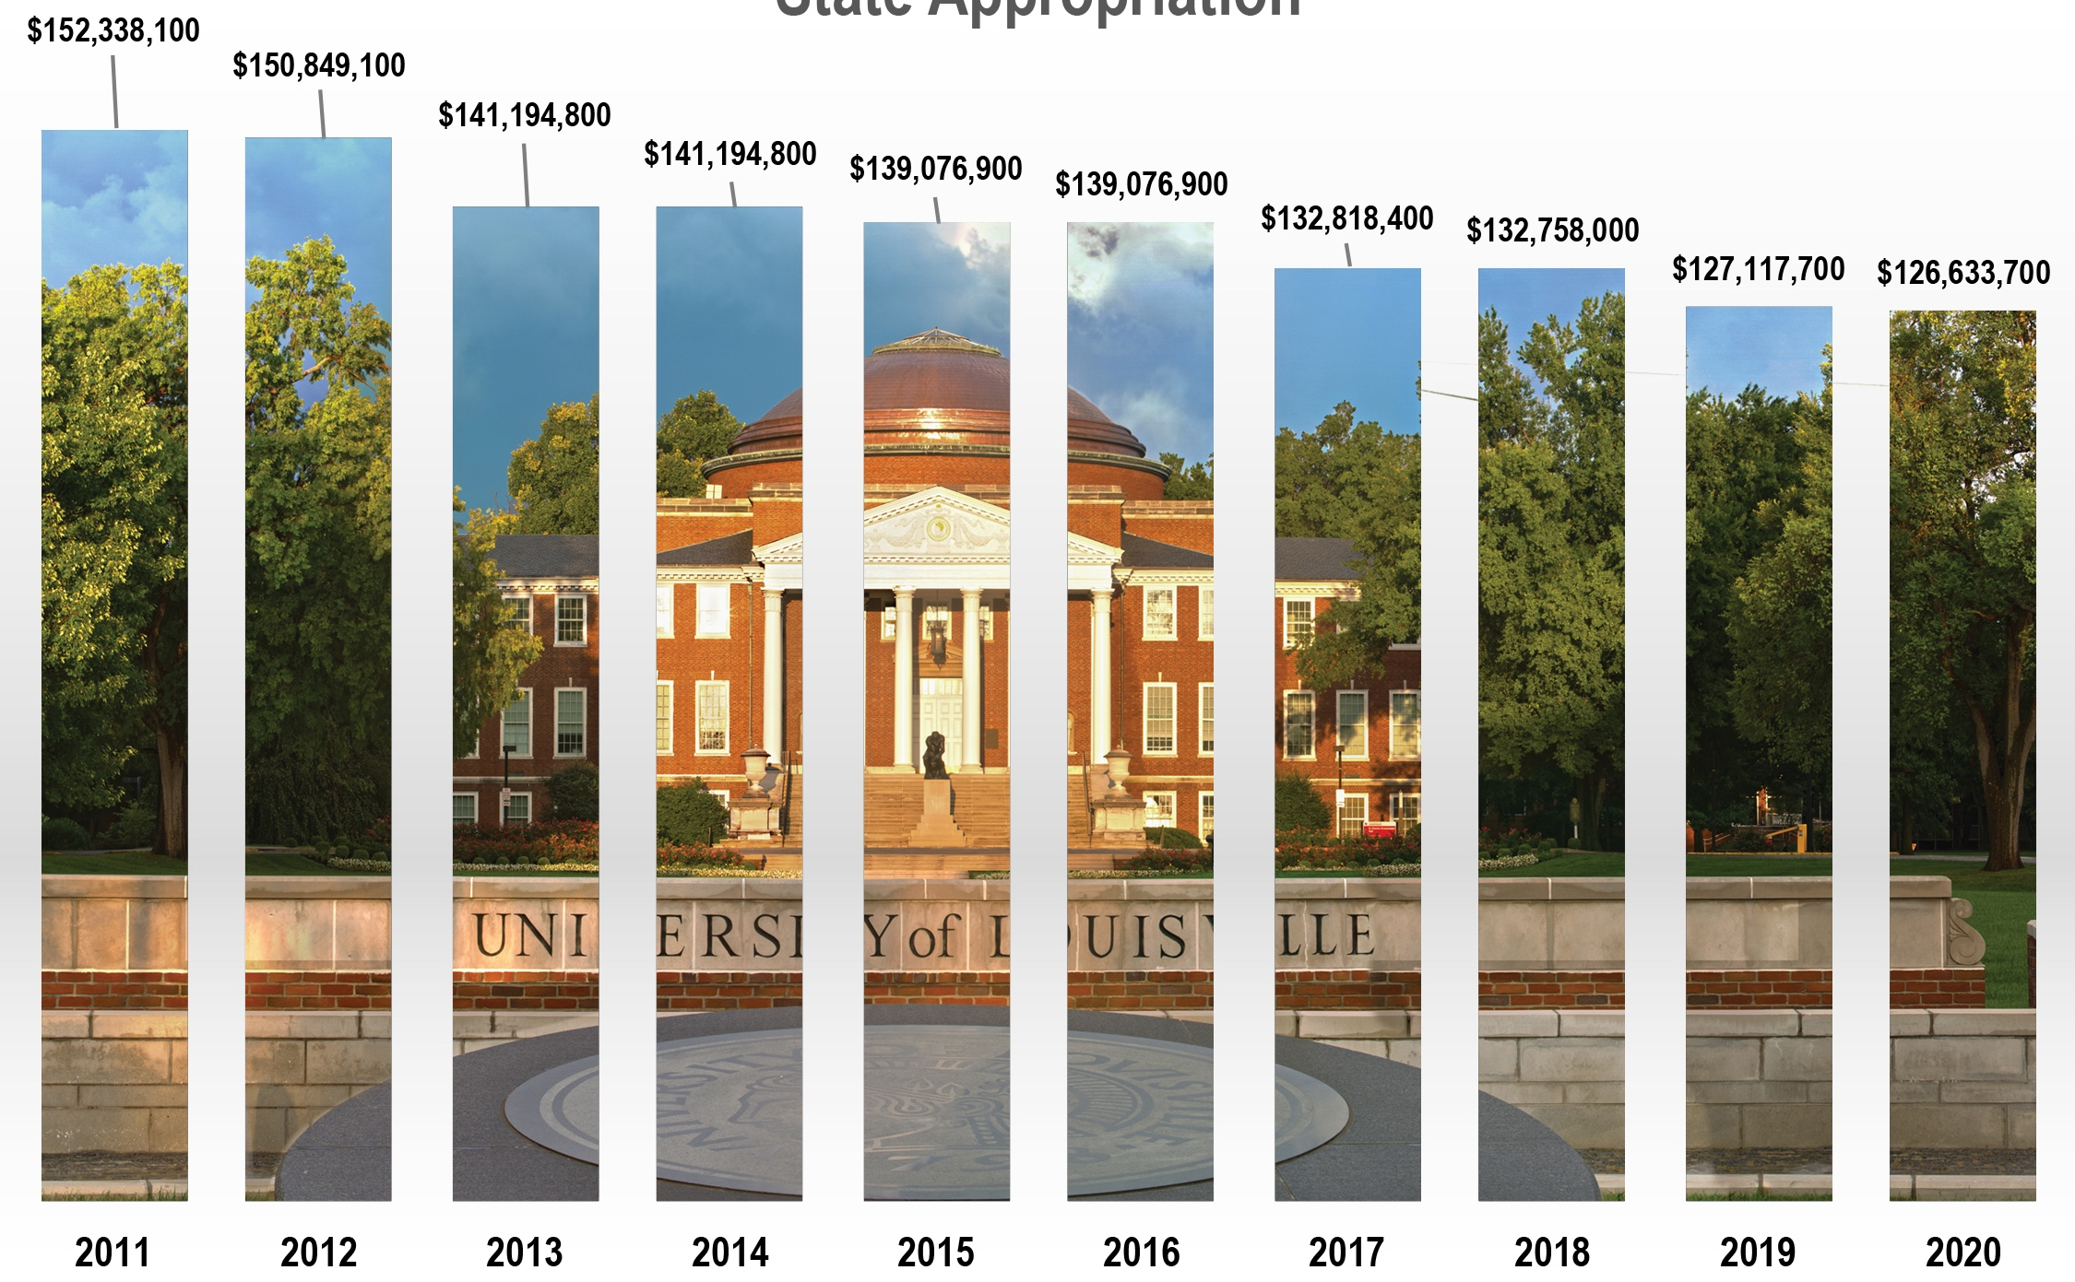
State Appropriations
% of
University
Budget
15.1%
14.7%
13.3%
13.2%
11.4%
11.4%
10.4%
10.8%
10.5%
10.3%
11

Slide 12
Support of CPE Budget Requests
Priorities
Asset preservation
  Why maintaining infrastructure matters
    Provides a safe and healthy environment to learn and work
    Preservation investments yield efficiency and dollar savings
    Reduces cost of operations
  Estimated deferred maintenance and renovation needs at UofL are more than $1 billion
  Request
    Establish funding pool to renovate and update instructional, research and student spaces
    UofL already has identified projects to be funded
    For every dollar in state funding, UofL must provide 50 cents in matching funds
12
Notes:
Mention governors resurgence fund

Slide 13
Support of CPE Budget Requests
Priorities
Performance-based funding
  UofL outperformed the sector average:
    STEM+H degrees
    Student progression at 30 hours
    Student credit hours earned
    Number of FTE students
  UofL also improved in the following metrics:
    3.3% increase in STEM degrees from 2017-18 to 2018-19
    4.6% increase in URM enrollment from fall 2018 to fall 2019
    2.1% increase in student progression at 90 hours from 2017-18 to 2018-19
  Request:
    New state funds allocated to performance funding pool
    Maintain 2% stop-loss
13

Slide 14
Support of CPE Budget Requests
Priorities
    Mandated programs
      UofL Rural Health Care: The Rural Health program is administered through the University of Louisville’s AHEC office within the School of Medicine Office of Community Engagement and Diversity. UofL is affiliated with Family Medicine Residencies in Madisonville and Glasgow. The UofL School of Medicine is exploring additional partnerships to expand training in other regions.
      Statute: 164.938 (Rural Health Education Program)
  Request:
    Maintain mandated program funding
14

Slide 15

Extraordinary Achievements
Nationally recognized (again) as top producer of Fulbright Scholars
  14 winners in 2019-20
  134 winners since 2003
  More than all other Kentucky public universities combined
15

Slide 16

THANK YOU FOR YOUR
CONTINUED SUPPORT AND INVESTMENT IN
The University of Louisville and the
Commonwealth of Kentucky!
Neeli@Louisville.edu
16

