Slide 1
Budget Review Subcommittee on Postsecondary Education
January 27, 2022
Interim President Lori Stewart Gonzalez, University of Louisville

Slide 2
Thank you!

Slide 3
A banner year
Continued academic momentum
Enrollment and campus presence
Record-breaking research
Supporting our community

Slide 4
Monetary
$130 million of state support generates $1.3 bill of direct output (10x the return on taxpayer investment- excluding health system)
Our Students
Access and Opportunity
Highest Pell-eligible student population in Kentucky, ACC
Top-ranked for minority access
Lowest average student debt upon graduation (4-year Ky publics)
Our Citizens
Prevented closure of Jewish Hospital and continued system-wide care
Scheduled to repay KEDFA loan ahead of schedule
A careful steward of state resources

Slide 5
Key funding Components
Asset Preservation
Bucks for Brains
Speed School of Engineering Building

Slide 6
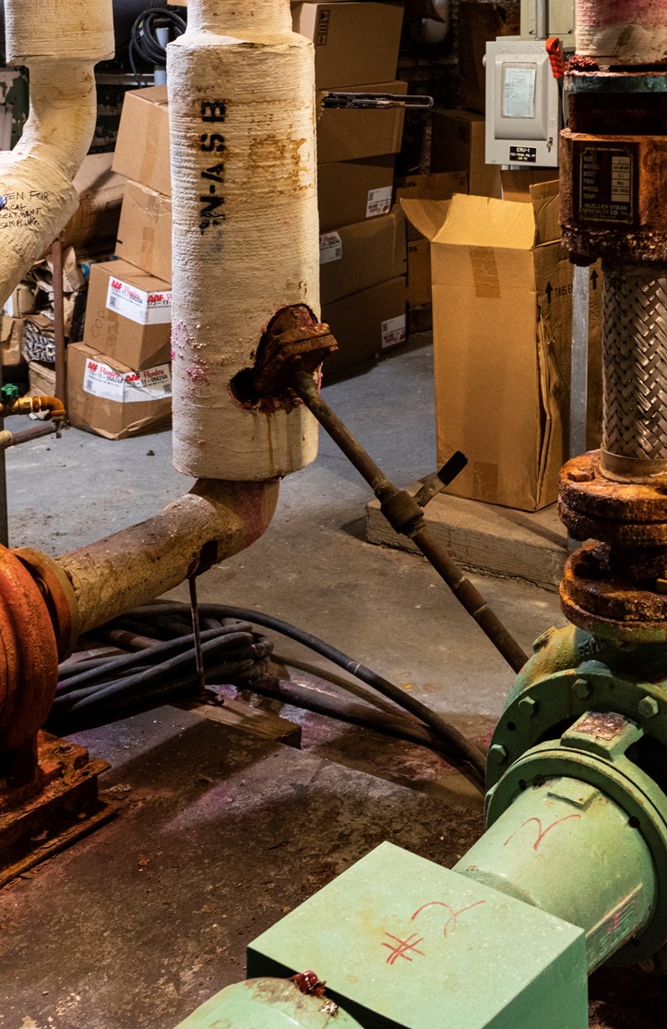
Asset Preservation
More than $1 Billion in deferred maintenance
10.4 Million square feet
Average building is 55 years old

Slide 7
Asset Preservation
With your support
Provide safer, healthier, more effective learning environment across the campus:
Upgrade infrastructure systems (HVAC, electrical & mechanical)
Repair roofs, windows, lighting on campus facilities
Extend the useful life of facilities
Reduce future costs

Slide 8
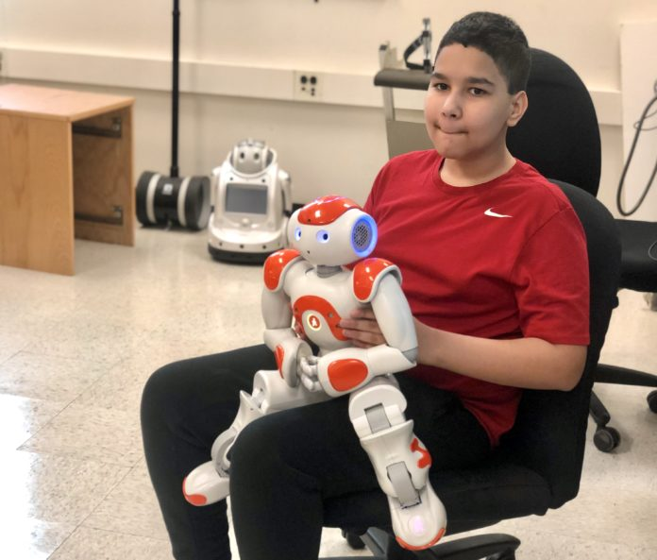
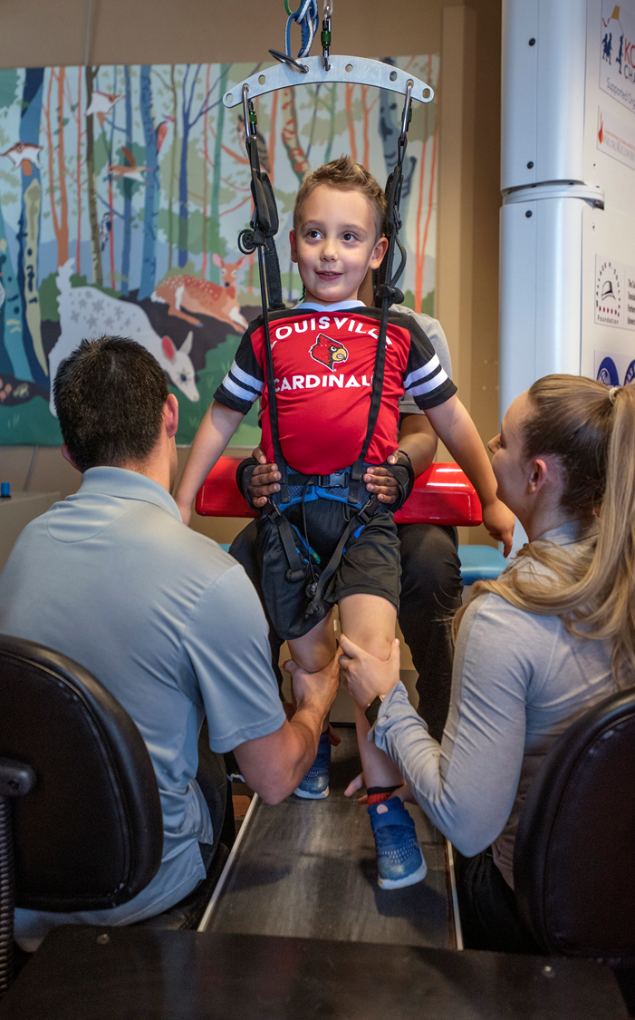
BUCKS For BRAINS
Successes
Funding led to explosive grant growth
$34 million (1997) to $201 million (2021)
Supports research and education in medicine, engineering, nursing and more
Spinal Cord
Robotics

Slide 9
Bucks for brains
With your support
Build upon prior successes
Attract and retain top students (STEM+ H)
Solutions for societal, health, economic development needs
Strengthen high-impact research
Incubator for start-ups
Talaris Therapeutics

Slide 10
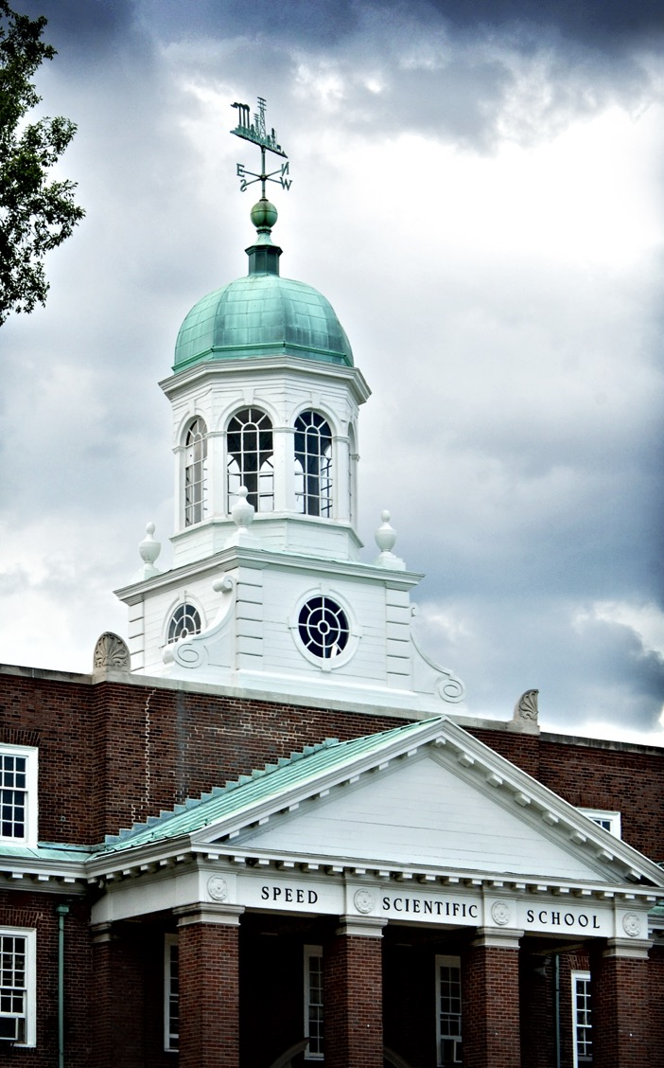
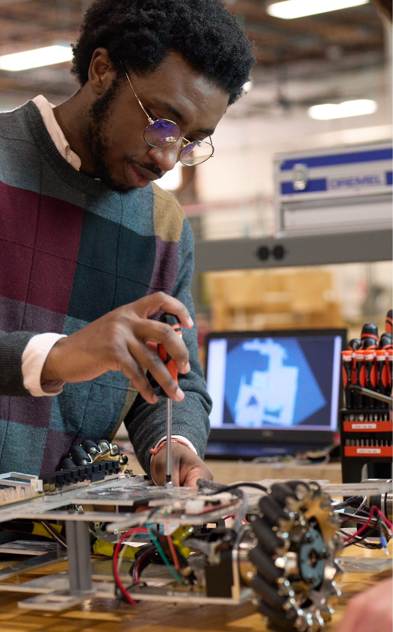
SPEED School engineering building
Manufacturing drives Kentucky’s economy
Fulfilling market demand for engineers and conducting groundbreaking research

Slide 11
Speed School Engineering Building
With your support
Enhance learning and research capabilities
Strengthen partnerships with industry to create synergies and student co-ops
GE/First Build
Create the engineering workforce needed to drive Kentucky’s economy

Slide 12
Questions?

