Slide 1
Council on Postsecondary Education
Budget Priorities for 2022-2024
Budget Review Subcommittee on Education
February 17, 2022

Slide 2
CPE Agency Budget
General Fund Budget Components
Decreased Funding and Personnel
Expanded Duties and Responsibilities
Progress Toward 60x30 Goal
2022-24 Budget Priorities

Slide 3
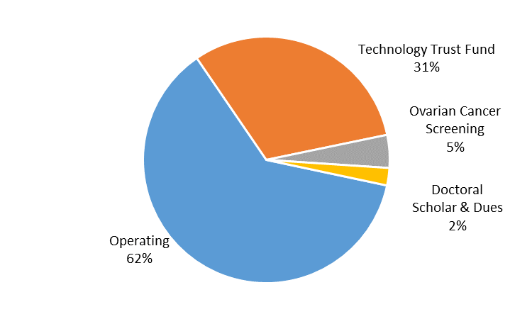
CPE Agency Budget
General Fund Budget Components

Slide 4
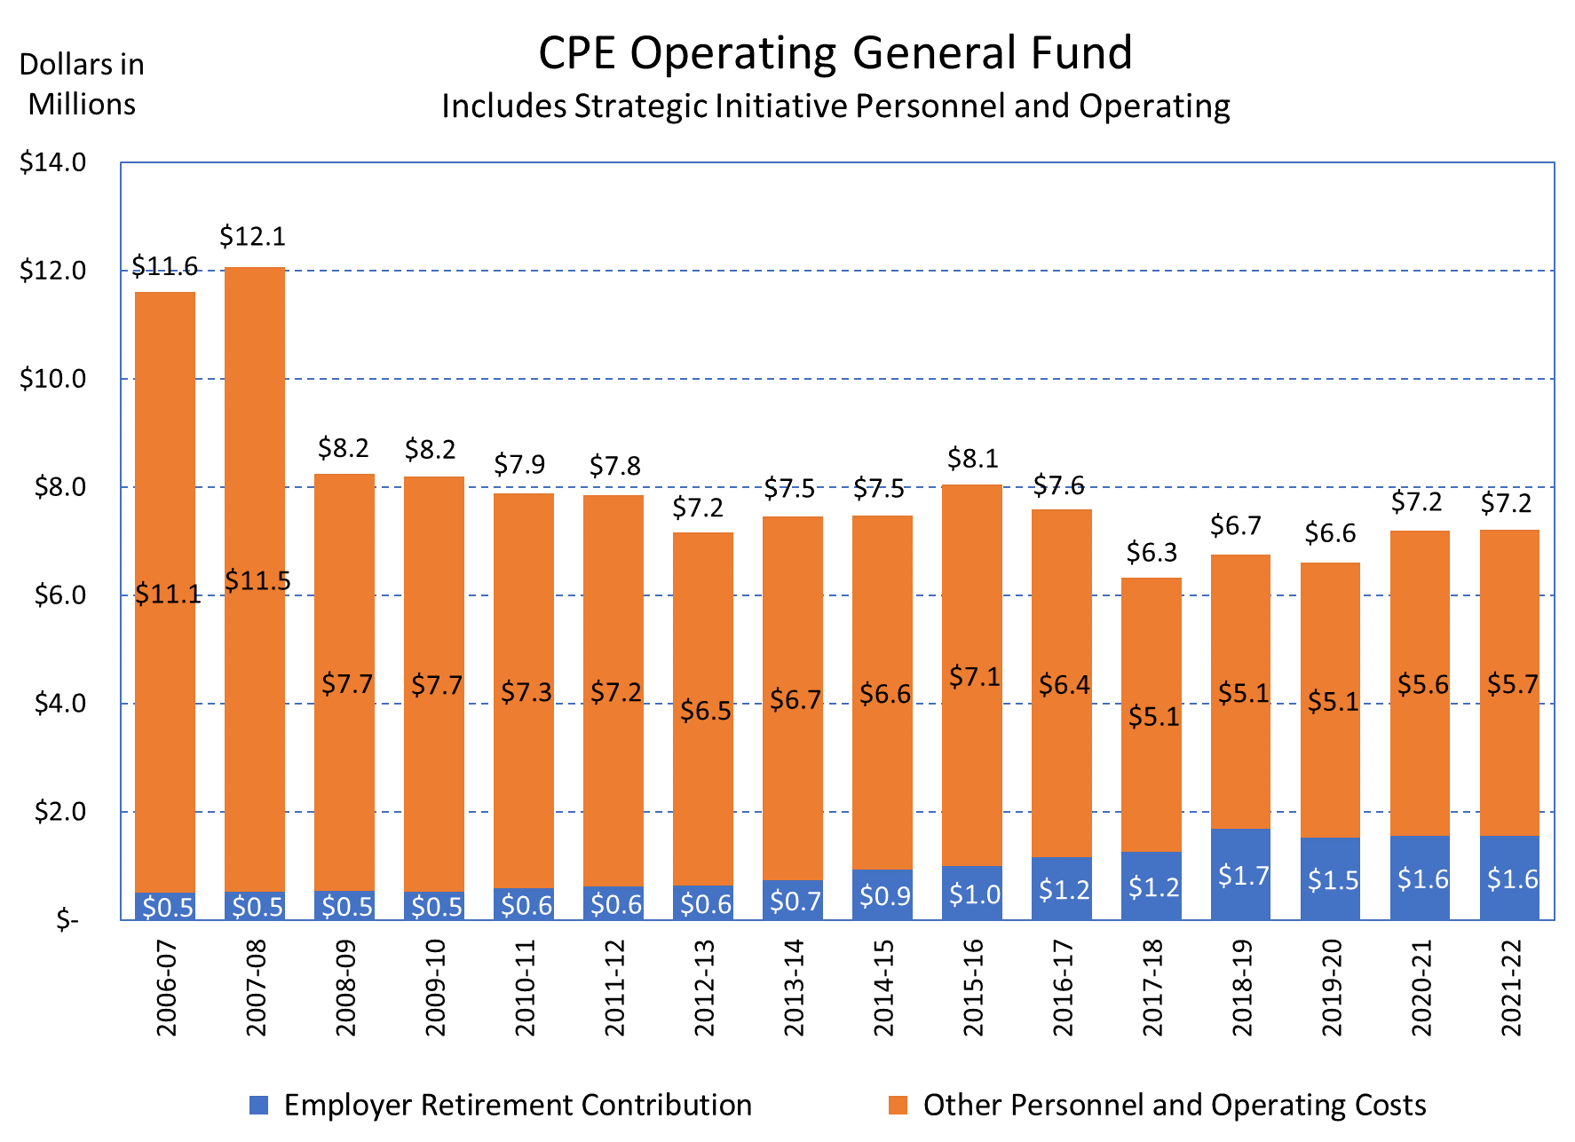
CPE Agency Budget
Decreased Funding

Slide 5
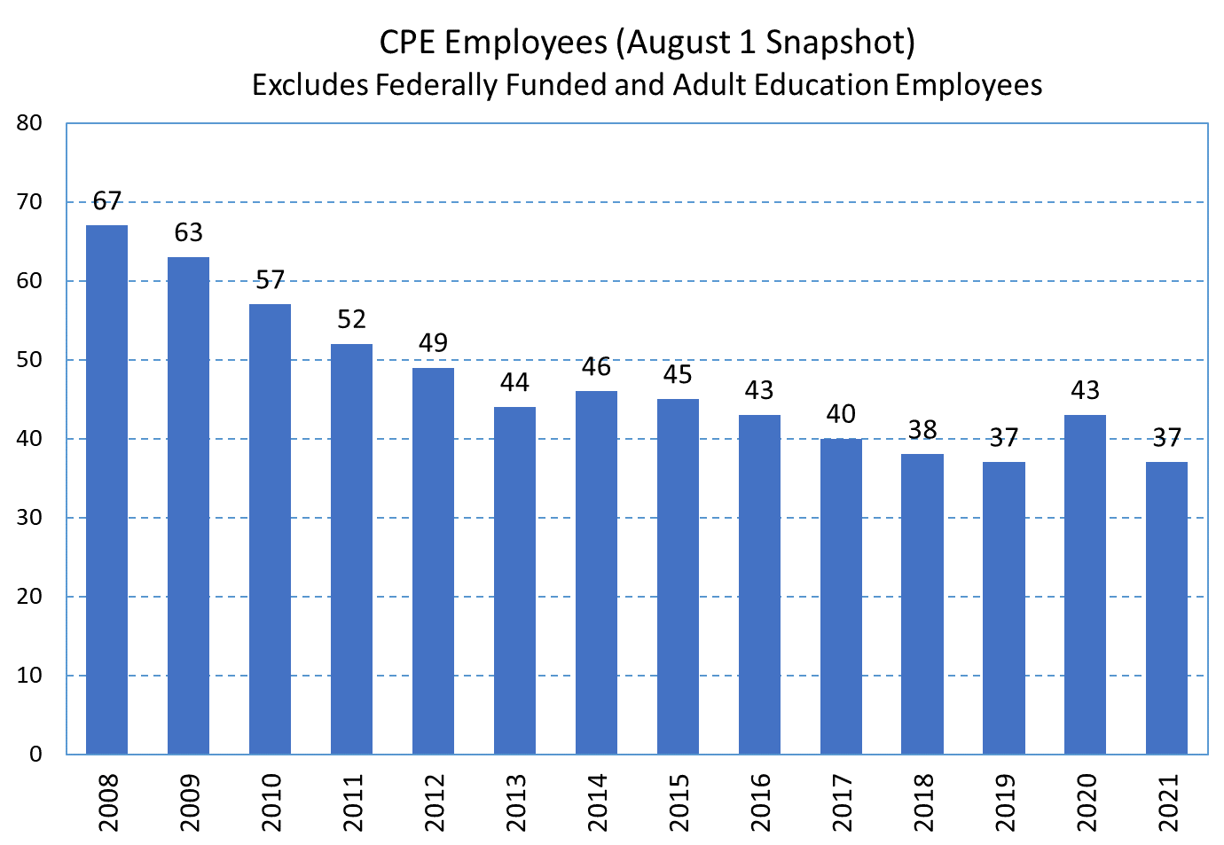
CPE Agency Budget
Decreased Personnel

Slide 6
CPE Agency Budget
Expanded Duties and Responsibilities
Examples (since 2008):
Stronger coordinating role to meet the needs of the state
Higher education performance funding model
Revamped academic program review and evaluation process
College and university financial health assessments
Administrative and academic oversight of Kentucky State University
COVID-19 related federal funds management and tracking
New statewide DEI policy and state-level programming to close achievement gaps
Increased alignment between postsecondary and business/industry

Slide 7
CPE Agency Budget
Expanded Duties and Responsibilities (Cont’d)
Training and professional development for all campus board members
Expanded private and proprietary institution licensure responsibilities
Credit transfer and articulation agreements
Enhanced higher education data collection, analysis, and reporting
Student Right to Know website and other ROI data/reports
Expanded state programming supporting college completion
Project Graduate and other programs supporting adult learners
Commonwealth Education Continuum and other programs supporting stronger pathways between secondary and postsecondary education

Slide 8
CPE Agency Budget
Progress Toward 60x30 Goal
Performance funding and student success initiatives have supported degree and credential production despite recent enrollment declines
Increases in unduplicated, undergraduate degrees and credentials are exceeding the growth needed for Kentucky to achieve its 60x30 goal

Slide 9
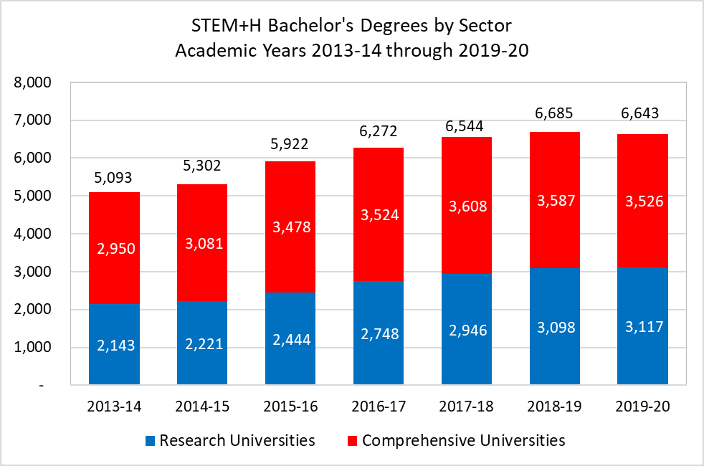
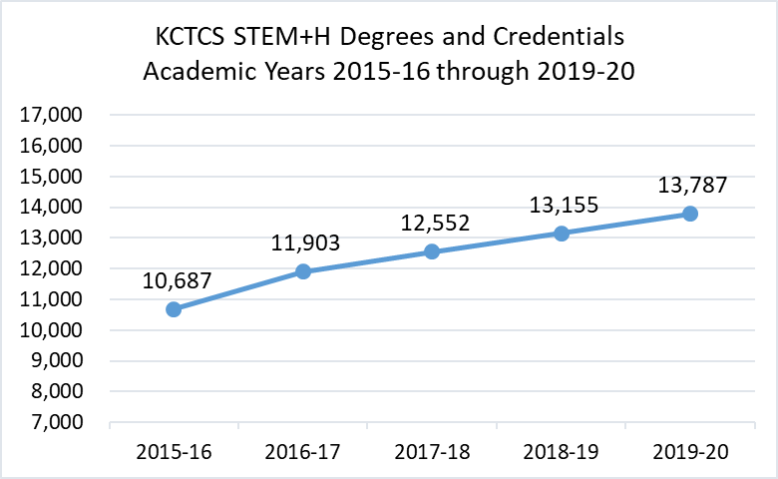
CPE Agency Budget
STEM+H Degrees and Credentials
Between 2016 and 2020, STEM+H degrees and credentials at KCTCS increased by 3,100 awards, or by 29%
This represents an average annual growth rate of 6.6% in STEM+H degrees and credentials
Between 2014 and 2020, STEM+H bachelor’s degrees grew by 1,550 degrees, or by 30%
The research sector accounted for 63% of that increase, with STEM+H degrees growing by 45% at the research universities and by 20% at comprehensive universities

Slide 10
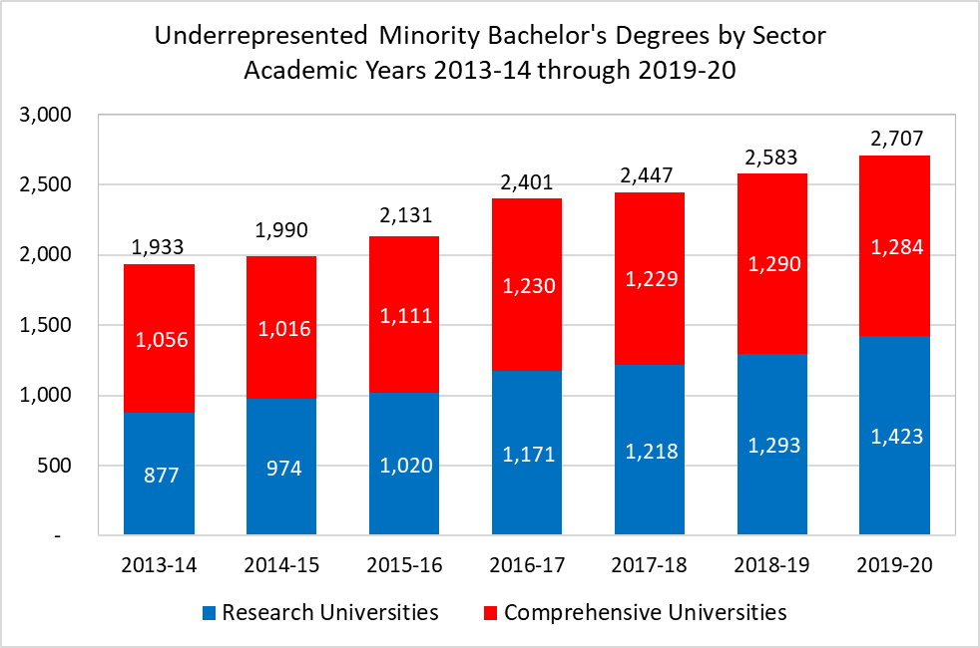
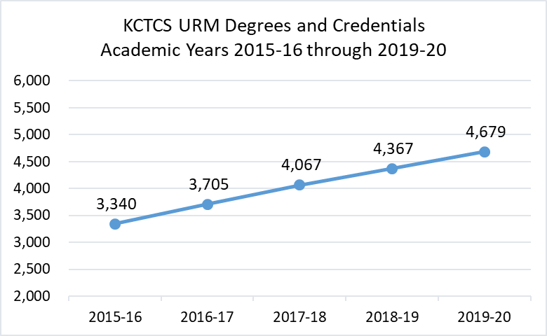
CPE Agency Budget
URM Degrees and Credentials
Between 2016 and 2020, KCTCS degrees and credentials awarded to URM students increased by 1,339, or by 40%
This represents an average annual growth rate of 8.8% in URM degrees and credentials
Between 2014 and 2020, bachelor’s degrees awarded to URM students grew by 774 degrees, or by 40%
The research sector accounted for 71% of that increase, with URM degrees growing by 62% at the research universities and by 22% at comprehensive universities

Slide 11
CPE Agency Budget
2022-24 Budget Priorities
¹ Includes costs associated with expanded responsibilities in workforce and economic development, academic program evaluation, financial oversight and the Student Success Collaborative.
Note: Components included in the House Budget are shown in Green Font.

Slide 12
Remaining Priorities
Expanded Duties and Responsibilities
Early Postsecondary Advising
Innovation Fund

Slide 13
Remaining Priorities
Expanded Duties and Responsibilities
Component | 2022-23 | 2023-24
Expanded Duties and Responsibilities | $1,032,500 | $1,383,400
Request Features:
Funding will allow CPE to expand its role in aligning higher education and workforce needs, monitoring campus finances, and evaluating academic programs
Additional funding in the second year will replace private grant funds that support the Student Success Collaborative (i.e., the grant ends in 2023-24)

Slide 14
Remaining Priorities
Expanded Duties and Responsibilities (Cont’d)
Request Features (Cont’d):
The Student Success Collaborative aims to improve student success outcomes at both KCTCS and public universities by:
  improving credit transfer,
  redesigning developmental education, and
  working with mid-level managers (deans, directors, program chairs)
Rationale:
Requested funding is needed to effectively respond to growth in CPE’s duties and responsibilities and expanded due diligence and oversight role

Slide 15
Remaining Priorities
Early Postsecondary Advising
Component | 2022-23 | 2023-24
Early Postsecondary Advising | $1,285,000 | $3,285,000
Request Features:
These funds will enhance and enrich postsecondary advising for high school students and improve awareness of early postsecondary opportunities
Provides professional development opportunities and resources to high school counselors to help students transition to postsecondary education through use of intentional advising and systemic, holistic supports
Current funding was secured through GEER II and ARP Act funds, but those funds will not be available in 2023-24

Slide 16
Remaining Priorities
Early Postsecondary Advising (Cont’d)
Rationale:
Increasing college-going rates and enrollment at Kentucky postsecondary institutions is important to help the state meet its 60x30 college attainment goal
Expanded advising will strengthen the P12 to postsecondary pipeline, encourage college participation, and help students navigate career pathways
Early Postsecondary Advising will increase college access through more college applications, admissions and enrollments; and benefit students as they transition to postsecondary through higher retention, persistence and degree attainment rates

Slide 17
Remaining Priorities
Innovation Fund
Component | 2022-23 | 2023-24
Innovation Fund | $2,500,000 | $0
Request Features:
Provide grants to campuses to achieve state goals for higher education
Fund statewide initiatives
Reward collaboration, innovation and evidence-based practices
Target four priority areas:
  College affordability
  Transition to postsecondary programs
  Student success
  Kentucky workforce priority areas

Slide 18
Remaining Priorities
Innovation Fund (Cont’d)
Request Features (Cont’d):
Funds will be used to:
  Strengthen programs and services for adult learners
  Build program capacity in high-demand workforce fields
  Expand workforce learning opportunities and career placement services
  Evaluate and strengthen dual credit and other early college programs
  Implement the Kentucky Graduate Profile
Rationale:
    Funding is needed to implement best-practice approaches for re-skilling and up-skilling adult learners, better align academic programs with workforce needs, and build an educated workforce

Slide 19
Questions?

