Slide 1
House Budget Review Subcommittee on Postsecondary Education
February 3, 2022

Slide 2
Murray State University Presenters:
Dr. Bob Jackson, President
Dr. Dina Byers, Dean of the School of Nursing and Health Professions
Mr. Jordan Smith, Executive Director of Government and Institutional Relations
Dr. Debbie Reed, Director of the Breathitt Veterinary Center (BVC)
Dr. Tony Brannon, Dean of the Hutson School of Agriculture

Slide 3
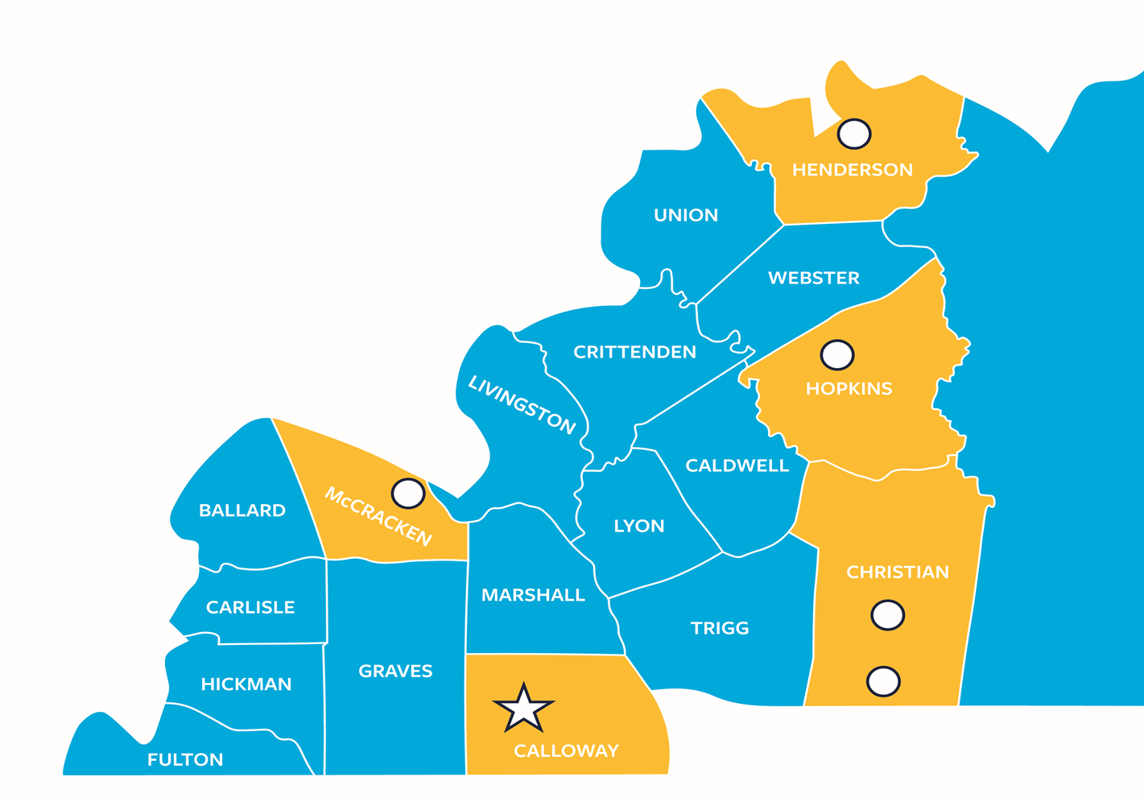
18-County Service Region

Slide 4
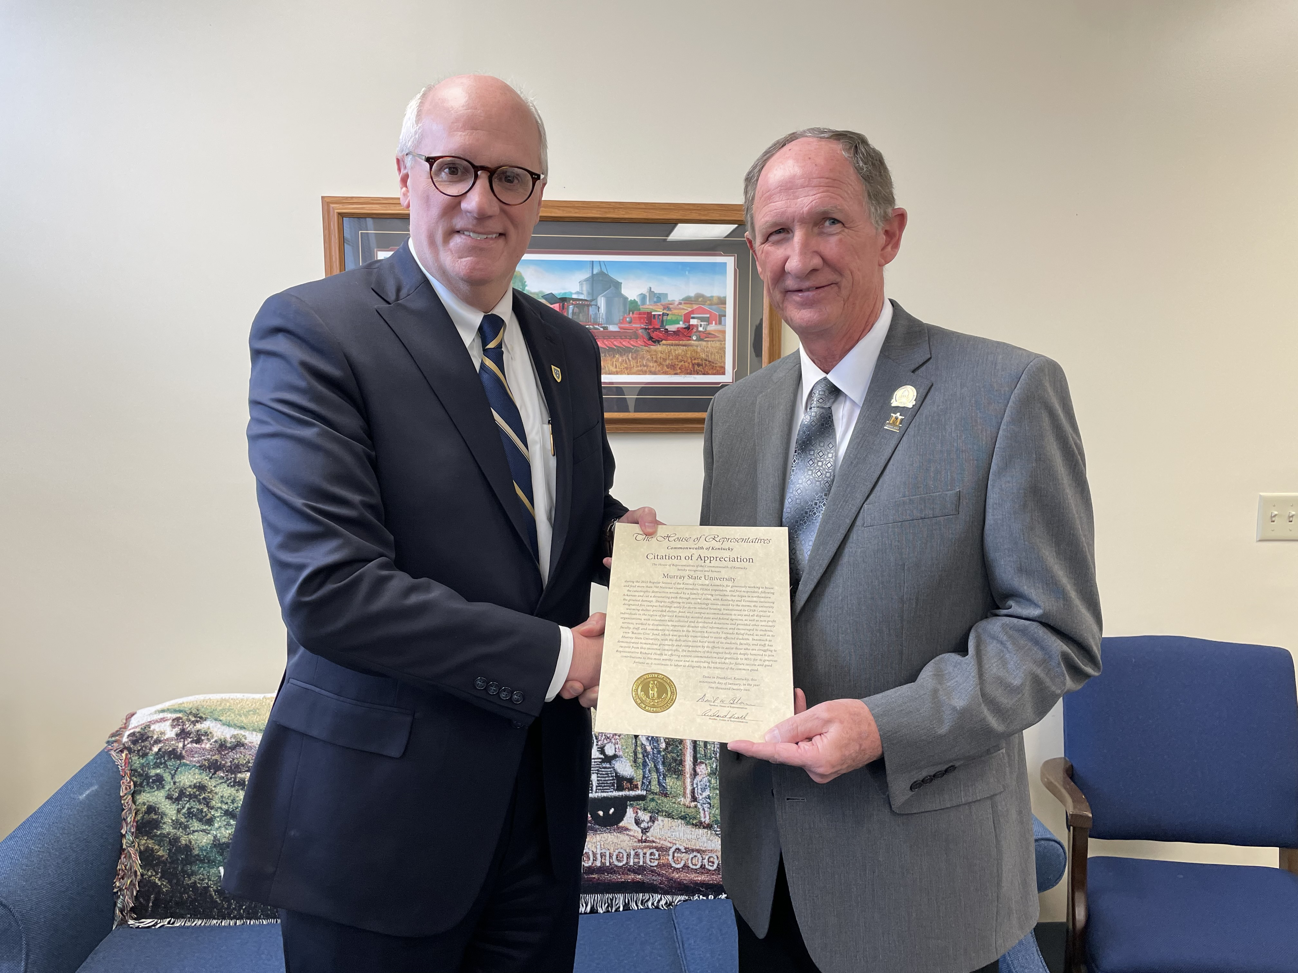
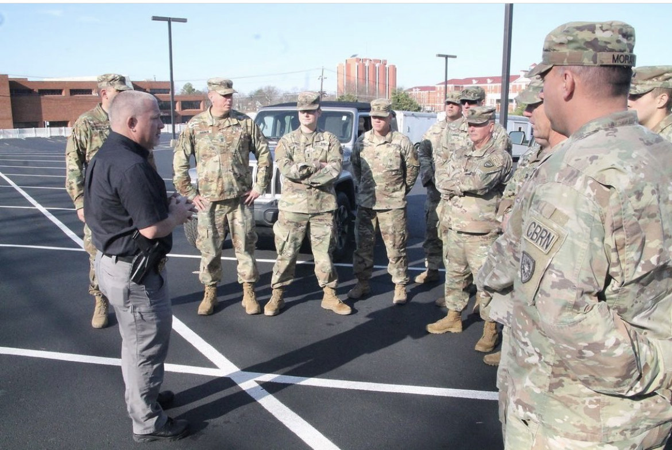
18-County Service Region
MSU supplied food and housing to over 700 National Guard, FEMA personnel and first responders immediately after the devastating tornado and storms hit our region in December.
The MSU CFSB Center was transitioned into a warming shelter and we provided housing for displaced students and families.
Continue to provide aid and assistance to students impacted by the disaster through our “Racers Give” fund.
Partnering with the West Kentucky Workforce Board to further help with student needs.
We will continue to provide necessary assistance and support to the counties impacted by these devastating storms.

Slide 5
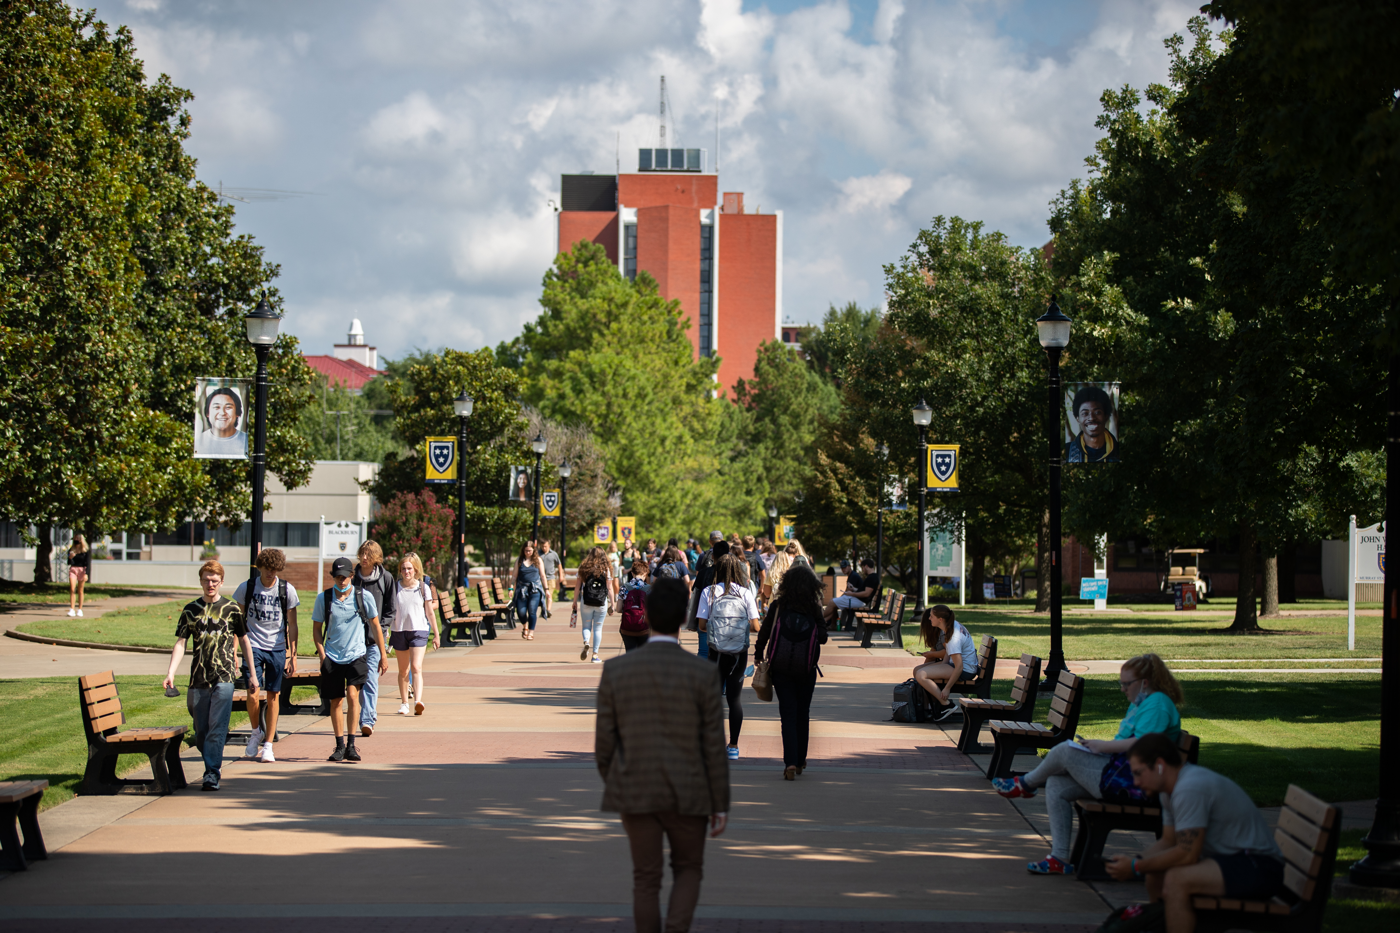
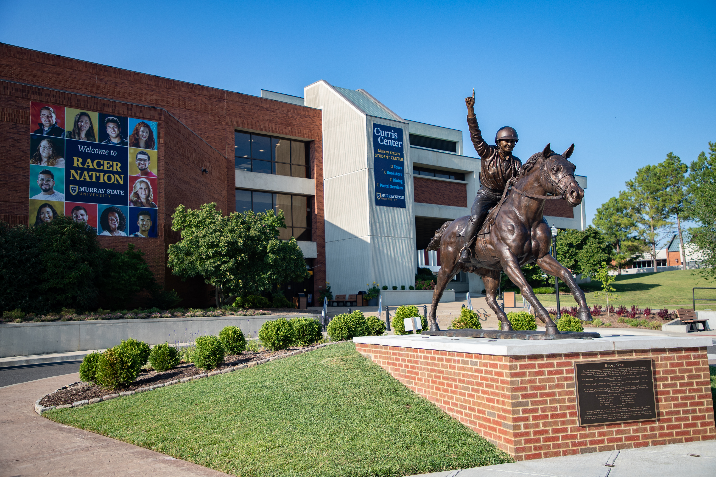
Overview
Fall 2021 Enrollment: 9,427
Students reside in 113 Kentucky counties
2,302 degrees conferred for 2020-21
– 10% increase in degrees/credentials over the last two years
75,000 alumni worldwide
38,000 alumni in Kentucky

Slide 6
Academic Quality, Access & Affordability

Slide 7
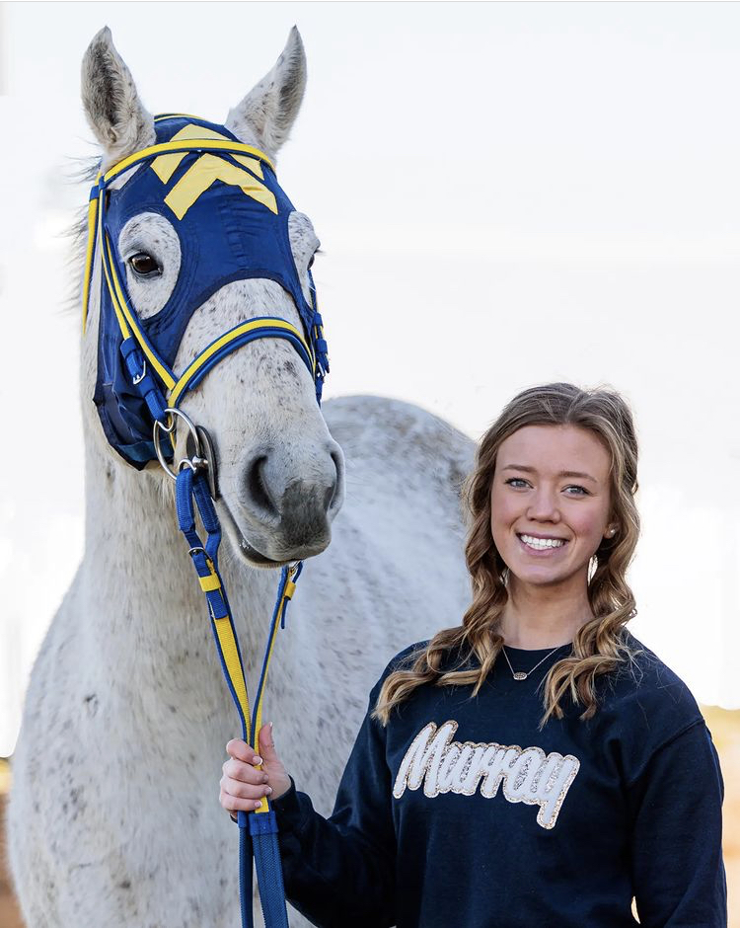
Overview
99% of First-Time/Full-Time Students Receive Financial Aid
$115 Million in Financial Aid and Scholarships Awarded Annually
Top First-Time-Freshmen (FTF) Majors: Nursing, Vet-Tech, Biology, Computer Science, Engineering and Physics, Elementary Education
Business and industry partners such as Boeing, Lockheed Martin, Microsoft, Yamaha and many others on workforce solutions and initiatives
$500 Million Economic Impact Annually to the State

Slide 8
School of Nursing & Health Professions Overview
Enrolled 820 students in Fall 2021
Programs include:
Bachelor of Science Nursing (BSN)
RN-BSN
Bachelor of Science in Exercise Science (Pre PT and OT, among others)
Bachelor/Master of Science in Nutrition and Dietetics
Bachelor/Master of Science in Public and Community Health
Bachelor of Science in Respiratory Therapy – Madisonville/WKCTC
Master of Science in Occupational Therapy – Paducah
Doctor of Nursing Practice (DNP)
Nurse Anesthesia Track
Family Nurse Practitioner Track
Specialty Track

Slide 9
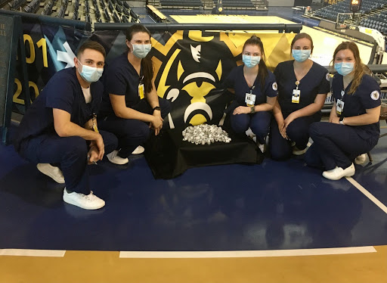
School of Nursing & Health Professions Overview
Our partners include the Murray-Calloway County Hospital, Baptist Health, Mercy Health, Jackson Purchase Medical Center, Jennie Stuart Health, Deaconess Henderson Hospital, Baptist/Deaconess Madisonville Hospital, area health departments, local schools and other hospitals/healthcare facilities throughout our region/state.
Kentucky will have over 30,350 openings for Registered Nurses by 2026
MSU Regional Vaccination Center (2.14.2021 – 5.7.2021)
Over 11,000 vaccinations given
Over 125 MSU SONHP and OSH Students assisted

Slide 10
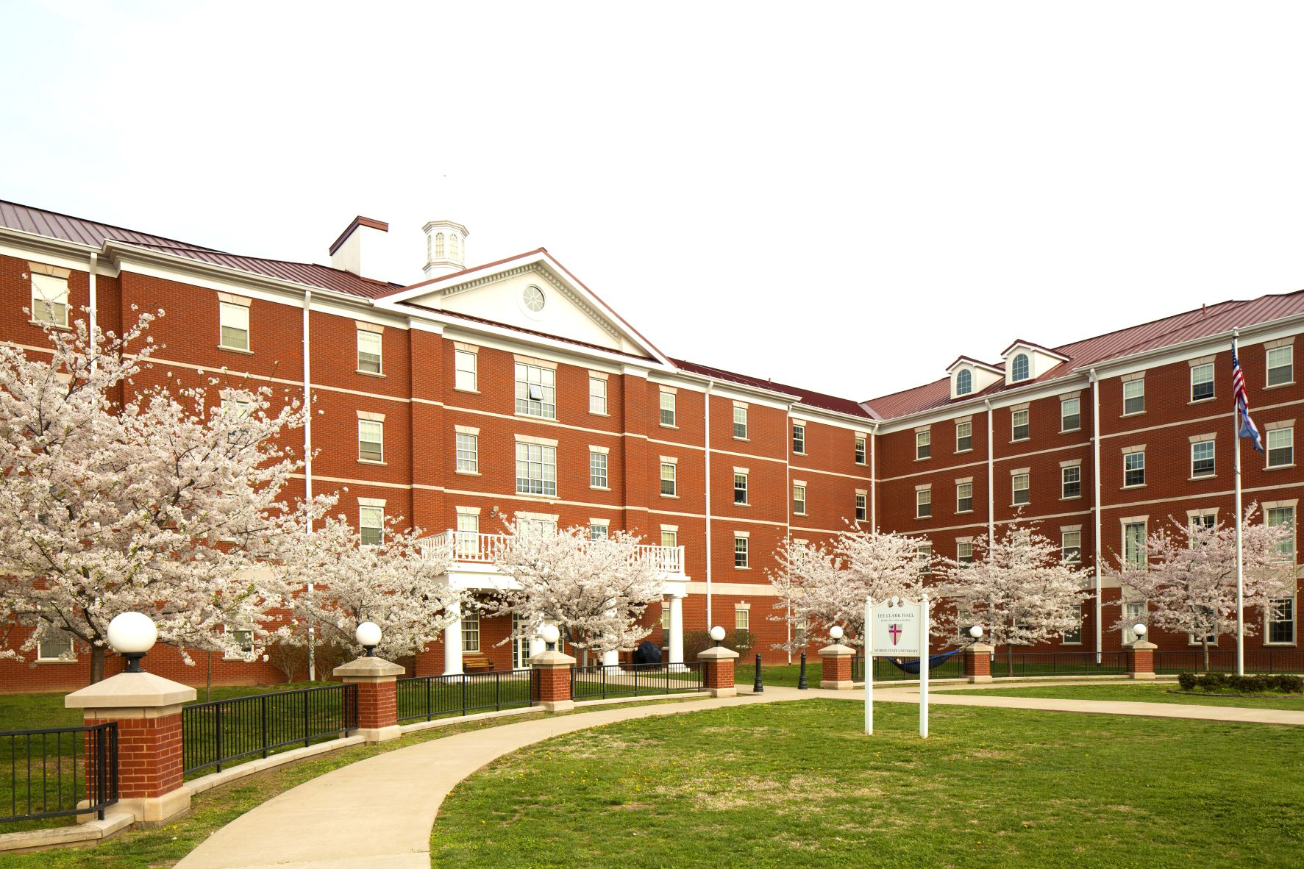
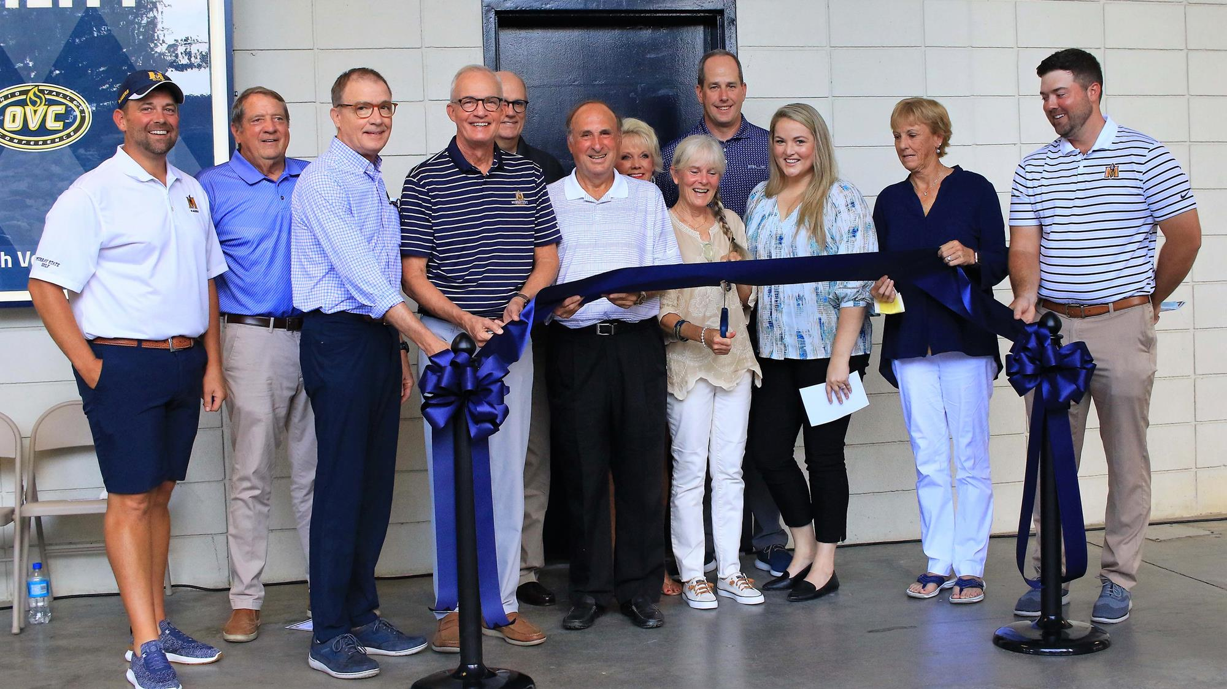
Moving Forward
New Strategic Plan
Campus Master Plans
Campus
Housing – P3
Athletics

Slide 11
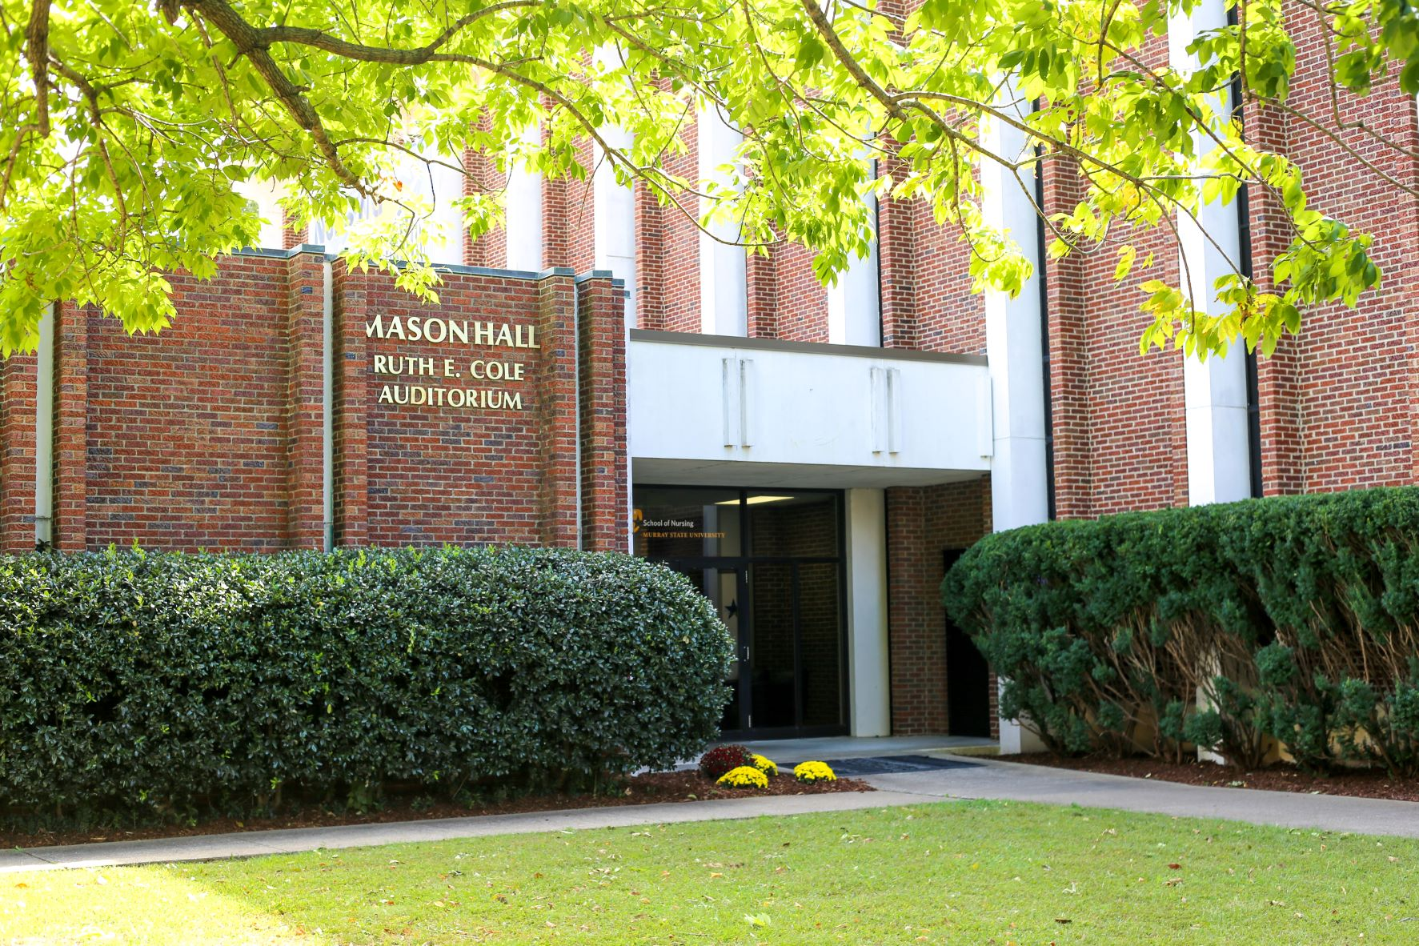
School of Nursing & Health Professions Overview
Capital Priority - Construction of a new School of Nursing and Health Professions Building - $45.5M
Mason Hall – Built in 1967
Expansion urgently needed to increase lab space for students to practice advanced assessment/technical skills (IV therapy, wound care, etc.)
Increase nursing/healthcare programs to meet crucial regional and state-wide demand.

Slide 12
Asset Preservation/Deferred Maintenance
HB 1 – Thank You
In addition to the MSU SONHP $45.5M Capital Construction
HB 1 contains $47.2 million for MSU for deferred maintenance needs, with no match required.
MSU is celebrating 100 years
These funds will allow us to complete major deferred maintenance and improvements to many of our historic buildings, student center, among others
Hutson School of Agriculture – Oakley Applied Science
Electrical grid upgrades, campus steam distribution system upgrades, building systems and energy efficiency projects.
Public-private partnerships (P3 – housing/dining) and other authorizations and approvals are also contained in HB1.

Slide 13
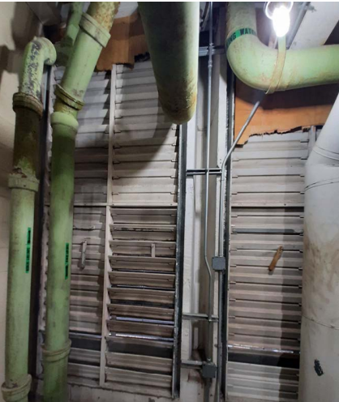
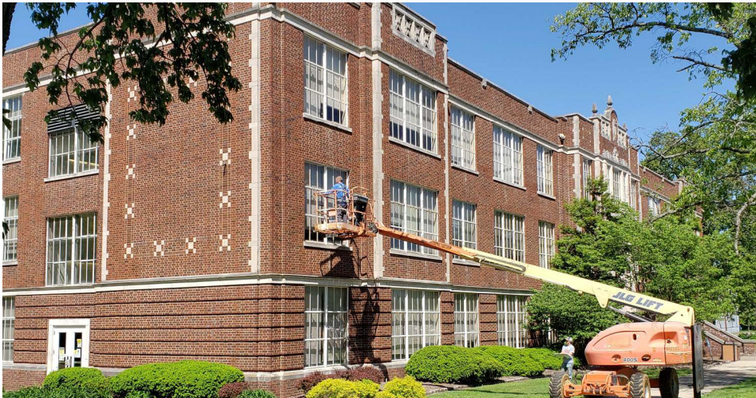
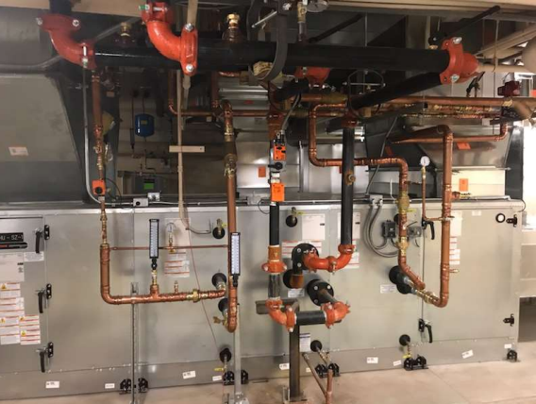
Asset Preservation/Deferred Maintenance

Slide 14
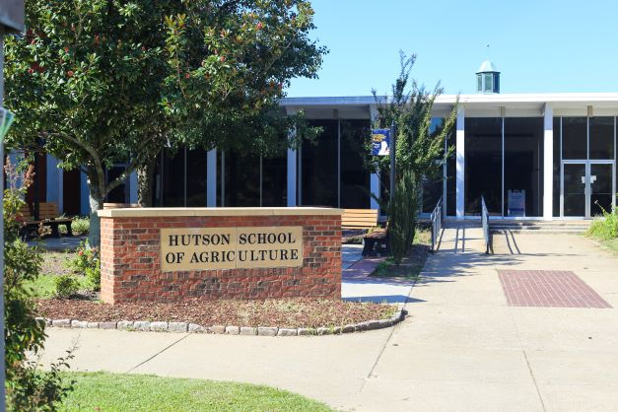
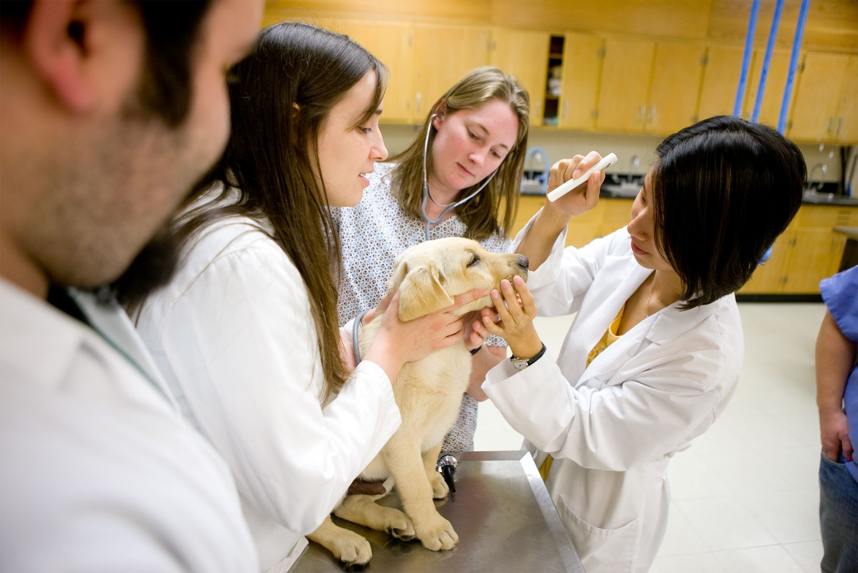
Hutson School of Agriculture – Asset Preservation
The asset preservation funds will also allow us to complete deferred maintenance and needed renovations to the Oakley Applied Science Building - home of the Hutson School of Agriculture

Slide 15
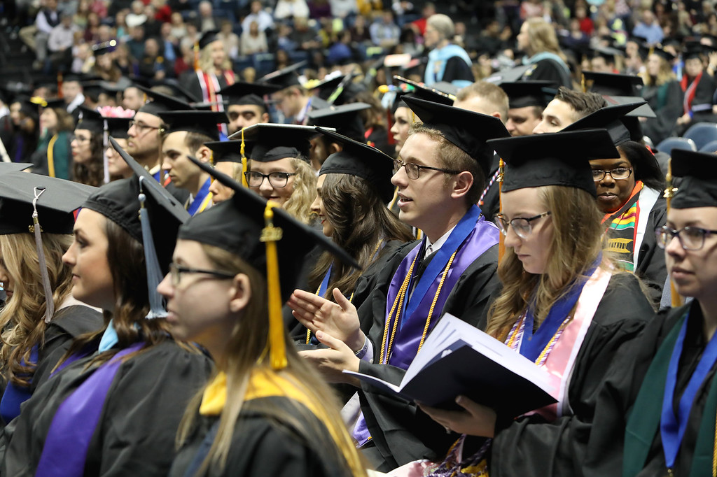
Additional House Bill 1 Items
KERS Funding
Thank you for providing the $4.2 million KERS pension appropriations in HB 1 – corrected amounts from 2021 HB 8.
Performance Funding
HB 1 also recognizes the importance of postsecondary education and funds $67 million in each year of the budget to enhance the performance funding model.

Slide 16
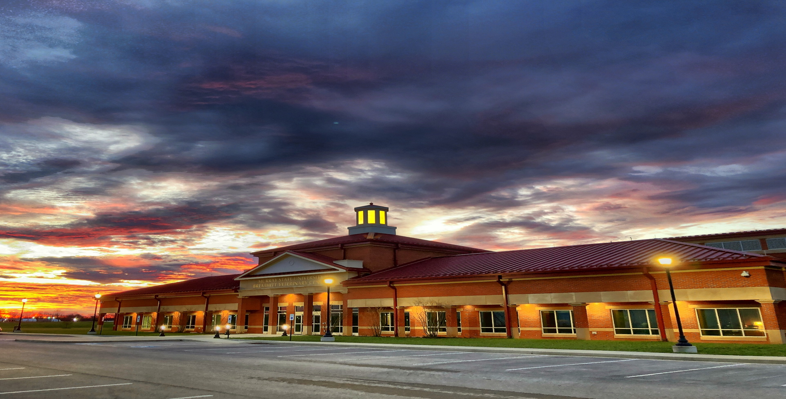
Breathitt Veterinary Center
Testing for the predictable, prepared for the unimaginable
Kentucky’s only NAHLN Level 1 laboratory
Testing added:
Chronic Wasting Disease
African Swine Fever
Meat Testing
SARS Covid-19 in animals
Hemp analysis
Foreign Animal Disease Testing
New Castle Disease
High Pathogen Avian Influenza
Swine Influenza
Classic Swine Fever
African Swine Fever
Foot and Mouth Disease

Slide 17
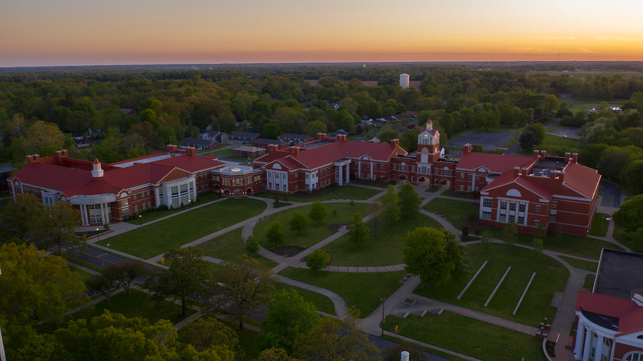
Questions?

