Slide 1
Budget Review Subcommittee on
Postsecondary Education
President Timothy C. Caboni
February 17, 2022

Slide 2



G od News
WKU Opportunity Fund
Increasing access
Student success
Reimagining the total college experience
  First Year Village
  Living Learning Communities
  The Commons at Helm Library

Slide 3
The Gatton Academy of Mathematics & Science
Kentucky’s first residential STEM academy
190 students
117 Kentucky counties represented
Average ACT: 32
Average GPA: 3.87

Slide 5
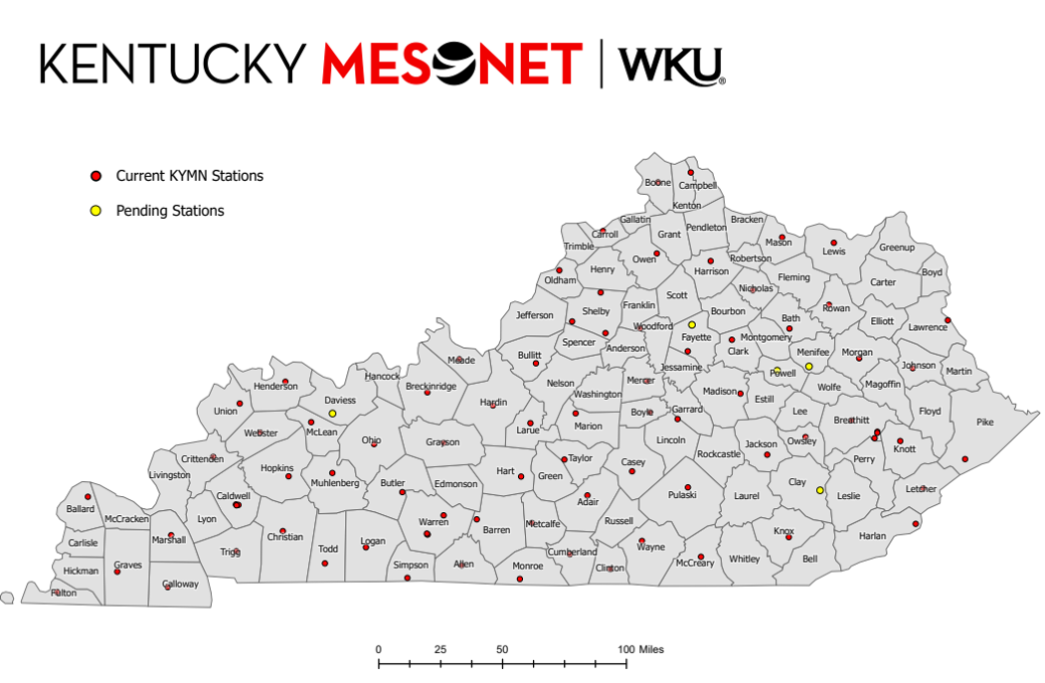

Slide 6
Gordon Ford College of Business
New 144,000 square foot home for the Gordon Ford College of Business
State-of-the-art facility
  Classrooms designed for applied learning
  Centers of Excellence
  Faculty and student collaboration spaces

Slide 7
Asset Preservation
$500 Million in deferred maintenance
Types of Projects
  Underground Infrastructure
  Roof Repair and Replacement
  HVAC System Replacements
  Life Safety

Slide 8
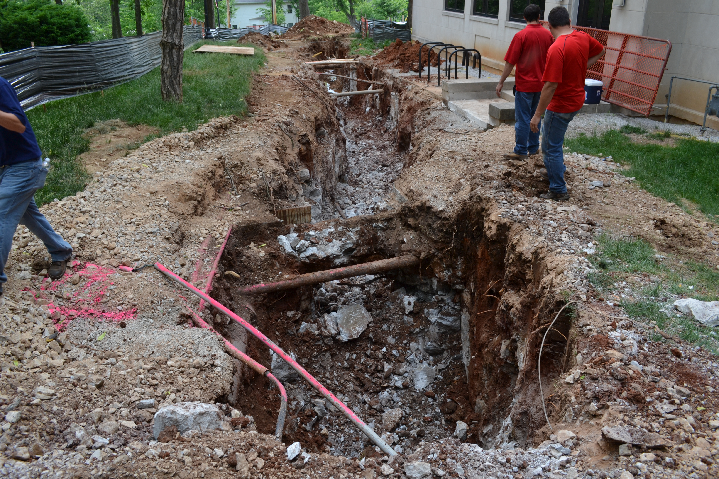
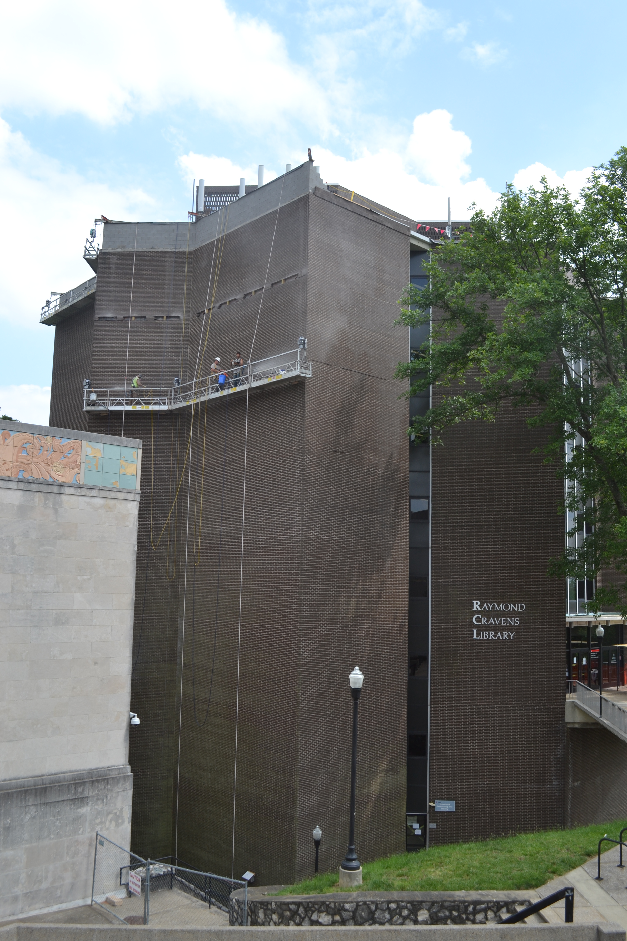
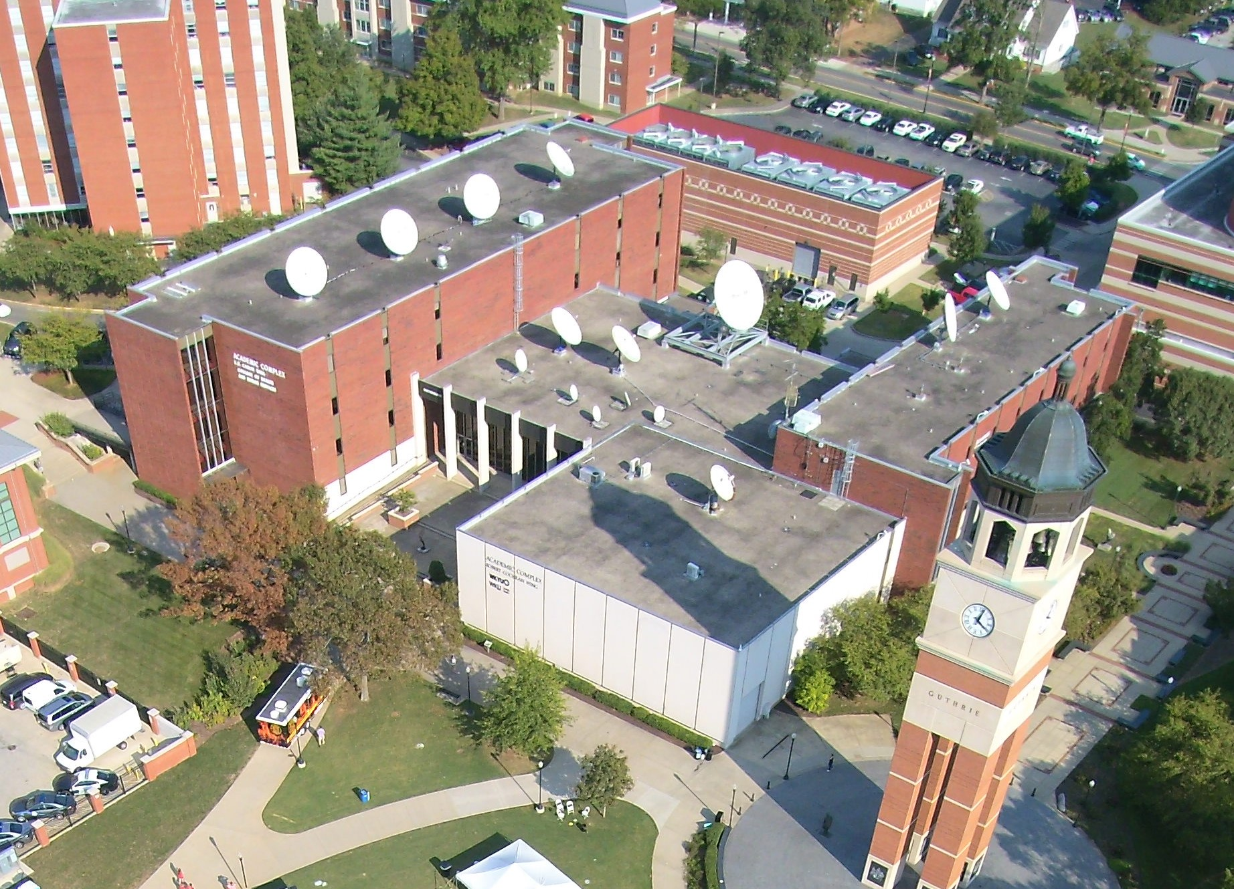

Slide 9
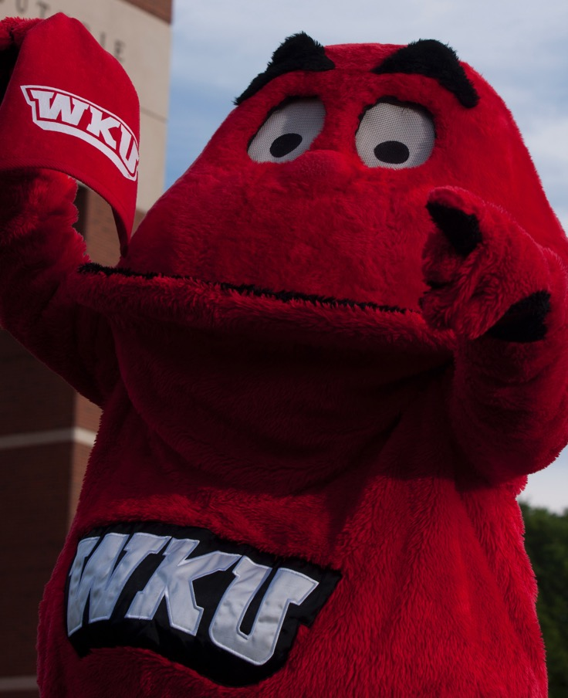
Questions?

