Slide 1

MOREHEAD STATE UNIVERSITY
House Budget Review Subcommittee on Postsecondary Education
February 10, 2022

Slide 2
Morehead State University Presenters
Dr. Joseph (Jay) Morgan, President
Mr. Kim Oatman, Asst. Vice President of Facilities & Operations
Dr. Carol Christian, Director, Craft Academy for Excellence in
Science and Mathematics

Slide 3
Request of the Committee
Discuss the University’s Priority Capital Project
Utilization of Possible Asset Preservation Funds
Brief Overview of the Craft Academy for Excellence in Science and Mathematics

Slide 4
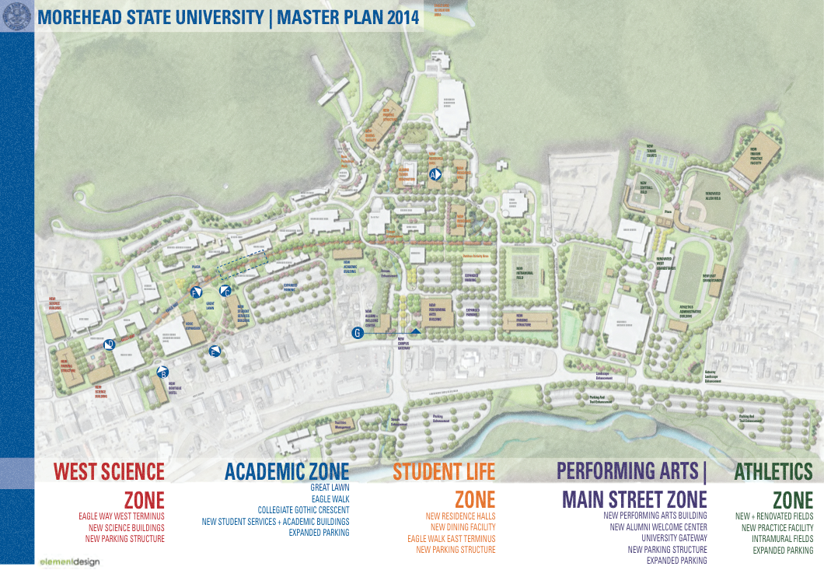
Overview Master Plan & Projects
Repair existing campus facilities
Raze or sell older, non-core facilities
(10 buildings and 150 acres)
  (10 buildings = 130,000 sq ft. & 150 ac.)
Replace outdated STEM facilities

Slide 5
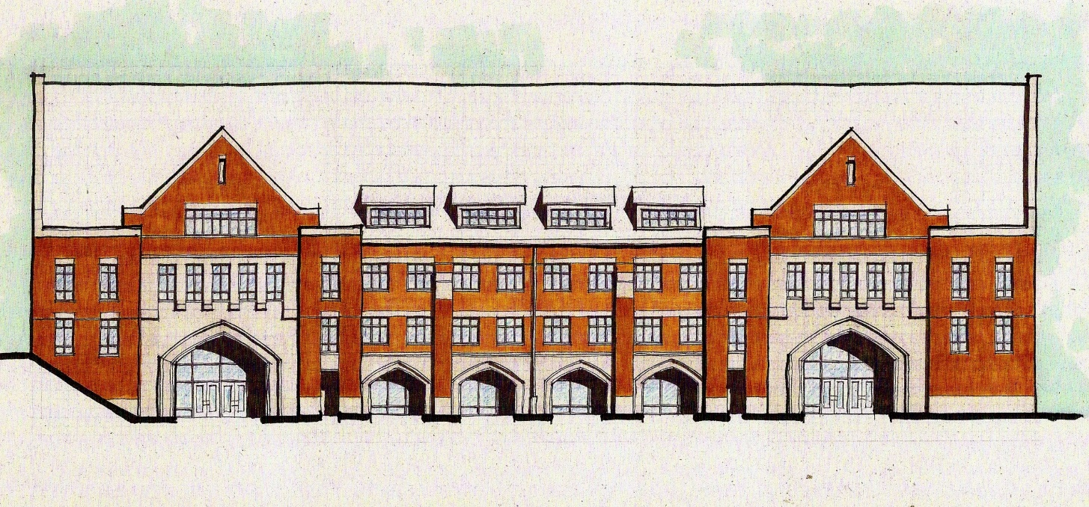
#1 Capital Project Request-
Construct a New Science & Engineering Building
General Fund Request - $98,000,000 140,000 Square Feet

Slide 6
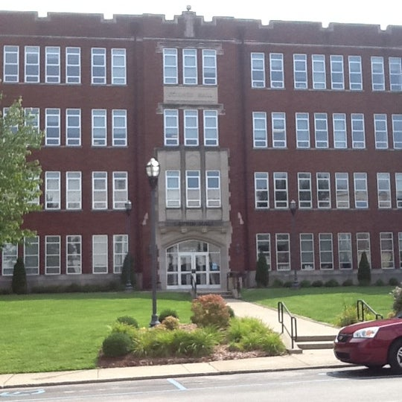
Why a new Science & Engineering Building?
Current facility built in 1937, renovations in 1967 and 1993

Slide 7
Utilization of Asset Preservation
Replace building roofs
Replace HVAC systems
Elevator repair and replacement
Replace electrical and mechanical systems
Water system upgrades
Upgrade campus fire and security systems
Replace building façade
Request to use funds to upgrade state-owned residence halls (roof, HVAC, etc.)

Slide 8
Asset Preservation Language Request
A request to insert clarifying and supportive language in the Budget Bill to assist with residential housing.
“Asset preservation funding shall be applicable for usage by public higher education institutions for education & general facilities, as well as state-owned and operated residential housing facilities.”

Slide 9

Craft Academy for Excellence in Science and Mathematics
Residential dual credit academy on MSU’s campus
Students can complete first 2 years of college
Accept 74 students for each Fall entering class – Total 148
May 2022 marks our 6th Graduating Class
Funded by $3.4 million of General Funds – Mandated Program
Average ACT is ~ 30
Matriculate to internships, graduate, and professional schools
Strong STEM+H pipeline for our state and economy

Slide 10
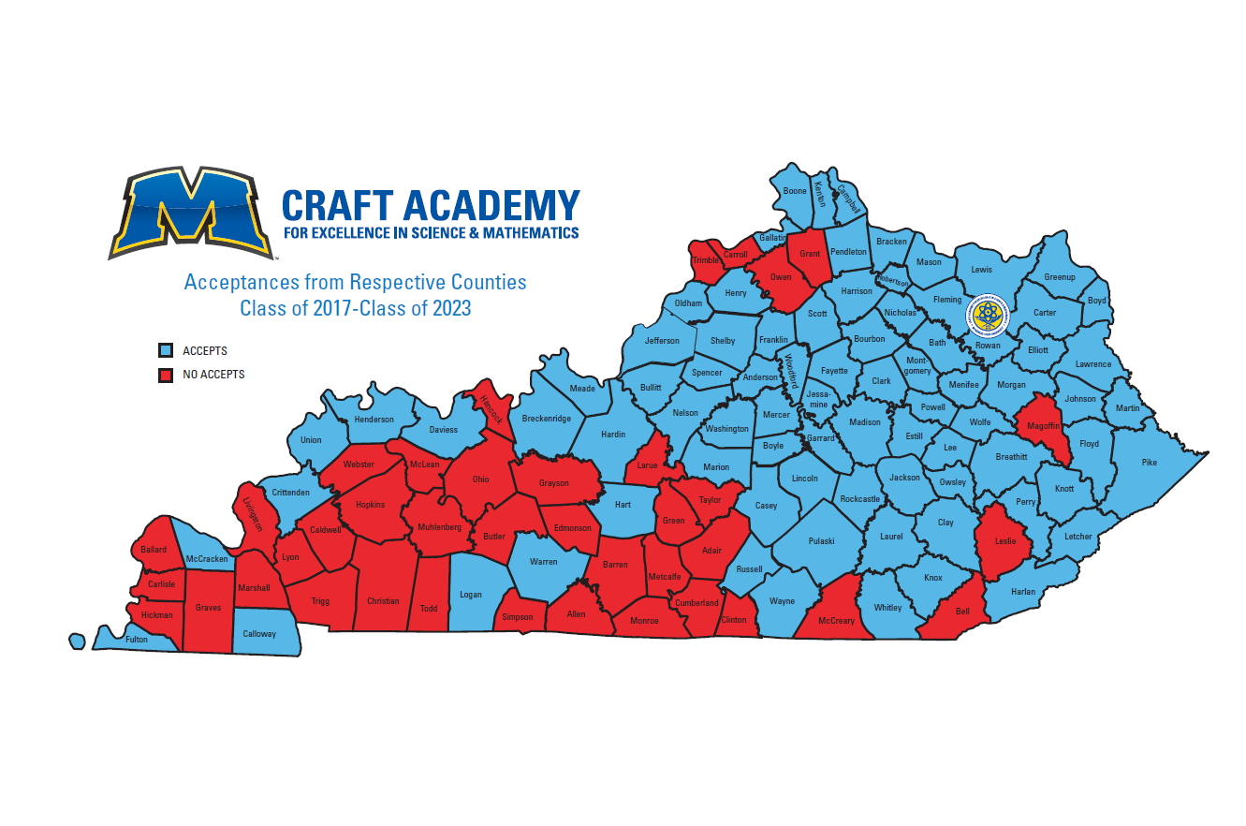
Craft state map here

Slide 11
Goal of Craft Academy
Being on the Same Funding Level as Gatton Academy
Craft Academy
Gatton Academy
Mandated Program
G.F. Appropriation: $3,480,400
Students: 148
Goal for Equalization:
Students: Add 40 - 45 to Craft
Funding: Add $1,504,700 to Craft
A significant imbalance presently for our end of the state
Mandated Program
G.F. Appropriation: $4,985,100
Students: 190 - 200

Slide 12

Questions?

