Slide 1

CPE: Kentucky Higher Education Matters
Budget Review Subcommittee on Education
February 9, 2023

Slide 2
Overview of CPE and
Key Progress and Initiatives
CPE President Aaron Thompson

Slide 3
60x30 Goal: Progress and Concern
Kentucky’s current levels of educational attainment – Half the population has a postsecondary credential.
High school diploma
or less
42.9%
Some
College
7.7%
Certificate
13.3%
Associate
Degree
9.6%
Bachelor’s Degree
16.3%
Graduate
or Higher
10.3%
Annual increases in number of Kentuckians with a postsecondary education – 1.7% needed to meet the goal.
2016-17 | 2017-18 | 2018-19 | 2019-20 | 2020-21 | 2021-22
4.7% | 2.8% | 3.5% | 3.3% | .5% | 1.6%

Slide 4
Key Progress
Enrollment Trends
(PUBLIC ONLY) | Fall 2017 | Fall 2021 | Fall 2022 | One-Year | Five-Year
Total Enrollment | 181,371 | 163,958 | 163,086 | -0.5% | -10.1%
Total Undergrad Enrollment | 157,199 | 135,363 | 134,853 | -0.4% | -14.2%
Total URM Undergrad Enrollment | 25,286 | 25,431 | 26,100 | 2.6% | 3.2%
Total Adult Undergrad Enrollment | 36,206 | 27,939 | 27,897 | -0.2% | -22.9%
Total Graduate Enrollment | 24,172 | 28,595 | 28,233 | -1.3% | 16.8%
Degree and Credential Production
(PUBLIC ONLY) | 2016-17 | 2020-21 | 2021-22 | One-Year | Five-Year
Total Degrees and Credentials | 62,062 | 68,189 | 67,695 | -0.7% | 9.1%
Total Undergraduate Degrees and Credentials | 54,195 | 59,266 | 57,657 | -2.7% | 6.4%
Total URM Undergrad Degrees and Credentials | 6,209 | 7,774 | 8,078 | 3.9% | 30.1%
Total Adult Undergrad Degrees and Credentials | 24,780 | 23,188 | 22,052 | -4.9% | -11.0%
Total Graduate Degrees and Credentials | 7,867 | 8,923 | 10,038 | 12.5% | 27.6%
Sources: CPE Degrees Dashboard and Preliminary Enrollment Dashboard.

Slide 5

CPE’s innovations with private partners
Launched the nation's first Student Success Collaborative
for two- and four-year campuses.
Added staff focusing on the needs of adult learners.
Developed a new unit focusing on P-12-to-Postsecondary policies and programs.
Expanded focus of GEAR UP Kentucky to include first-year college success.
Created a “Kentucky Graduate Profile,” which looks at curriculum for essential/employability skills.

Slide 6
Update on the
Healthcare Workforce Collaborative
Leslie Sizemore

Slide 7







Overview of the Healthcare Workforce Collaborative (HWC)
7 months
Into the program
$10 million
Funding from legislature
$8 million
Grants to institutions
Grantee | Amount
KCTCS | $4,000,000
EKU | $634,500
KSU | $219,500
Morehead | $294,600
Murray | $307,800
NKU | $599,000
UK | $824,100
UofL | $640,900
WKU | $479,600
48
Employer partners
4
Collaborative meetings
23
Healthcare & higher education leaders
23
Campuses

Slide 8
HWC Grant Program Occupational Areas of Focus
55
Programs Total
43%
Focused on nursing

Slide 9

Increases in Health-Related Program Enrollment
Fall 2021 to Fall 2022
Overall
3.7%
Undergraduate Level
5.9%
Certificate Level
27.9%
Associate Level
4.2%
Baccalaureate Level
6.4%

Slide 10

Increases in Health-Related Program URM Enrollment
Fall 2021 to Fall 2022
Overall
10.6%
Undergraduate Level
12%
Graduate Level
7.3%
Certificate Level
66.7%
Associate Level
12.1%
Baccalaureate Level
13.3%

Slide 11
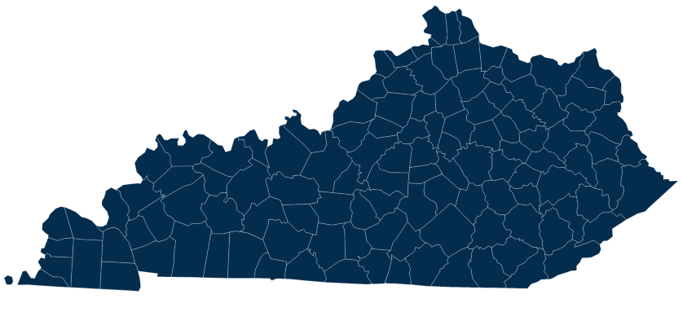
Behavioral health is an evolving issue – are we prepared?
Behavioral Health Shortage Areas
Not affected by shortage
Part of county is affected by shortage
Whole county is a shortage area
Source: Rural Health Information Hub. July 2022.
Notes:
Mental Health Practitioner workforce is also a critical need in Kentucky. As you can see, our entire state is in a shortage for mental health interventionists.

Slide 12
Update on Recent Campus Issues
Travis Powell

Slide 13
Campus Updates
Kentucky State University
HB 250 (2022 Regular Session)
Northern Kentucky University
Jan. 18 appointment of Bonita Brown as NKU’s interim president

Slide 14
Update: Annual Sworn Financial Disclosure Statements
House Bill 663 (2022 Regular Session)
Requires the president and chair of the governing board of each postsecondary education institution licensed or overseen by the CPE to jointly execute a signed, sworn financial disclosure statement and submit to CPE and the General Assembly by June 30 of each year.
Authorizes CPE to investigate if an institution fails to provide a statement to designated recipients.

Slide 15
Update on Usage of Budgetary Items
Bill Payne and Shaun McKiernan

Slide 16
Asset Preservation: Enacted Budget
$683.5M in General Fund supported Bond Funds for Asset Preservation (AP) pools.
$16.5M for a stand-alone AP project at KCTCS, taking the total for asset preservation to $700.0 million, the amount CPE requested in its budget submission.
30¢ institutional match per state $1.00 required for research universities, 15¢ for comprehensive universities and KCTCS.
Funds may be used to preserve, renovate, or renew Education and General facilities and campus-owned and operated dorms.
Budget language approves capital projects funded with asset preservation pool funds and requires institutions to report projects to CPBOC.

Slide 17
Asset Preservation: Bond Funds and Campus Match
Bond Funds appropriated based on share of Category I and II square feet.

Slide 18
Asset Preservation: Planned Projects
CPE approved a set of guidelines for AP Pool projects in June 2022 to facilitate project identification and reimbursement
Each institution has compiled a list of planned projects (see handout). These lists are subject to change as priorities change, emergencies arise, and as projects are bid and evolve
Institutions regularly communicate with CPE to ensure projects meet the guidelines. CPE and OSBD approve all reimbursements to campuses from their Asset Preservation Pools
Campuses have found that projects are coming in, on average, 24% more than originally estimated, reducing the buying power of the state funds by $168 M.
Cost pressures will lead to projects being adjusted (value-engineered, scaled down). Lower priority projects may have to wait

Slide 19
Capital Construction: Line-itemed Projects
HB 1 (2022, RS) includes $811,850,000 in Bond Funds for specified capital construction projects on postsecondary campuses (see handout).

Slide 20
Bucks for Brains: Program Features
Bucks for Brains began with passage of the Postsecondary Education Improvement Act of 1997 (HB 1).
It matches public dollars with private donations to encourage research at UK and UofL and to strengthen key programs at Kentucky’s comprehensive universities.
The program encourages private giving because donors are able to “double their contribution” to the universities by having it matched by the state.
Prior to 2022-24, there were four rounds of funding for the program totaling $410 million.
HB 1 provides a fifth round of funding, totaling $40.0 million in 2022-24.

Slide 21
Allocation of Bucks for Brains Funds

Slide 22
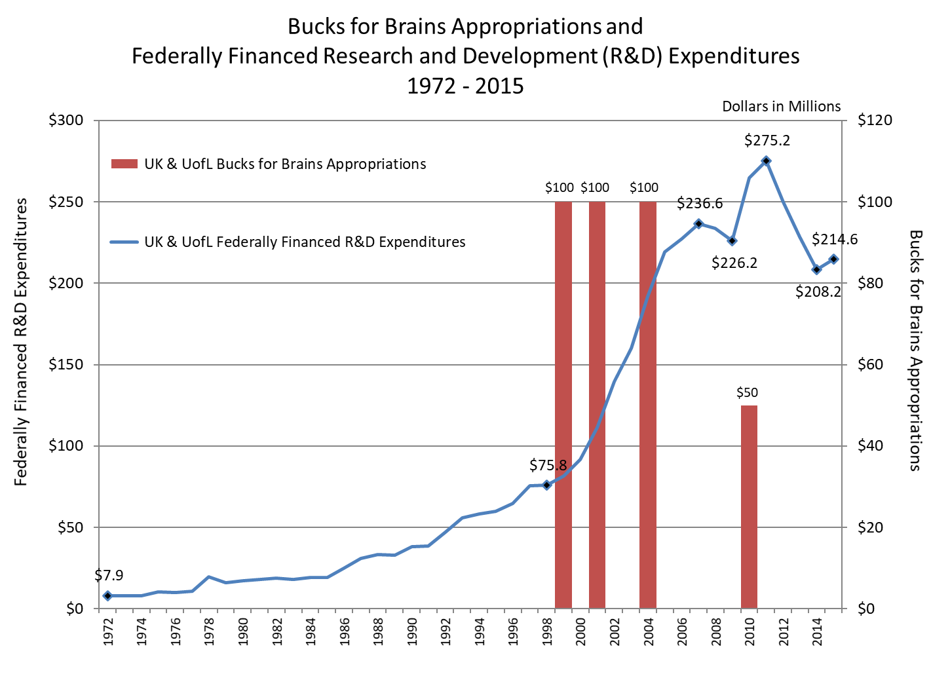
Bucks for Brains: Program Impact
Growth in federal research dollars is highly correlated with Bucks for Brains funding
Since program inception, federally financed Research and Development (R&D) expenditures at UK and UofL have nearly tripled
For every federal research dollar generated by this program there is a 2.2x impact on the state economy

Slide 23
Workforce Development Trust Fund: Program Funds
The enacted state budget (HB 1) appropriated $2,225,000 in fiscal year 2022-23 to the Workforce Development Trust Fund (non-recurring)
The bill requires funds to be used to “increase credential production capacity for identified supply gaps and support program offerings in targeted industry sectors” (HB 1, p. 124)
CPE and KCTCS staff developed program guidelines, which the Council approved on June 17, 2022
KCTCS colleges submitted applications to a system office selection committee. Projects sent to CPE for final review and approval

Slide 24
Workforce Development Trust Fund: Uses of Funds
Workforce funds must be used to establish new programs or expand existing programs in the following industry sectors:
  healthcare
  advanced manufacturing
  transportation and logistics
  business services and information technology
  construction and trades
Funds may be used to support faculty positions, purchase equipment and supplies, develop or evaluate curriculum, or defray marketing expenses

Slide 25
Workforce Development Trust Fund: Distribution of Funds

Slide 26
Agency Needs and Q&A
CPE President Aaron Thompson

Slide 27
Where we’re headed
Transitions: 5 out of 10 Kentucky high school graduates go on to college.
  We need to increase college readiness, advising, dual credit participation.
Affordability: 6 out of 10 Kentucky public university students graduate with debt.
  We need to reduce financial barriers and debt; improve the public’s understanding of paying for college.
Success: 6 out of 10 students attending a state university complete their degree.
  We need to ensure timely completion, maximize transfer of credit, and ensure high-quality programs.
Talent: 7 out of 10 Kentucky college graduates are working in state 3 years after graduation.
  We need to focus on our workforce output, and especially on high-need areas, such as health and education.
Value: 1 out of 3 adults say college is worth the cost.
  We need to keep spreading the “Higher Education Matters” message; that for every higher ed dollar invested, a $67 return on investment for the state.
Notes:
Some key concerns:
Increasing enrollment of specific student populations:
White males
Adult learners
Addressing student basic needs
Food and housing insecurity
Mental health and social/emotional needs
Better advising.
Focusing on employability:
Integration of “essential skills” in all our programs.
Cultural competency to prepare graduates for a diverse workforce.
Increasing experiential learning and career services.

Slide 28
CPE is doing more with less, but we need to be doing more with more
Includes Strategic Initiative Personnel and Operating

Slide 29

Maintaining Momentum Across the Commonwealth
Agency operating funding is needed to support growth in CPE’s duties and responsibilities and to further the goals and objectives of the state’s strategic agenda:
Addressing Kentucky’s teacher and healthcare workforce shortages.
Strengthen pathways between K-12 and postsecondary programs.
Improving access to high-demand postsecondary training and education programs for working-age adults.

Slide 30
Questions?

