Slide 1
Dr. Larry Ferguson, Acting KCTCS President
VP Jessie Schook, Workforce & Economic Development
Owensboro CTC President Scott Williams

Slide 2



16 Community and Technical Colleges
70 Campuses
330 Buildings

Slide 3
KCTCS MISSION STATEMENT
The mission of the Kentucky Community and Technical College System is to enhance the quality of life and economic vitality of the Commonwealth by serving as the primary provider of:
College and Career Readiness
Transfer Education
Workforce Education and Employment Training
Notes:
KCTCS MISSION STATEMENT
The mission of the Kentucky Community and Technical College System is to enhance the quality of life and economic vitality of the Commonwealth by serving as the primary provider of:
College and Career Readiness
Transfer Education
Workforce Education and Employment Training

Slide 4
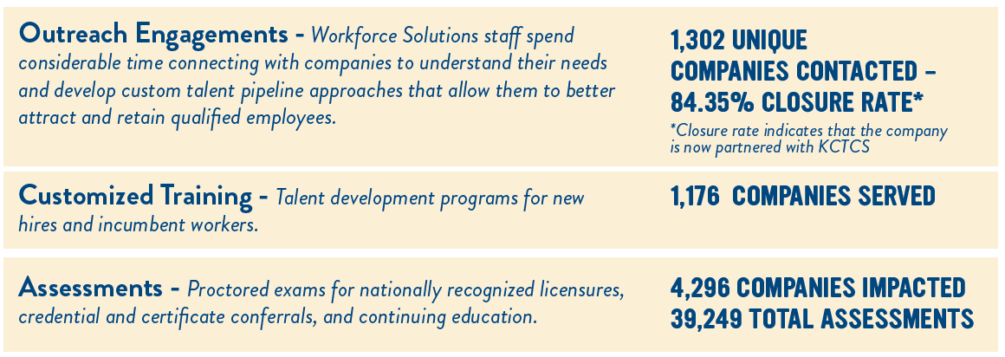
Employer Outreach

Slide 5
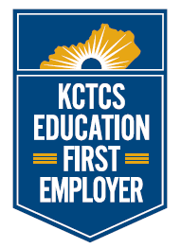
Apprenticeship & Work-Based Learning
KCTCS Apprenticeship
  Apprenticeship Services
  Employer feedback
Work-Based Learning
  Employer support in experience design
  Credit – Expedite time to completion
Education First Employers
  Preferred Network of Employers
  Pathway & Non-Pathway Related
  Brand strategy – KCTCS as Premier Destination to Earn and Learn
  ROI – Retention & Attraction for Partners & KCTCS

Slide 6
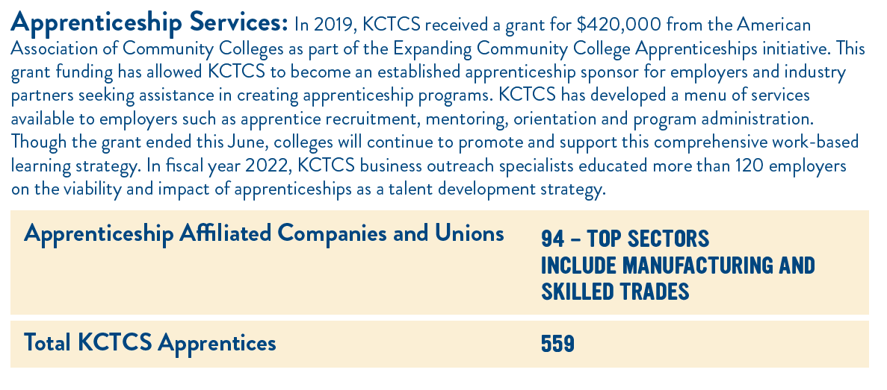
Apprenticeship

Slide 7
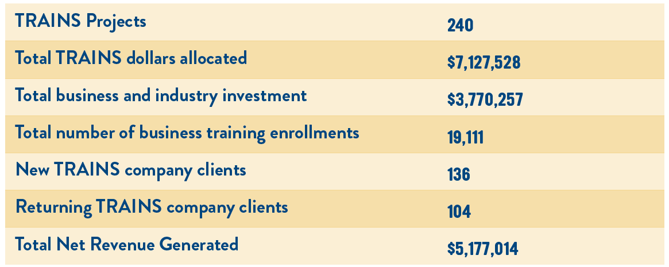
Customized Training: KCTCS-TRAINS – Fiscal Year 2022 Impact

Slide 8
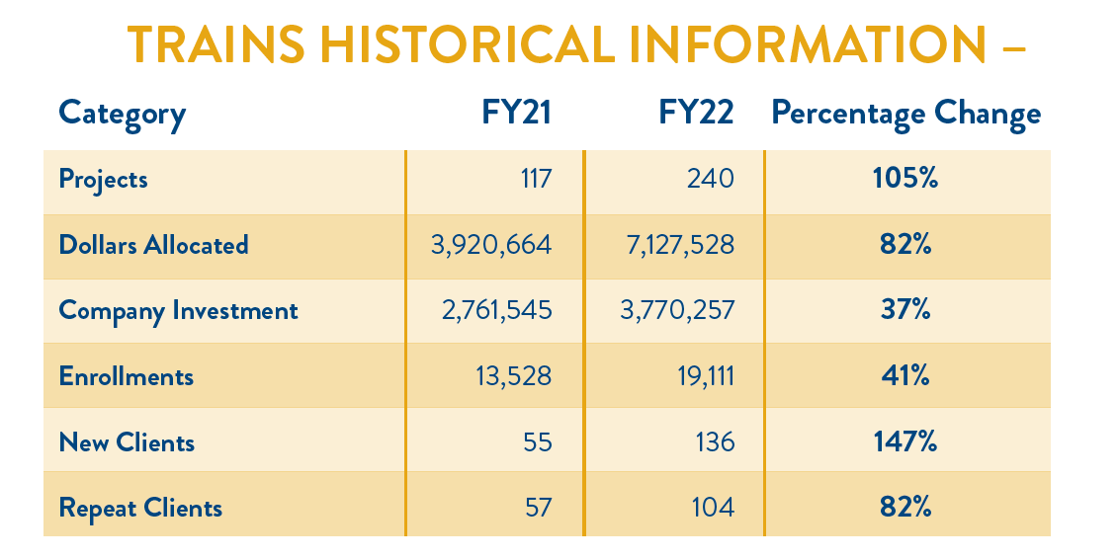

KCTCS-TRAINS Year to year Growth

Slide 9
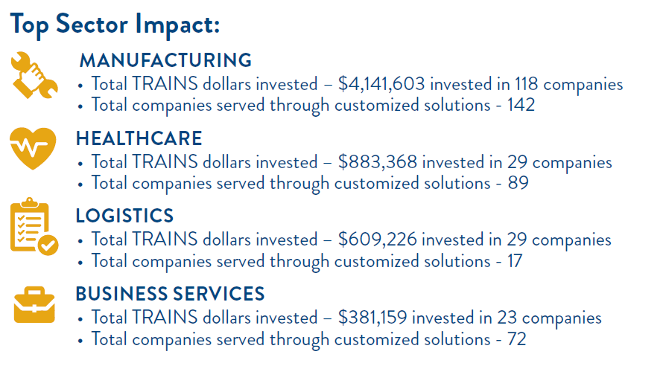
KCTCS-TRAINS Top Sector Impact

Slide 10
KCTCS
Asset Preservation Projects
Notes:
Throughout our nearly 25 years of existence, the maintenance of KCTCS facilities has not been significantly state funded, but rather has come mostly from KCTCS restricted funds.
Even with a focused effort to maintain the sustainability of our operational facilities and develop and implement our asset preservation plan, we continue to have an ever-increasing backlog of deferred maintenance.
The influx of funding for asset preservation in the 2022 budget was greatly, greatly appreciated.

Slide 11


State Bond Match: $179,262,000
KCTCS Match (13.4%): $26,890
Total Asset Preservation Funding: $206,890,00
The 2022-24 State Budget – Asset Preservation Funding for KCTCS
Notes:
Throughout our 20 years of existence, the maintenance of KCTCS facilities has not been significantly state funded, but rather has come mostly from KCTCS restricted funds.
Even with a focused effort to maintain the sustainability of our operational facilities and develop and implement our asset preservation plan, we continue to have an ever-increasing backlog of deferred maintenance.
The influx of funding for asset preservation in the 2022 budget was greatly, greatly appreciated.

Slide 12
The KCTCS capital plan was to accomplish the asset preservation projects that were submitted in our 2022-2024 budget request. These have all been approved by the Board of Regents.
  18 Building Renovation projects.
  5 College Site improvement projects.
  21 Roof Replacement projects.
  2 Campus Life Safety/ ADA projects.
  Fire Alarm updates at all 16 campuses.
  Significant mechanical system upgrades at 6 campuses.
  2 Energy Savings projects which will improve overall operating budgets in the coming years.
Notes:
Every College has multiple projects being accomplished with this funding. Should funds allow, we planned to accomplish additional asset preservation projects, that were included in the 2024-2026 Capital Plan and projects that have a scope of less than $1M.

Slide 13
This funding is having a tremendous (and much needed) impact on the condition, functionality, code compliance and comfort of our facilities that students use everyday.
Roof Replacement and Repair projects top the list of projects we are accomplishing. A roof can have a significant impact on the life of the building and on the health of building occupants.
A number of the projects that we are undertaking are replacement and upgrades of Mechanical and Electrical systems (many from the 1960s). This is providing energy savings that will continue for decades.

Slide 14
Current Market Conditions
Current construction market conditions affected by supply chain issues and skilled labor availability is causing wide fluctuations in the cost of projects that cannot be predicted until time of bidding.
Projects can bid at prices in a range of 15% below estimates to 30% above estimates, and sometimes even higher.
We are attempting to schedule asset preservation projects, in coordination with Finance Cabinet – DECA, to determine appropriate timing of project bids to hopefully maximize the funding.

Slide 15
Current Market Conditions
The economic situation has caused the current funding to appear to be insufficient to accomplish the original list of projects that KCTCS expected to be able to fund. The impact is as follows:
Current Asset Preservation Pool Funding $ 206,152,000 (bonds & match)
Anticipated Cost of Current Project List $ 247,382,400
________________________________
Shortfall of Funding to accomplish current project list $ 41,230,400 (20% shortfall)

Slide 16
Current Market Conditions
Mitigation efforts to this shortfall that are being undertaken:
  Value Engineering is given priority in earlier design phases of the project.
  Scheduling of Bid lettings to react to volatile market conditions.
  Active recruitment for bidding activity.
  Reduction of project scope / deferred project scope.

Slide 17
Impact on Capital Budget and 6-year planning
Asset Preservation funding
6-Year Planning
KCTCS has a total of approximately $310M in asset preservation projects that will remain. These were included in the 2nd and 3rd biennium (2024-2028).

Slide 18
A Note on the Huron Study
The state Legislative Contract Review Committee recently approved a contract with Huron Consulting Group Education – Huron - to review the following at KCTCS (16 Colleges and the System Office):
Space utilization assessment
Academic programming optimization
Financials and organization assessment
Compensation and equity
Career framework to define career paths, compensation compared to market and internal equity

Slide 19
Commonwealth West Healthcare Workforce Innovation Center
Collaborative of 8 Higher Education Institutions, Regional Healthcare Providers, School Districts in 20 Counties, and Owensboro Health to increase the pipeline of healthcare workers via recruitment, education, and training.
KY nonprofit corporation formed, CWHWIC, Inc.
8 Member Board
Physical Center located 2511 Frederica Street, Owensboro, KY
MOA completed
Staffing

Slide 20

Commonwealth West Healthcare Workforce Innovation Center
Design Healthcare Pathways (Secondary and Career Centers)
Design phase of physical Innovation Center
Obtain virtual reality training equipment
Obtain mobile training labs

Slide 21
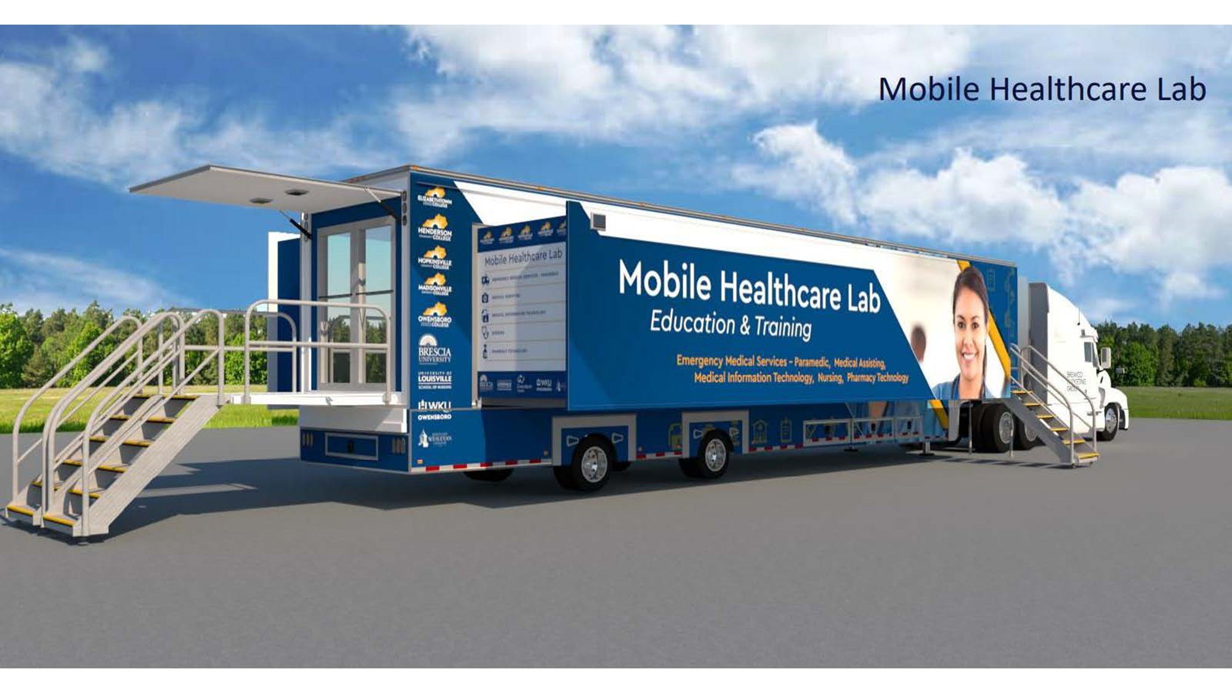
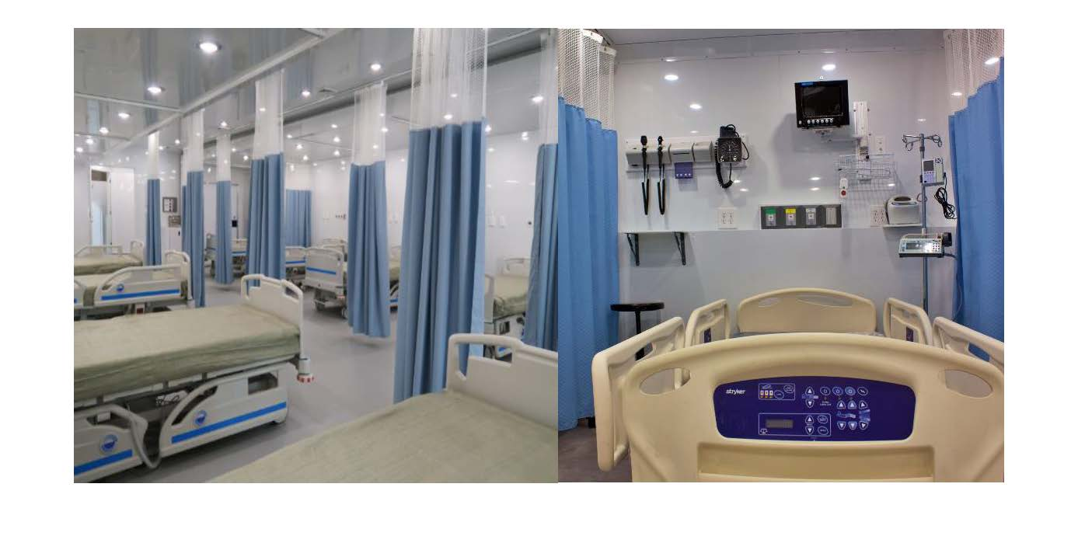
Commonwealth West Healthcare Workforce Innovation Center

