Slide 1
Murray State University:
House Budget Review Subcommittee on Postsecondary Education
February 16, 2023
President Robert L Jackson

Slide 2



Rankings and Reputation
Highest rankings in our history
Wall Street Journal/Times Higher Education – 2022 Best College
US News & World Report (South region)
    8th in Top Public Schools
    8th in Best Value Schools
    7th in Best Colleges for Veterans
    23rd in Best Regional Universities
  Washington Monthly - Best Bang for the Buck

Slide 3
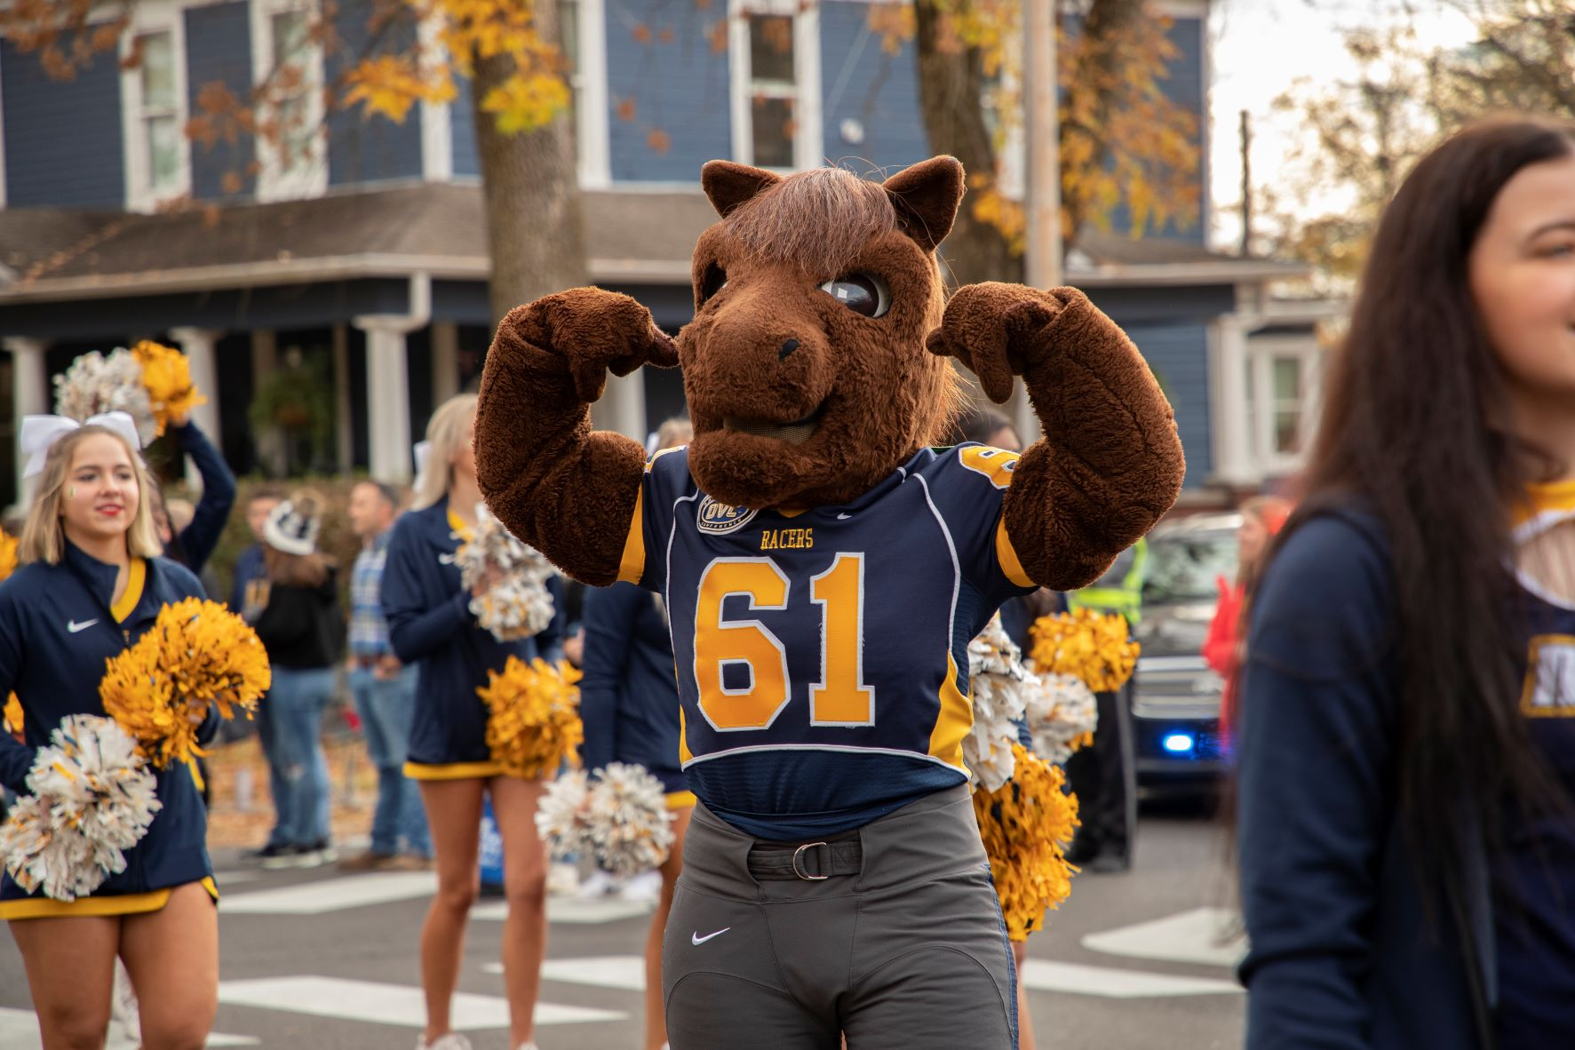
Rankings and Reputation
University Business – Top 100 National Award – Fall 2022
  The colleges that rank highest for the most transparent merit scholarships provide clear, easily accessible information on the awards and the criteria they use, according to a new analysis.

Slide 4
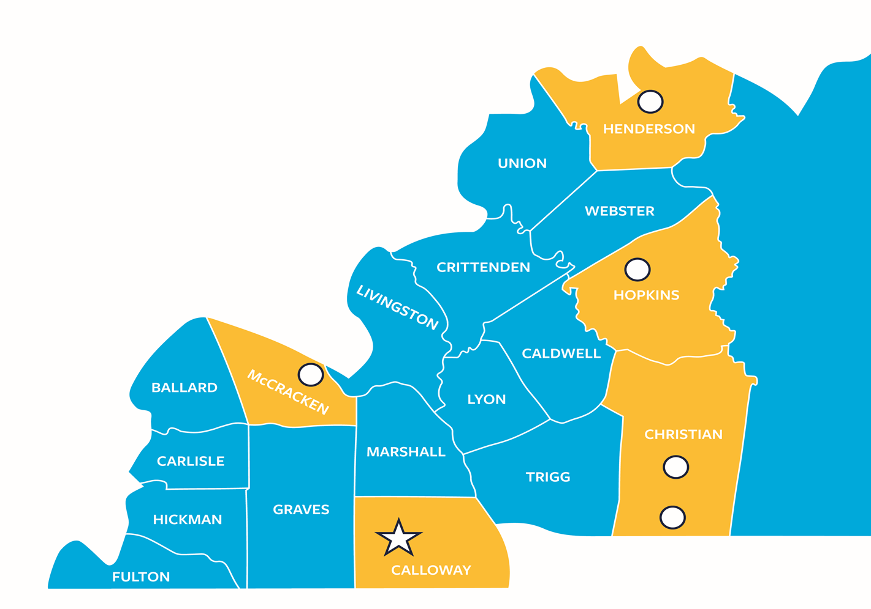
18-County Service Region

Slide 5
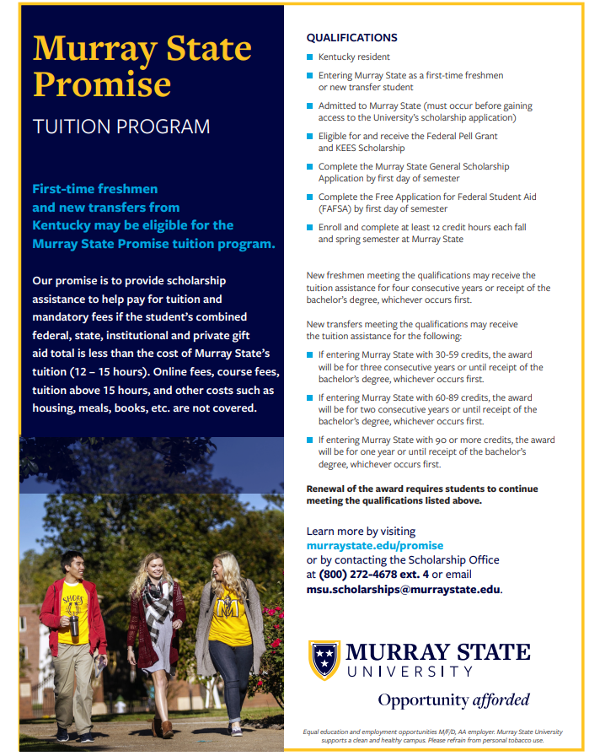
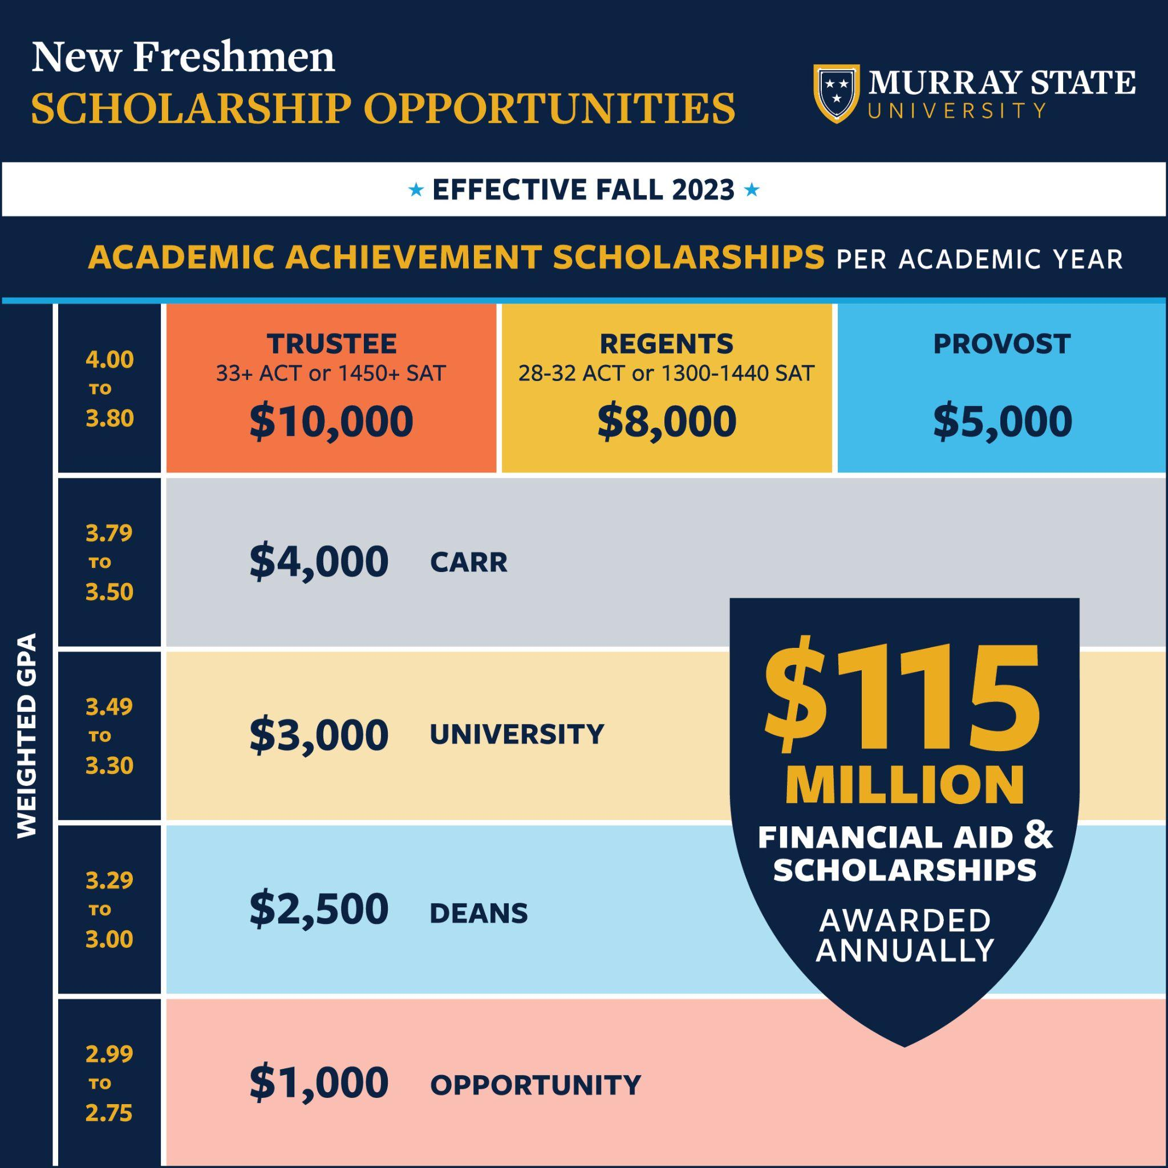
Recruiting and Retention
Record scholarships/financial aid - $115M
Over 50% of our students graduate with no known debt
72% of our budget is enrollment driven

Slide 6
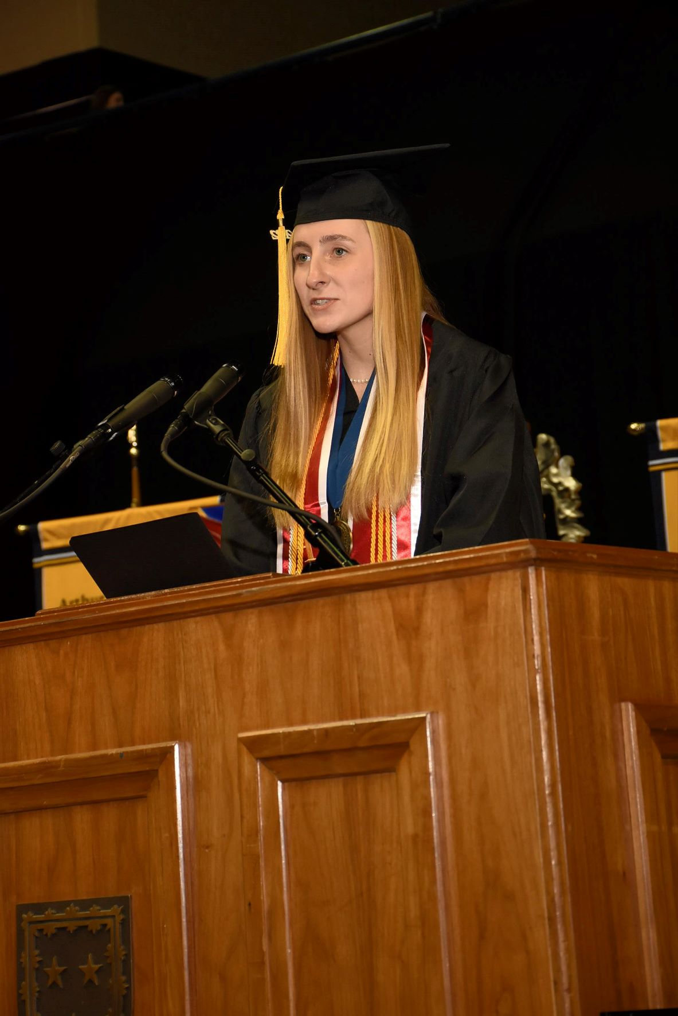
Academic Excellence
99% of First-Time/Full-Time Students Receive Financial Aid
Top Undergraduate Majors:
  Nursing, Psychology, Business Administration, Accounting, Biology, Elementary Education, Animal Health Technology/Pre-Vet, Finance, Agribusiness, Engineering
Top Graduate Majors:
  Business Admin, Public Admin, Computer Science, Teaching Certification, Doctor of Nursing Practice (DNP)
Business and industry partners:
  Boeing, Lockheed Martin, Microsoft, Yamaha and many others on workforce solutions and initiatives
$500 Million Economic Impact Annually to the State

Slide 7
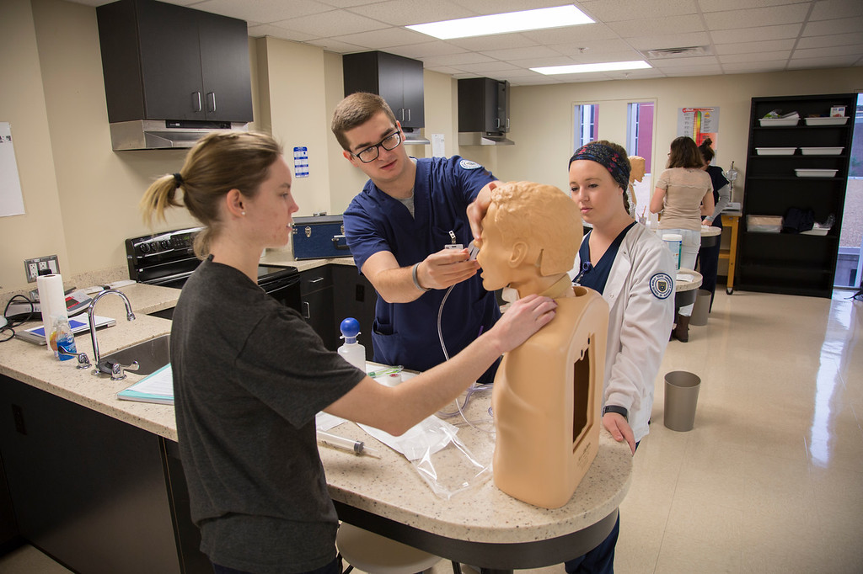
Academic Colleges and Schools
Bauernfeind College of Business
Hutson School of Agriculture
Jones College of Science Engineering and Technology
School of Engineering
School of Nursing and Health Professions
College of Education and Human Services
College of Humanities and Fine Arts

Slide 8

Enrollment and Retention
42% - First Generation
38% - Low Income
109 KY counties
Highest Retention rate among public, comprehensives
Lowest time to degree for regional, comprehensives (4 years)

Slide 9
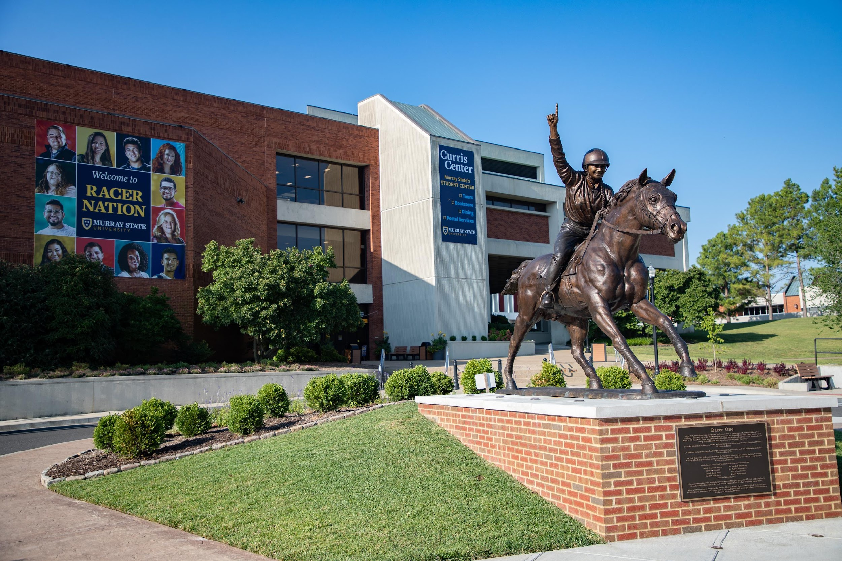
Enrollment and Retention
Total Enrollment: 9489
Headcount:
    2018 – 2022: (+2.8%)
Freshmen:
    2018 – 2022 (+3.5%)
    URM – +10%
Graduate:
    2018 – 2022 (+27%)
  International:
    2018 – 2022 (+67%)
Dual Credit:
    2018 – 2022 (+32%)
64% of students have UG credit upon matriculation

Slide 10
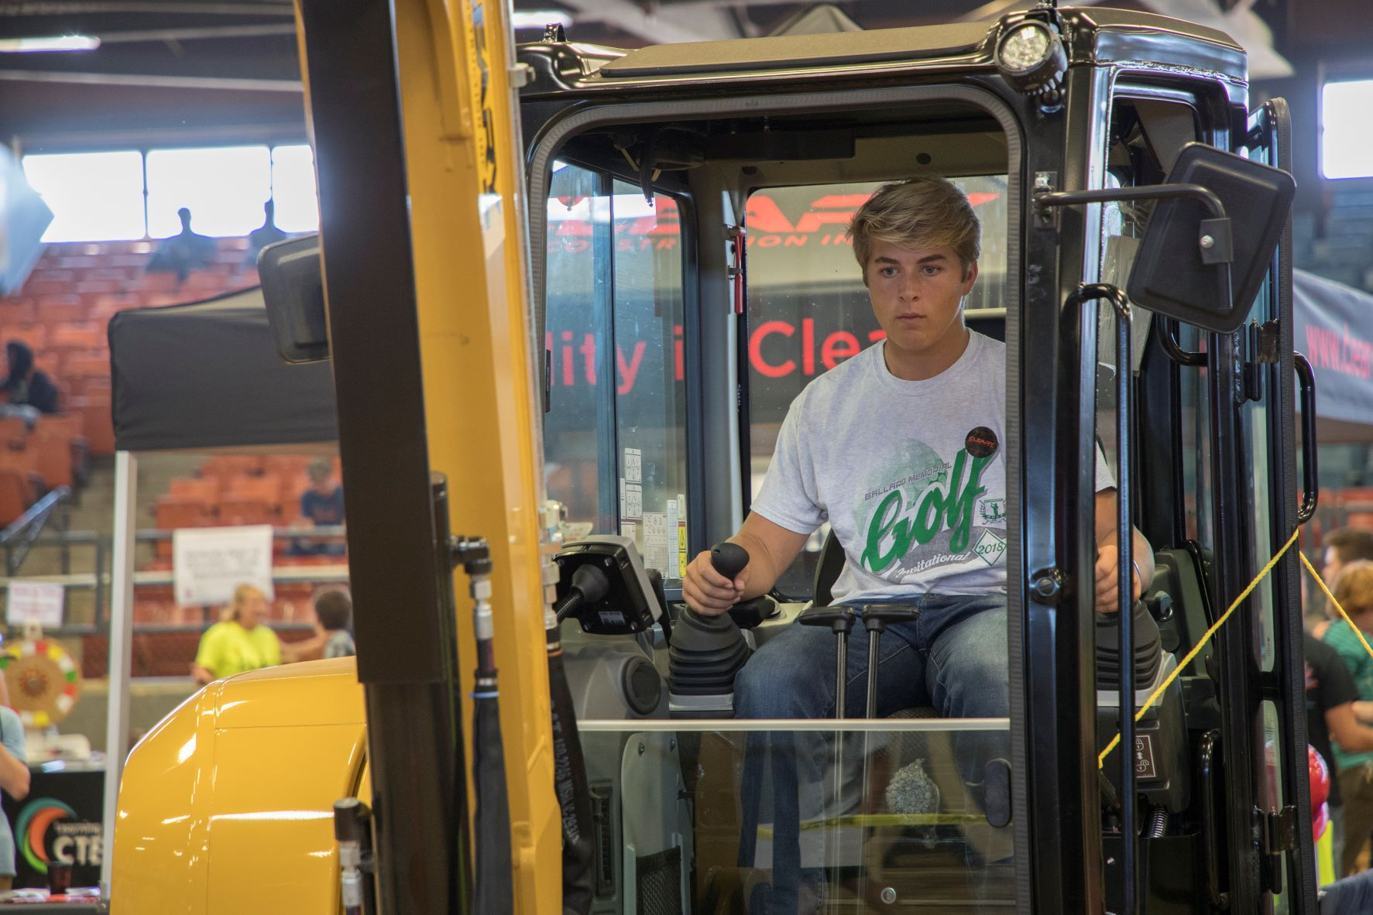
Quality Assurance Commons
Essential Employability Qualities Certification (EEQ) – at least one per college/school at Murray State
EEQ – communication, problem solvers, inquirers, collaborators, adaptable, principled, responsible, learners
QA Commons certification for 9 programs across all 6 colleges/schools – MOST IN THE NATION

Slide 11

Cybersecurity at Murray State
Program of Distinction for KY – HB 1 (1997)
30% increase in enrollment - Fall 2020 to Fall 2022
Cyber Center provides both face-to-face and online options
PISCES (Public Infrastructure Security Cyber Education System) project – student experiential learning w/ principalities (pipeline to address shortage of cyber professionals in KY)
Recognized by the National Security Agency - Center for Academic Excellence in Cyberdefense
Recognized by the International Telecommunication Education and Research Association (ITERA) -
  #1 program in the nation for both graduate and undergraduate cybersecurity programs
Notes:
Murray State University received funding in 1998 for a Program of Distinction in telecommunications, using resources made available through the Regional University Excellence Trust fund. Specifically, a Center for Telecommunications Systems Management (CTSM) was established through which the University is to address regional and national public and private sector needs. As technology has evolved, so has Murray State's approach to technology education. As of December 2021, the center changed its name and focus. The Cyber Education and Research Center (Cyber Center) will provide education, research, development and outreach support for Murray State's cyber-related programs.

Slide 12
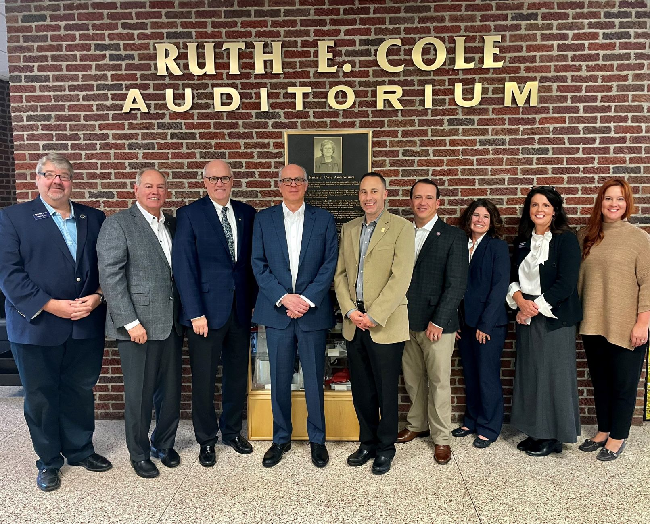
New Academic Building for School of Nursing and Health Professions
Building scope = 72,000 sq. ft
2022-24 authorized amount - $45.5M
Effective July 1, 2023
Planning work on design is occurring now
A&E estimates from this initial planning - $11.6M (25.5%+) to complete the project.

Slide 13
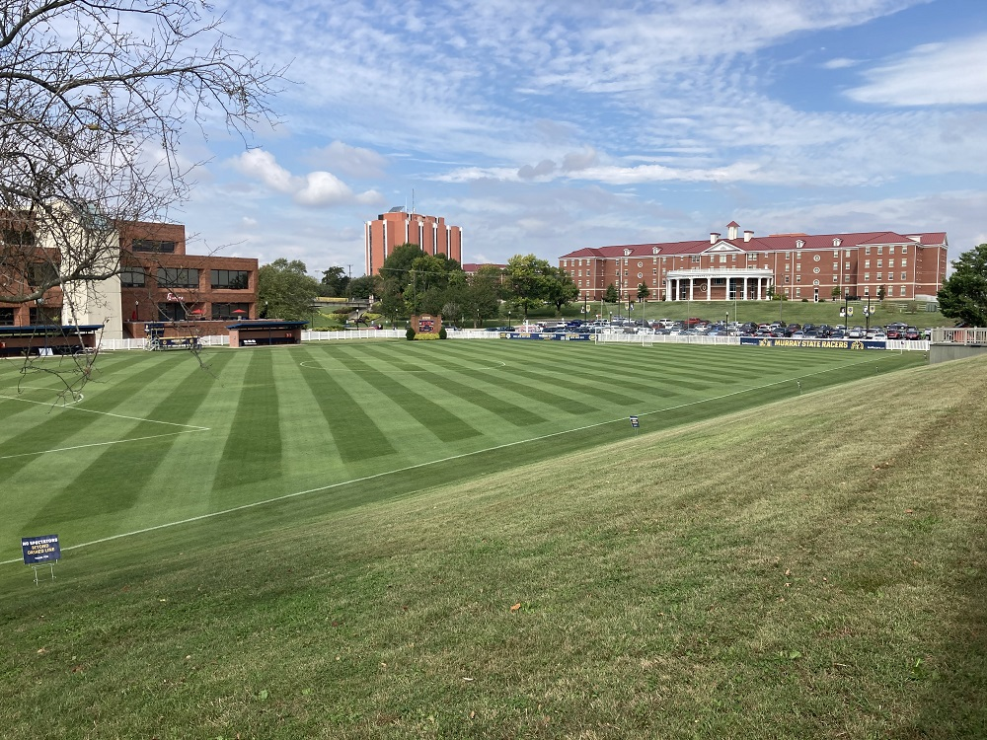
Deferred Maintenance and Campus Improvements
Curris Center (Student Center)
Wrather Hall – among numerous other projects
SSC National Award
  Campus Grounds Beautification (2021)
  Sports Grounds Complex (2022)

Slide 14
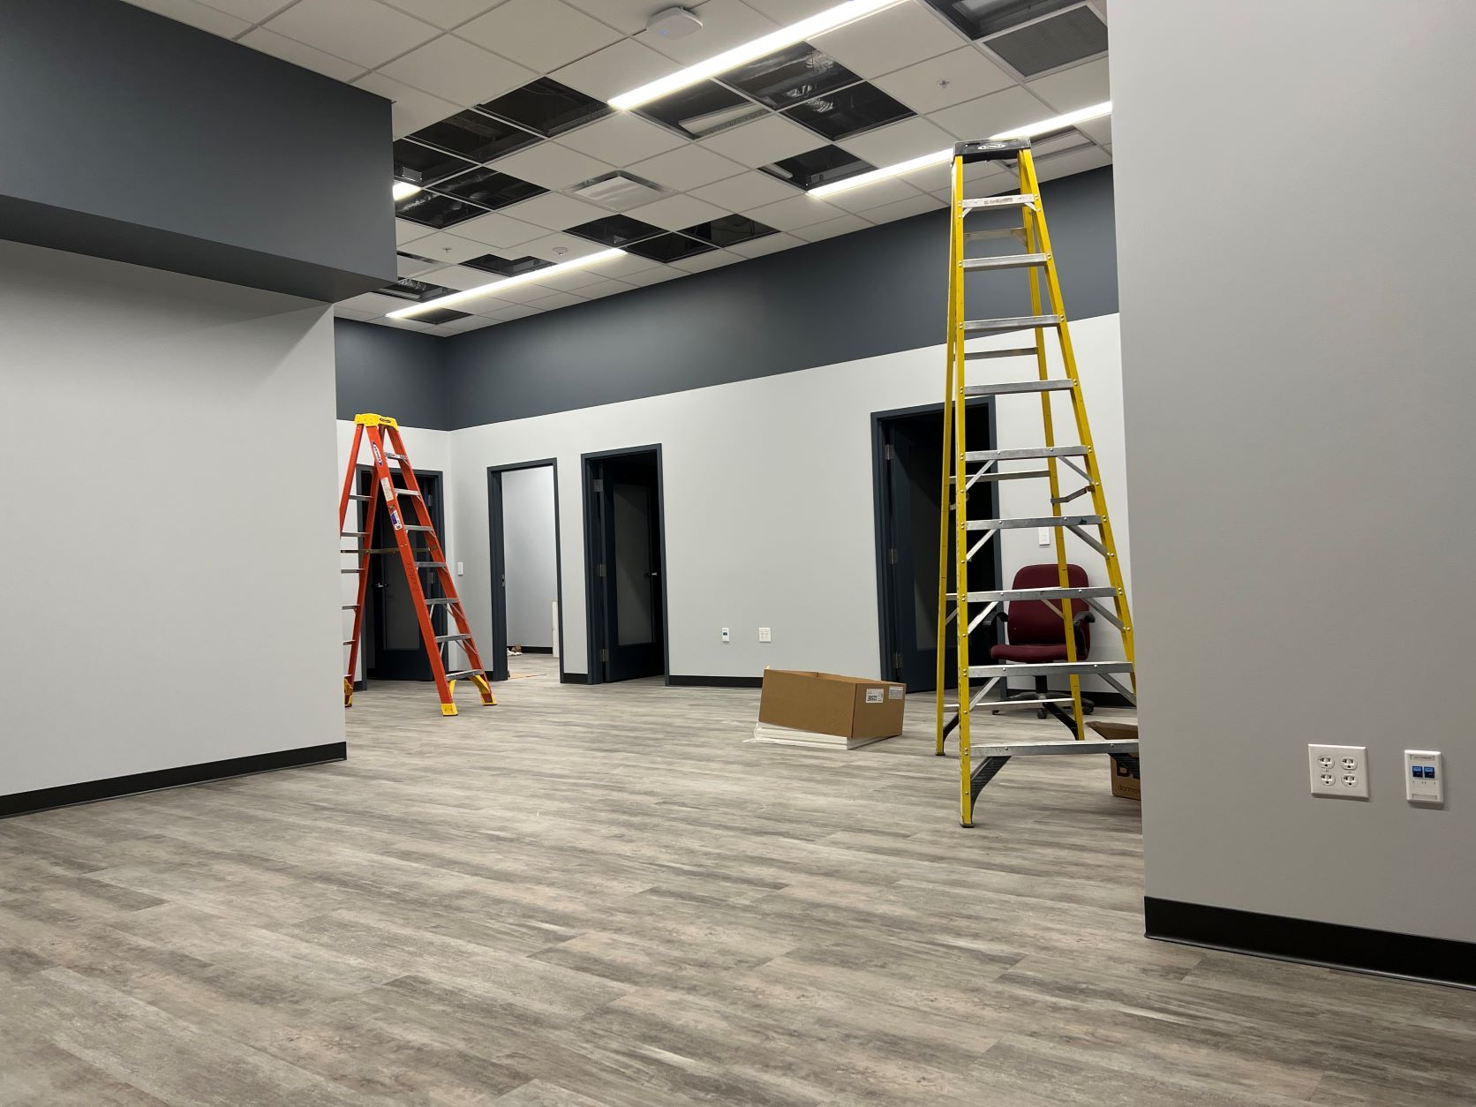
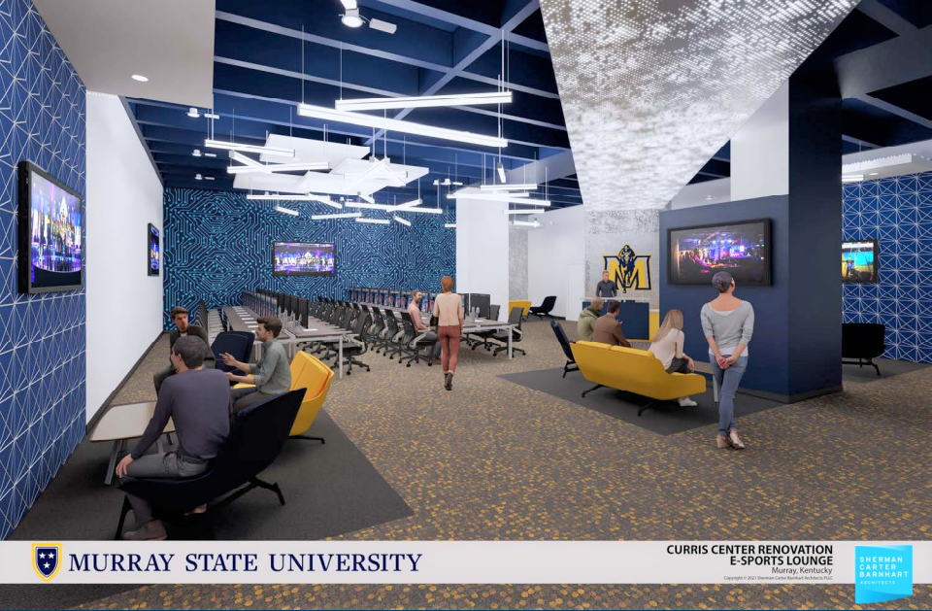
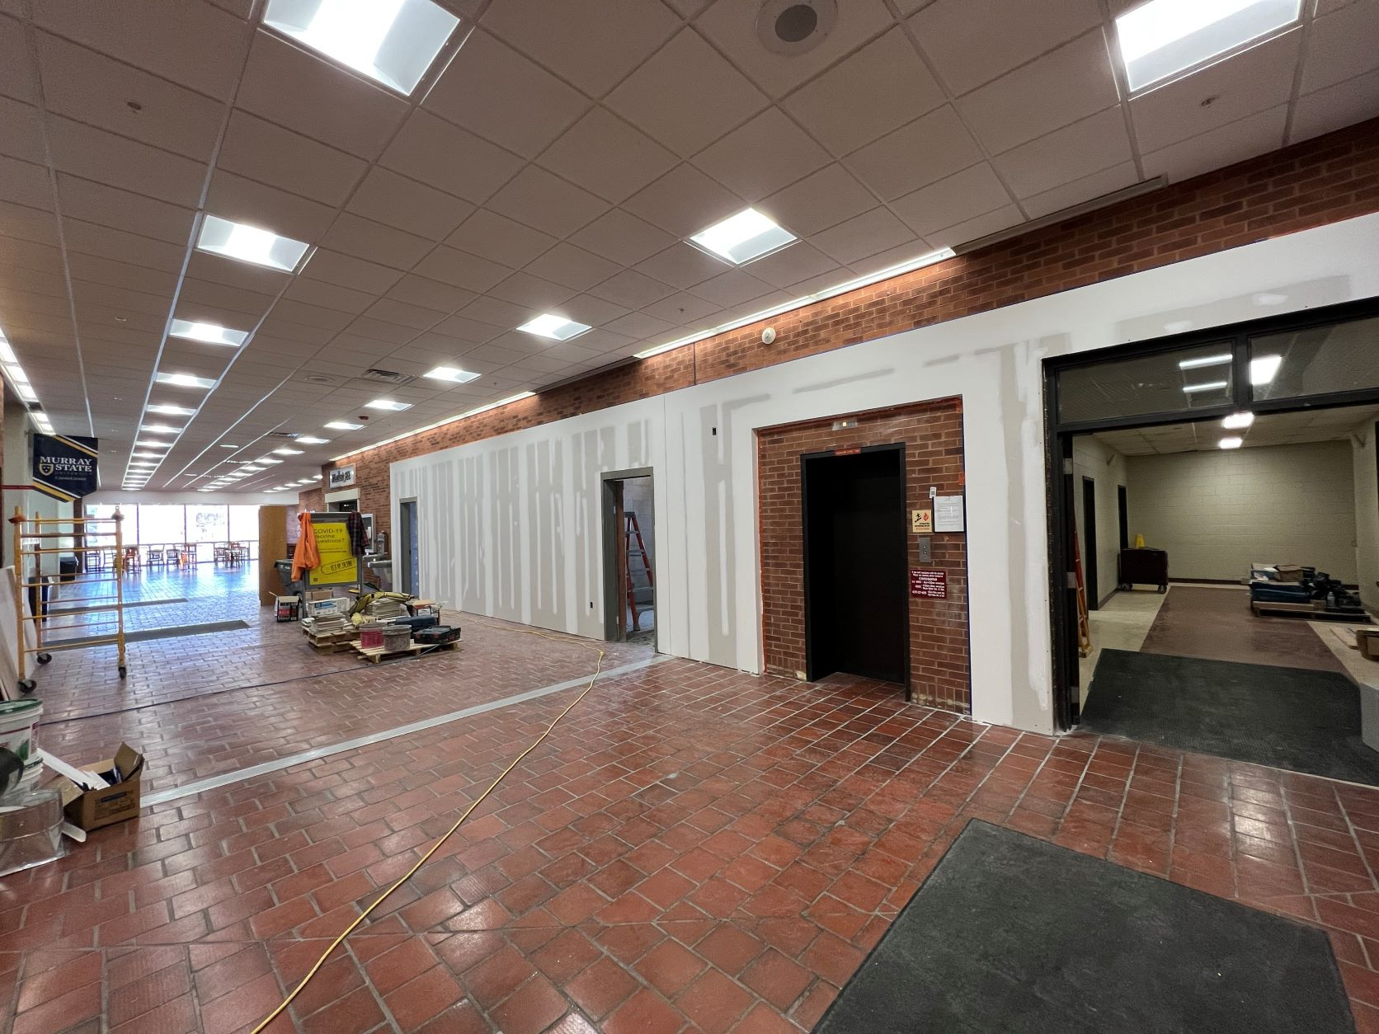
Deferred Maintenance and Campus Improvements
Curris Center Renovation Project

Slide 15
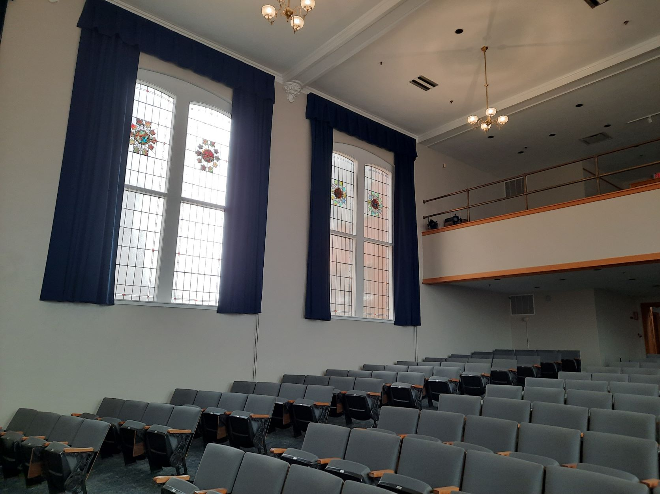
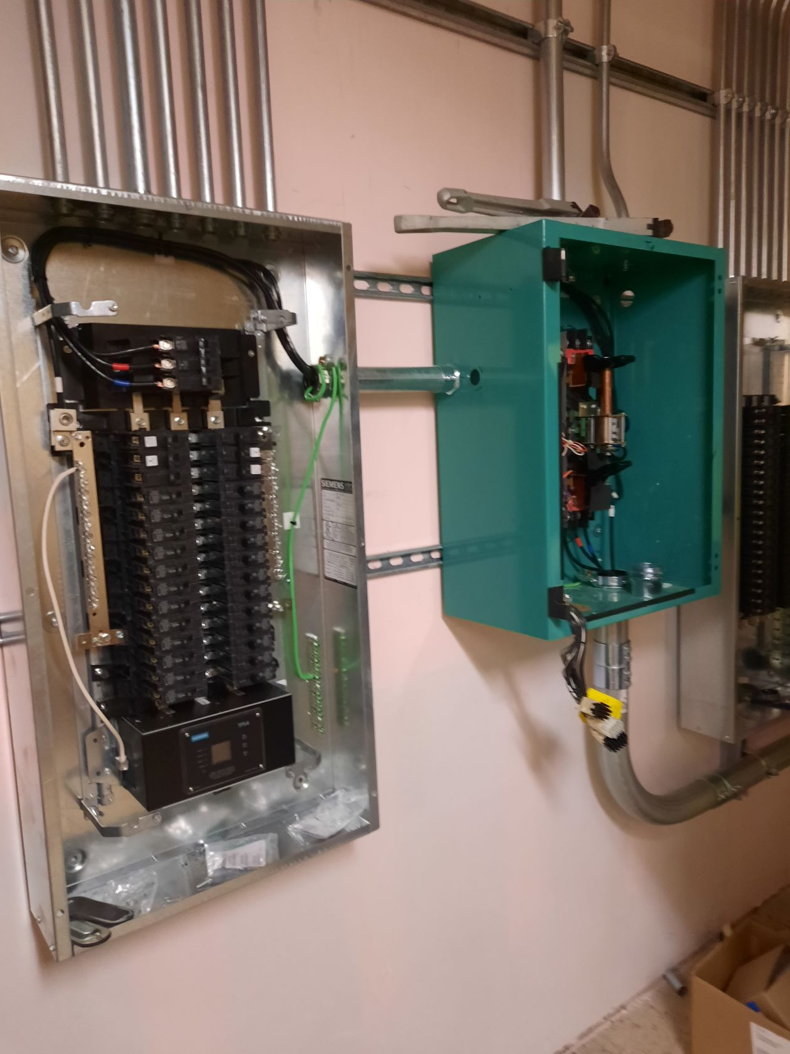
Deferred Maintenance and Campus Improvements
Wrather Auditorium Renovation Project
(Mechanical and physical: structural, HVAC, audio)

Slide 16
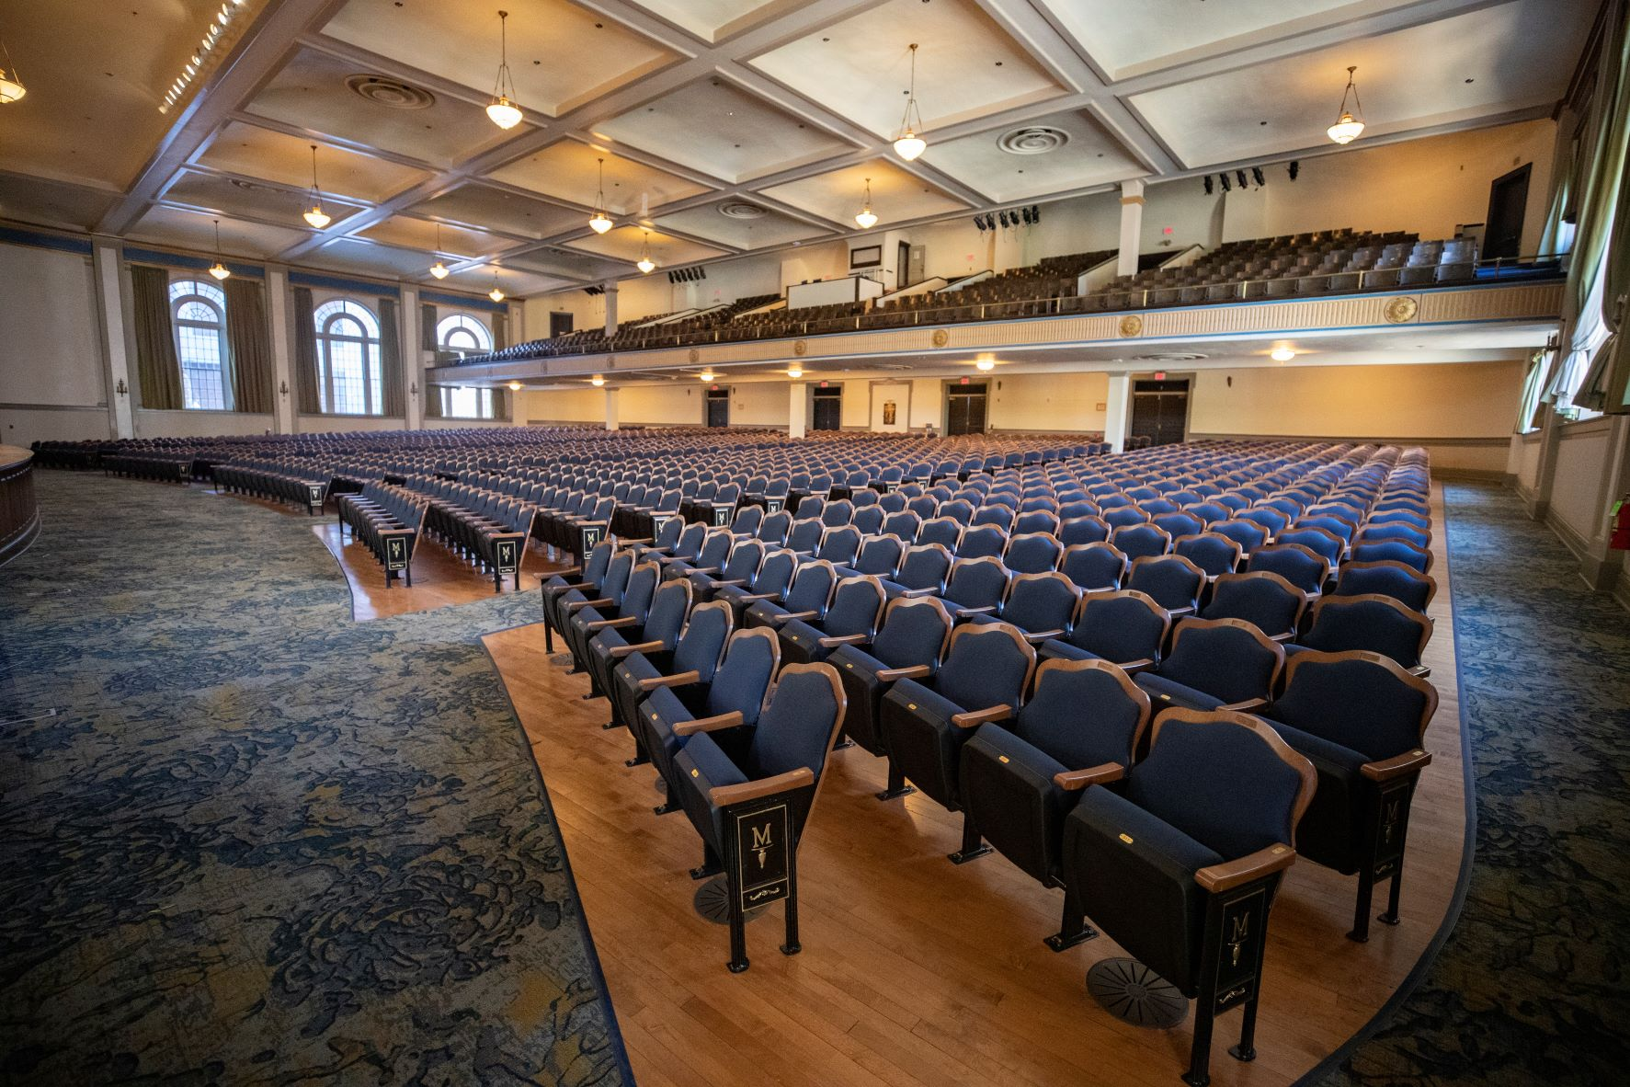
Deferred Maintenance & Campus Improvements
Lovett Auditorium Renovation Project
(HVAC, auditorium, ceiling, electrical, windows)

Slide 17
Asset Preservation Projects
Project scopes are having to be reviewed and reduced and deferred maintenance projects eliminated due to significant increases to cost

Slide 18
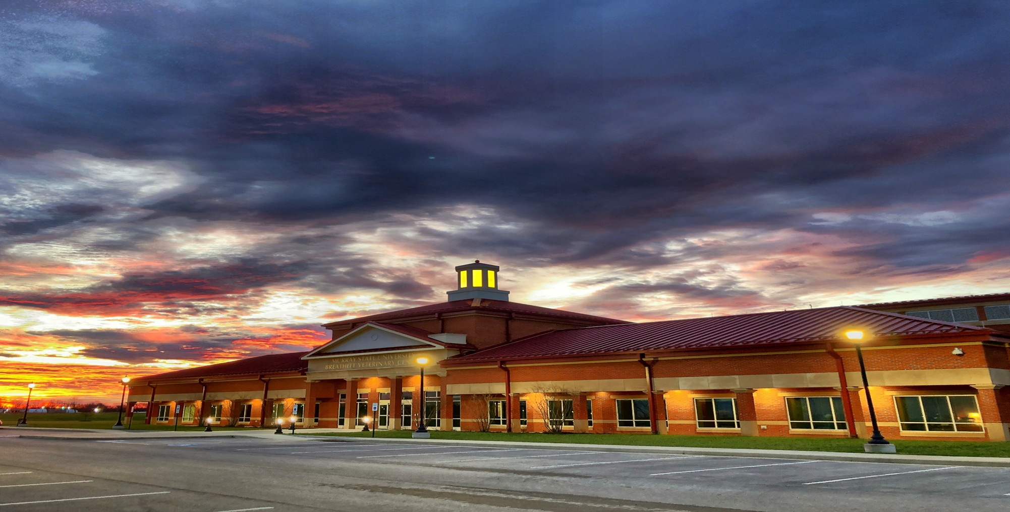
Breathitt Veterinary Center (BVC)
Kentucky’s only NAHLN Level 1 laboratory: Serving the entire Commonwealth
Testing added:
  Chronic Wasting Disease
  African Swine Fever
  Meat Testing
  SARS Covid-19 in animals
Foreign Animal Disease Testing
  New Castle Disease
  High Pathogen Avian Influenza
  Swine Influenza
  Classic Swine Fever
  African Swine Fever
  Foot and Mouth Disease

Slide 19

Free Application for Federal Student Aid (FAFSA)
Only 55% of KY students completed the FAFSA in 2021 – leaving $54.4M in Pell Grant funding on the table
Pell Grants are the largest sources of grants for post-secondary education and do not need to be paid back
To increase college going rates and the workforce pipeline in KY, Murray State calls on the KY General Assembly to pass a FAFSA Completion Bill this legislative session.

Slide 20
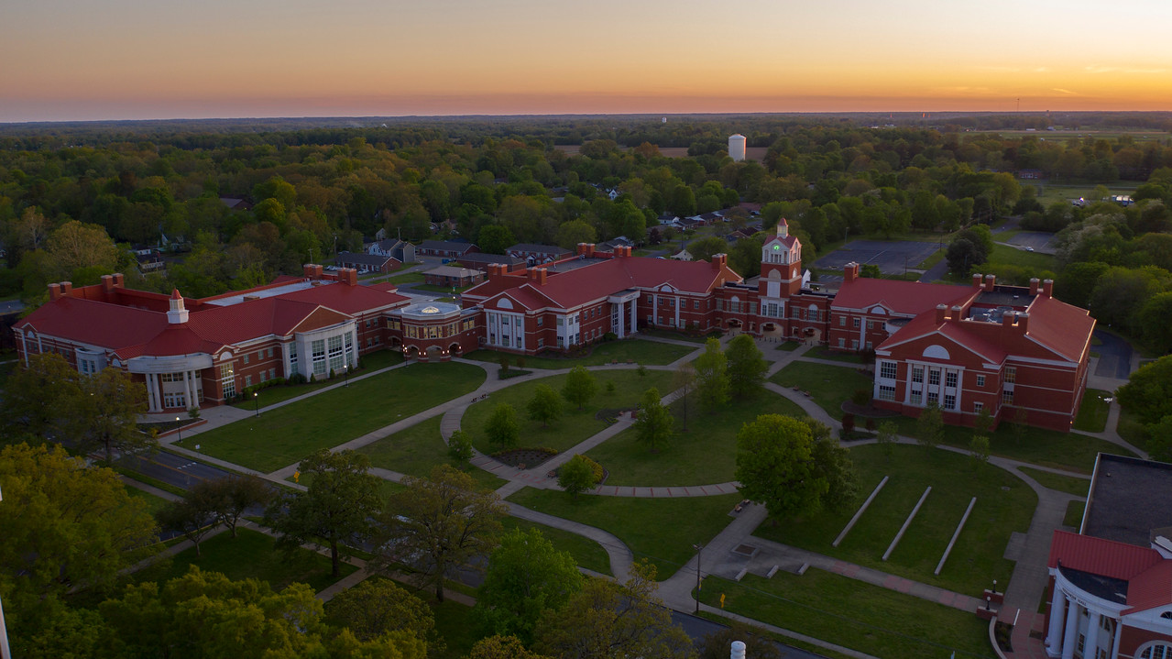
Questions?

