Slide 1
University of Kentucky
February 23, 2023

Slide 2
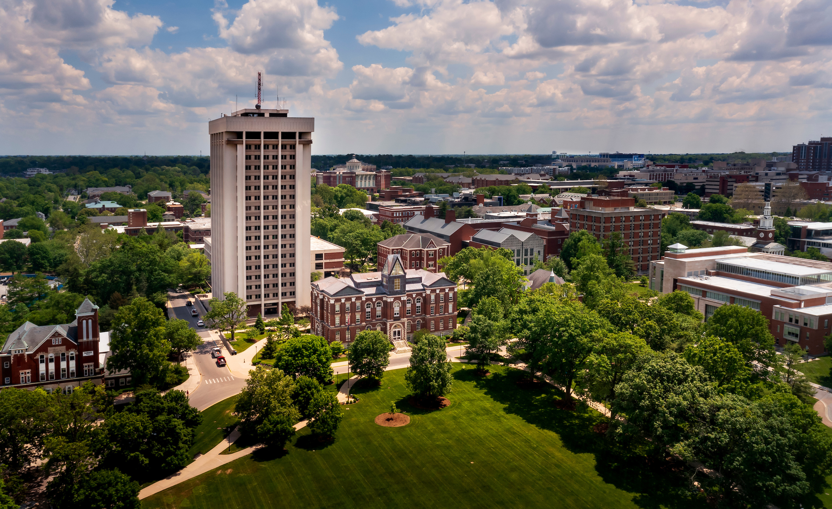
The University of Kentucky
As Kentucky's university, we are anchored in our mission to educate, innovate, heal and serve.
Our mission has evolved, but our sense of responsibility and vision of service remain the same.
UK has a broad range of resources centered on a single campus in the heart of the Bluegrass, but with a presence in every county of the state.
Our wide array of programs fosters engagement and collaboration across colleges, programs and research endeavors.

Slide 3
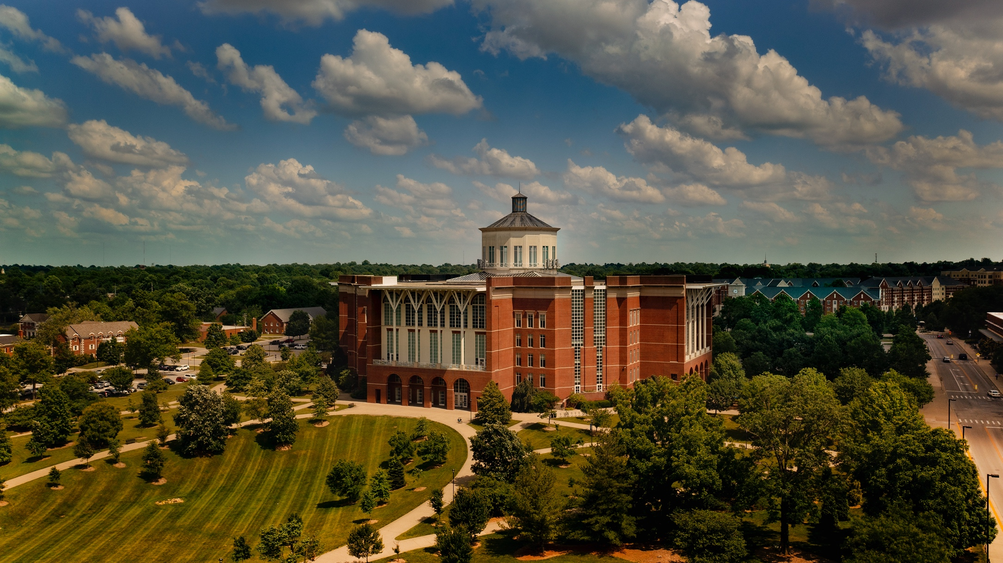
ABOUT UK
UK is home to nearly 33,000 students and approximately 25,000 employees, including almost 2,800 full-time faculty, and operates an annual budget of $6.2 billion.
UK is one of eight universities in the United States that has colleges of agriculture, engineering, medicine and pharmacy on a single campus, leading to groundbreaking discoveries and unique interdisciplinary collaboration.

Slide 4

Academics
The state’s flagship university consists of 16 academic and professional, degree-granting colleges where students can choose from more than 200 majors and degree programs at the undergraduate and graduate levels.
This past fall, we had about 6,100 students — a record — enroll as first-time students.
Our six-year graduation rate is almost 69%, more than 10 percentage points higher than it was a decade ago.

Slide 5
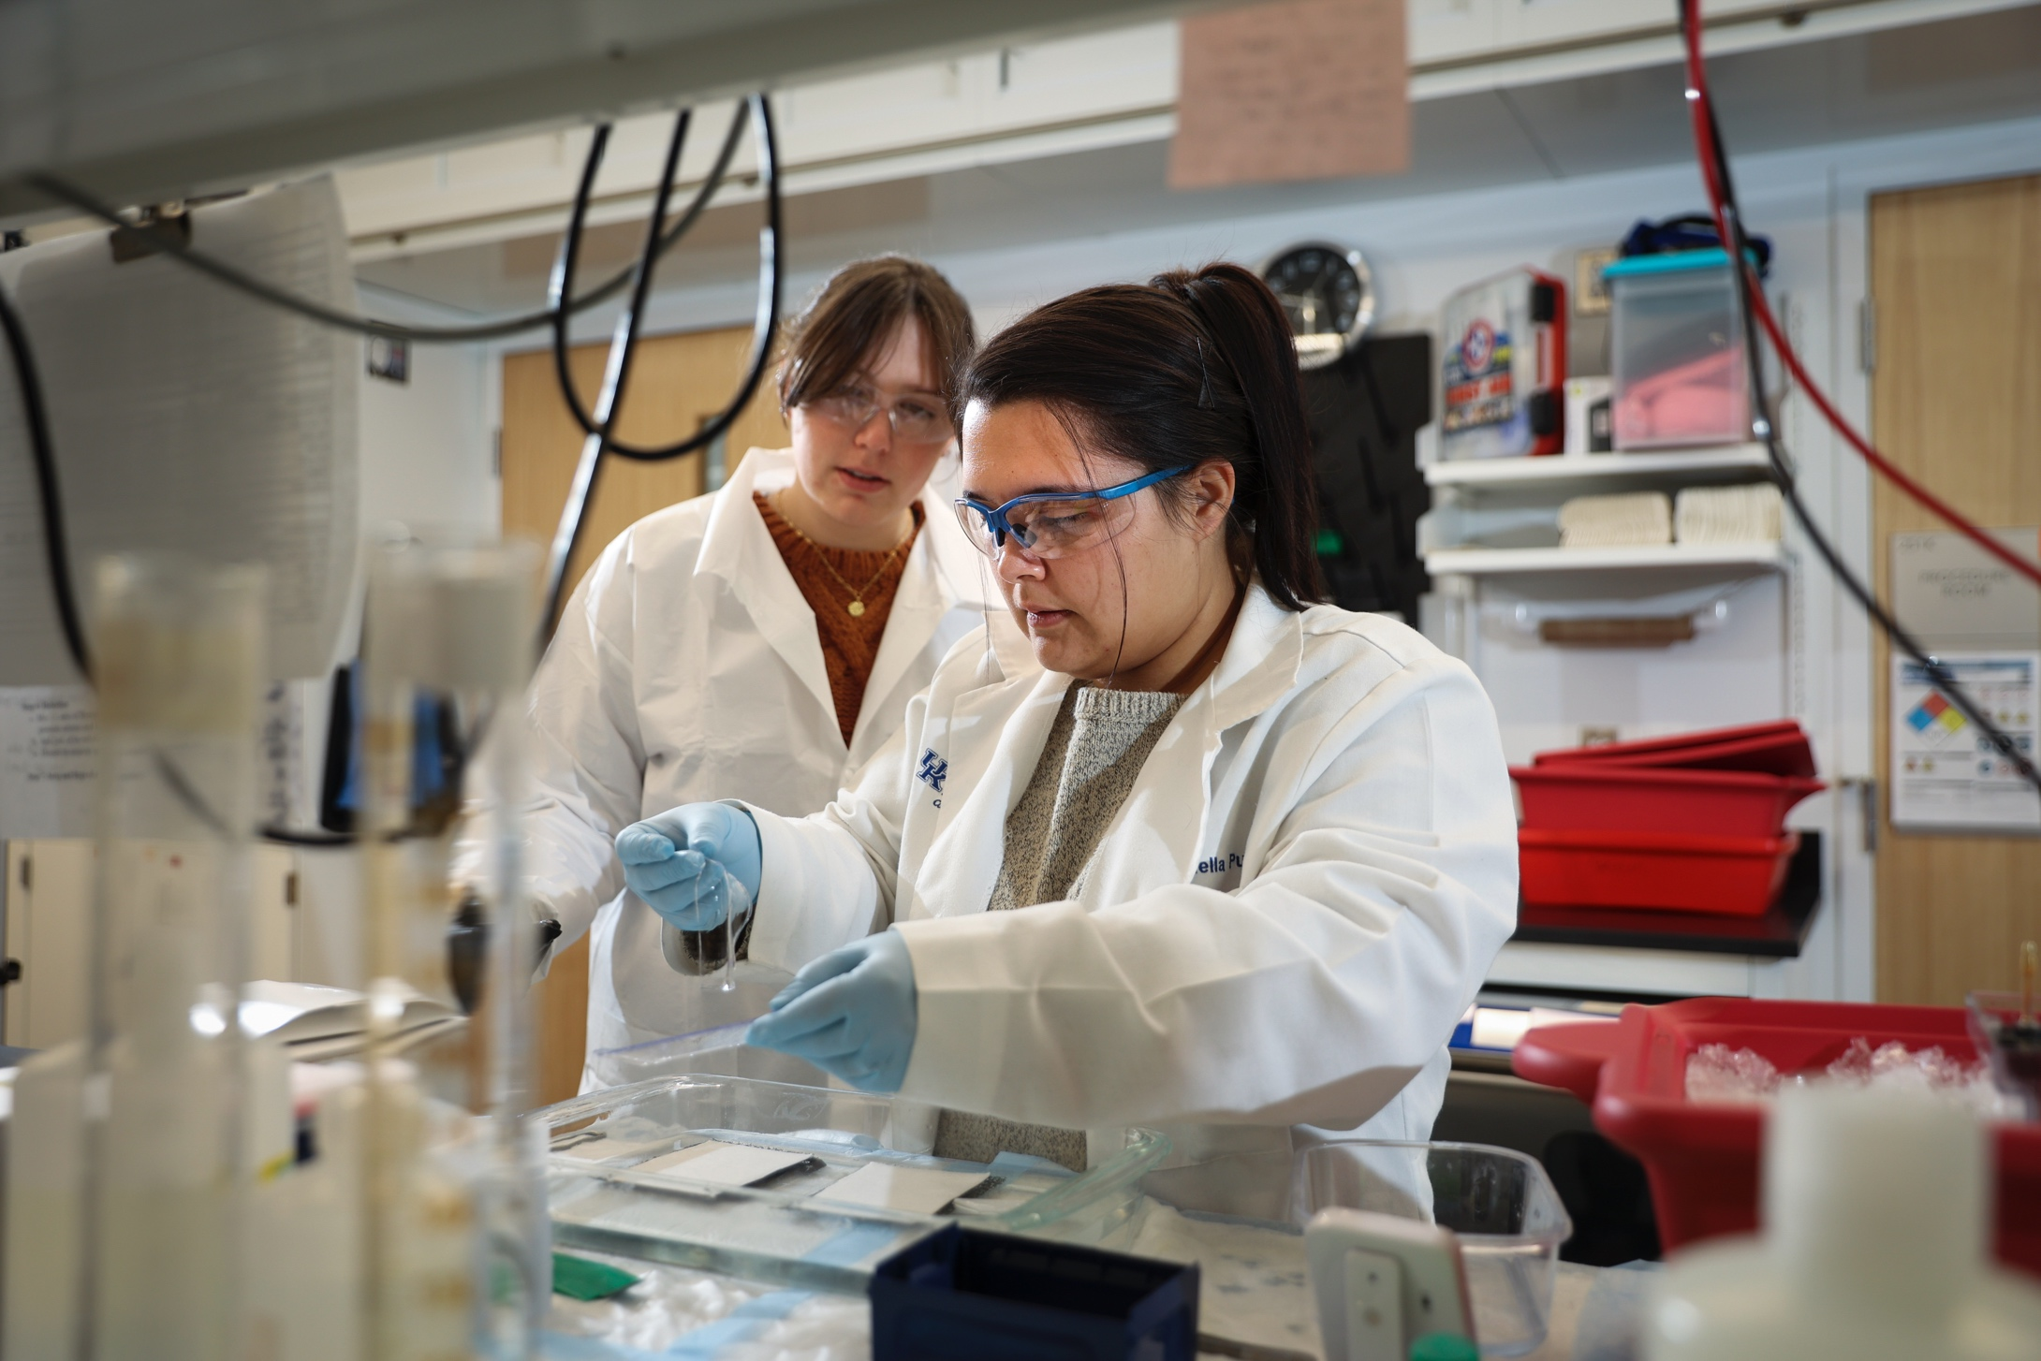
RESEARCH
For the fourth year in a row, UK earned more than $400 million in grants and contracts: $452.9 million in fiscal year 2022, signifying a vibrant and deep research enterprise that is focused on our state and its needs.

Slide 6
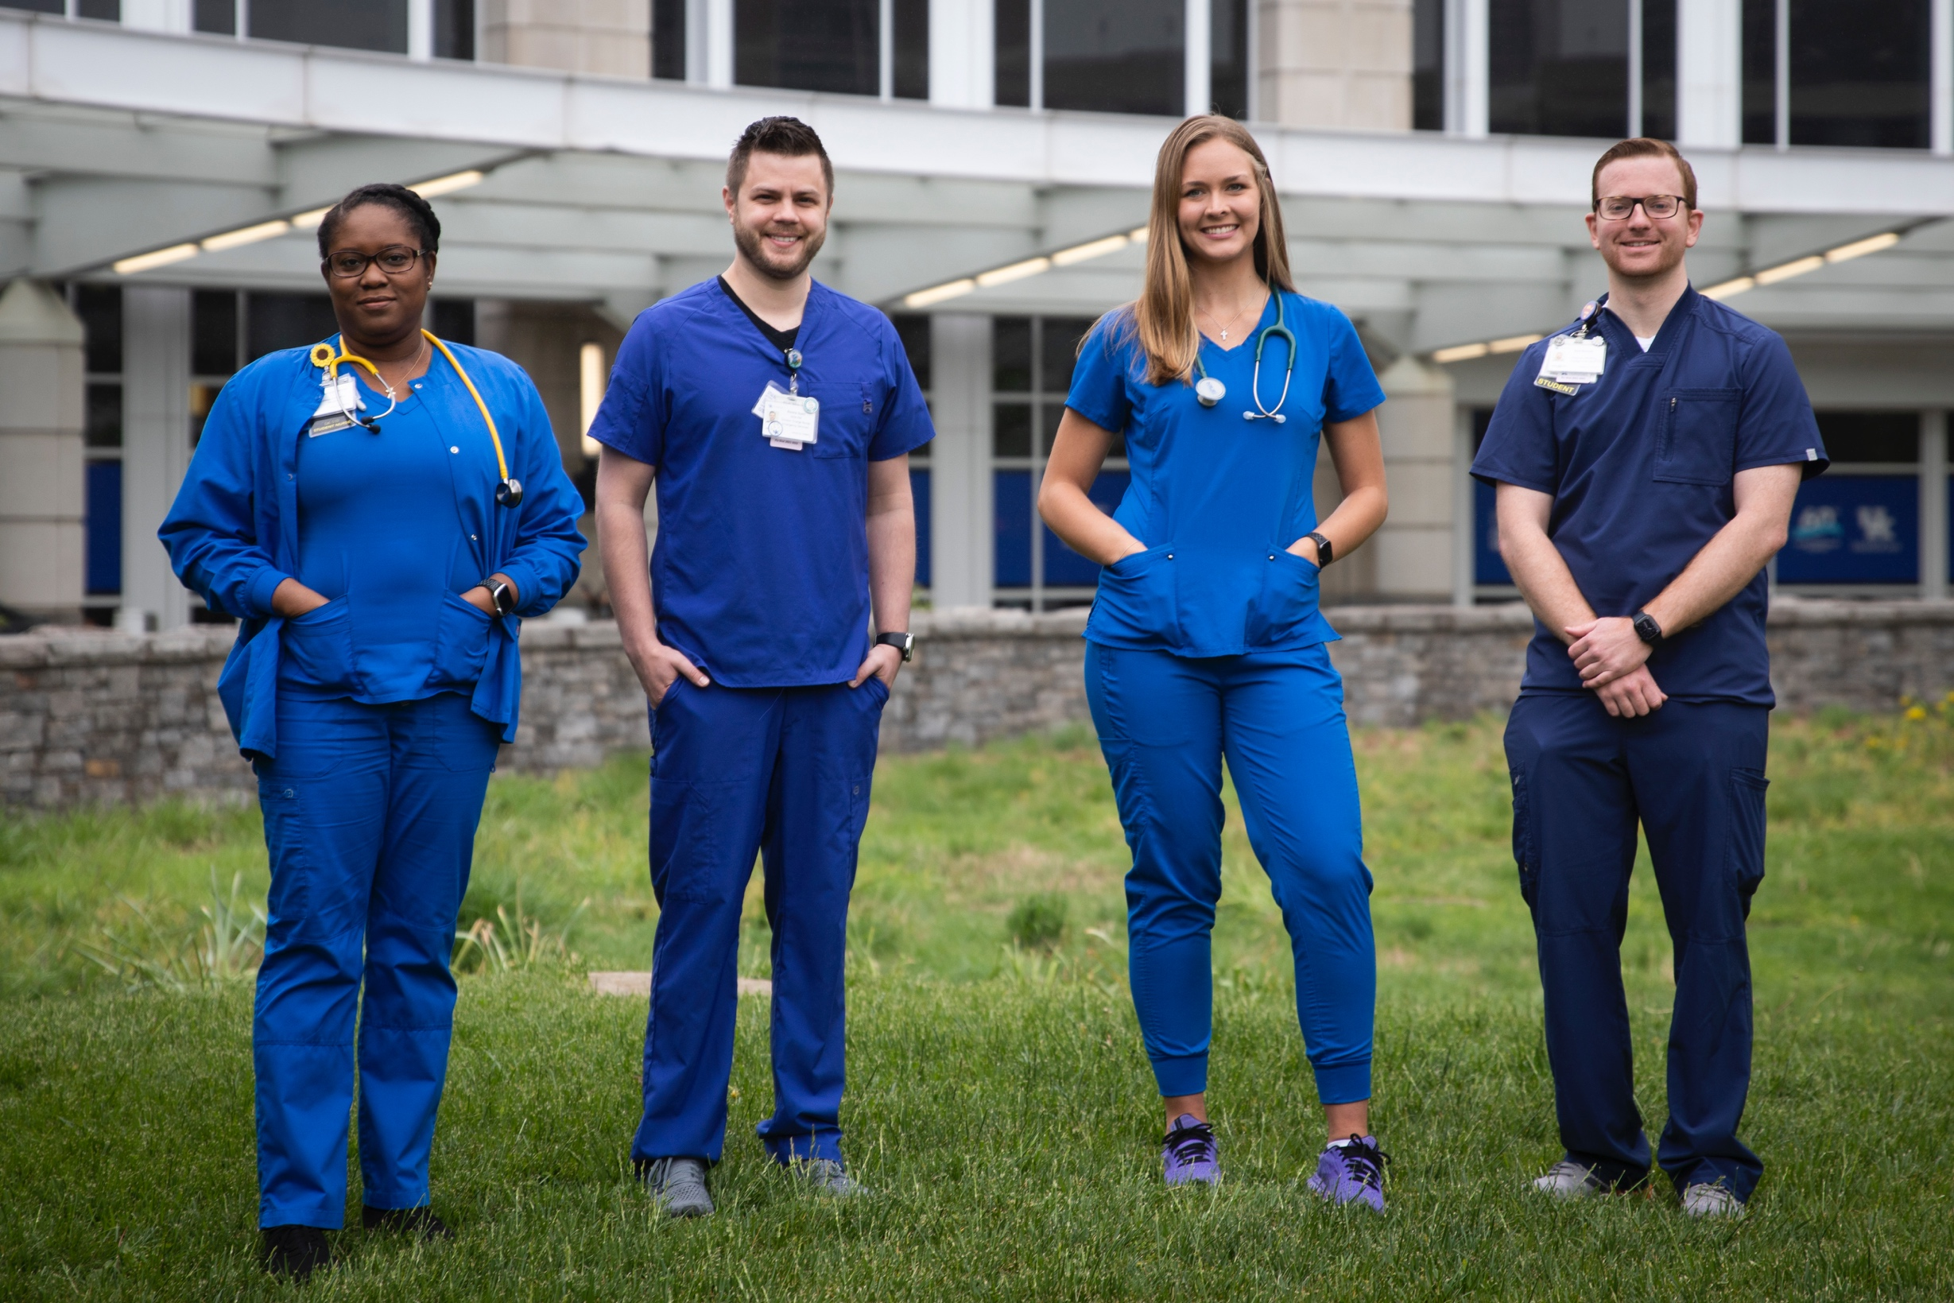
HEALTH CARE
UK’s Albert B. Chandler Hospital was recognized for the seventh year in a row as the state’s top hospital by U.S. News & World Report.

Slide 7
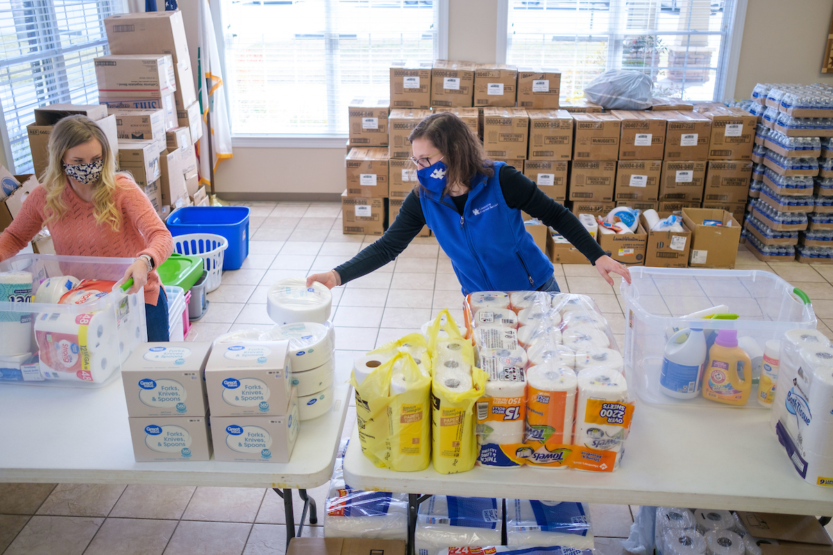
OUTREACH
The UK Cooperative Extension Service, with offices in all 120 Kentucky counties, is a valuable resource for communities across the Commonwealth.
In the aftermath of recent natural disasters, employees in those offices stepped up, providing service and outreach to survivors and their communities.

Slide 8
Kentucky performance funding model
Since 2017, state funds are allocated using Kentucky Performance Funding Model.
For the public universities, the model includes 11 metrics such as bachelor’s degrees awarded, student progression and earned credit hours.
For FY 2022-23, UK was the only university to exceed the growth of the system average for each of the 11 metrics.
8

Slide 9
Current construction environment
Procurement Lead Times
  Unprecedented orders in 2022 have caused manufacturers significant delays in filling orders. To manage this, we have been utilizing early procurement packages for these long-lead items. The result, however, is that it takes longer to complete a construction project, which leads to increased overall costs.
Skilled Trade Shortages
  In combination with the high level of construction activity in the state, skilled trade shortages have caused trade contractors to be more selective in the work that they perform. This results in a decrease in the competition for trade packages. Less competition results in higher costs.
Inflation/Escalation
  While inflation seems to be leveling off somewhat overall, the material costs associated with construction remain high and are still increasing, albeit at a slower rate than in the past year and a half. We are mitigating this by including a “Volatility Contingency” in our project budgets upwards of 30%. We are also implementing a “design to 90%” strategy early on with the design teams.
9

Slide 10
Health Education Building legislative authorization
Construct Health Education Building | $380,000,000
Restricted Funds | $30,000,000
State Bond Funds | $250,000,000
Agency Bonds | $50,000,000
Other | $50,000,000
10

Slide 11
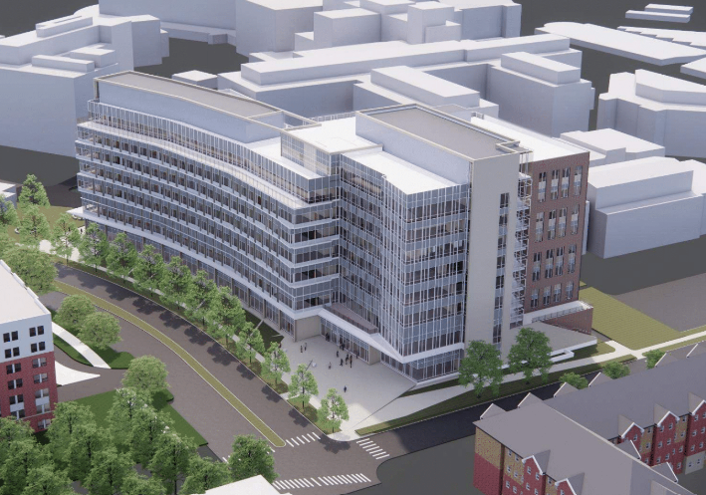
Health Education Building
$30M was approved by UK Board of Trustees in May 2021 for design.
Design is scheduled to be complete in April 2024 with construction ending in April 2026.
The building is going to be shared by the colleges of Medicine, Nursing, Health Sciences and Public Health.

Slide 12
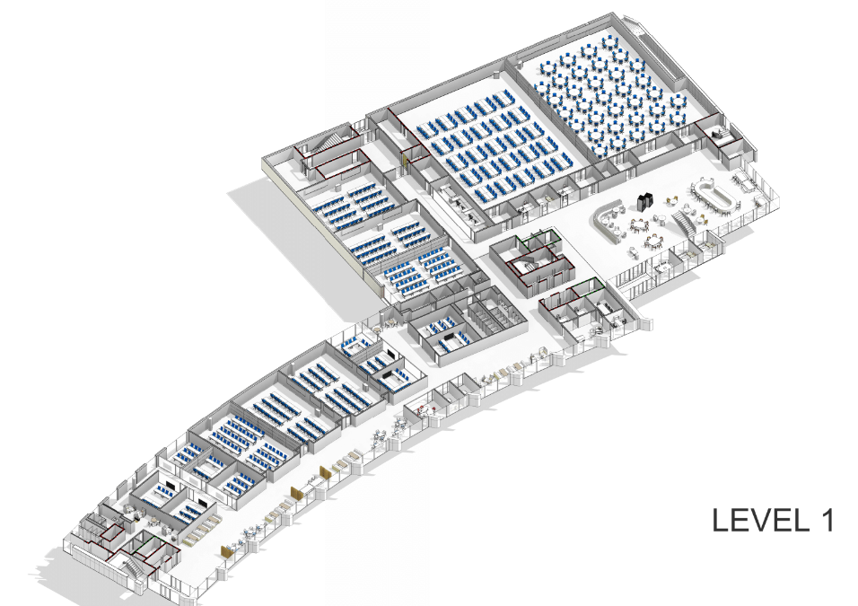
HEALTH EDUCATION BUILDING
The August 2022 cost estimate indicated a 9.5% increase over the initial estimate.
To stay within budget, approximately 42,000 GSF of area was cut from the building. The focus of the reductions were workplace areas and not classrooms and simulation lab spaces.
Additional measures that may need to be taken to accommodate increases in the cost of construction include “shelling” portions of floors for a future construction project.
12

Slide 13





Principles for the Asset Preservation Pool
Preserve and extend the useful life of existing facilities.
Improve the utilization of space by providing a more flexible array of classrooms to serve our growing student population, creating spaces that are responding to Kentucky’s workforce needs, especially in the STEM+H (science, technology, engineering, math and health) disciplines.
Create better space to increase research collaboration among faculty, staff and students across and among disciplines where ingenuity can unfold.
Efficiently manage repair and maintenance costs.
Upgrade existing infrastructure to improve energy efficient systems that reduce operating costs and lower future maintenance expenses.
13

Slide 14
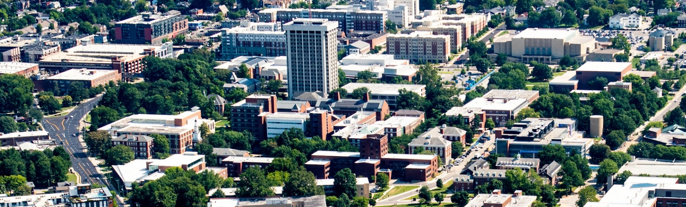
Asset Preservation Funding
 | FY 2022-23 | FY 2023-24 | Total
State Bond Funds | $77,098,000 | $77,098,000 | $154,196,000
Campus Match, Agency Bonds | $23,130,000 | $23,130,000 | $46,260,000
Grand Total | $100,228,000 | $100,228,000 | $200,456,000
14

Slide 15
Asset Preservation Projects
Projects |  | Estimated Scope
FY 2022-23 | Improve Multi-Disciplinary Science Building | $15,000,000
 | Improve White Hall Classroom Building Phase I | $8,000,000
 | Improve Pence Hall | $32,000,000
 | Improve Patterson Office Tower | $7,250,000
 | Improve Miller Hall | $7,250,000
 | Improve Peterson Service Building | $5,000,000
 | Various Infrastructure/System Improvements | $25,500,000
FY 2023-24 | Improve White Hall Classroom Building Phase II | $75,000,000
 | Various Infrastructure/System Improvements | $25,000,000
Grand Total |  | $200,000,000

Slide 16
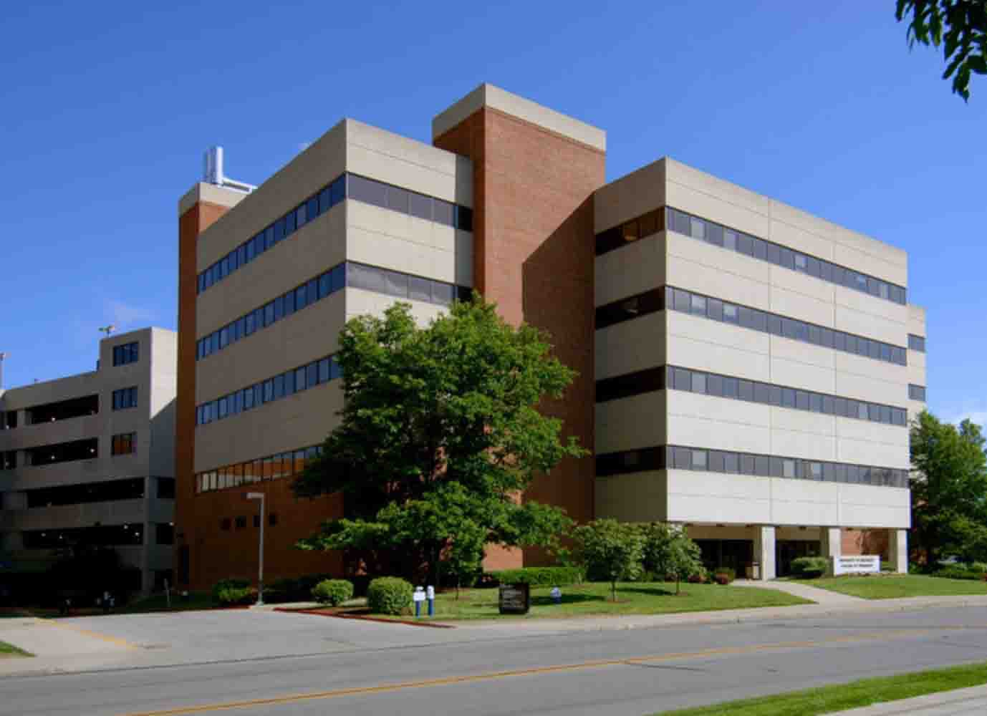
Multi-disciplinary science building – 5th floor
Asset preservation
The UK Board of Trustees approved the renovation of 15,800 GSF of lab space, which will add needed teaching space and offices for the colleges of Health Sciences and Nursing.
Design is scheduled to be complete in June 2023, with construction complete in summer 2024.

Slide 17
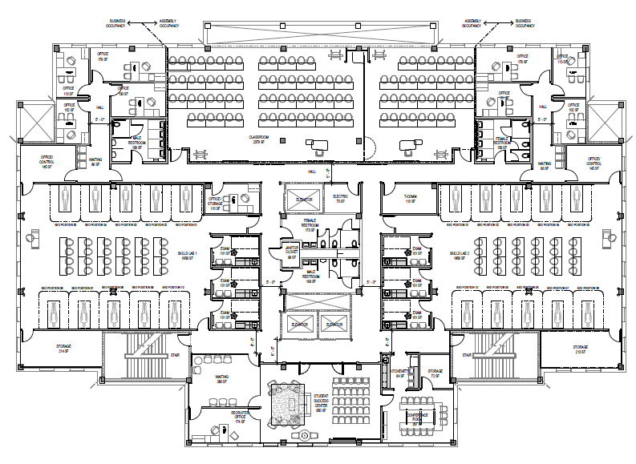
Multi-disciplinary science building – 5th floor
Asset preservation
The original estimate of $10M has been increased to $15M due to cost escalations as well as the addition of new air handling units and needed repairs to the existing elevators to bring them up to current code.

Slide 18
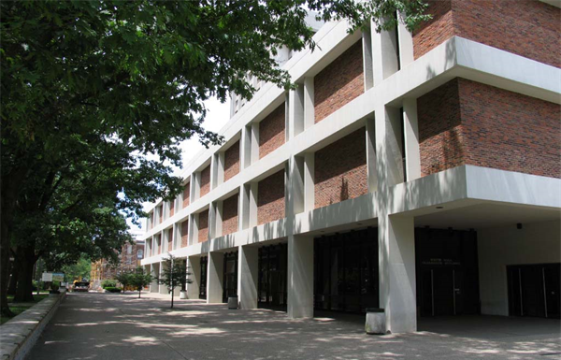
White hall classroom building
Asset preservation
This project includes extensive renovations of approximately 119,000 GSF of the original 1960 building.
The project will provide much needed updates to classrooms and public spaces as well as necessary code and building system replacements.
Design is scheduled to be complete in January 2024 and construction complete in summer 2026.

Slide 19
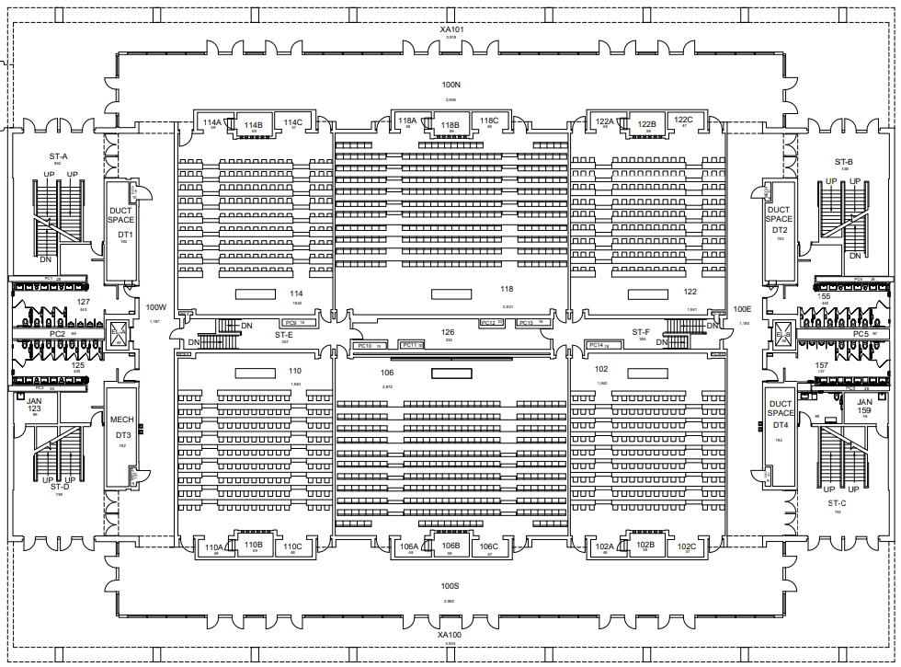
White hall classroom building
Asset preservation
The initial budget of $670/SF has been determined with a 34% cost increase built in over a more typical major renovation cost of approximately $500/SF.
To allow for flexibility on bid day, we will also design up to 90% of the project budget with the remaining 10% being addressed as additive alternatives to the project.

Slide 20
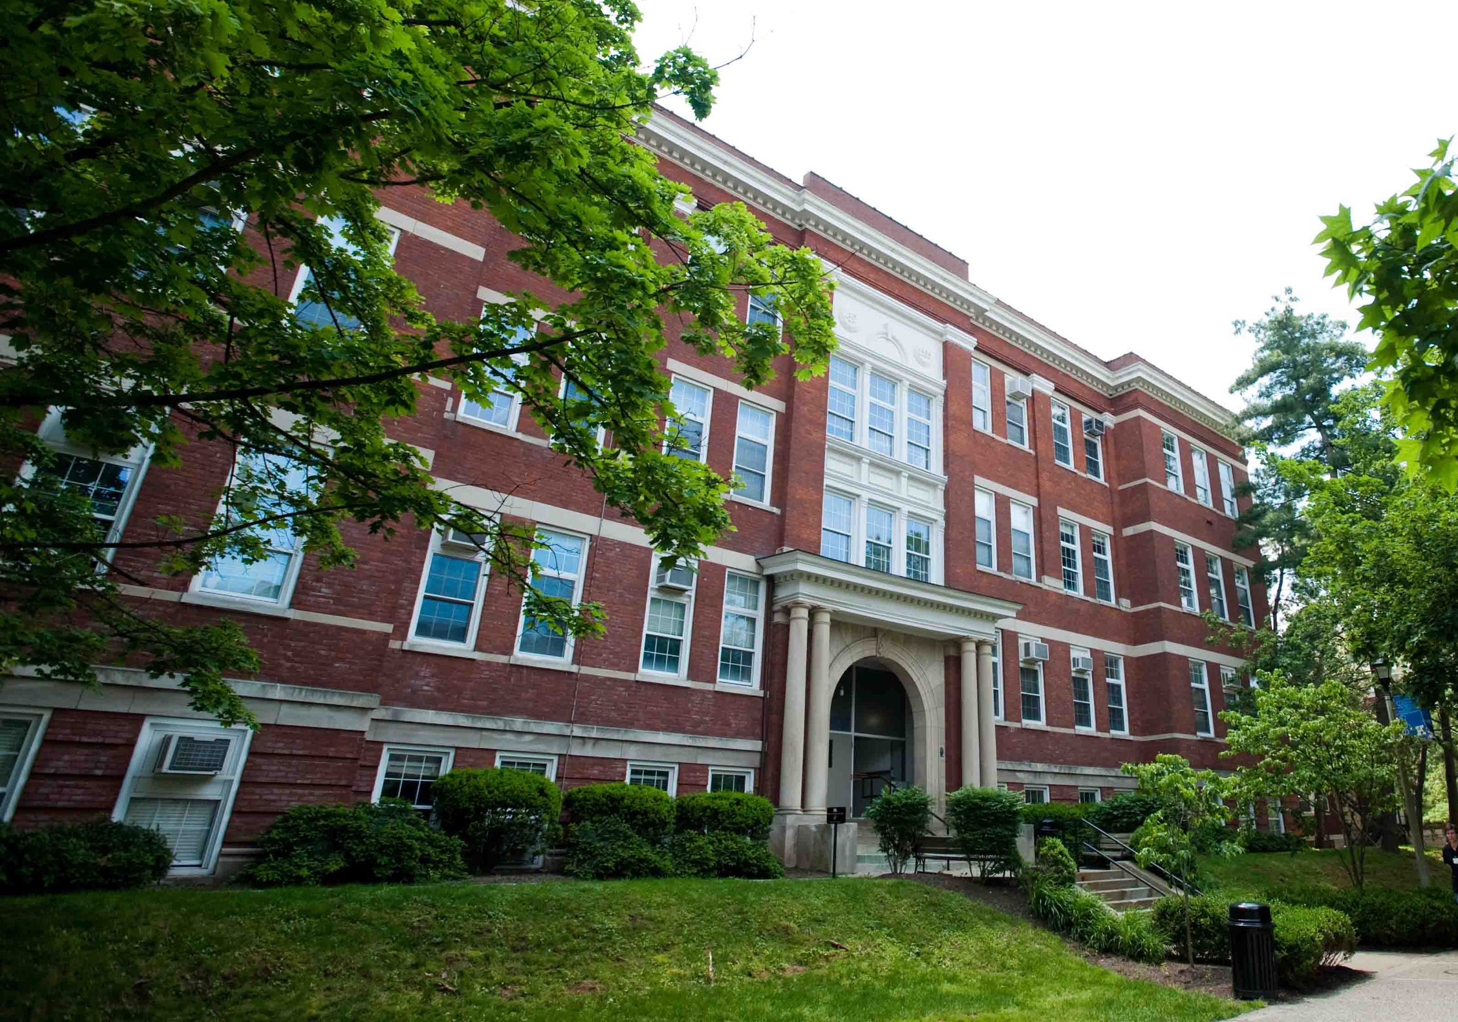
Pence Hall
Asset preservation
The UK Board of Trustees approved renovations for Pence Hall.
Originally built in 1907, renovations will add classroom and office space for the College of Communication and Information.
The design process should be complete in July 2023 and construction complete in summer 2025.

Slide 21
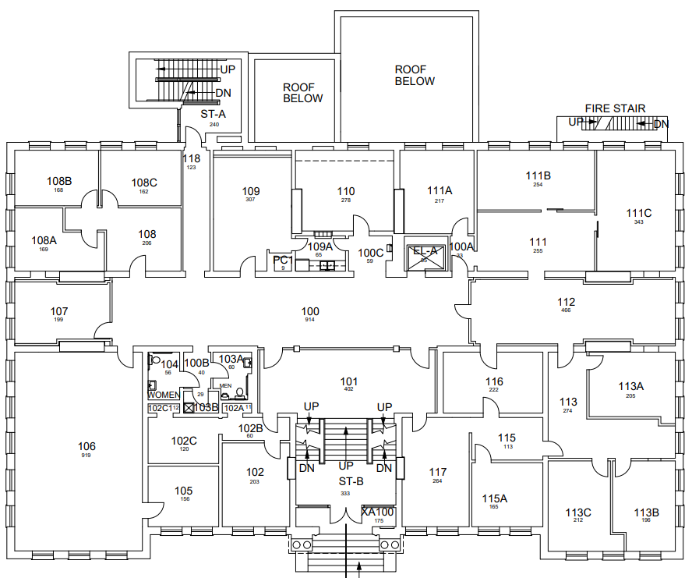
Pence Hall
Asset preservation
The total project cost of $32M equates to approximately $760/SF. This includes a 30% increase over normal major renovation costs. This also includes a higher-than-normal renovation cost due to the need for the building to be connected to the chilled water and steam system as well as a complete replacement of aging electrical systems.
To allow for flexibility on bid day, we will design to 90% of the project budget with the remaining 10% being addressed as additive alternatives.

Slide 22
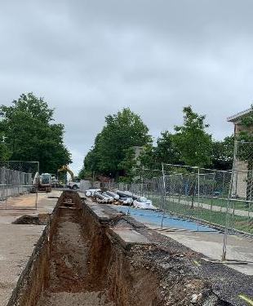
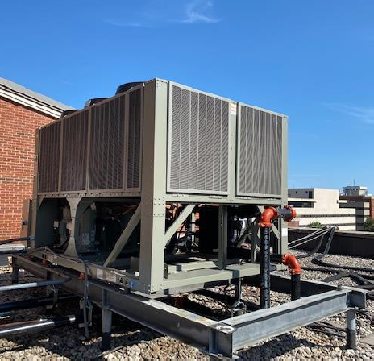
Building Systems & Infrastructure Projects
Asset preservation
Several projects have been initiated to address needs with our utility infrastructure and specific systems within existing buildings.
Examples include major sanitary sewer repairs, steam and condensate line replacement, window replacements, improving HVAC systems and replacing window units in several older classroom buildings.

Slide 23
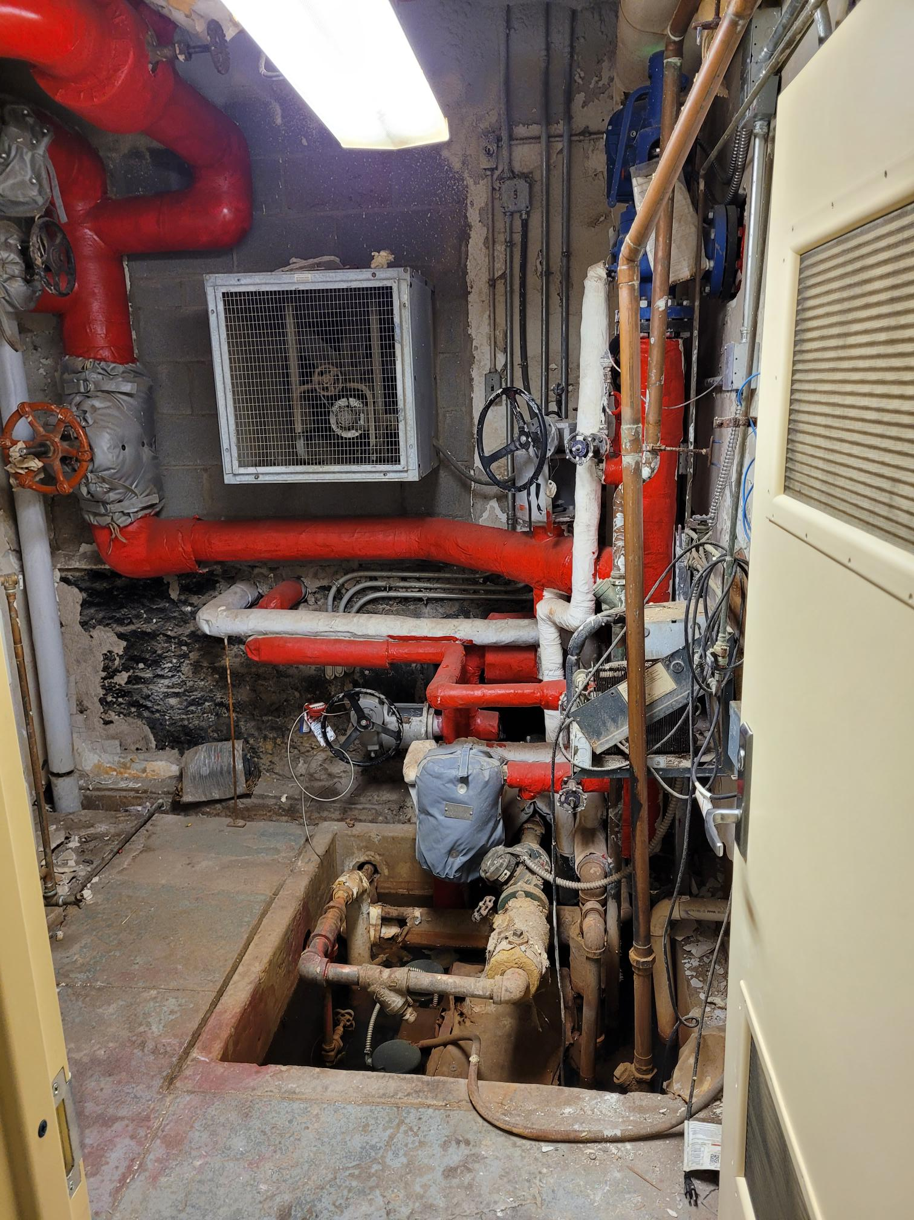
Building Systems & Infrastructure Projects
Asset preservation
The plan is to set aside $25M +/- for building systems and utility infrastructure projects for each year of the biennium.
The budgets set aside for each of these projects have been increased by approximately 25% to account for market escalation and a tighter bid environment.
As budgets have increased on high priority projects, other projects will be delayed.

Slide 24
QUESTIONS

