Slide 1
Budget Review Subcommittee on Postsecondary Education
February 23, 2023
Kim Schatzel, PhD
President, University of Louisville

Slide 2
Highest Carnegie Research classification (R1) and Community-Engaged designation
More than 166,000 alumni; 98,000+ in Kentucky
UofL/UofL Health second-largest employer in Louisville – 19,500 employees
Comprehensive academic health sciences with affiliated health care system
More than 23,000 students (largest freshman class)
72% are Kentucky residents; 79% of undergrads
Students from 119 counties
39% are Pell-eligible & 33% are first-generation
Improved retention (78.2% in 2023)
2nd lowest student debt among all Kentucky publics
Who We Are
Leading for Student Success

Slide 3
Great economic investment for the Commonwealth:
$145 million yields $8.6 billion economic impact
Partners: Humana, GE/Haier, UPS, Yum!, CEOC, Ford
Health Care and Academic Medicine:
Approximately 1.5 million patient encounters annually
16 health care facilities
Nursing and family medicine residency programs
Dental clinics
Record research funding: Over ~$200 million each of the last two years
KY MEP Program
$15 million from US Dept of Commerce
Economic impact of ~$150 million
4 Regions
Cybersecurity:
NSA NCAE-C and other cybersecurity grants – $15 million
Training/research grants DoD, DHS, DOJ
KY Field Offices for FBI, Secret Service, Homeland Security
Research and Innovation
Powerhouse

Slide 4
Mission Statement
The University of Louisville pursues excellence and inclusiveness in its work to educate and serve its community through:
teaching diverse undergraduate, graduate and professional students in order to develop engaged citizens, leaders and scholars
practicing and applying research, scholarship and creative activity
providing engaged service and outreach that improve the quality of life for local and global communities
The University is committed to achieving preeminence as a premier metropolitan research university.

Slide 5
A Good Steward
Last year, the Legislature appropriated funding for the following important areas:
Asset Preservation
Bucks for Brains
Performance Funding
Engineering Building
Military-Connected Student Center

Slide 6
Funding to keep physical infrastructure in reliable and safe operating condition
Total program = $106 million ($53 million per year)
Total state funding of $81.9 million
Institutional match of $24.6 million
More than 120 projects identified/funds fully committed to:
Benefits:
All campuses and colleges
All significant infrastructure support systems including HVAC, electrical and campus safety
Inflationary pressures impacted project costs
Asset Preservation

Slide 7
Long term debt at 6/30/22: $298 million
Debt includes funding for residence halls, student recreation center, football stadium expansion, energy efficiency and dental school building
All debt is fixed rate between 1.5% and 5% (average of 4%)
Ratings:
Moody’s rating of Baa1/ stable (2021)
S & P rating of A+/Stable (2022)
Debt to assets ratio: 12% (sector average of 23%)
Debt burden ratio: 3.0% (sector average of 3.9%)
40% of our current debt will be paid off within 5 years
Profile of
Long-Term Debt
Notes:
Add list/explanation of inflationary pressures

Slide 8
With your support:
Since the Kentucky General Assembly passed the Postsecondary Education Improvement Act of 1997 (House Bill 1)
Federally funded research and development (R&D) expenditures increased from $13.5 million to $97.2 million in FY21
89 endowed chairs and 127 graduate students in FY21
Over $168 million in direct economic impact in FY21
About 50% of research funding secured by Bucks for Brains chairs
In FY21, two new startups resulted from faculty discoveries
Bucks for Brains- A Record of Success

Slide 9
State funding: $10 million
To be matched by at least $10 million in private philanthropy
Areas of research emphasis:
Inflammation and Microbiome
Immunogenomics
Cybersecurity
Energy storage
Nano-enabled medicine
and healthcare
Bucks for Brains

Slide 10
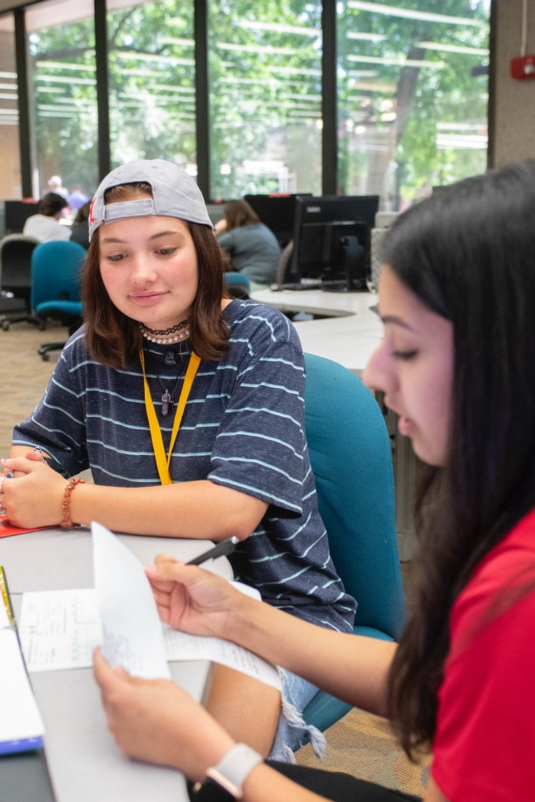
Performance Funding
Funding Increase: $14.5 million
Used for student aid, direct academic support to colleges and UofL’s new Center for Engaged Learning, among other needs

Slide 11
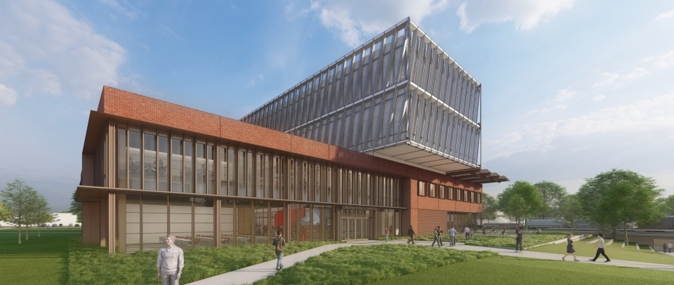
State funding: $65 million (FY24)
Speed School Engineering Building
Adds 115,000 sq ft of new classroom, research, and academic support space
Will facilitate enrollment growth
Programming complete and moving to design phase
Estimated completion Fall 2025
UofL to raise $10 million

Slide 12
State funding: $600,000 (2 years)
Center for Military-Connected Students
UofL serves about 2,000 military-connected students
Military Tuition Assistance (TA) usage:
More students using TA than all ACC schools
Almost as many as all other Kentucky publics combined
$250/credit for most graduate programs
Earned Military Friendly Gold and Military Friendly Spouse designations – top 1 percent nationally
Center to open Fall 2023

Slide 13
State funding: $800,000
Rural Health Program $650,000
Kentucky Area Health Education Centers (AHEC)
Rural medicine education and Family Medicine residency programs – Glasgow, Owensboro, Madisonville
Kentucky Autism Training Center – $150,000
Impacted all 120 counties through:
Training initiative with public schools
First Responder training – police, fire, EMS
Professional development for industry, agencies
Partners with regional cooperatives, mental health professionals, Kentucky Council for Autism
State-mandated programs

Slide 14
Moving Forward

Slide 15
Continuing Funding
Asset Renovation and Preservation
Infrastructure improvements
Renovation to meet current, future needs
Bucks for Brains
STEM related research
New Funding
Kentucky Cybersecurity Center
Builds on existing assets – FBI, DHS, Secret Service
Health Sciences Center Building
Contemporary, state-of-the-art research and instruction facilities
Interprofessional education
Clinical and Translational Research Network
Our Priorities

Slide 16
Questions?

