Slide 1
EASTERN KENTUCKY UNIVERSITY
MARCH 9, 2023

Slide 2
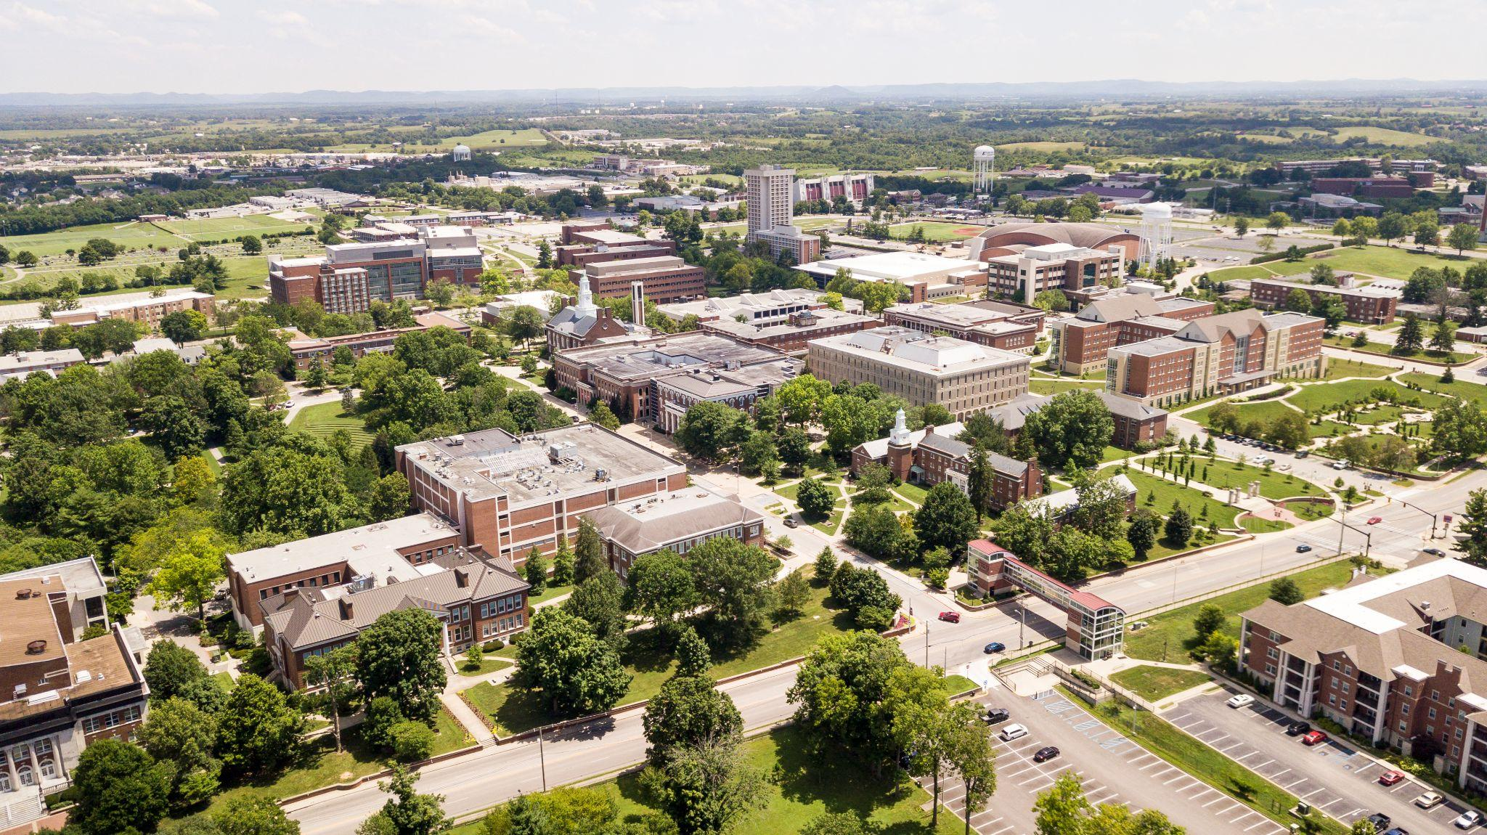
About EKU
Enrollment: 14,324 students (2.3% increase)
85% of undergraduates are from Kentucky
Freshman and Transfer class: 3,654 (3.7% increase)
Average student GPA: 3.40
15:1 student-to-faculty ratio
53% of freshmen are first-generation college students
Graduation rates increased more than 10% in the last 8 years

Slide 3
Serving Our Students
Awarded more than $91 million in financial aid to students in 2022
100% of students on scholarship through BookSmart
Competitive merit based scholarship model
94% of EKU graduates report satisfaction with their career choice 6 months after graduation
Ranked #3 in the Country and #1 in Kentucky Best for Vets

Slide 4
Impacting the Commonwealth
EKU fuels Kentucky’s talent pool
Highest graduate employment rate among public institutions
Internship Programs
$580 million annual economic impact to the local, regional and state economy
Supports more than 6,000 jobs and $324.6 million in wages

Slide 5
Standing Out in the Crowd
#1 in the U.S. - Risk Management and Insurance Degree
#1 Best RN to BSN in Kentucky
Ranked Top 10 Nationally - Occupational Safety Degree
Only 4 year aviation program in KY with more than 300 students
Third busiest airport in the Commonwealth
Voted “Best Bang for the Buck”
Ranked “America’s Top Colleges”
Ranked Best Regional University in the South

Slide 6
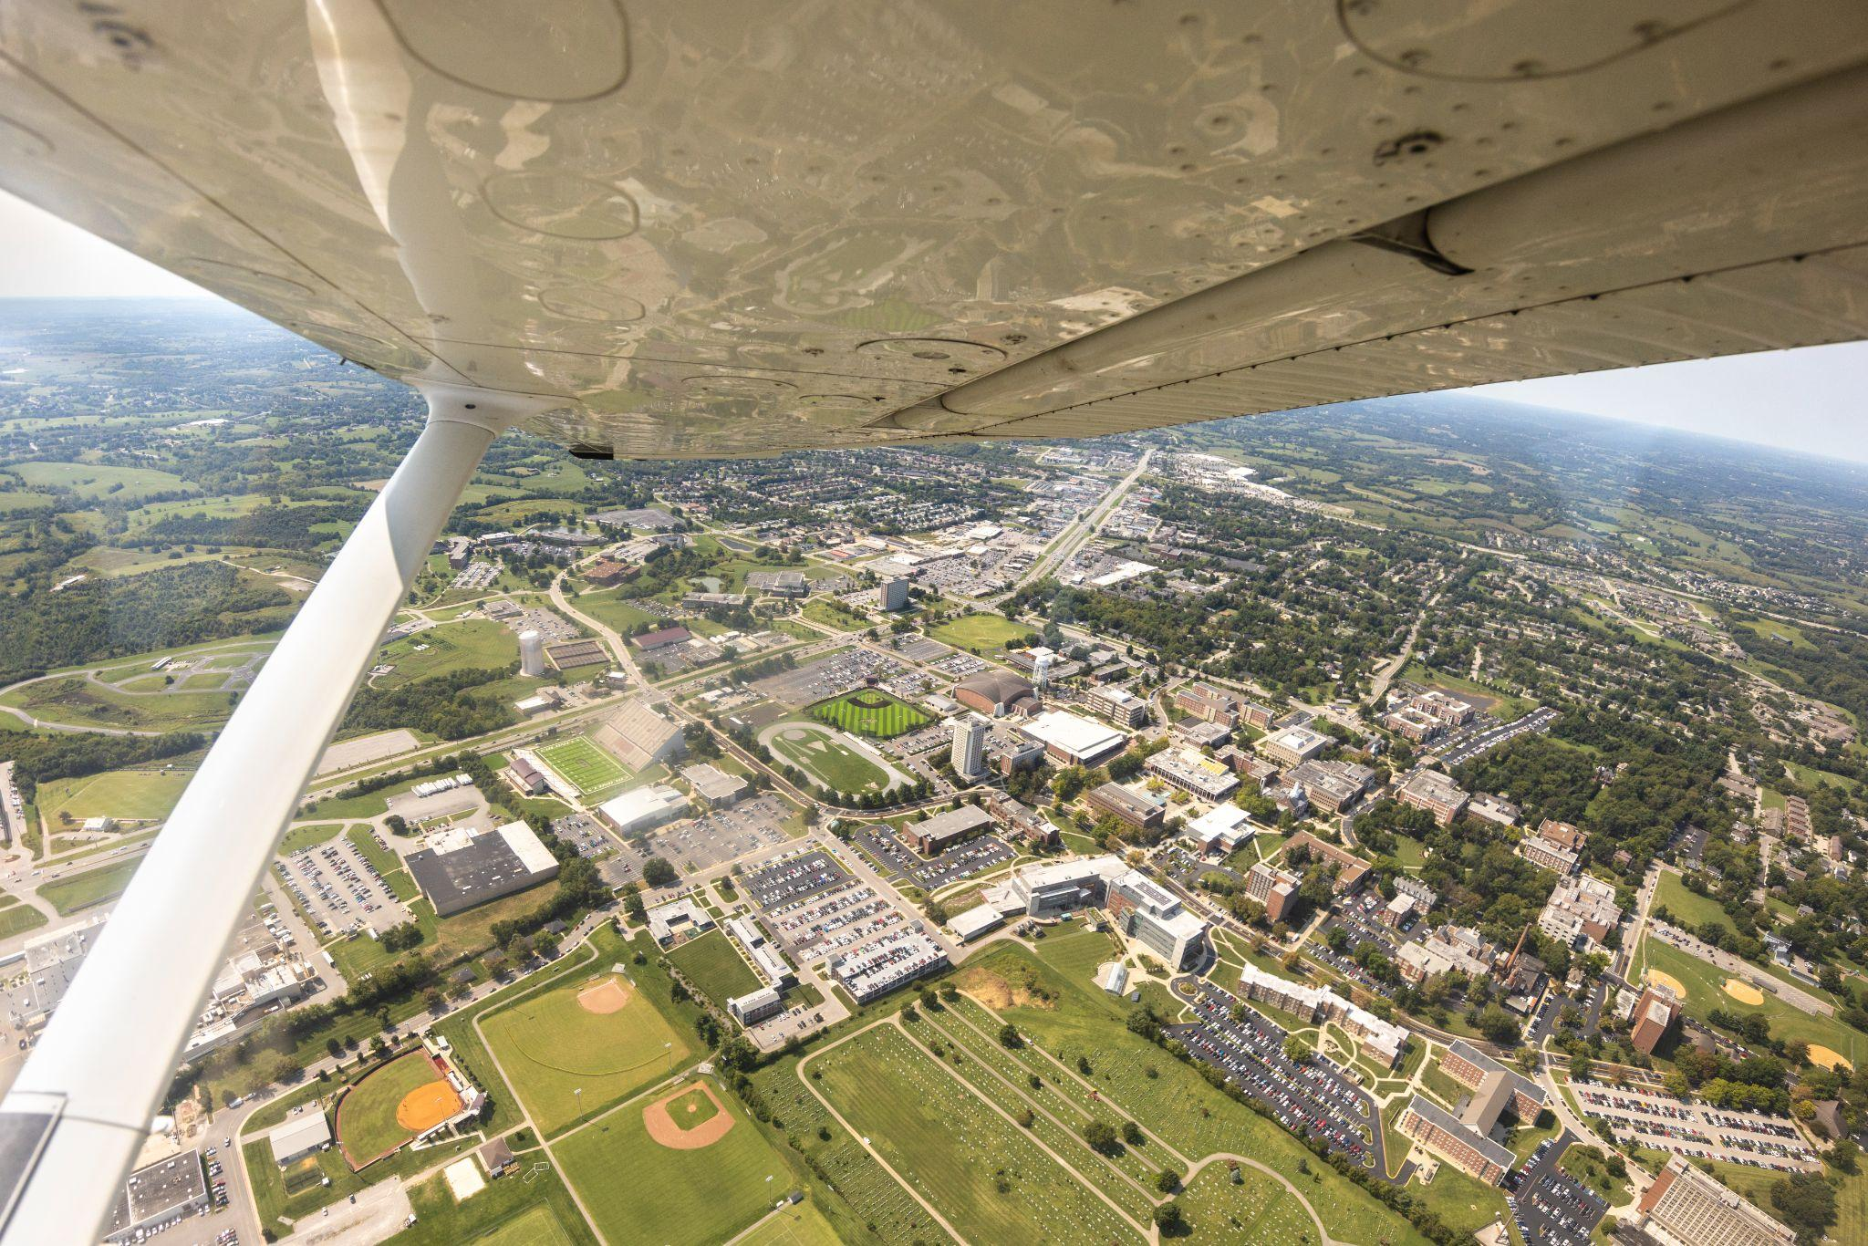
Academic Excellence
EKU offers more than 100 degrees and concentrations with nationally prominent signature programs in:
• Aviation
• Nursing
• Manufacturing Engineering (NEW)
• Mental Health and Social Services
• Occupational Therapy
• Global Supply Chain Management
• Risk Management and Insurance
• Occupational Health and Safety

Slide 7
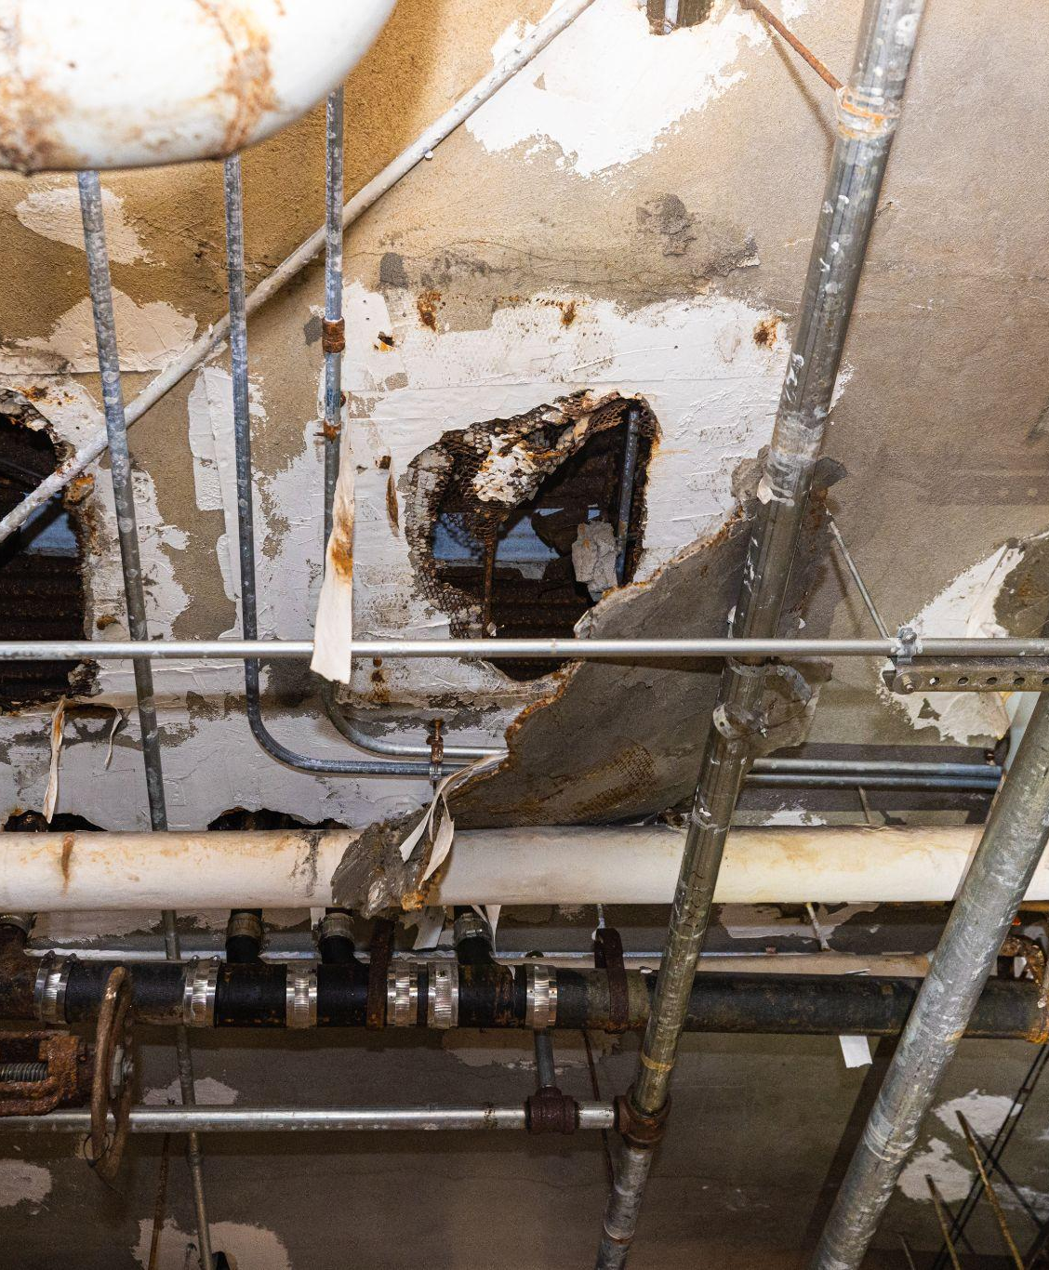
Asset Preservation Summary
Total 2022 HB 1 Asset Preservation Pool for EKU: $63,028,000
$59,200,000 has been approved by the Board of Regents, CPE, and the Office of the State Budget Director.
Projects are underway with the remainder of the pool in reserve for potential cost fluctuations.

Slide 8
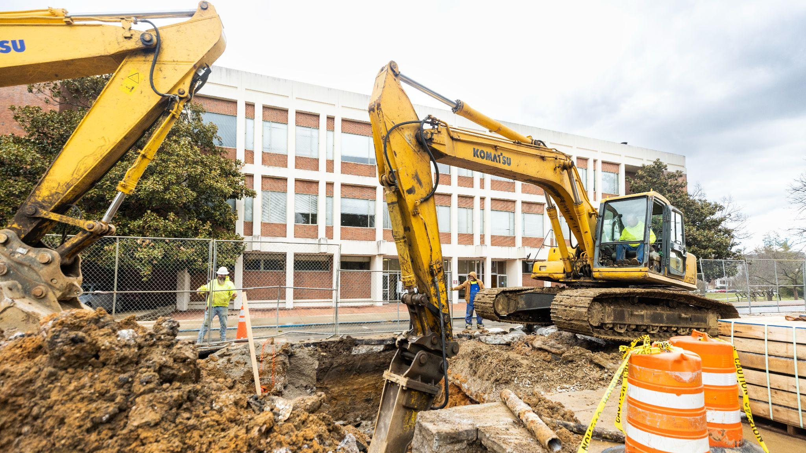
Maintenance Needs Campus-Wide
Thirteen Capital Projects from the pool are addressing extensive deferred maintenance needs across the entire campus.

Slide 9
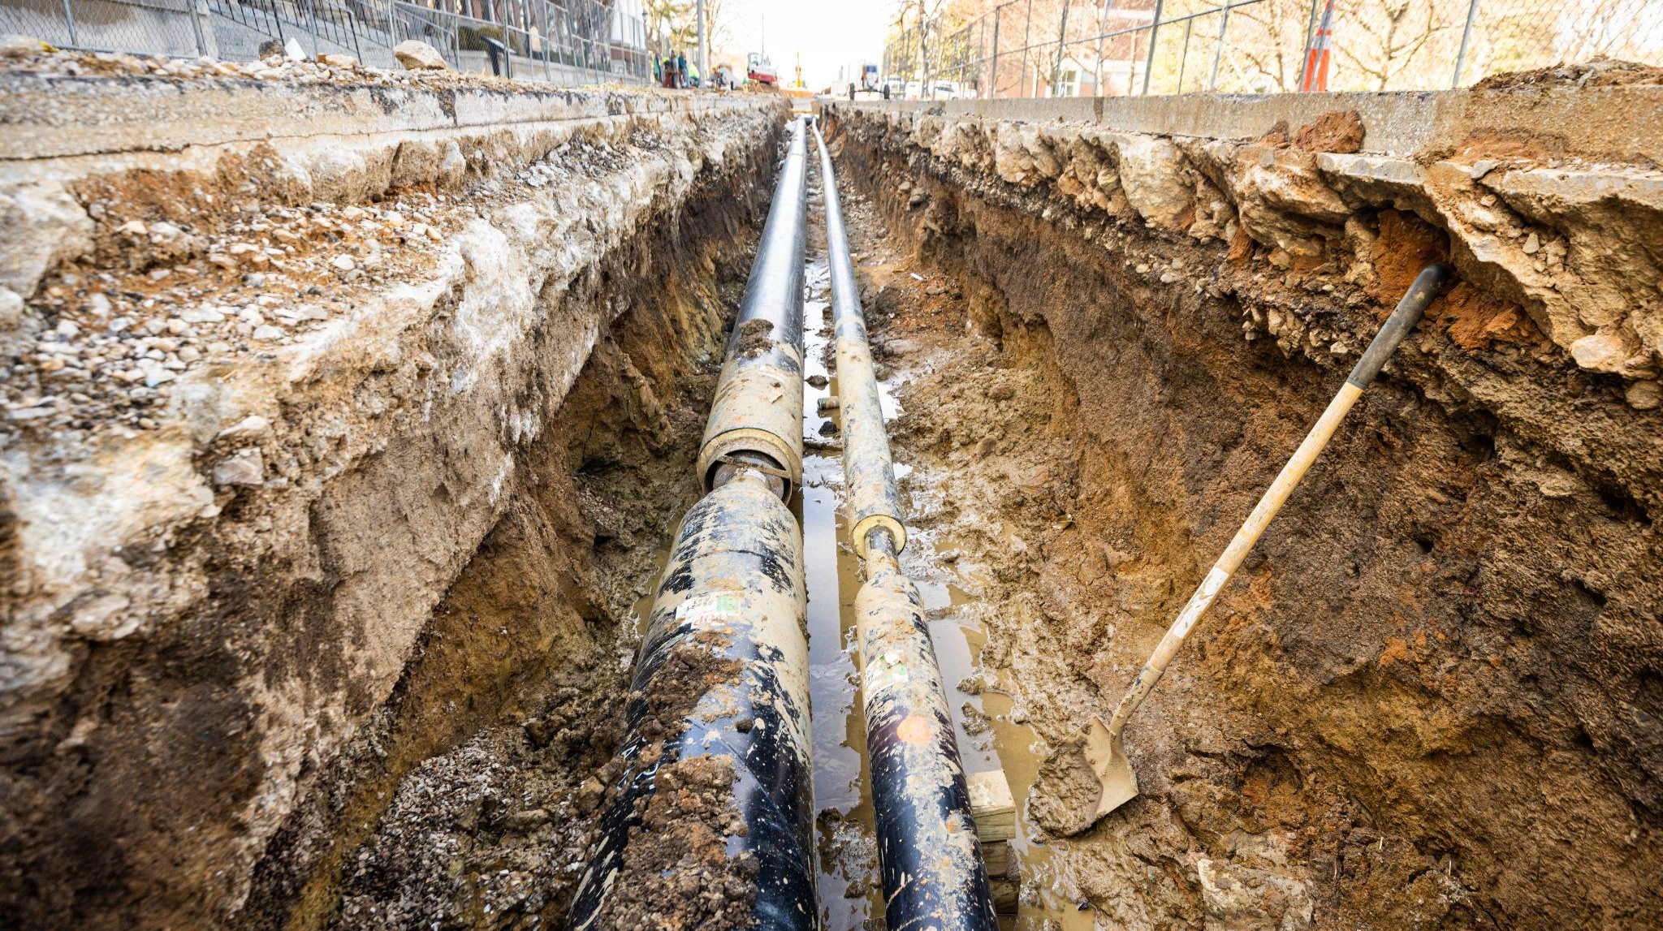
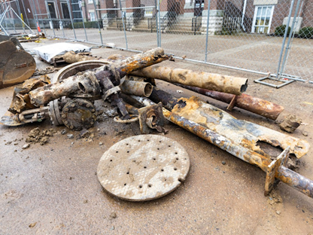
Steam Distribution Systems
Upgrade of 80-90 year old steam lines to modern efficient steam distribution systems.

Slide 10
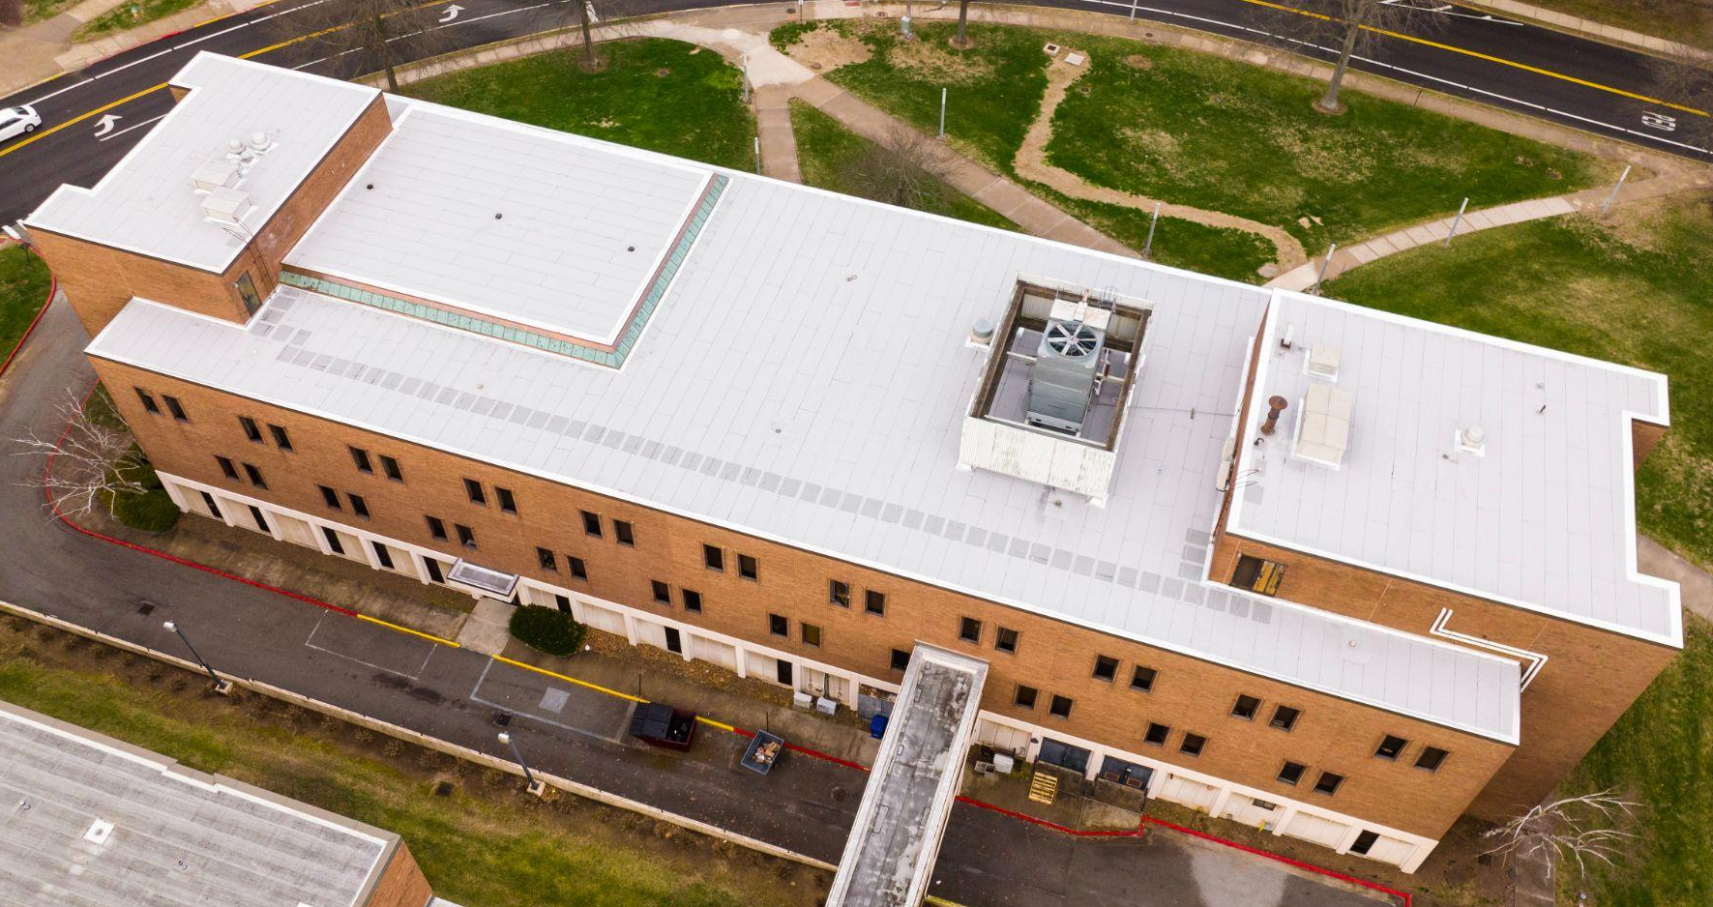
Roof Project - Rowlett
The Rowlett Building houses:
A portion of the College of Health Sciences
Classrooms for 500 students
Student Health Clinic, serving 3,500 students each semester.
Notes:
Two roof projects, Rowlette and Powell, are complete and came in under budget but still with similar volatility seen in other project concepts and with higher costs than if completed in the recent past.

Slide 11
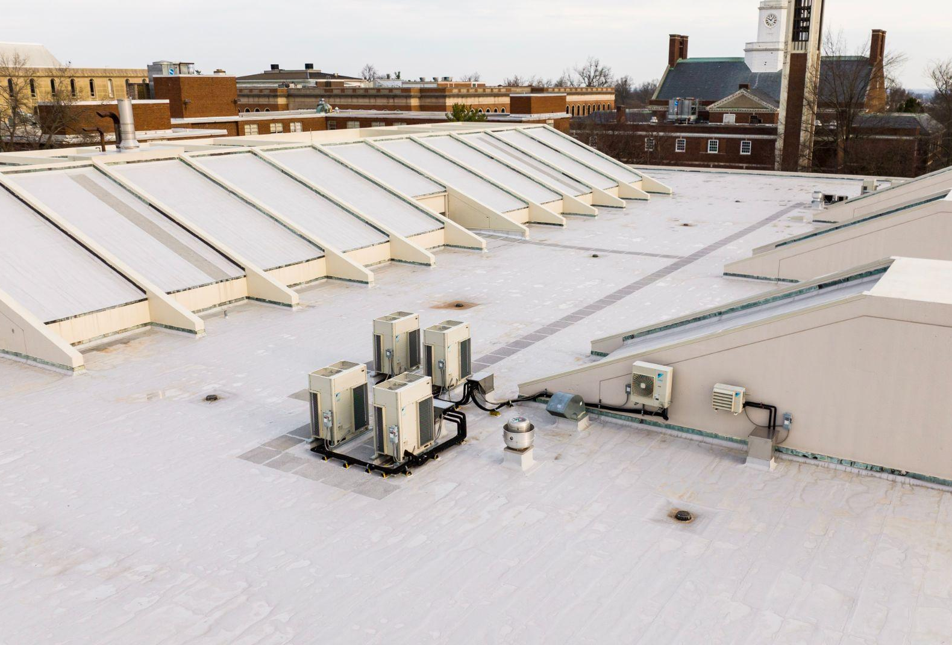
Roof Project - Powell Student Center
The Powell Student Center houses:
Student Life
Veterans Affairs
Student Government Assoc
Classrooms
Gathering/study spaces
EKU Bookstore
Dining venues

Slide 12
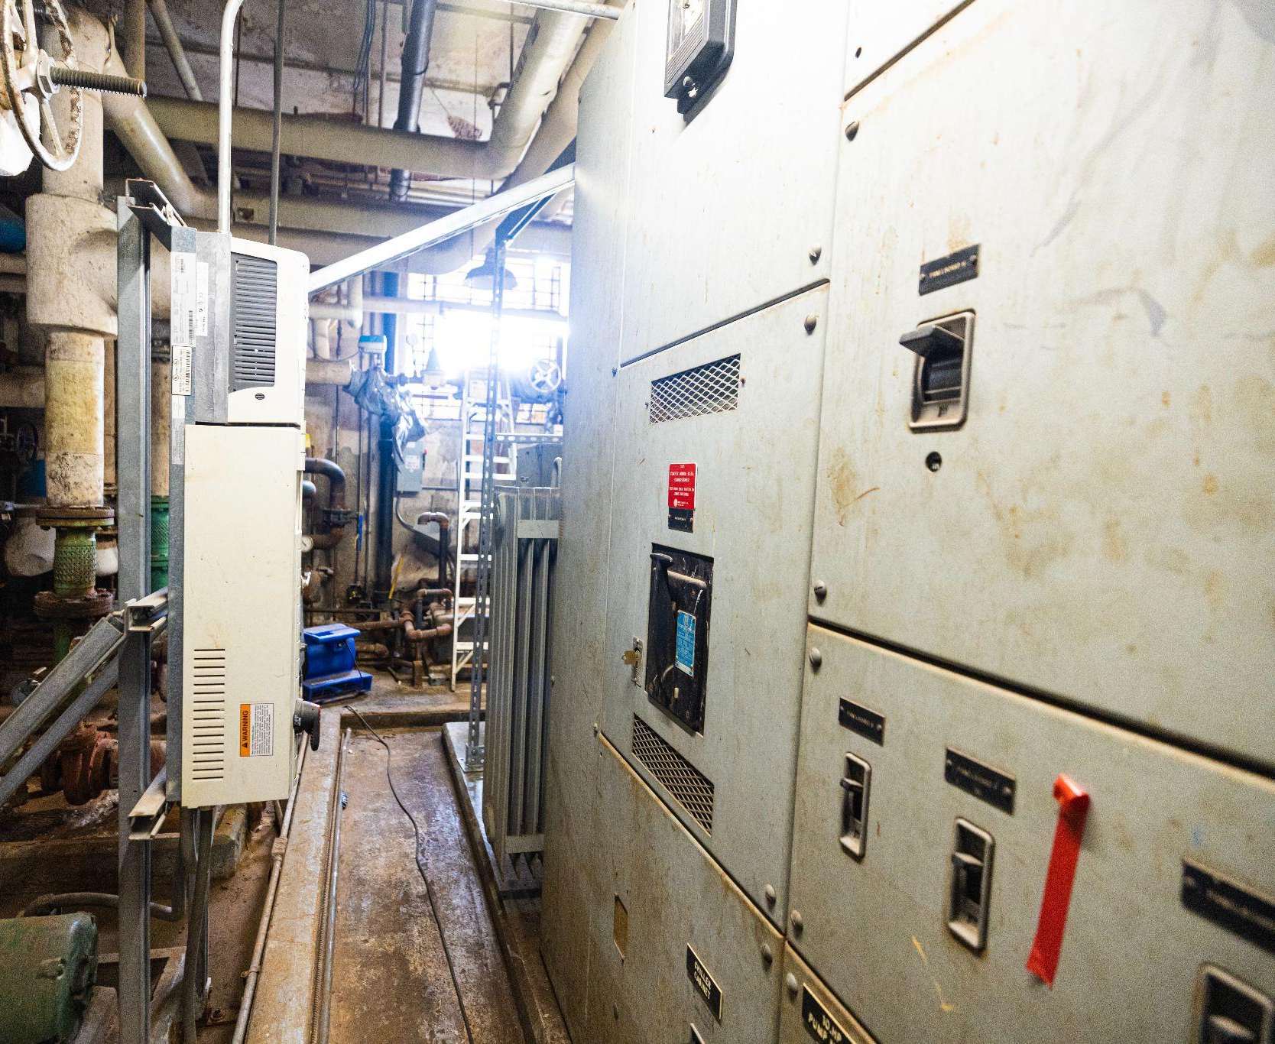
Electrical
Distribution
Systems
Electrical distribution systems with significant deferred maintenance are being modernized.

Slide 13
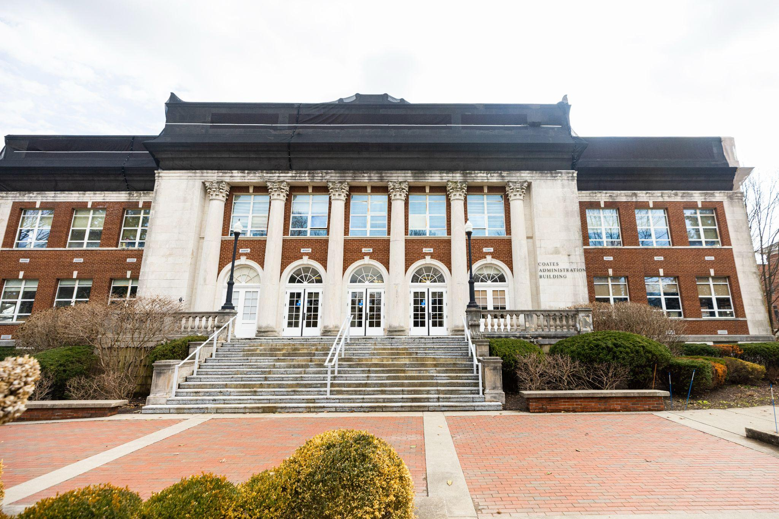
Coates Building
First extensive renovation since the early 1980s.
Home to:
EKU Alumni Student Ambassadors
Youth Music Programs
High School Conferences
Community Events

Slide 14
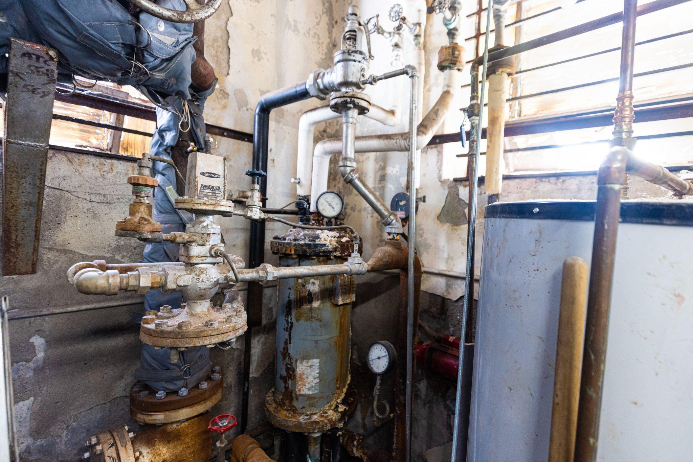
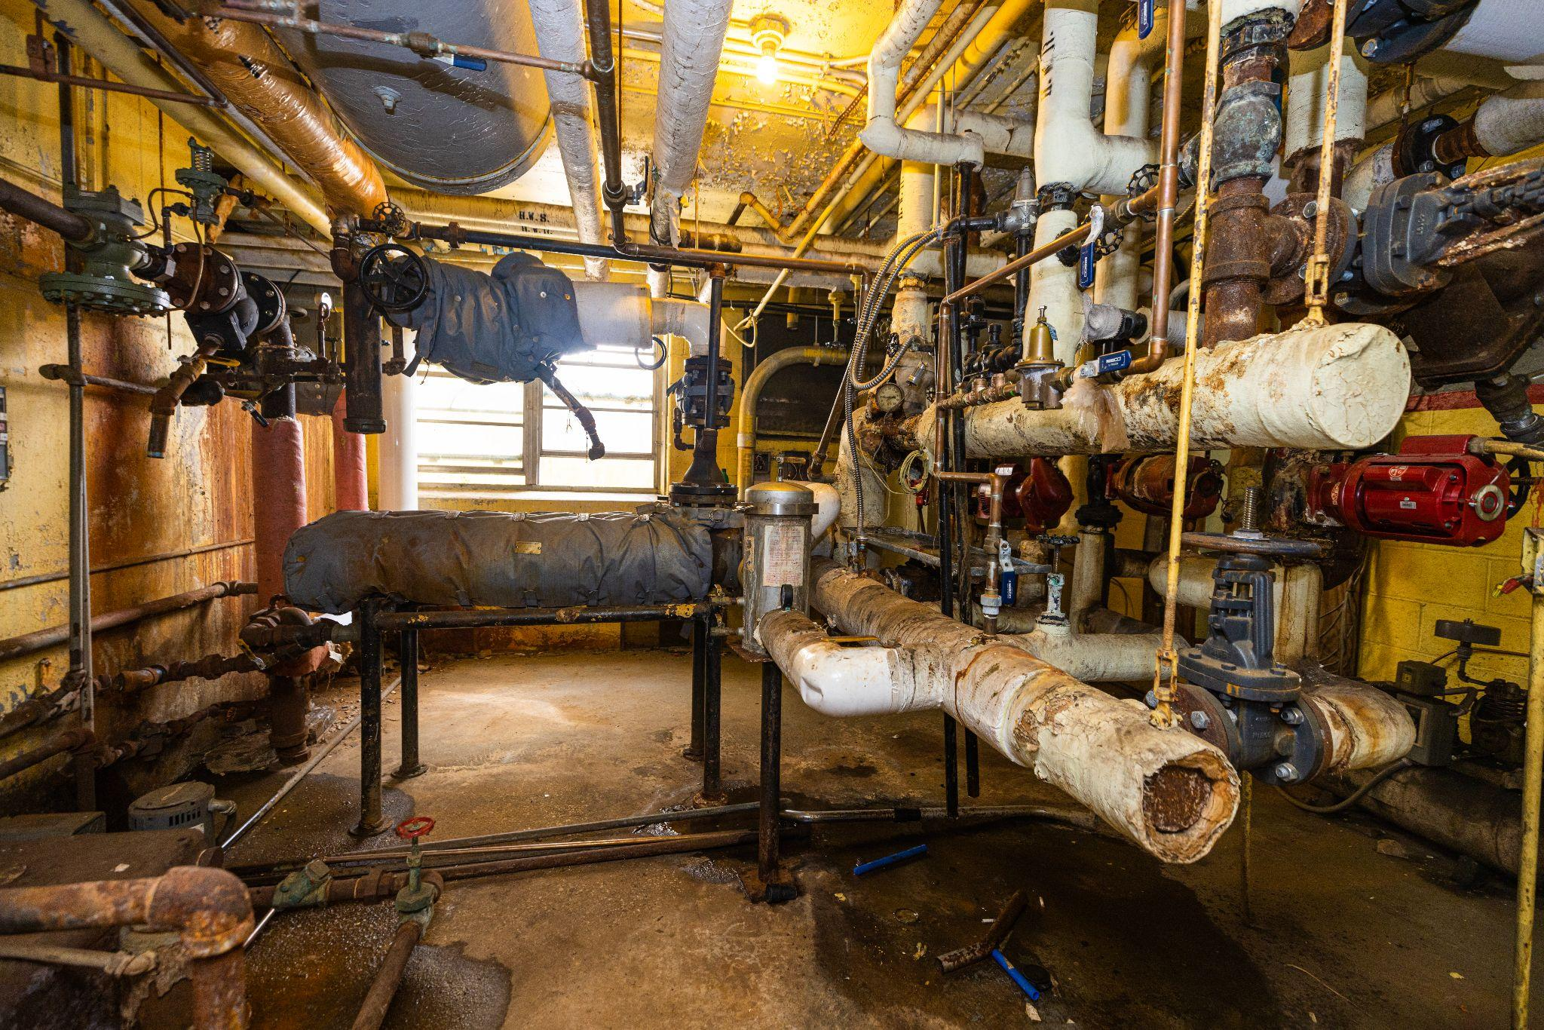
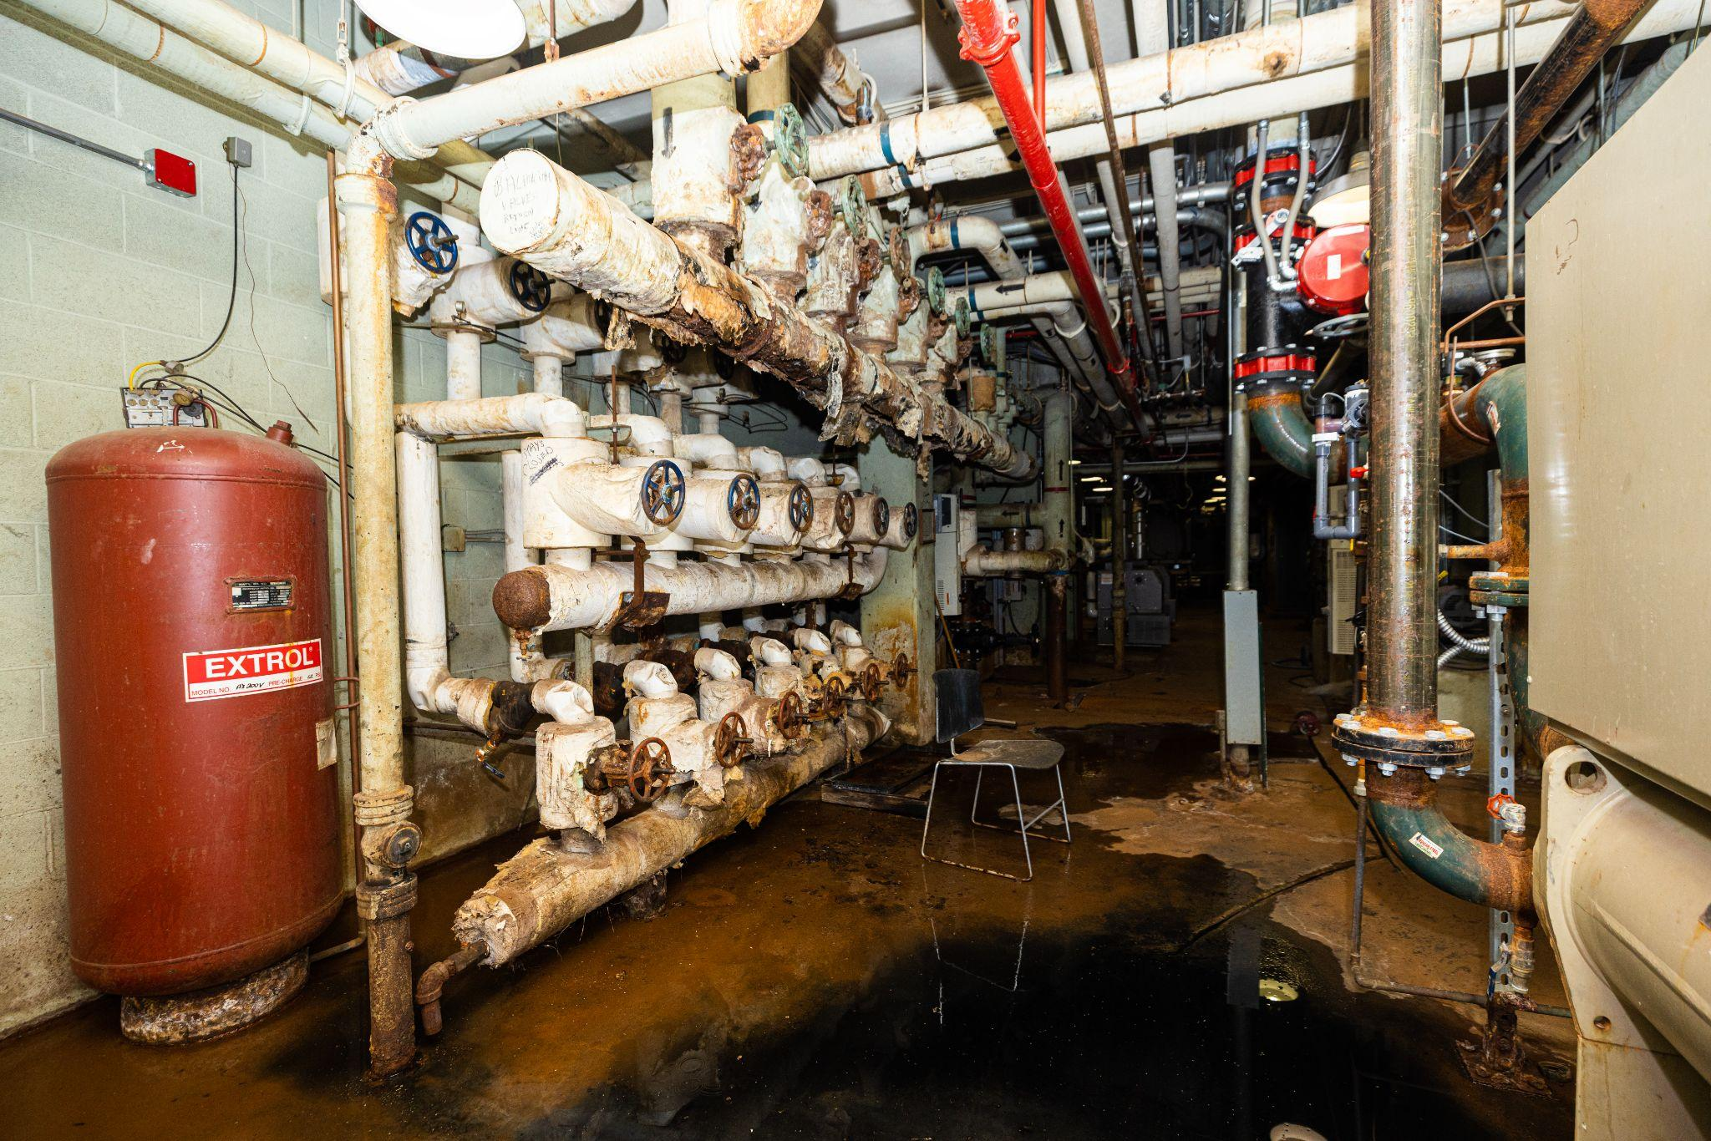
Campus Utilities
Extensive plumbing, water distribution, boiler and heating, cooling and chiller systems are being replaced/upgraded based on the season of use to keep campus disruptions to a minimum.

Slide 15
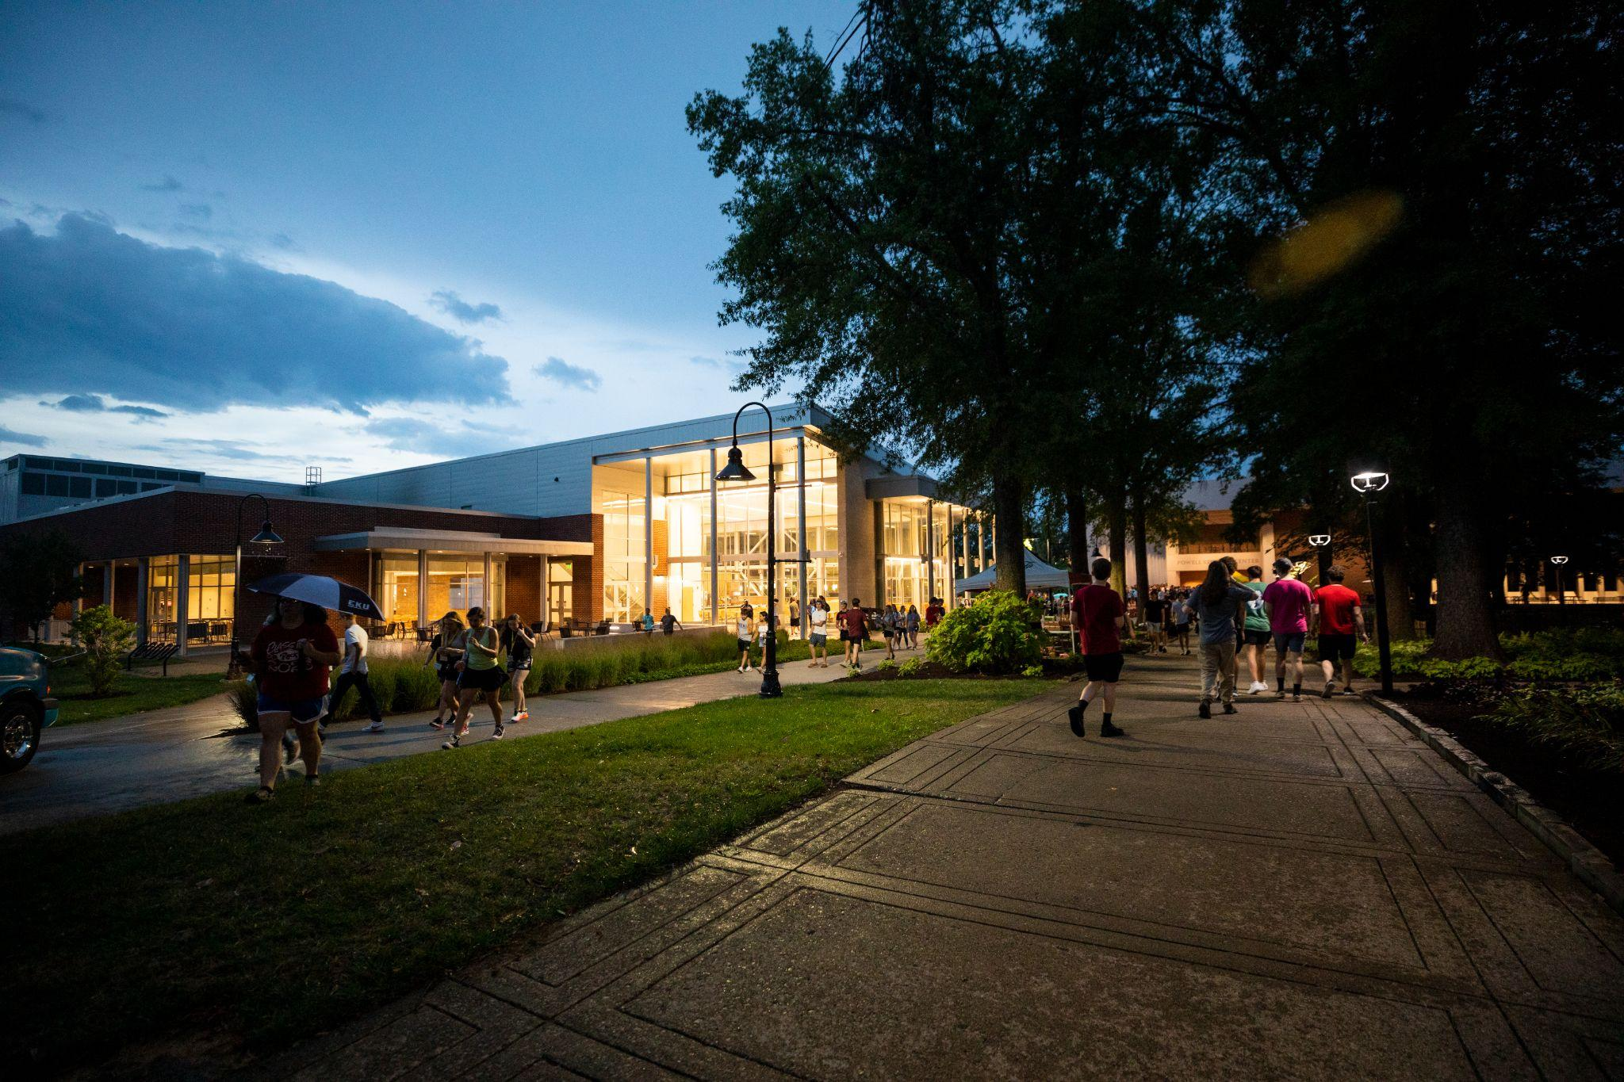
Walkability Upgrades
Sidewalks, area lighting and pedestrian routes and pathways are being addressed as well to retain campus walkability and improve safety.

Slide 16
Eastern Kentucky University Thanks You!

Slide 17
Questions?

