Slide 1
Budget Review
Subcommittee on Higher Education
BONITA BROWN, J.D.
INTERIM PRESIDENT, NOTHERN KENTUCKY UNIVERSITY
MARCH 9, 2023

Slide 2
REGIONAL LEADERS
77,000 Alumni
82 percent stay in our region

Slide 4
Success By Design

Slide 5
HIGH RANKINGS
Top tier of Economic Mobility
Rankings for return on investment
According to policy think tank, Third Way
WalletHub Rankings on Return on Investment
NKU Ranks No. 1 in Kentucky
World’s Universities with Real Impact – Top 100 Most Innovative Universities in the world (No. 78)
NKU also ranked No. 17 globally in category of Entrepreneurial Spirit
Only university in Greater Cincinnati or Commonwealth of Kentucky included in rankings
Impact
Economic Mobility
ROI

Slide 6
SPRING 2023
Total enrollment:
15,827 (Fall 2022)
Retention rate:
77.5% (an increase of 9 percentage points since 2018)
Graduation rate:
51.7% (an increase of 8 percentage points since 2018)
Dual credit:
46% of our students arrive at NKU with some college credit
Enrollment

Slide 8
MEETING THE REGION’S NEEDS
Overall Top 5 programs
Primary Care Nurse Practitioner
Business Administration (MBA)
Psych-Mental Health Nurse Practitioner
Biological Sciences Major (BS)
Computer Science Major
Top 5 Undergrad
Biological Sciences Major (BS)
Computer Science Major
Nursing Major RN-BSN
Psychology Major (BA)
Nursing Major Traditional
Top 5 Graduate
Primary Care Nurse Practitioner
Business Administration (MBA)
Psych-Mental Health Nurse Practitioner
Law Major (Full-Time)
Doctor of Nursing Practice
Top Programs

Slide 9
MEETING THE REGION’S NEEDS
Data Science Programs – Achieved ABET Accreditation
Engineering Technology Programs – ABET Accredited since 1994
Verst Group Logistics Hub of Supply Chain Excellence
Health Innovation Center
Attracted multi-million investment form St. Elizabeth Healthcare
More than $10 million grants for Institute for Health Innovation
Home to UK College of Medicine co-location on Campus
Cybersecurity Program - NSA Designation and Homeland Security partner
CINSAM STEM Education
Programs of Distinction

Slide 11
STRATEGIES FOR THE FUTURE
Doubling down on our enrollment marketing strategies
Rightsizing our expenditures in all areas across the institution
Ramping up fundraising efforts for scholarship support
Maximizing alternative revenue opportunities
Realignment of Financial Aid

Slide 12
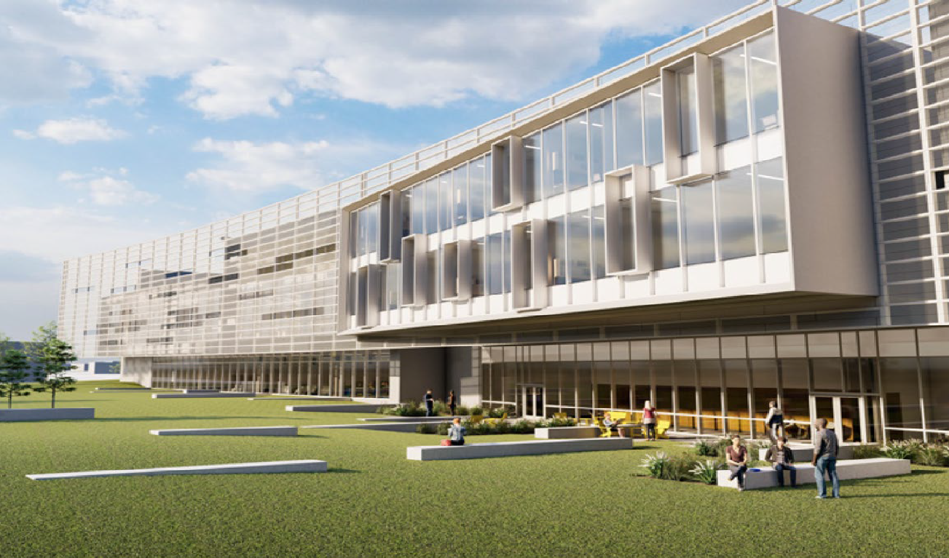
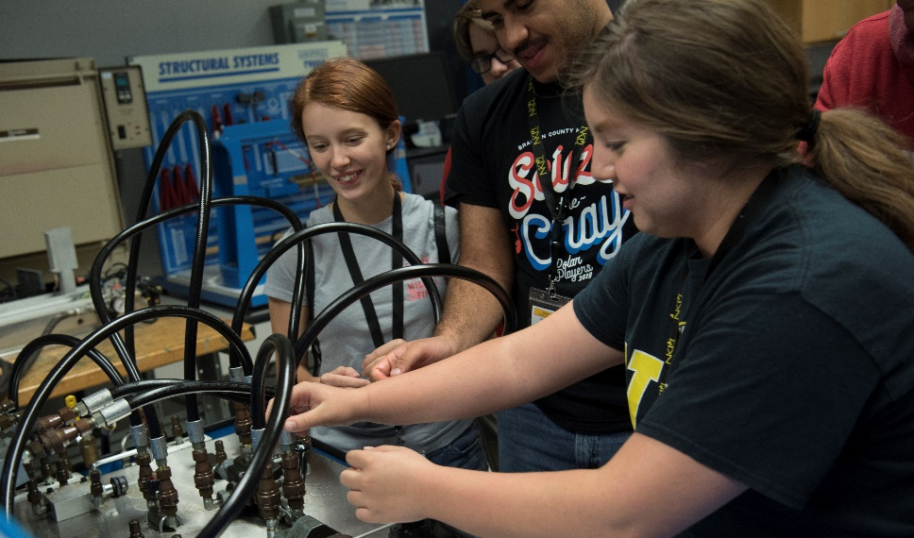
CAPITAL PROJECT
HERMANN SCIENCE CENTER EXPANSION
87,000 square-foot addition
Addresses urgent need for STEM
Currently in architectural design phase

Slide 13
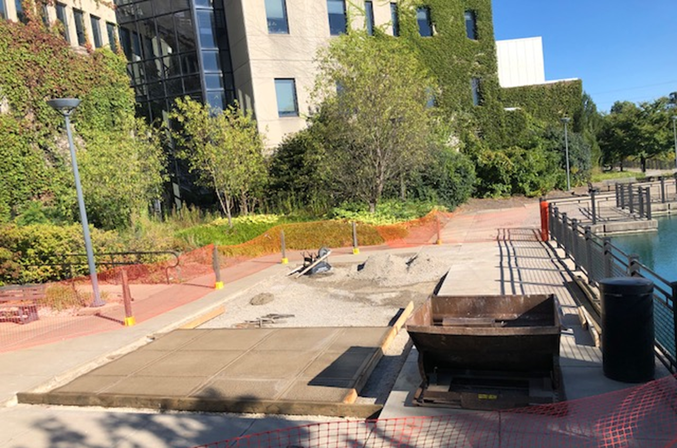
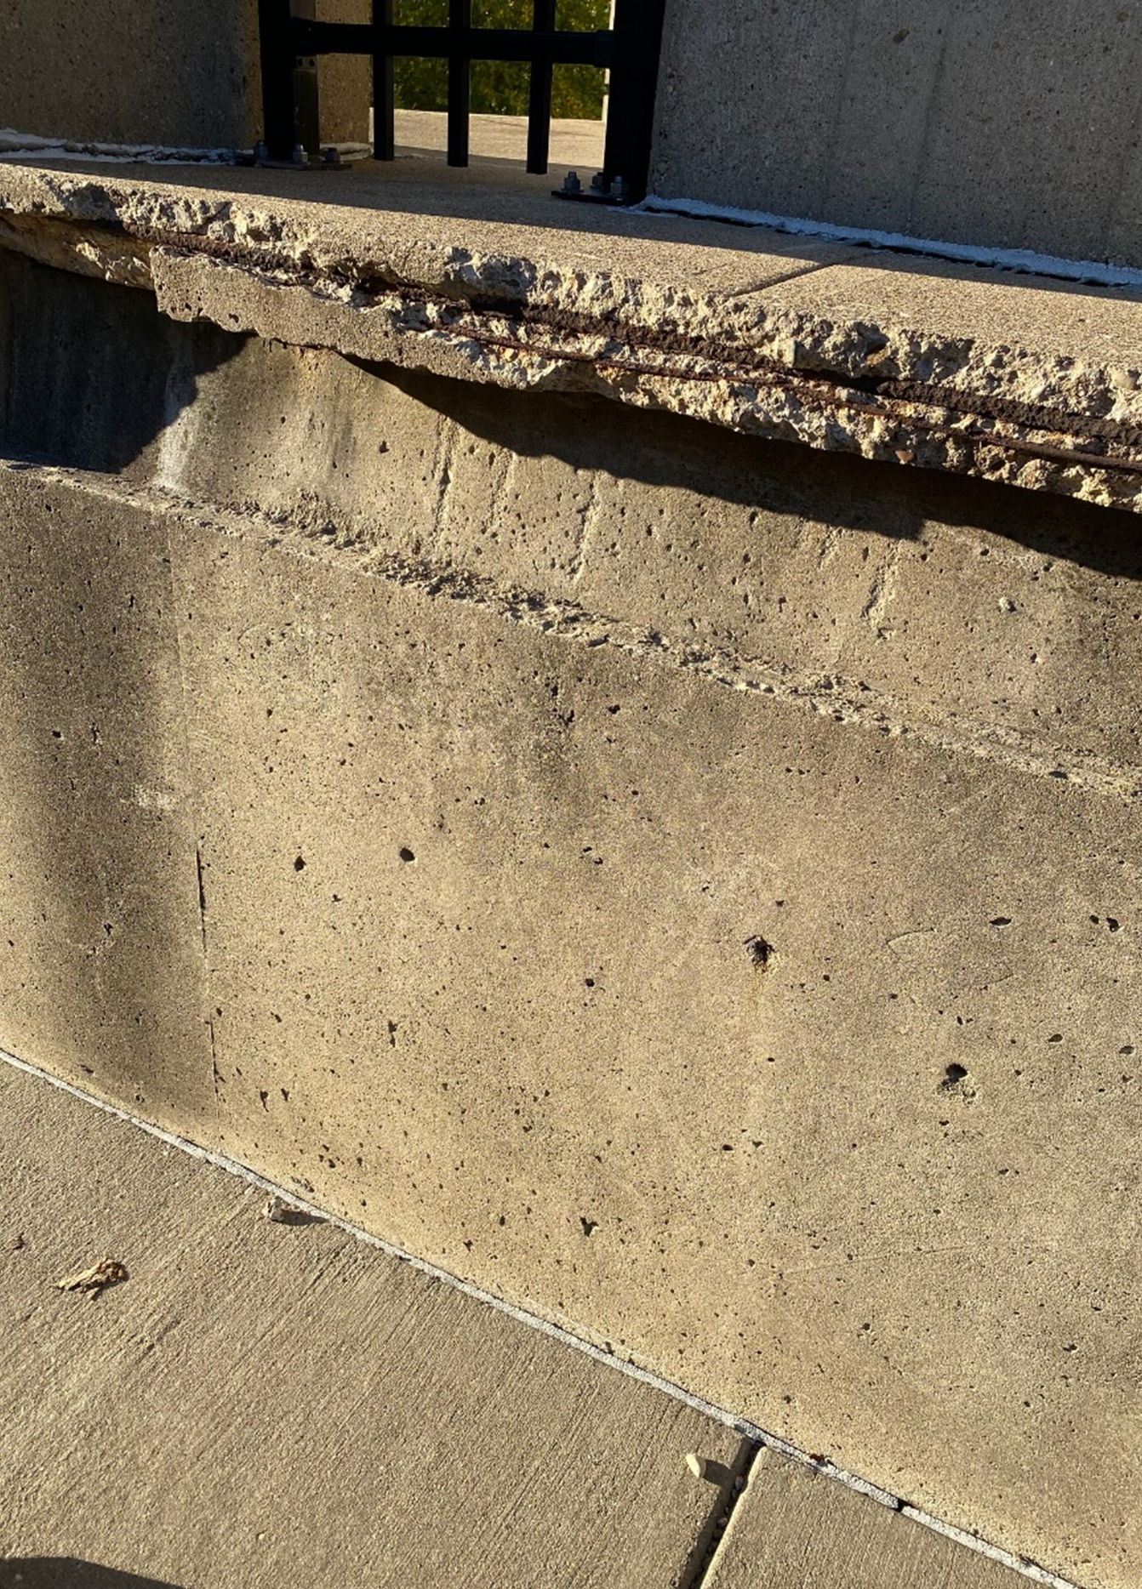
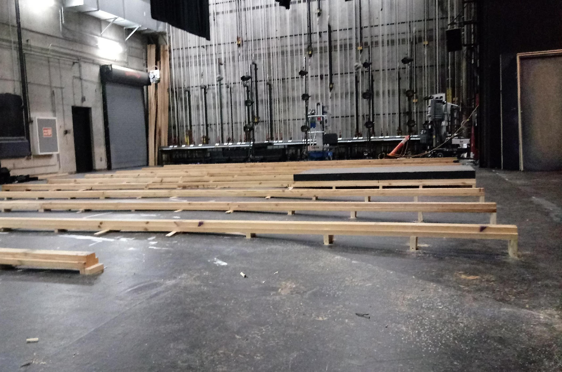
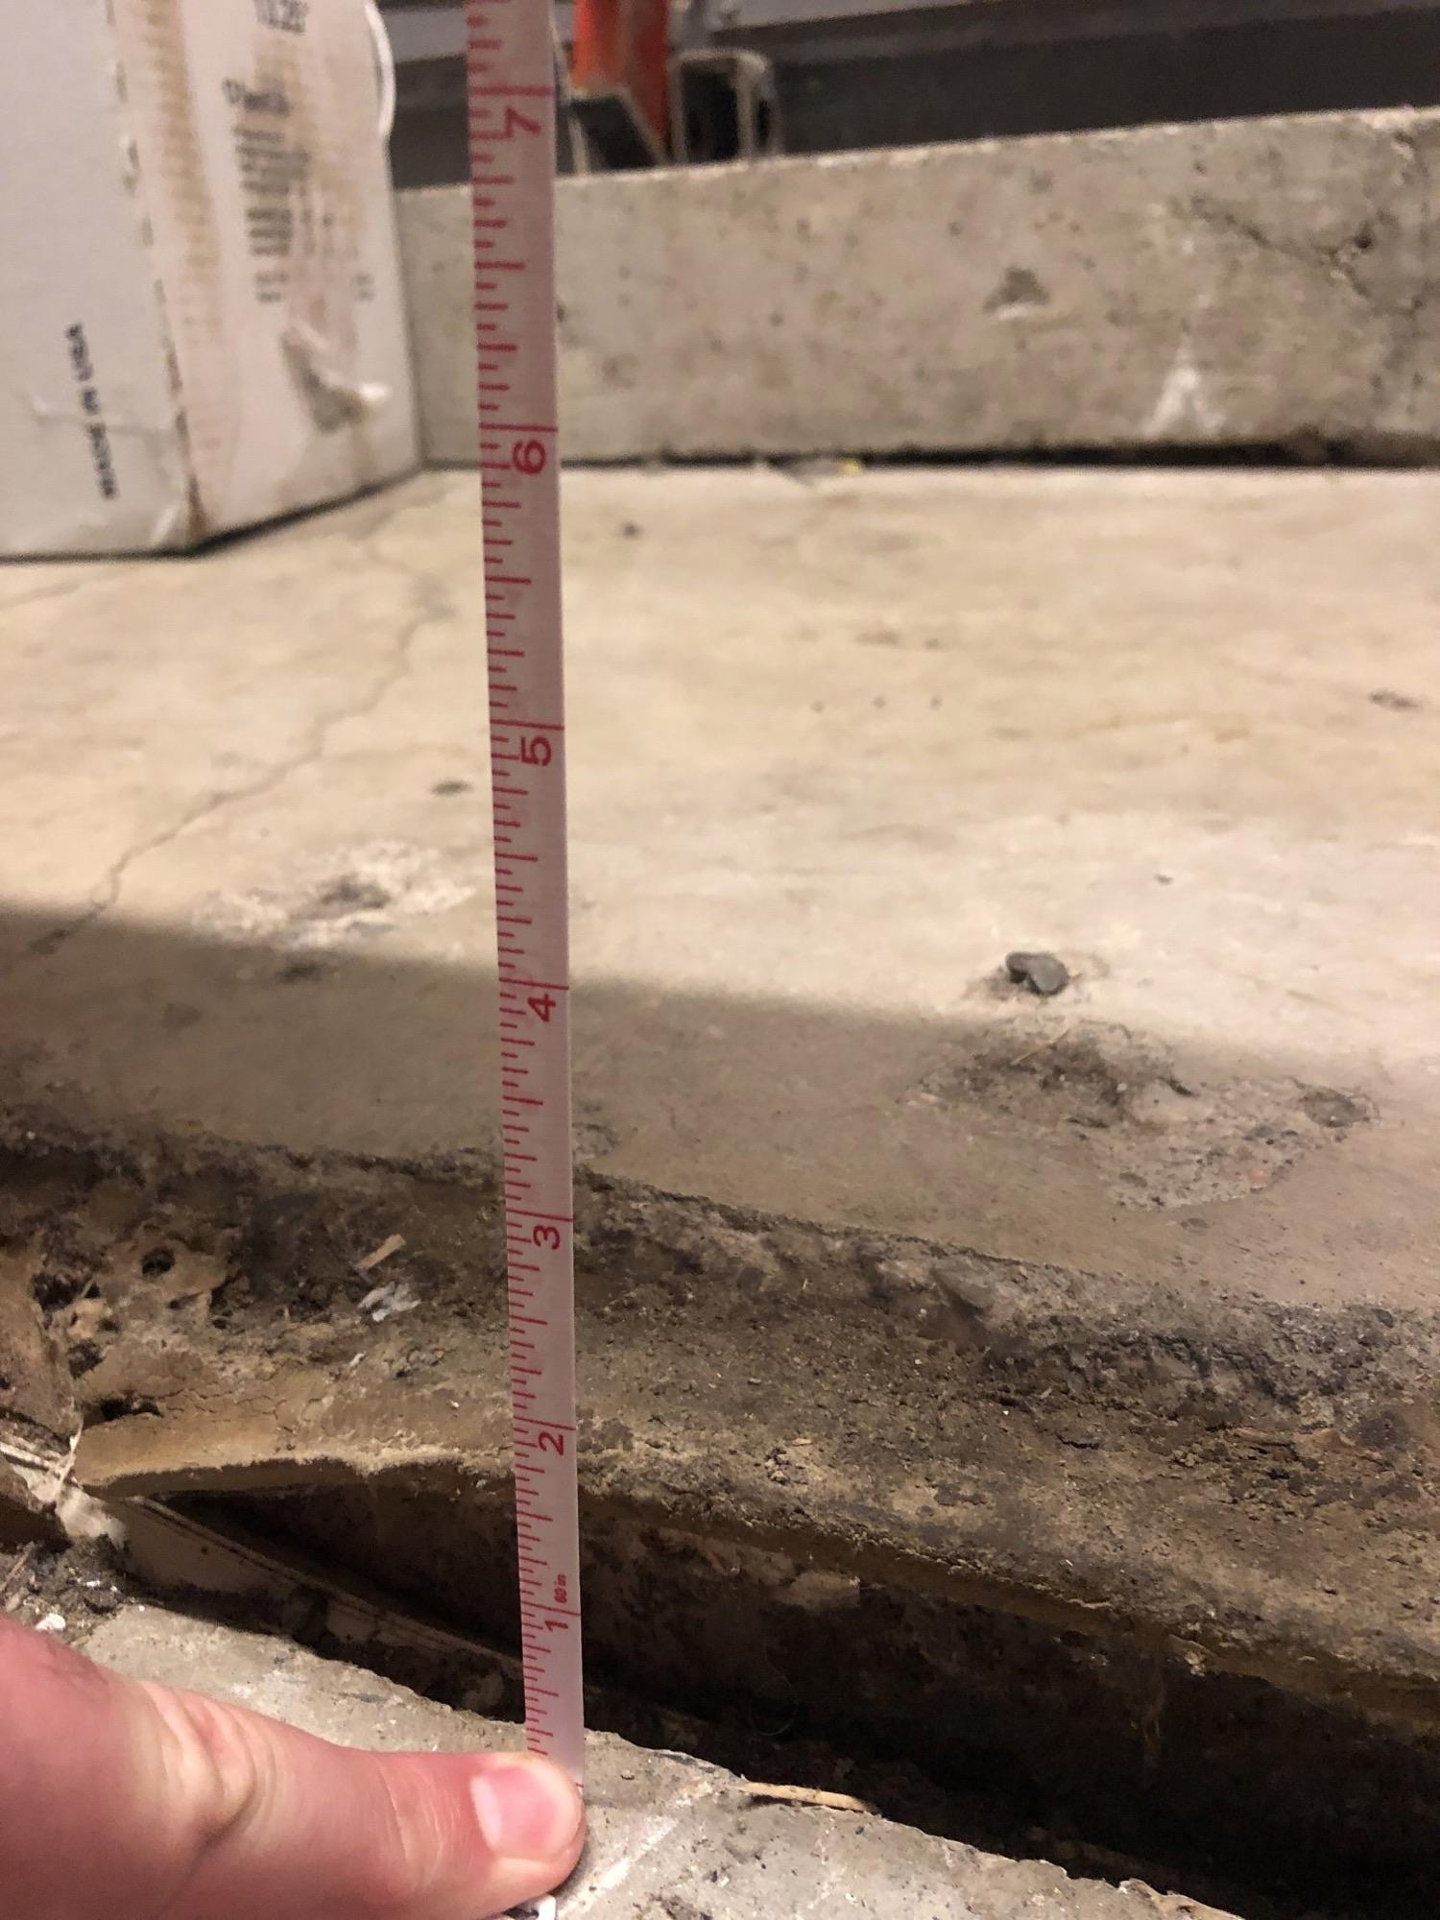
ASSET PRESERVATION
Preserve and extend life of legacy buildings
Improve space utilization
Manage repair and renovation efficiently
Create spaces that foster innovation and collaboration

Slide 14
ASSET PRESERVATION
Capital Project
NUMEROUS PROJECTS
Fine Arts Building
Steely Library
Nunn Hall
2022–2024 AP Funds for NKU (Bond Funds + Match) | $53,814,000
Increase Needed to Complete Projects | 16,500,000
New Amount Needed | $70,314,000
Percentage Increase | 31%

Slide 16
QUESTIONS?

