Slide 1


Kentucky State University Update Report
Joint Budget Review Subcommittee on Education
10:00 AM March 9, 2023
Capitol Annex, Room 171

Slide 2
Topics
Academic Affairs Overview | Dr. Michael Dailey, Interim Provost and Vice President for Academic Affairs
Financial Update | Dr. Daarel Burnette, Interim Executive Vice President for Finance and Administration and Interim Chief of Staff
Management Improvement Plan Update | Dr. Ronald A. Johnson, Interim President Dr. Daarel Burnette Dr. Michael Dailey Dr. Brigitte Golman, Interim Vice President Student Engagement and Campus Life

Slide 3
Faculty Evaluation Process
Annual – Tenure and Promotion – Post-Tenure Review
Dr. Michael Dailey, Interim Provost & Vice President for Academic Affairs
February 27, 2023

Slide 4
Purpose
House Bill 250, subparagraph 2 of Section 1(g)
  Create a process to determine a high level of employee performance
  Shall be used to determine continued employment, promotion, salary increases, tenure, etc.
The university performance standards in the areas of teaching effectiveness, scholarship, university and community service, as well as compliance are the four key components.

Slide 5
Annual Performance Evaluation Components
Four areas within the evaluation process
  Teaching Effectiveness
  Scholarship and Research
    Professional Development
  University and Community Service
  Compliance (contractual obligations and expectations)
Four Rating Categories
  Exceeds Expectations (3)
  Meets Expectation (2)
  Needs Improvement (1)
  Unsatisfactory (0)

Slide 6
Implementation Timeline
Fall 2022
  Training and Preparation
  Performance Evaluation Redesign (Performance Based Model)
January 2023
  CPE Collaboration for KSU Board Approval
  KSU Board of Regents approved Faculty Annual Performance Evaluation Redesign
  KSU Faculty received a copy of the performance evaluation
  Faculty Senate Presentation
February 2023
  Interactive Digital Training Tool shared with all faculty (shared with CPE)
  Training sessions with the Faculty, Chairs, and Deans
  Annual performance evaluation system launched through Interfolio
  Implementation Timeline shared with CPE
March 2023
  The Chairs will submit evaluation findings and recommendations
  The secondary “Dean level” review
April 2023
  Results of the evaluation initial findings
  Share initial findings with CPE

Slide 7
Program Review Process
Start, Stop, or Grow?
A Data – Informed Approach to Academic Program Evaluation and Management
By Robert Gray Atkins

Slide 8
Purpose
House Bill 250, subparagraph 2 of Section 2(d)
  CPE shall create a management improvement plan for Kentucky State University designed to assist with organization and financial stability that includes but not limited to…
  (2d) Academic program offerings, course offerings, and faculty productivity guidelines
CPE and KSU’s Management Improvement Plan
  Evaluate the viability of all current academic programs
  Close low performing programs
  Ensure alignment of course program plans with CPE’s Academic Program Inventory

Slide 9
Program Review Timeline
Fall 2022 – CPE Initial training overview, Grays & Associates data system
January 2023 – CPE and KSU collaboration meeting to establish academic program review process and timeline
February 2023 – CPE and KSU collaboration meeting to set the academic program score card parameters
March 2023 – CPE and KSU Academic Leadership Team meeting
March 2023 – CPE will host KSU work session for academic program assessment

Slide 10
The Intended Future…
Restore
(Internal Focus)
CPE program CIP code review
CPE sponsored Gray & Associates Training
Realign
(Internal Focus)
Academic program viability assessment
Reignite
(External Focus)
Academic programs that meet student demand
Degree to career pathway alignment
Program modality review
CPE inventory alignment
Faculty credentialing assessment
Program enrollment review
Data informed program decision making
Determine new programs to “Start”
Determine programs to “Stop”
Determine programs to “Grow”
Establish Academic program portfolio
Market positioning – competitive advantage
Meeting the needs of our community and the commonwealth
Measurable return on investment
Alignment to the 10 essential skills of the Kentucky Graduate Profile

Slide 11
Start, Stop, or Grow
Starting new programs
  What is the potential market?
  How is KSU positioned to implement new programs?
  Investment versus potential outcome
Stopping existing programs
  Continuity of program service delivery
    Teach out
    Student degree change potential
  Faculty and Staffing adjustments
Growing existing programs
  Determine marketability
  Program pairing to enhance market competitiveness
  Determine expanded career opportunities for program alignment

Slide 12

Financial Update
Daarel E. Burnette, PhD
Interim Chief of Staff & Interim VP of Finance (CFO)
March 9, 2023

Slide 13

Agenda
Spring 2023 Census Enrollment
Significant Achievements (July 22 – Dec 22)
E&G Budget Execution – Jan 31, 2023
Cash Flow Report – Jan 31, 2023
Unfunded Requirements - FY 2023 Budget
Assets Preservation Funding & Project List
Progress Report - FY 2021 & FY 2022 Audits
Management Improvement Plan

Slide 14
Spring 2023 Enrollment Update (exclude Dual Credit)
Student Type | Fall 2022 Census Enrollment | Spring 2023 Registration | Spring 2023 Protected Students* | Spring 2023 Financially Enrolled** | % Retention
New First Time Freshmen^ | 367 | 24 | 12 | 12 | -
New Transfer Students^ | 84 | 24 | 16 | 8 | -
Continuing Undergraduate Students | 892 | 1,119 | 418 | 697 | -
Total Undergraduate | 1,343 | 1,167 | 446 (38%) | 717 (61%) | ⁺87%
New Graduate Students^ | 33 | 28 | 19 | 9 | -
Continuing Graduate Students | 83 | 84 | 50 | 34 | -
Total Graduate | 116 | 112 | 69 (62%) | 43 (38%) | ⁺97%
TOTAL UNDERGRAD & GRAD | 1,459 | 1,279 | 515 (40%) | 760 (59%) | ⁺88%
Notes: * Protected students are those who are NOT financially enrolled but notified the Bursar of a pending payment from third party, protected scholarships, or eligible for HEERF. New students and continuing students with GPA >= 1.9 are also considered as protected. These students are expected to be rolled over into financially enrolled as soon as their loans being disbursed.
** Financially enrolled are students who have signed a payment plan and/or paid off their balance.
^ New students in the fall may return in the spring as continuing.

Slide 15
Spring 2023 Undergraduate Enrollment by Geographic Location
Residency | Headcount | Headcount, including Dual Credit
In-State | 423 | 867
Out-of-State | 744⁺ | 744⁺
Top Five Out-of-State⁺ Addresses:
Ohio | 201 | 201
Indiana | 141 | 141
Illinois | 96 | 96
Michigan | 81 | 81
Tennessee | 33 | 33

Slide 16

Spring 2023 Dual Credit Enrollment
Number of Courses | Headcount
1 | 335
2 | 63
3 | 35
4 | 10
5 | 1
Total Dual Credit | 444

Slide 17
Major Achievements (Jul 22 – Jan 23)
Hot Spots
Declaration of Emergency for Facilities Management Services (Sodexo Facilities Mgmt Services)
Engaged an Internal Audit Firm (CBIZ) to Mitigate Internal Control Risks
Engaged CPA Firm (Blue & Co) to complete FY 21 & FY 22 Annual Audits
Engaged Consultant (Your-Part Time Controller) to Compile Key Finance Reports
Completed 14 of 66 (21%) Management Improvement Plan Deliverables
Assembled Business Office Leadership Team (10 Key Personnel Hires)

Slide 18
E&G Budget Execution – January 31, 2023

Slide 19
Month Cash Flow Report
(E&G Funds)
January 2022 to January 2023 Comparison

Slide 20
Days of Cash Report
(E&G Funds)

Slide 21
Unfunded Requirements - Not in FY 2023 Budget

Slide 22
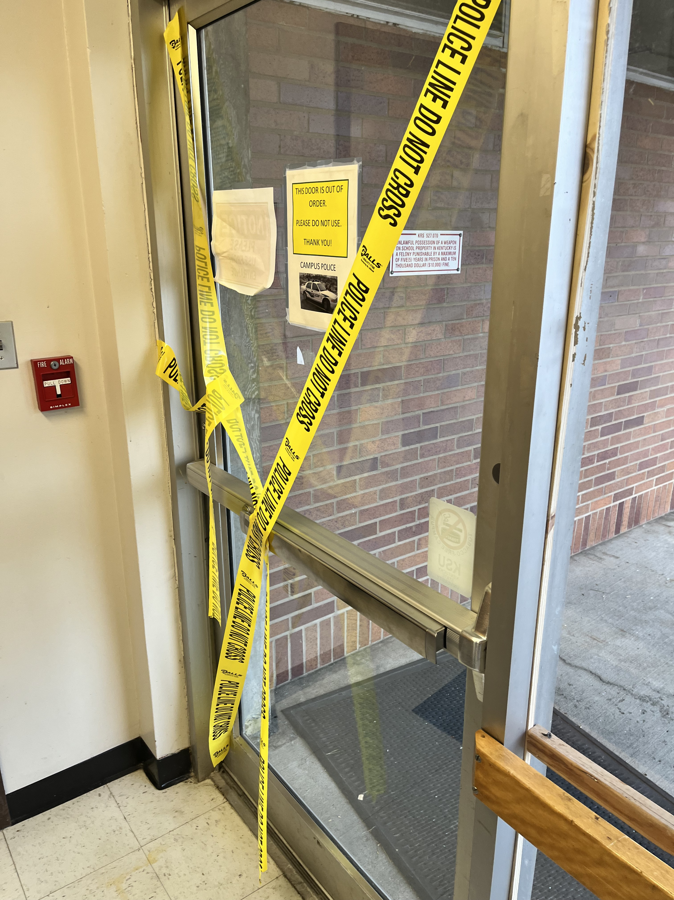
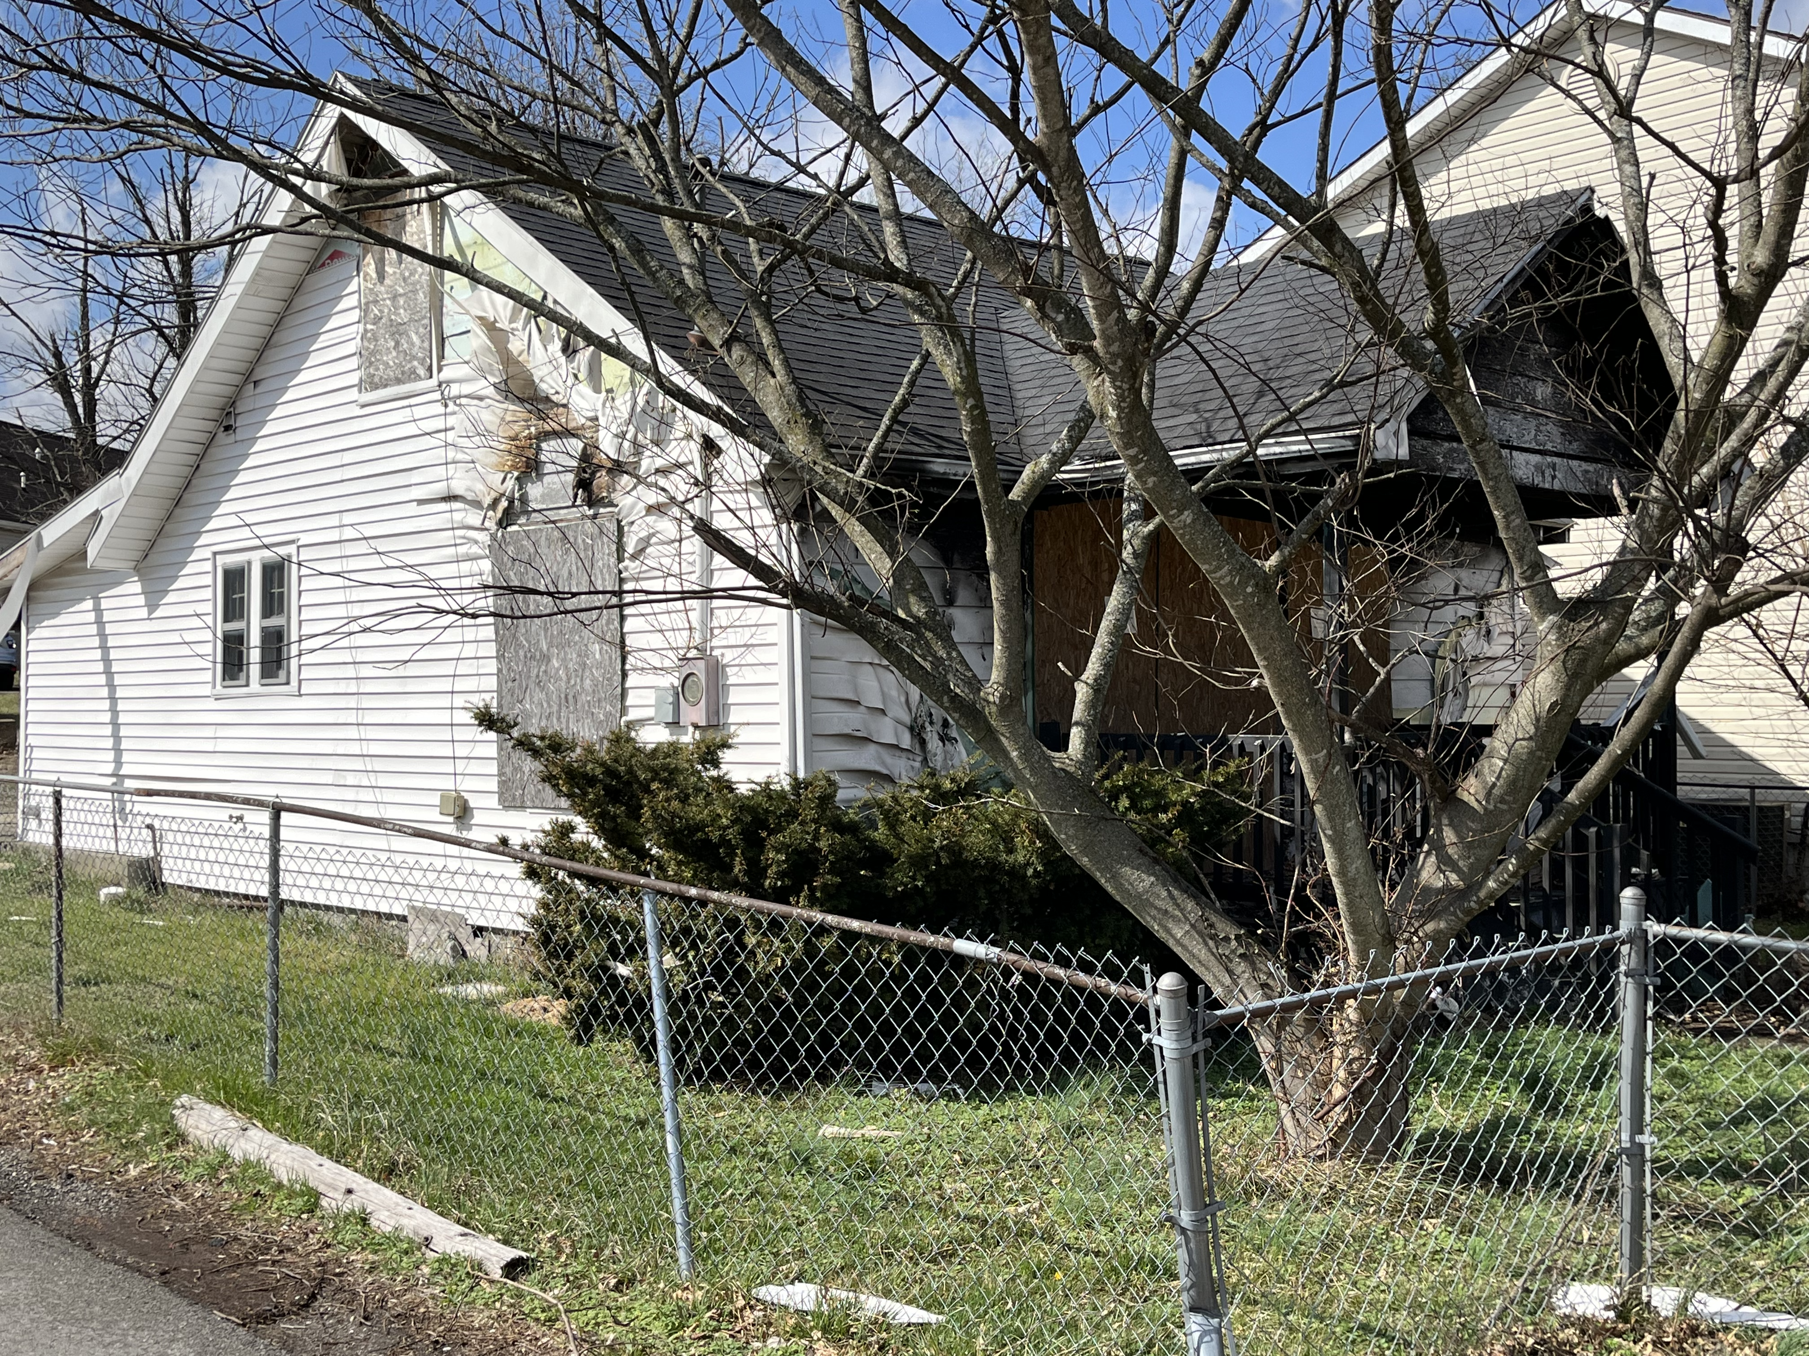
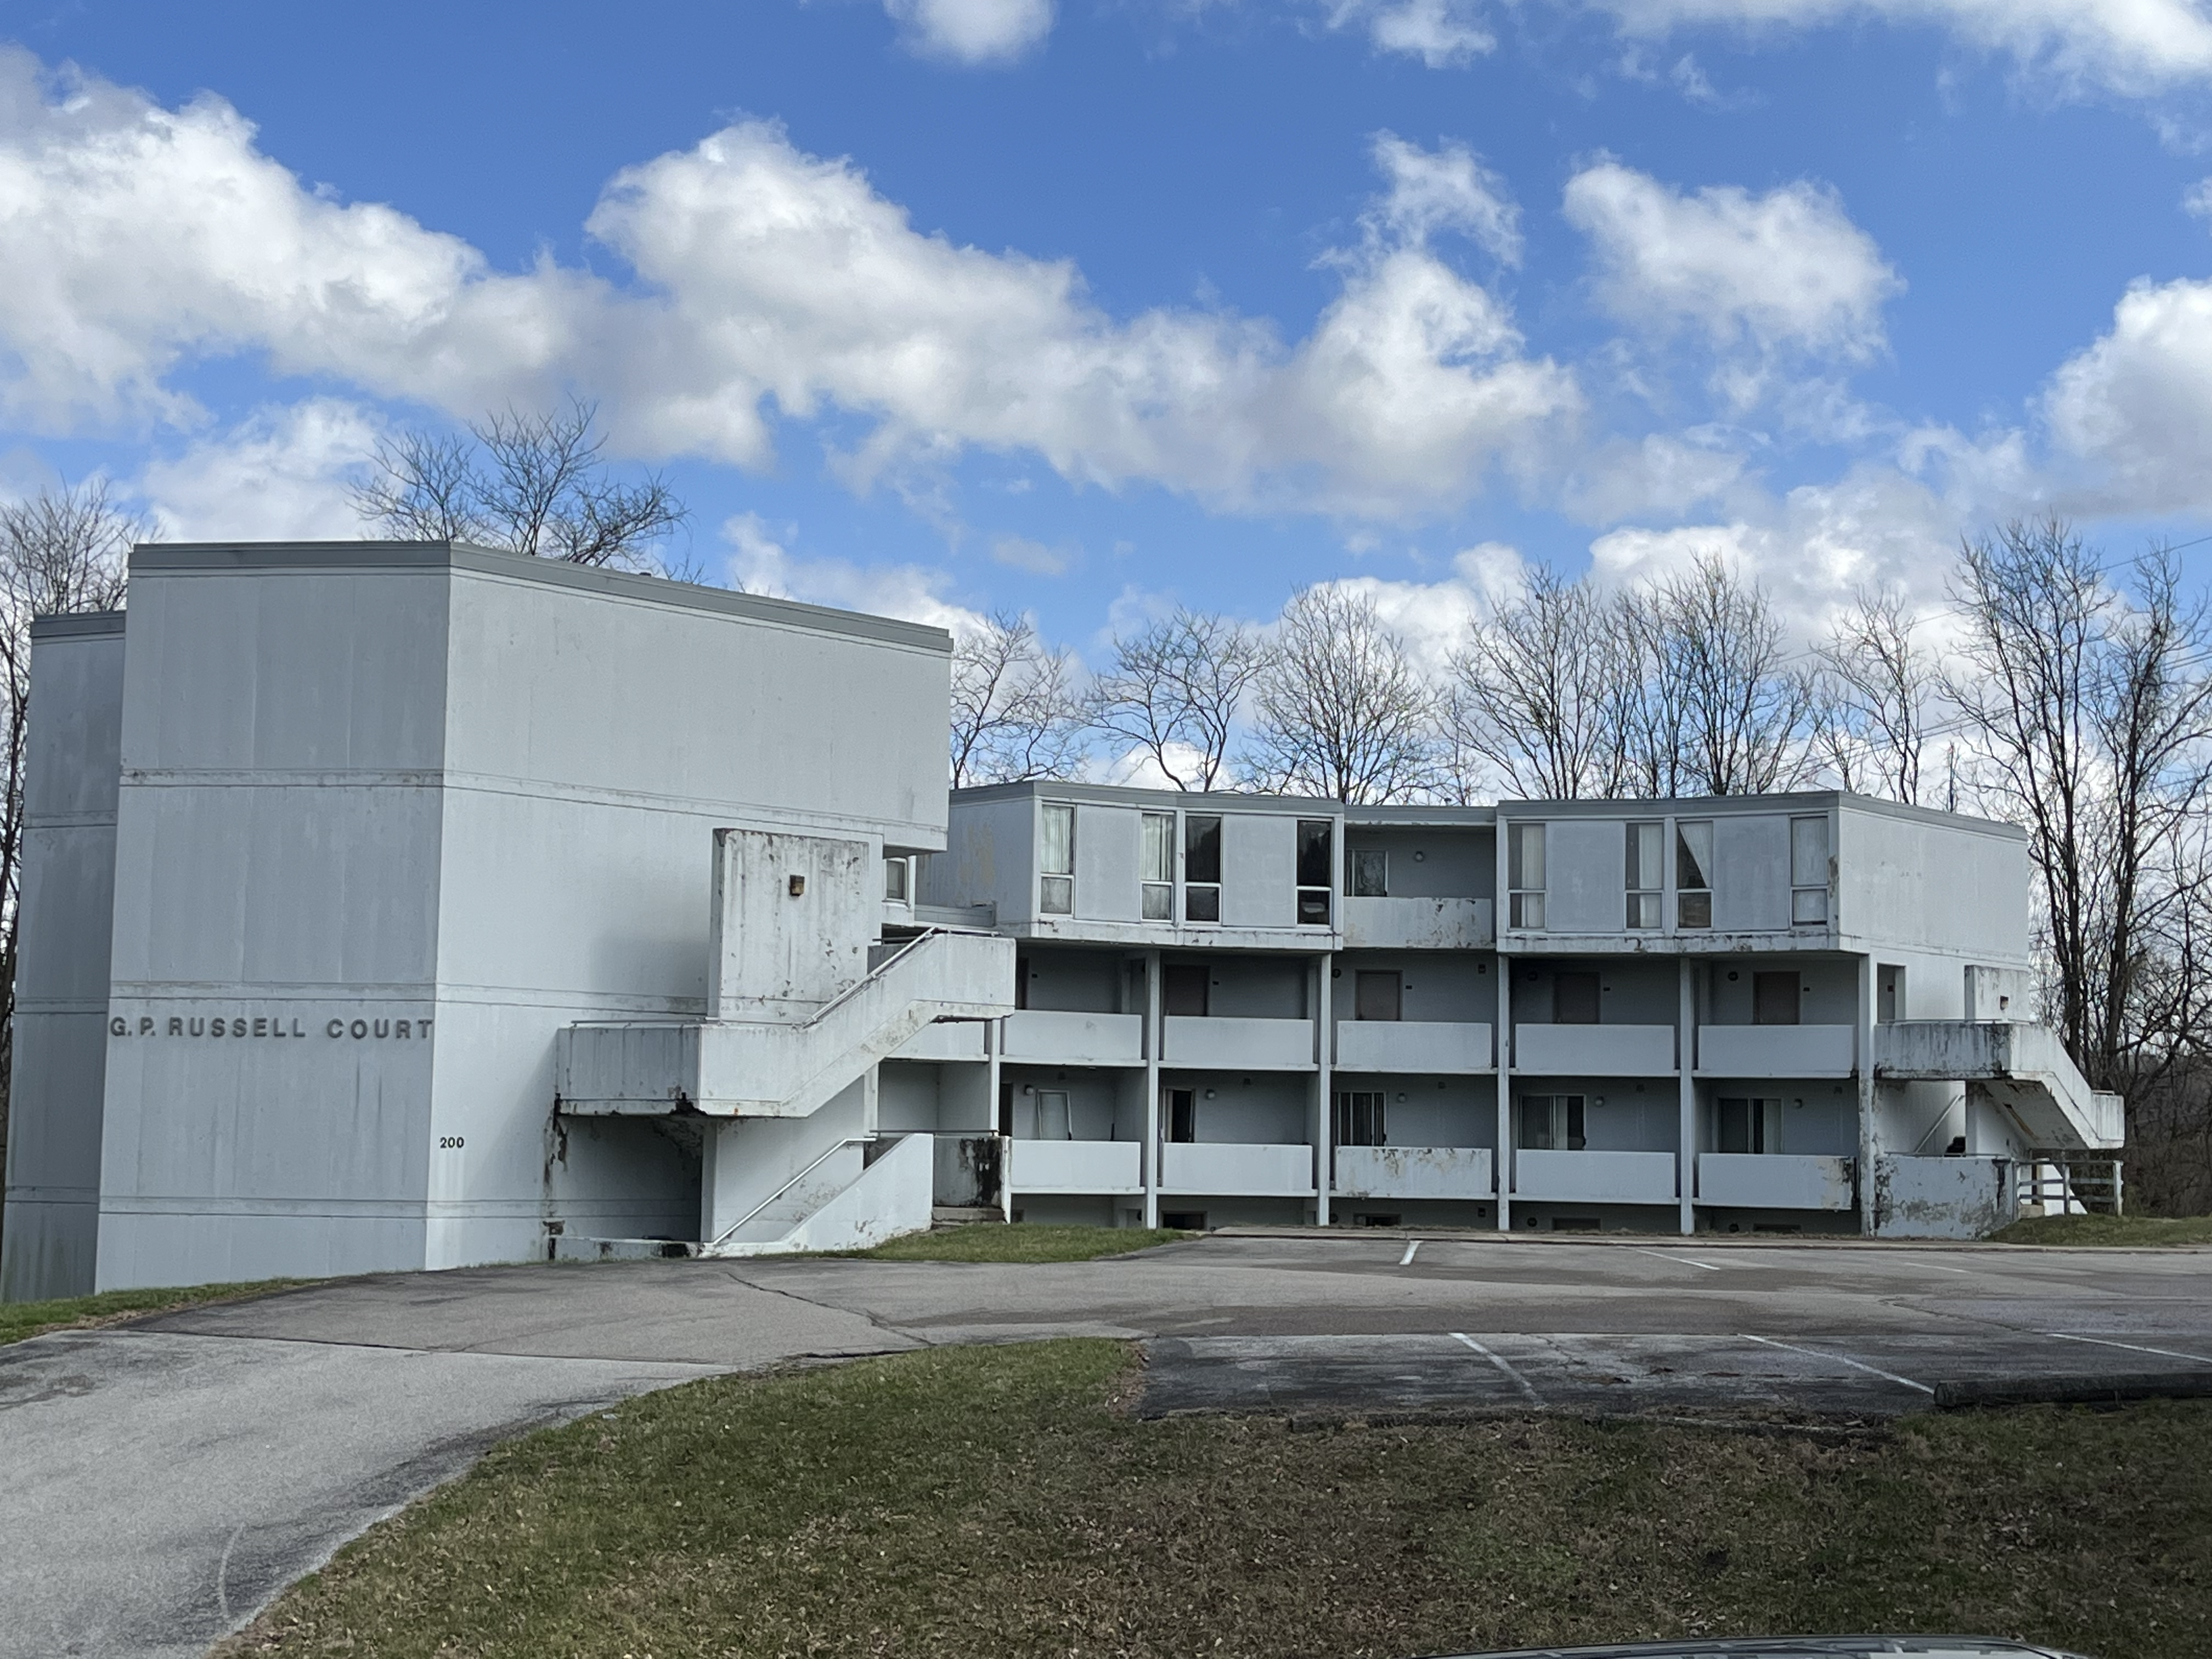
Asset Preservation Projects
“Burned Out Home”
Betty White Nursing Bldg Entrance
Russell Court – Abandoned Faculty Apartments

Slide 23
Asset Preservation Funding
 | Projects | Estimated Scope
FY 2022-23 | Residence Hall Interior and Exterior Upgrades | $3,500,000
 | Environmental, Health & Safety Repairs & Upgrades | $2,050,000
 | Upgrade Network Topology to Single Mode | $2,250,000
 | Site Work/Grounds/Parking Repairs | $1,445,000
FY 2023-24 | Building Utility Infrastructure (Chillers/Heat Exchange) | $1,500,000
 | HVAC Systems Repairs, Upgrades & Replacements | $1,545,000
 | Building Envelope Improvements | $2,000,000
 | Bell Gym Renovation (Interior & Exterior) | $700,000
 | Exum Center Renovation (Interior & Exterior) | $2,000,000
 | Bradford Hall Renovation (Interior) | $1,500,000
Grand Total |  | $18,490,000
Bond Fund $16,078,000
Campus Match $ 2,412,000
$18,490,000

Slide 24
FY 2021 & FY 2022
Single Audit Updates
Blue and Co. (CPA Firm) engagement term: Dec 2022 thru Jun 2023
FY 2021 audit fieldwork performed concurrently with the FY 2022 audit
Teams are meeting continuously and exchanging support documents and notes
The projected deadline for FY 2021 audit report is by June 30, 2023,
followed shortly by the FY 2022 audit report *
* A contract extension could be needed to complete the FY 2022 audit report.

Slide 25



Management Improvement Plan – Business Office
Element 1:
Policies & Procedures
Element 5:
Accounting, Budgets & Internal Controls
1
6 Objectives
6 Deliverables
1 of 6 Deliverables completed
18 Objectives
50 Deliverables
14 of 50 Deliverables completed
34 Objectives
&
66 Deliverables
Element 2:
Salary Ranges & Benefits
5
2
10 Objectives
10 Deliverables
1 of 10 Deliverables completed

Slide 26
Questions?

Slide 27
Management Improvement Plan Update
Dr. Ronald A. Johnson, Interim President
Dr. Daarel Burnette
Dr. Michael Dailey
Dr. Brigitte Golman, Interim Vice President Student Engagement and Campus Life

Slide 28
Element 1: Review and Catalogue KSU Policies and Procedures for Efficiency and Compliance with State and Federal Law
Activity | Objectives | Status | Assigned to | Completion Date
Review all Kentucky State University policies and procedures for compliance with the Policy on Policies | Summative Report |  | Office of the General Council and Outside Council | May-23
Review and revise The Gold Book, Bylaws of Kentucky State University | Revised Policy |  | Board of Regents assisted by the Board Secretary | Jun-23
Review and Revise the K-Book, The Kentucky State University Student Handbook | Revised Policy |  | Division of Student Affairs | Jun-23

Slide 29
Element 2: Guidelines for Salary Ranges and Benefits for all Faculty, Staff, and Administrators
Activity | Objectives | Status | Assigned to | Completion Date
Establish a master position list and develop protocols for adding and subtracting positions to and from the list | Master Position List and Modification Policy |  | President and Leadership Cabinet | Jan-23
Review all currently offered benefits, vacation, sick leave, and holiday policies at other Kentucky Institutions and ensure competitiveness and consistency | Summative Report |  | Department of Human Resources | Feb-23
Review all positions in the institution, including those filled and unfilled, to determine need | Summative Report |  | Department of Human Resources and the Budget Manager | Feb-23
Identify positions that should be eliminated or reconstituted to meet needs of the institution | Summative Report |  | President and Leadership Cabinet | Feb-23
Establish descriptions for all positions including any qualifications requirements and an outline of their duties and responsibilities | Summative Report |  | Department of Human Resources | May-23

Slide 30

Element 3: Mandatory board member training and development, including but not limited to financial oversight and effective committee structure
Activity/Action to Meet Objectives | Objectives | Status | Assigned to | Completion Date
Participate in the AGB/Gardiner Institute Governing Equity in Student Success Project | Participation Confirmed |  | Board Chair working with the Interim President | Ongoing
Complete Association of Governing Boards (AGB) training on Foundational Aspects of Trusteeship | Summative Report |  | Board Chair working with the Interim President | Nov-22
Make Regent attendance at the annual CPE Trustee conference mandatory | Board Action |  | Board Chair working with the Board Secretary | Jan-23
Conduct review of current board committee structure as compared to those at peer institutions and best practices for structure and charge of effective university board committee | Summative Report |  | Board of Regents assisted by the Board Secretary | Feb-23
Complete CPE-facilitated training on history of the institution as a state entity and its recent financial crisis | Training Completed |  | Board Chair working with the Board Secretary | Feb-23
Determine board committee structure and composition and outline and the charge of each committee | Revised Committee Structure |  | Board Chair working with the Board of Regents | Apr-23
CPE Review and approve KSU new board member orientation programs per KRS 164.020(25)© | Orientation Program Curriculum |  | Board Chair working with the Interim President | May-23
Develop with CPE financial oversight training modules for Regents | Training Modules |  | Board Chair working with the Chair of the Finance and Administration Committee, the Interim President, and the Interim Executive VP | Jun-23

Slide 31
Element 4: Academic program offerings and faculty productivity guidelines
Activity | Objective | Status | Assigned to | Completion Date
Evaluate the viability of all current academic programs | Summative Report |  | Academic Affairs | Feb-23
Close low performing programs | Suspend programs with plan to close in CPE program inventory and teach out plan |  | Academic Affairs | Apr-23
Determine appropriate class sizes, approval process and pay structure for faculty overload and adjunct faculty | Summative report and updated HR policy |  | Academic Affairs | May-23
Ensure alignment of course program plans with CPE's Academic Program Inventory and degree plan site. | Summative report and inventory/site updates |  | Academic Affairs | May-23
Evaluate cost/benefit of the dual credit program | Summative report and performance improvement plan |  | Academic Affairs | May-23
Evaluate curriculum for all non‐educator preparation programs | Posted RFP and contract awarded |  | Academic Affairs | May-23
Review educator preparation programs and redesign to provide culturally responsive teaching, improve K12 pipeline, meet market demands, and address shortage of teachers of color. | Posted RFP and contract awarded |  | Academic Affairs | May-23
Determine number of faculty needed for each program | Summative report |  | Academic Affairs | Jun-23
Evaluate potential new program offerings | Summative Report and proposal development plan |  | Academic Affairs | Jun-23

Slide 32
Element 5: Accounting and fiscal reporting systems, collections, budget, and internal controls over expenditures and financial reporting
Activity | Objective | Status | Assigned to | Completion Date
Evaluate and revise internal budgetary controls and provide a quarterly budget to actual report to the Board of Regents. | Master list of budgeted positions reconciled to departmental budgets monthly | In Progress | Finance and Administration | Jun-23
 | Monthly budget to actual reports for E&G, Auxiliaries, Land Grant Match, and Asset Preservation | In Progress | Finance and Administration | Jun-23
 | Budget projection prepared monthly for E&G, Auxiliaries, Land Grant Match, and Asset Preservation | In Progress | Finance and Administration | Jun-23
 | Audit of all contracts to determine institutional need. | In Progress | Finance and Administration | Jun-23
 | Annual Budget Variance Report | In Progress | Finance and Administration | Annually at the close of the fiscal year

Slide 33
Element 5: Accounting and fiscal reporting systems, collections, budget, and internal controls over expenditures and financial reporting (continued)
Activity | Objective | Status | Assigned to | Completion Date
Improve the accounting and reporting system, as well as internal controls over financial reporting, and provide quarterly GAAP statements and other financial information to the Board of Regents. | Issue RFP and award a contract for accounting services to assist in the addressing ongoing accounting issues |  | Finance and Administration | Dec-22
 | Clearing accounts reconciled within 7 days of end of each month | In Progress | Finance and Administration | Jun-23
 | Bank accounts reconciled within 7 days of end of each month | In Progress | Finance and Administration | Jun-23
 | Monthly closing entries posted within 7 days of end of each month | In Progress | Finance and Administration | Jun-23
 | Month closed by the 10th day of each month | In Progress | Finance and Administration | Jun-23
 | Credit card account reconciliations | In Progress | Finance and Administration | Jun-23
 | Revise and update Business Procedures Manual | In Progress | Finance and Administration | Jun-23
 | Statement of Revenues, Expenses and Changes in Net Position by 10th of each month | In Progress | Finance and Administration | Jun-23
 | Statement of Net Position by 10th of each month | In Progress | Finance and Administration | Jun-23
 | Annual Financial Statement Analysis | In Progress | Finance and Administration | Jul-23
 |  | In Progress | Finance and Administration
 |  | In Progress | Finance and Administration
 |  | In Progress | Finance and Administration
 |  | In Progress | Finance and Administration
 |  | In Progress |  | Mar-23
 |  | In Progress
 |  | In Progress |  | Mar-23
 |  | In Progress |  | Mar-23
 |  | In Progress |  | Jan-23

Slide 34
Element 5: Accounting and fiscal reporting systems, collections, budget, and internal controls over expenditures and financial reporting (continued)
Activity | Objective | Status | Assigned to | Completion Date
Outsource or co‐source the internal audit function and reinstate the externally managed tip line. | Adopt audit plan for internal audit | In Progress | Finance and Administration | Dec-22
 | Award contract for internal auditing services | Completed | Finance and Administration | Nov-22
 | Reinstitute external tip line | Completed | Finance and Administration | Nov-22
Implement a formal endowment management framework | Review endowment agreements and execute new agreements where needed | In Progress | Finance and Administration | Feb-23
 | Correct accounting for prior withdrawals in 2019 and 2020 | In Progress | Finance and Administration | Feb-23
 | Correct accounting structure in Banner for endowment accounts | In Progress | Finance and Administration | Feb-23
 | Correct endowment reporting on FY 2021 and FY 2022 financial statements | In Progress | Finance and Administration | Feb-23
 | Review and update endowment investment policy | In Progress | Finance and Administration | Apr-23
 | Conduct a review of endowment manager performance | In Progress | Finance and Administration | Apr-23
 | Report on Fundraising Efficiency | In Progress | Finance and Administration | Jun-23

Slide 35
Element 5: Accounting and fiscal reporting systems, collections, budget, and internal controls over expenditures and financial reporting (continued)
Activity | Objective | Status | Assigned to | Completion Date
Improve the collection of student accounts receivable, including implementation of a comprehensive Student Financial Responsibility Agreement and utilization of external collection agencies, including Kentucky’s Department of Revenue. | Monthly report of outstanding student balances | In Progress | Finance and Administration | February and September
 |  | In Progress | Finance and Administration
 |  | In Progress | Finance and Administration
 | Monthly report of collection activity | In Progress | Finance and Administration | Jun-23
 | Executed student financial responsibility agreement | In Progress | Finance and Administration | Jun-23
 | Revised collection policy | In Progress | Finance and Administration | Jun-23
Complete a comprehensive review of expenses to ensure they are charged to the correct functional area and that costs are appropriately allocated to grants and auxiliary units. | Revised chart of accounts | In Progress | Finance and Administration | Jun-23
 | Summative report on account revisions | In Progress | Finance and Administration | Jun-23
Complete Banner optimization project and ADP to Banner Transition. | Completed optimizations by module | In Progress | Finance and Administration | Sep-23
 | Summative report on necessary optimizations | In Progress | Finance and Administration | Nov-23
 | Completed transition from ADP to Banner payroll module | In Progress | Finance and Administration | Jun-23

Slide 36
Element 5: Accounting and fiscal reporting systems, collections, budget, and internal controls over expenditures and financial reporting (continued)
Activity | Objective | Status | Assigned to | Completion Date
Implement a long‐range planning process to support the strategic and capital investment decision‐making process. | Contract for custodial, grounds, and facilities management | Completed | Finance and Administration | Nov-22
 | Deferred Maintenance Schedule | In Progress | Finance and Administration | Jun-23
 | Asset Preservation Funding Allocation Program | In Progress | Finance and Administration | Jun-23
Implement an enterprise risk management process to identify, evaluate, and mitigate key risks facing the institution and higher education industry, including strategic | Create BOR committee for enterprise risk management or assign to existing committee |  | Finance and Administration | Jan-24
 | Summative report |  | Finance and Administration | Mar-24
Develop appropriate policies and procedures governing the key functions of treasury management including cash management, operating investment management, debt management, and internal loans. | Annual cash flow projection | In Progress | Finance and Administration | Jun-23
 | Cash and Treasury management procedures manual | In Progress | Finance and Administration | Jun-23
Implement quarterly reporting to the Board of Regents on the President's travel, entertainment, and discretionary expenses. | Quarterly report |  | Finance and Administration | Jan-23

Slide 37
Element 5: Accounting and fiscal reporting systems, collections, budget, and internal controls over expenditures and financial reporting (continued)
Activity | Objective | Status | Assigned to | Completion Date
Improve the collection of student accounts receivable, including implementation of a comprehensive Student Financial Responsibility Agreement and utilization of external collection agencies, including Kentucky’s Department of Revenue. | Monthly report of outstanding student balances | In Progress | Finance and Administration | February and September
 |  | In Progress | Finance and Administration
 |  | In Progress | Finance and Administration
 | Monthly report of collection activity | In Progress | Finance and Administration | Jun-23
 | Executed student financial responsibility agreement | In Progress | Finance and Administration | Jun-23
 | Revised collection policy | In Progress | Finance and Administration | Jun-23
Complete a comprehensive review of expenses to ensure they are charged to the correct functional area and that costs are appropriately allocated to grants and auxiliary units. | Revised chart of accounts | In Progress | Finance and Administration | Jun-23
 | Summative report on account revisions | In Progress | Finance and Administration | Jun-23
Complete Banner optimization project and ADP to Banner Transition. | Completed optimizations by module | In Progress | Finance and Administration | Sep-23
 | Summative report on necessary optimizations | In Progress | Finance and Administration | Nov-23
 | Completed transition from ADP to Banner payroll module | In Progress | Finance and Administration | Jun-23

Slide 38
Element 5: Accounting and fiscal reporting systems, collections, budget, and internal controls over expenditures and financial reporting (continued)
Activity | Objective | Status | Assigned to | Completion Date
Complete software audit to identify if all purchased and licensed software is necessary and being used effectively. | Summative Report | In Progress | Finance and Administration | Jun-23
Incorporate NACUBO FARM as a guiding document for all business procedures. | Revised business procedures document | In Progress | Finance and Administration | Jun-23
Review endowment performance and develop related management metrics. | Summative report | In Progress | Finance and Administration | Jun-23
Determine professional organizations that provide resources to assist the university with planning and evaluation of effectiveness (CUPA, NACUBO, etc) and secure membership. | Summative report | In Progress | Finance and Administration | Sep-23
Encourage attendance at CBMI for Finance staff. | Report of attendance | In Progress | Finance and Administration | Sep-23
Develop a campus master plan and a 3‐ and 5‐year capital project plan focused on asset preservation. | Campus Master Plan | In Progress | Finance and Administration | Dec-23
Evaluate all established Centers (Atwood, CREED, etc.) for cost/benefit. | Summative report | In Progress | Finance and Administration | Jun-24

Slide 39
Element 6: Student success and enrollment management strategies
Activity | Objective | Status | Assigned to | Completion Date
Review the current reporting and organizational structure across student success and enrollment management | Summative report and updated organizational chart |  | Student Engagement | Dec-22
With the assistance of a private consultant, develop a student success model supporting the profile of KSU admits from enrollment through completion rooted in evidence‐based best practices | Issuance of RFP and award of contract |  | Student Engagement | May-23
Redesign first‐year experience course | Summative report and Implementation and Training Plan |  | Student Engagement | May-23
Develop and improve processes around opening of term | Summative report and Implementation Plan |  | Student Engagement | May-23
Evaluate the athletics programming and structure | Summative report |  | Student Engagement | Jun-23

Slide 40
Element 7: Student academic progress and results
Activity | Objective | Status | Assigned to | Completion Date
Develop a system to manage institution‐wide and program/departmental student cohorts | Summative report and Implementation Plan |  | Student Engagement and Academic Affairs | May-23
Implement a predictive analytics model to develop a student recruitment profile and early warning system | Summative report and Implementation Plan |  | Student Engagement and Academic Affairs | May-23

Slide 41
Element 8: Development of online offerings
Activity | Objective | Status | Assigned to | Completion Date
Identify a partner to provide online programs | Issue RFP and contract award |  | Academic Affairs | May-23
Utilize Gray Associates PES+ Market system to identify high demand online programs to implement | Summative report and proposal development plan |  | Academic Affairs | May-23

