Slide 1

House Budget Review Subcommittee on Postsecondary Education
Presentation – March 2, 2023
Morehead State University
Dr. Jay Morgan, President

Slide 2
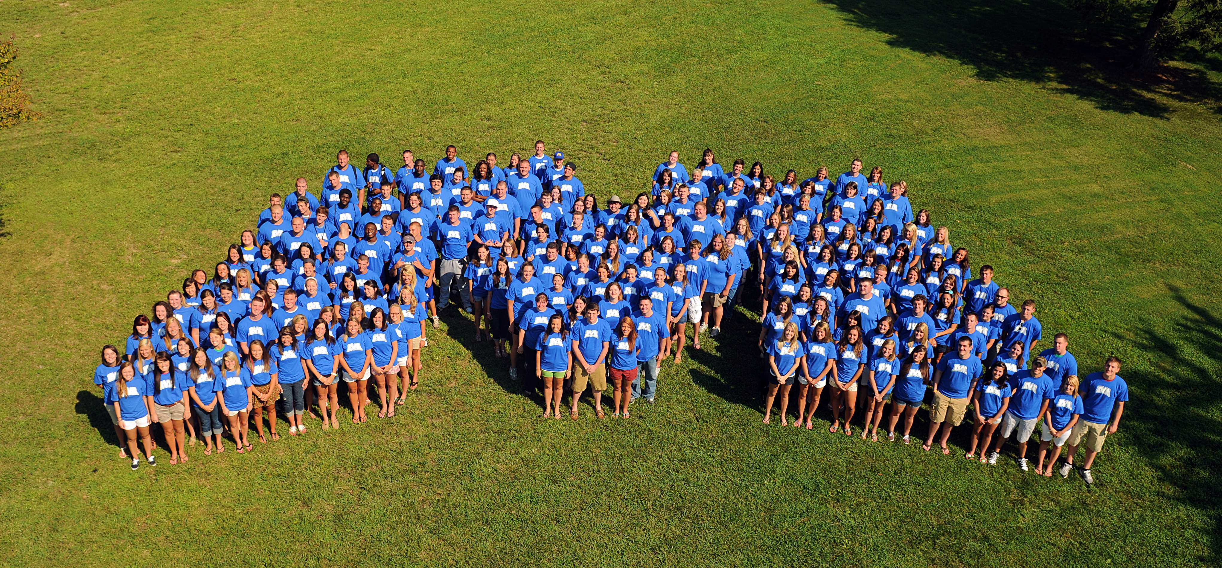
University Overview
11 Regents = 8 Appointed by Governor, Faculty, Staff, Student
Enrollment 8,800
Students Living in Campus Housing 2,700
Percentage of Students from Kentucky 90%
Pell / Low Income 55%
Average Time to Degree 4.09 Yrs.

Slide 3
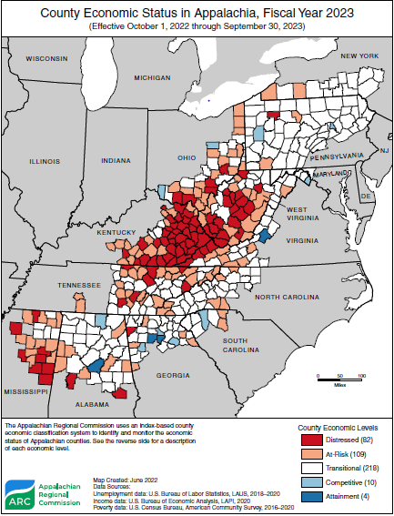
We Serve a Distinct Region of KY
Most Distressed Counties
Low Income
High Need for Pell Aid
High Need for Supports
Limited Tuition Abilities
Resulting in a Higher
Need for State Support

Slide 4
Commitment to Affordability
Percentage of Low Income Students 54-55%
Average Faculty Salary $60-70k
Lowest Tuition Other than KY State University $9,560
*With Minor Adjustments

Slide 5
State Performance Funding Formula

Slide 6


Slide 7
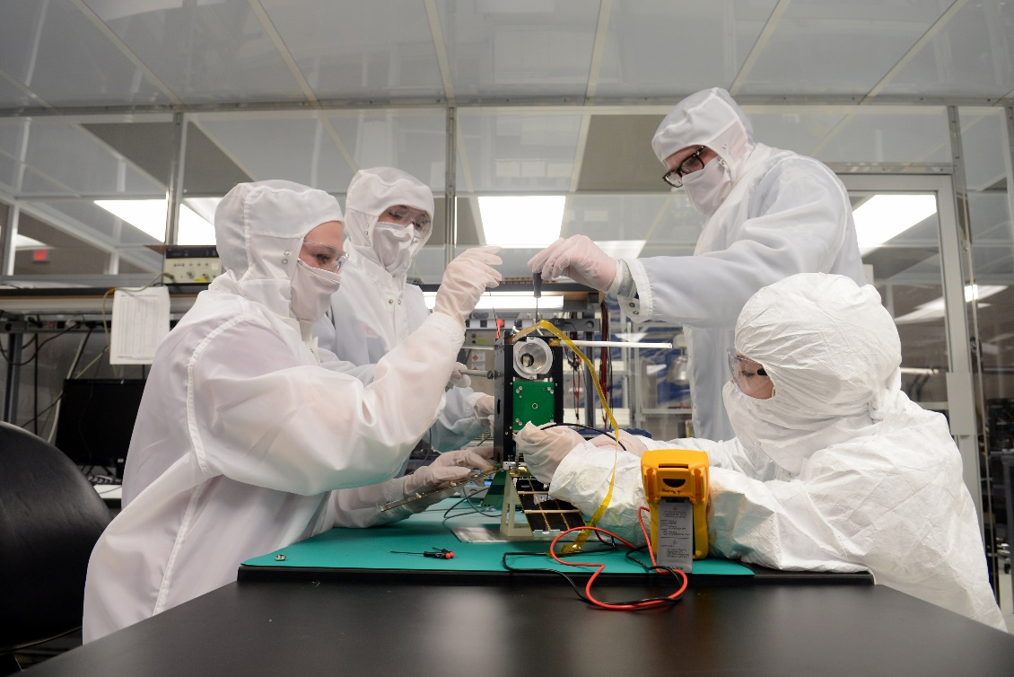
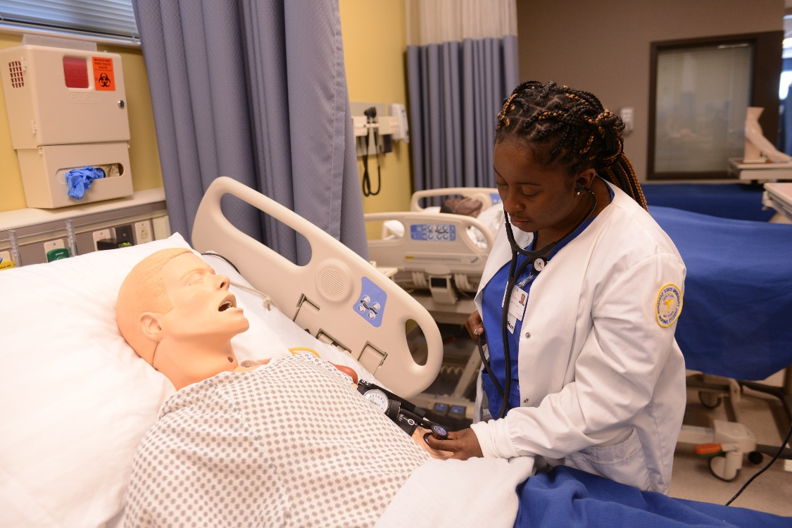
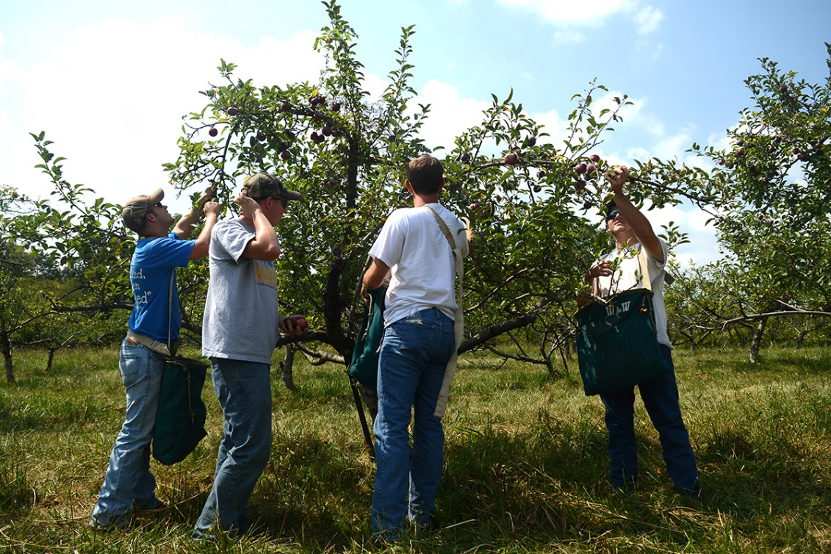

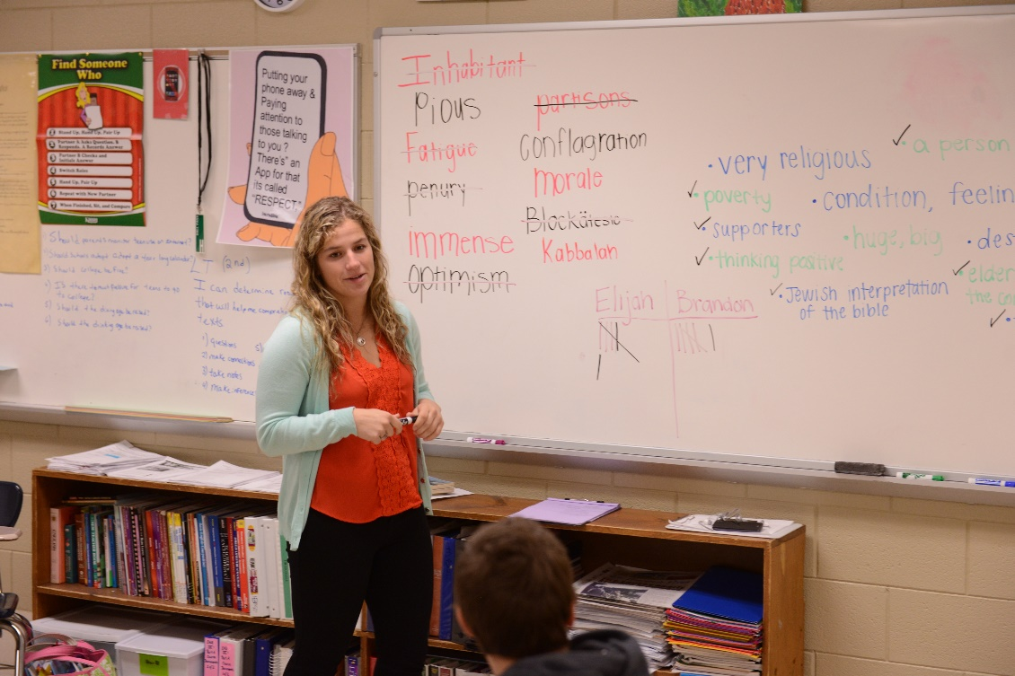
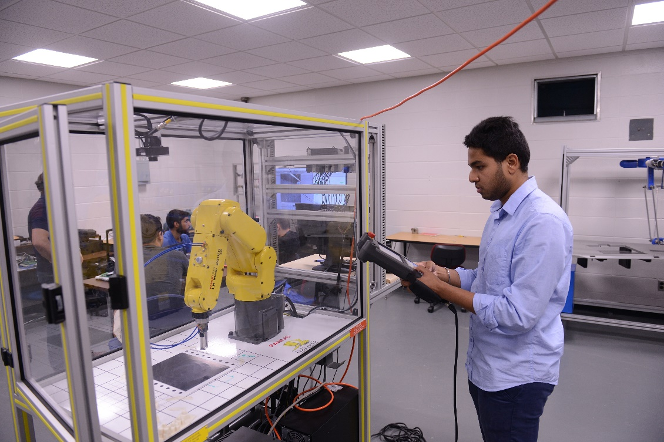
Strong Academic Programs
Serving the Economy and Region
Space Science
Nursing
Agriculture
Biomedical Sciences
Teacher Education
Engineering

Slide 8
Strong Portfolio of Academic Programs
Business Administration
Computer Science
Art, English, Theatre
Convergent Media
Biomedical Sciences
Veterinary Technology
Computer Science
Education
Legal Studies
Imaging Sciences
Pre-Med, Dentistry, P.T.
Mathematics
Social Work
Criminal Justice
Independent Studies
Sports Management
Psychology
Engineering

Slide 9
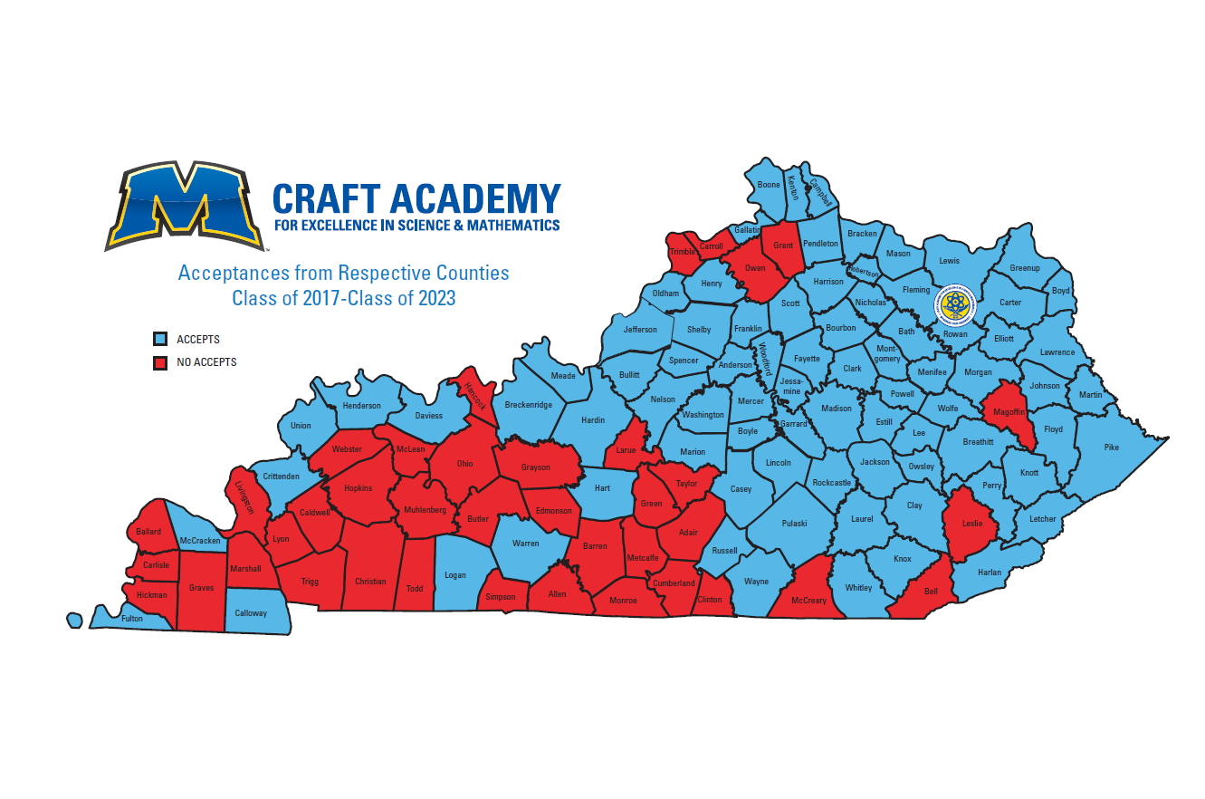
Craft state map here

Slide 10
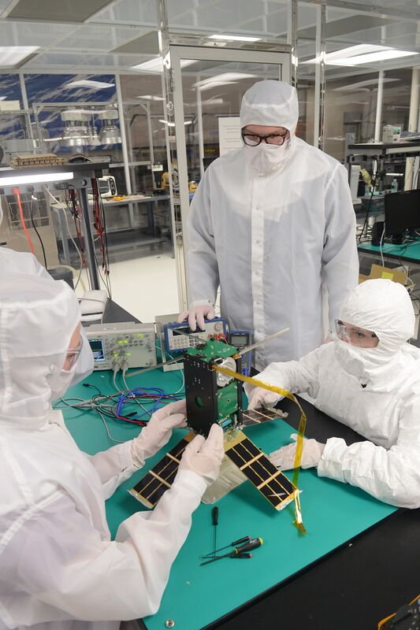
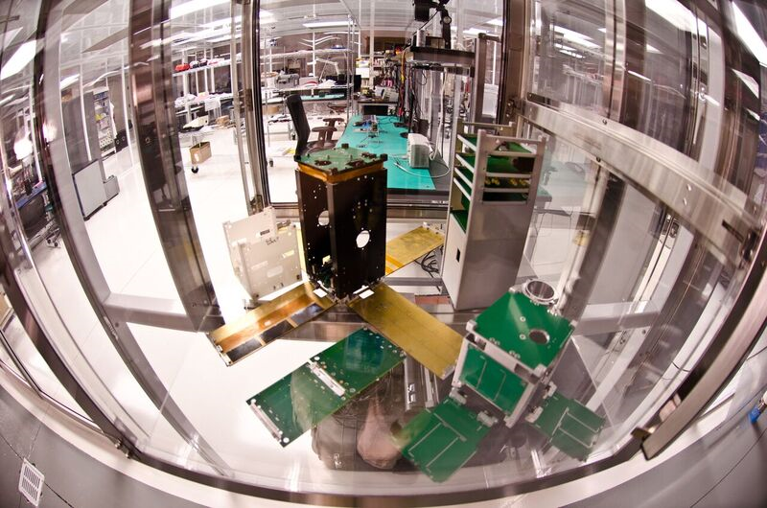
Space Systems Engineering
Program of Distinction

Slide 11
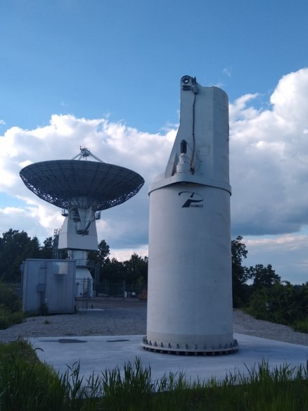
Strong Economic Development

Slide 12
State Asset Preservation Funding
Notes:
Total annual debt service for FY 2024-2028 ranges from $7.3 to $7.58 million which was only 5.66% of our revenues for FY 2022.

Slide 13
State Asset Preservation Funding
FY 23 Focus – Roofs, HVAC, & Life Safety

Slide 14
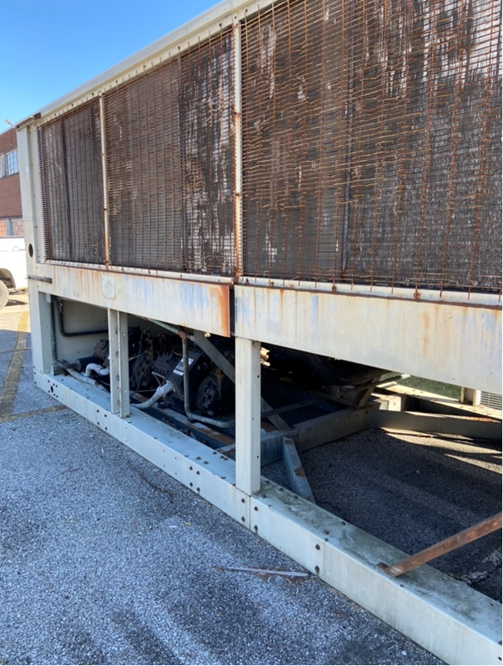
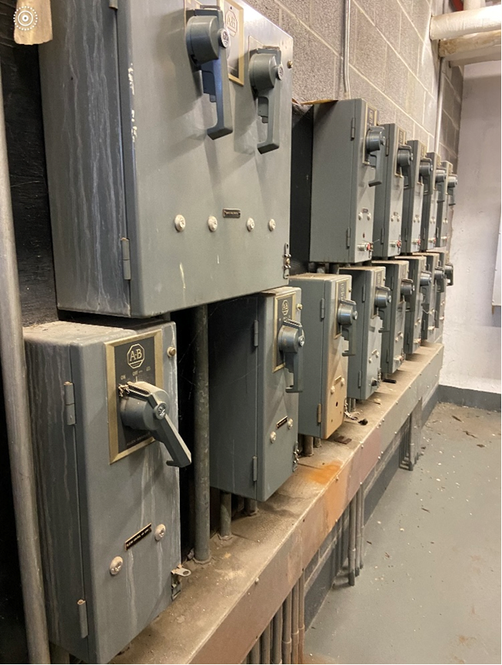
HVAC / Electrical Focus
Project Status

Slide 15
HVAC / Electrical
Project Status

Slide 16
Roof and Life Safety
Project Status

Slide 17
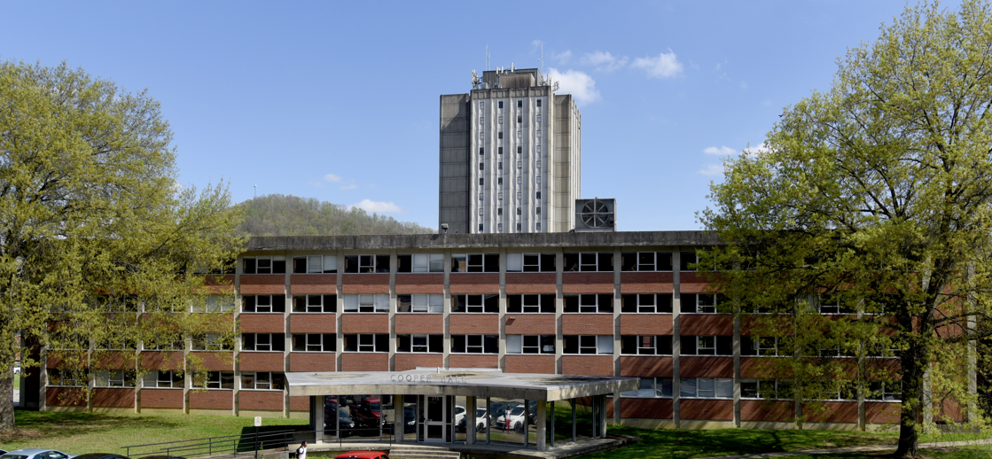
Cooper Hall Renovation

Slide 18
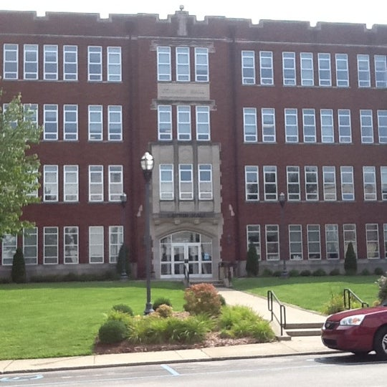
New Science & Engineering Building
Replaces 1937 Building
140,000 Sq. Ft.
$98 million appropriated
20% cost escalations
Planning for survey, utility, architectural design
Completion window 4 yrs.
Consolidate two buildings

Slide 19
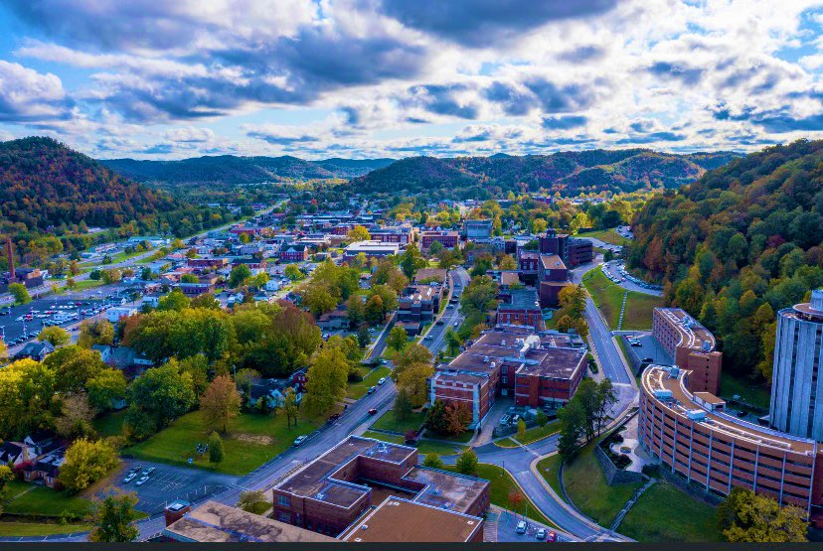
Questions

